Slide 1
Top 12 Tricks for mainstreaming gender in publications
Amanda Bradley | Title, FAO
August 2021| Rome, Italy

Slide 2
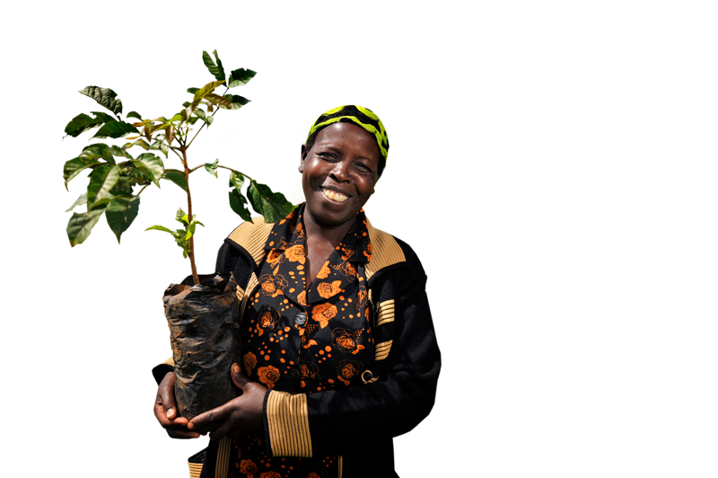
Tip #1. Consider gender throughout the whole process of developing the publication, not just in the final product.
Tip #2. Consider a section on gender when developing the outline.
Tip #3. Consider the specific and unique needs and concerns of women and men, girls and boys in relation to the topic area.
Tip #4. Think about how gender might be integrated in each section of the publication.
Notes:
Questions to consider:
o What are the different roles played by women and men in forest use and forest management?
o Are there any gender differences in access to and control over forest resources?
o Do women and men have different priorities for the REDD+ action/activity being undertaken?
o How may the REDD+ action/activity differentially affect women and men?
o How may the REDD+ action/activity differentially benefit women and men?
o How are women and men currently represented in decision-making processes relevant for REDD+?
o Is there any gender or forestry-specific policy and legislation that should be taken into account?
Items to consider during data collection:
o Review and compilation of gender policies and legislation, relevant to REDD+ processes
o Compilation and analysis of sex-disaggregated data; on forest livelihoods, forest use and forest management, as well as land and tenure rights as it relates to the REDD+ action/activity being undertaken or analyzed.

Slide 3
Tip #5. If primary research is needed, make sure to seek also women’s perspectives, if necessary in private or in separate break-out groups. Keep track of who is consulted. (See questions in notes)
Tip #6. Think about how your research process can build awareness on gender. For instance, in briefing at the start of an interview, mention how your interest in a gender perspective is essential for a full understanding of the topic.
Tip #7. If providing data on participation or other such statistics, ensure that gender disaggregated data is included.
Tip #8. Aim for gender balance among the reviewers of the publication.

Slide 4
Tip #9. Request a gender expert to review the draft publication.
Tip #10. If including photos with people, ensure that equal numbers of men and women are shown as active participants.
Tip #11. In distributing the publication, consider how to reach both women and men, youth and elderly. For instance, would an audio message increase accessibility for those who are illiterate?
Tip #12. If appropriate, include a gender perspective in any marketing activities for the publication.

Slide 5
Thank you

