Slide 1
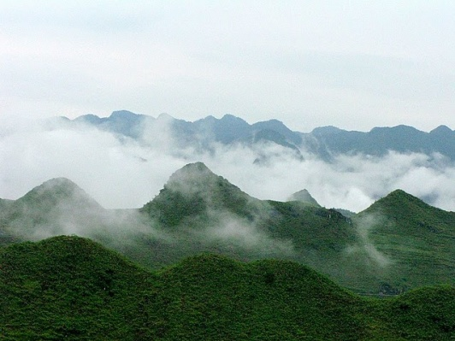

Group 3
Group Reports
Corruption risk | Baseline (Actions already taken) | Actions | Actors
Artificially inflating the baseline in order to increase the emissions reductions Not having a national inventory system Not having an independent audit system for verification | -PNG Government undertaken a baseline study but validation questioned by CSO -Mongolia has a central Data hub for a baseline -SI-Some data Collected by forest projects but no inventory system established | -National Baselines to be undertaken with technical agencies but validated independently and subjected to FPIC. -Reach out programme to members of parliament -Establishment of a inventory system with support from FAO (implementation risk :Political-disagreements between governments and other actors) | Government, CSOs, Communities, JICA,UNREDD Agencies

Slide 2
Group 1
Group Reports
Corruption risk | Baseline (Actions already taken) | Actions | Actors
Undue influence and bribery to ignore breaches of REDD+ regulations Risk of having a corrupt audit system Non-enforcement | Mongolia-Special National Inspection Administrative Unit and also has a CSO Hotline-reports illegal forestry activities SI-Attempt to table the revision Forest Act of 1969 PNG-Special Agriculture Business Lease in place | Capacity Building and education awareness for local communities Increasing engagement of communities on penalties Setting up a Hotline as Mongolia Stakeholders (Business) fully aware of the process of RECOURSE actions | Anticorruption Commission:Police,communities. Parliament bodies

Slide 3
Group 1
Group Reports
Corruption risk | Baseline (Actions already taken) | Actions | Actors
Fraud related to the distribution of benefits from REDD+ revenues Not having clear rights holders identified Corrupt processes/systems of distribution | PNG- Land group incorporation Act(1974):review done to amend the land rights and ownership Act &BDS Drafted Mongolia-Forestry ACT Amendment but land is still owned by the state Mongolia: Cash for work Programme | Government working on physical distribution-decentralization needs to looked at | Local Government

