Slide 1
Engaging Indigenous Peoples in the Forest Carbon Partnership Facility
Benoît Bosquet
The World Bank
UN Permanent Forum on Indigenous Issues
New York, May 26, 2009

Slide 2
Outline of the Presentation
Quick Introduction to REDD
The Forest Carbon Partnership Facility
Indigenous Peoples and the FCPF
Notes:
Assess Land Use, Forest Policy and Governance *
Organize its REDD Readiness Management **
Design its national REDD Strategy
Design its REDD Implementation Framework
Assess the Impacts of REDD Strategy
Assess the Investment and Capacity Building Needs
Establish its national Reference Scenario
Design its national Monitoring, Verification & Reporting System
Design a Readiness Management System (optional)
2

Slide 3
1. Quick Introduction to REDD
Notes:
Assess Land Use, Forest Policy and Governance *
Organize its REDD Readiness Management **
Design its national REDD Strategy
Design its REDD Implementation Framework
Assess the Impacts of REDD Strategy
Assess the Investment and Capacity Building Needs
Establish its national Reference Scenario
Design its national Monitoring, Verification & Reporting System
Design a Readiness Management System (optional)
3

Slide 4
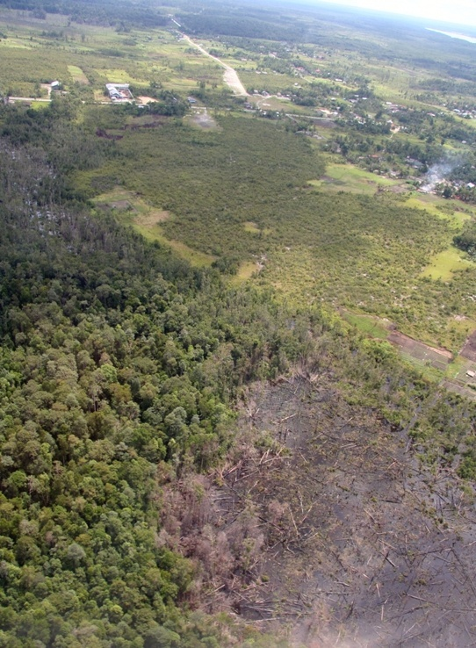
What is REDD?
“Reducing Emissions from Deforestation and Forest Degradation in Developing Countries”
Attempt to recognize role of forests in climate change mitigation
Forests are needed to achieve +2°C objective
20% of the problem → 20% of the solution?
Discussed in UNFCCC negotiations as part of ‘post-2012’ climate regime
Excluded from Clean Development Mechanism
Allowed for Annex I countries and under Joint Implementation
Notes:
Assess Land Use, Forest Policy and Governance *
Organize its REDD Readiness Management **
Design its national REDD Strategy
Design its REDD Implementation Framework
Assess the Impacts of REDD Strategy
Assess the Investment and Capacity Building Needs
Establish its national Reference Scenario
Design its national Monitoring, Verification & Reporting System
Design a Readiness Management System (optional)
4

Slide 5
Following traditional development paths, most countries lose most of their native forests
North Amazon Basin
Congo Basin
National forest cover
South Amazon Basin
Europe
North America
South East Asia
North East Asia
South Asia
West Africa
Atlantic forest
Oceania
Time
Source: REDD OAR, 2009

Slide 6
REDD can form a bridge on forest transition path
National forest cover
REDD bridge
Forest transition path
Time
Source: REDD OAR, 2009

Slide 7
REDD: National or Sub-national?
For the bridge to be built, REDD should be at the heart of national development policy
REDD is not a substitute for development policies
Other reasons REDD should be handled at the national level
Projects may not achieve necessary scale
Leakage from projects
Benefit-sharing mechanisms may be necessary
REDD implementation may have to start at sub-national level to gain experience and before sufficient financing is available
Notes:
Assess Land Use, Forest Policy and Governance *
Organize its REDD Readiness Management **
Design its national REDD Strategy
Design its REDD Implementation Framework
Assess the Impacts of REDD Strategy
Assess the Investment and Capacity Building Needs
Establish its national Reference Scenario
Design its national Monitoring, Verification & Reporting System
Design a Readiness Management System (optional)
7

Slide 8
REDD or ‘REDD plus’?
Bali Action Plan calls for “policy approaches and positive incentives on issues relating to reducing emissions from deforestation and forest degradation in developing countries; and the role of conservation, sustainable management of forests and enhancement of forest carbon stocks in developing countries”.
A broader definition of REDD adds methodological and financial issues, but removes perverse incentives
Limiting financial compensation to reduced deforestation/degradation may discourage early action
Notes:
Assess Land Use, Forest Policy and Governance *
Organize its REDD Readiness Management **
Design its national REDD Strategy
Design its REDD Implementation Framework
Assess the Impacts of REDD Strategy
Assess the Investment and Capacity Building Needs
Establish its national Reference Scenario
Design its national Monitoring, Verification & Reporting System
Design a Readiness Management System (optional)
8

Slide 9
The Three Phases of REDD
Maintenance
Payments
Performance-based
FCPF Carbon Fund, Norway,
GFCM (?), carbon market (?)
Capacity, Reforms
& Investments
Institution strengthening
Forest governance
and information
Sustainable forest
management
Investments outside
forest sector
FIP, UN-REDD, CBFF,
GEF, ODA, AAU set-aside,
REDD Bonds (?)
Readiness
Assessment of situation
Reference Scenario
REDD Strategy
Monitoring System
FCPF Readiness Fund,
UN-REDD, CBFF, GEF, ODA
Notes:
Assess Land Use, Forest Policy and Governance *
Organize its REDD Readiness Management **
Design its national REDD Strategy
Design its REDD Implementation Framework
Assess the Impacts of REDD Strategy
Assess the Investment and Capacity Building Needs
Establish its national Reference Scenario
Design its national Monitoring, Verification & Reporting System
Design a Readiness Management System (optional)
9

Slide 10
Indigenous Peoples and REDD
Anchorage Declaration (April 24, 2009), para. 5:
All initiatives under Reducing Emissions from Deforestation and Degradation (REDD) must secure the recognition and implementation of the human rights of Indigenous Peoples, including security of land tenure, ownership, recognition of land title according to traditional ways, uses and customary laws and the multiple benefits of forests for climate, ecosystems, and Peoples before taking any action.
Notes:
Assess Land Use, Forest Policy and Governance *
Organize its REDD Readiness Management **
Design its national REDD Strategy
Design its REDD Implementation Framework
Assess the Impacts of REDD Strategy
Assess the Investment and Capacity Building Needs
Establish its national Reference Scenario
Design its national Monitoring, Verification & Reporting System
Design a Readiness Management System (optional)
10

Slide 11
Risks and Opportunities of REDD
Risks
Opportunities
New sources of revenues
Clarification of rights
Insert local knowledge and practice into global system
Monitoring
Verification
Enforcement
Recognition of the contributions of forests people to climate regulation
Enhanced participation in political processes
Will investments and payments weaken customary rights and access to land/ natural resources?
Can Indigenous Peoples and other forest dwellers participate in the development of REDD schemes?
Who owns the carbon?
Who will be paid?
Will investments affect livelihoods and cultures?
What is the economic future of small and medium-size enterprises and local markets?
Notes:
Assess Land Use, Forest Policy and Governance *
Organize its REDD Readiness Management **
Design its national REDD Strategy
Design its REDD Implementation Framework
Assess the Impacts of REDD Strategy
Assess the Investment and Capacity Building Needs
Establish its national Reference Scenario
Design its national Monitoring, Verification & Reporting System
Design a Readiness Management System (optional)
11

Slide 12
2. The Forest Carbon Partnership Facility
Notes:
Assess Land Use, Forest Policy and Governance *
Organize its REDD Readiness Management **
Design its national REDD Strategy
Design its REDD Implementation Framework
Assess the Impacts of REDD Strategy
Assess the Investment and Capacity Building Needs
Establish its national Reference Scenario
Design its national Monitoring, Verification & Reporting System
Design a Readiness Management System (optional)
12

Slide 13
What is the FCPF?
One of the REDD demonstration activities called for by Bali Action Plan
G8 initiative (Heiligendamm, 2007)
Support from 40+ developing countries
Partnership + Facility
Notes:
Assess Land Use, Forest Policy and Governance *
Organize its REDD Readiness Management **
Design its national REDD Strategy
Design its REDD Implementation Framework
Assess the Impacts of REDD Strategy
Assess the Investment and Capacity Building Needs
Establish its national Reference Scenario
Design its national Monitoring, Verification & Reporting System
Design a Readiness Management System (optional)
13

Slide 14
FCPF: From REDD Readiness to REDD Payments
Readiness Mechanism
READINESS FUND
Capacity
Building
(2008-2012)
Carbon Finance Mechanism
CARBON FUND
Payments for Emission Reductions
(2010-?)
~$185 million
~$200 million
Notes:
14

Slide 15
Roles of FCPF, UN-REDD and FIP
FCPF
UN-REDD
Readiness,
Quick start
Capacity building, Institution
strengthening & Local action
FIP
Large scale, transformational
investment programs
FCPF
Carbon fund

Slide 16
Countries Participating in FCPF
South America
Argentina
Bolivia
Chile
Colombia
Guyana
Paraguay
Peru
Suriname
Meso America
Costa Rica
El Salvador
Guatemala
Honduras
Mexico
Nicaragua
Panama
Southeast Asia & Pacific
Cambodia
Indonesia
Lao PDR
Papua New Guinea
Thailand
Vanuatu
Vietnam
South Asia
Nepal
Africa
Cameroon
Central African Republic
Dem. Republic of Congo
Equatorial Guinea
Ethiopia
Gabon
Ghana
Kenya
Liberia
Madagascar
Mozambique
Republic of Congo
Tanzania
Uganda
Notes:
16

Slide 17
The 3 Phases of FCPF Operations Main Documents and Milestones Legal Agreements and Financial Commitments
OPTIONAL:
$0.2 m
Grant Agreement for R-PFP preparation
$3.6 m
Grant Agreement for R-PFP implementation
Emission Reductions Payment Agreement
-1-
Proposal Formulation
-2-
Preparing for Readiness
-3-
Emission Reductions Program
Investments (FIP, etc.)
R-PIN
→ Country selection
R-PFP
→ R-PFP assessment & authorization to allocate Readiness Grant
R-Plan →
Assessment of Readiness
Emission Reductions Program → Selection in Carbon Fund
Readiness Fund
Carbon Fund

Slide 18
All 37 Countries are Here
All have submitted a Readiness Plan Idea Note (R-PIN)
Some of them have obtained a $0.2 million grant to develop their Readiness Preparation and Funding Proposal (R-PFP)
Three have submitted a R-PFP
OPTIONAL:
$0.2 m
Grant Agreement for R-PFP preparation
$3.6 m
Grant Agreement for R-PFP implementation
-1-
Proposal Formulation
-2-
Preparing for Readiness
-3-
Emission Reductions Program
R-PIN
→ Country selection
R-PFP
→ R-PFP assessment & authorization to allocate Readiness Grant
R-Plan →
Assessment of Readiness
Emission Reductions Program → Selection in Carbon Fund
Readiness Fund
Carbon Fund

Slide 19
3. Indigenous Peoples and the FCPF
Notes:
Assess Land Use, Forest Policy and Governance *
Organize its REDD Readiness Management **
Design its national REDD Strategy
Design its REDD Implementation Framework
Assess the Impacts of REDD Strategy
Assess the Investment and Capacity Building Needs
Establish its national Reference Scenario
Design its national Monitoring, Verification & Reporting System
Design a Readiness Management System (optional)
19

Slide 20
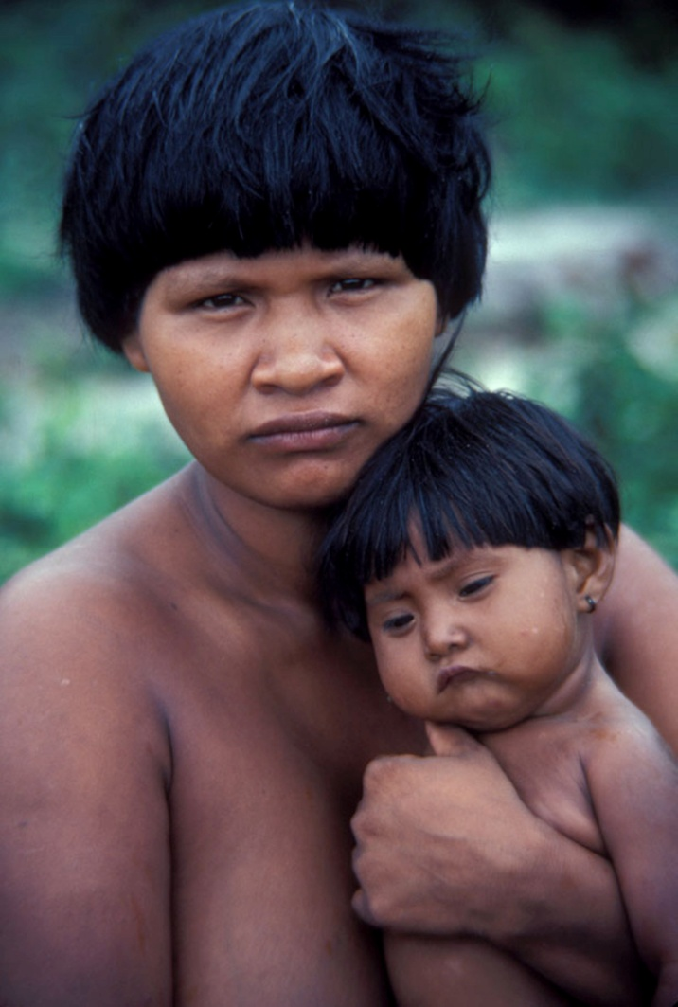
Information Exchanges Held with Forests People
3 regional meetings prior to start of operations
Kathmandu
Bujumbura
La Paz
Exchanges in conferences or during country visits
Barcelona
Marrakech
Bali
Nairobi
Kinshasa
Anchorage
Accra
Panama
Notes:
Assess Land Use, Forest Policy and Governance *
Organize its REDD Readiness Management **
Design its national REDD Strategy
Design its REDD Implementation Framework
Assess the Impacts of REDD Strategy
Assess the Investment and Capacity Building Needs
Establish its national Reference Scenario
Design its national Monitoring, Verification & Reporting System
Design a Readiness Management System (optional)
20

Slide 21
Indigenous Representatives in FCPF Governance
PARTICIPANTS COMMITTEE
REDD COUNTRIES
Bolivia
DRC
Gabon
Ghana
Guyana
Madagascar
Mexico
Nepal
Panama
Vietnam
CONTRIBUTORS
AFD (France)
Australia
Germany
Japan
Netherlands
Norway
Switzerland
TNC
United Kingdom
United States
TECHNICAL ADVISORY PANELS
OBSERVERS
Forests People, International Organizations, NGOs, UNFCCC Secretariat, UN-REDD Programme, Private Sector
Indigenous Representatives

Slide 22
Capacity Building Program for Indigenous Peoples
Provide small grants to Indigenous Peoples organizations to build capacity on REDD at regional and national levels.
Grants allocated based on proposals received from indigenous organizations and managed by them:
COICA (Amazonia)- organize regional level workshops and will produce a reference document on REDD as contribution towards Copenhagen
IPACC (Africa)- organize regional and national level workshops and will produce toolkit on REDD to be used for training of trainers at country level
COONAPIP (Panama)- organize 11 workshops for informational exchanges and arriving at common position on REDD and government’s proposal to the FCPF
New proposals can be funded starting July 1, 2009
Notes:
Assess Land Use, Forest Policy and Governance *
Organize its REDD Readiness Management **
Design its national REDD Strategy
Design its REDD Implementation Framework
Assess the Impacts of REDD Strategy
Assess the Investment and Capacity Building Needs
Establish its national Reference Scenario
Design its national Monitoring, Verification & Reporting System
Design a Readiness Management System (optional)
22

Slide 23
Role of Observer for Forests People (Forest Dependent Indigenous Peoples and Other Forest Dwellers)
Rights and Responsibilities:
Full participation in meetings
Full access to information prior to meetings
Costs of attending meetings covered for 1 person
Up to 3 persons represented at meeting
Budget for organizing ‘input-output’ process between forests peoples and FCPF
Selection:
Work with International Alliance of Indigenous and Tribal Peoples of Tropical Forests to
Organize selection process and manage budget – no World Bank prescription
Serve as interim Observer

Slide 24
Forests People’s Involvement at Country Level
Requirement that Indigenous Peoples will be consulted and participate in FCPF operations:
World Bank Safeguard Policy 4.10
FCPF guidance note on Consultation and Participation http://www.forestcarbonpartnership.org/fcp/sites/forestcarbonpartnership.org/files/FCPF_FMT_Note_2009-2_Consult_Particip_Guidance_05-06-09_0.pdf
Consultation and participation requirements start applying at Proposal Preparation stage, i.e., now.
Participation means participation in a national process, to design country-specific solutions to REDD
Participation of Indigenous Peoples in REDD processes is purely voluntary
Notes:
Assess Land Use, Forest Policy and Governance *
Organize its REDD Readiness Management **
Design its national REDD Strategy
Design its REDD Implementation Framework
Assess the Impacts of REDD Strategy
Assess the Investment and Capacity Building Needs
Establish its national Reference Scenario
Design its national Monitoring, Verification & Reporting System
Design a Readiness Management System (optional)
24

Slide 25
THANK YOU FOR YOUR ATTENTION
MERCI POUR VOTRE ATTENTION
GRACIAS POR SU ATENCION
www.forestcarbonparnership.org
Notes:
Assess Land Use, Forest Policy and Governance *
Organize its REDD Readiness Management **
Design its national REDD Strategy
Design its REDD Implementation Framework
Assess the Impacts of REDD Strategy
Assess the Investment and Capacity Building Needs
Establish its national Reference Scenario
Design its national Monitoring, Verification & Reporting System
Design a Readiness Management System (optional)
25

