Slide 1
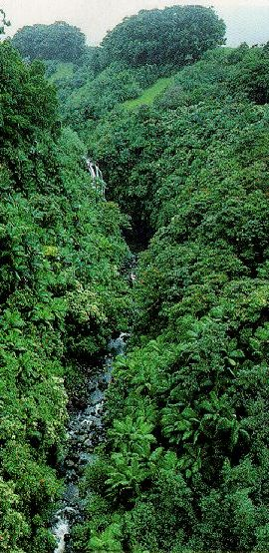



The UN-REDD Programme in Asia: status and experiences with Indigenous Peoples participation

Slide 2

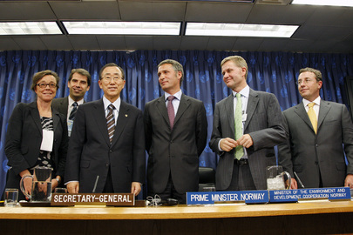
Basic UN-REDD formulation process
Scoping mission
Consultations
Draft Outline
Programming mission
Consultations
Detailed Outline
Validation, submission
Review and approval
Signature and inception
Consultations
Notes:
This is the general process (be sure to use Slideshow), but of course the process varies depending on circumstances in each country.

Slide 3
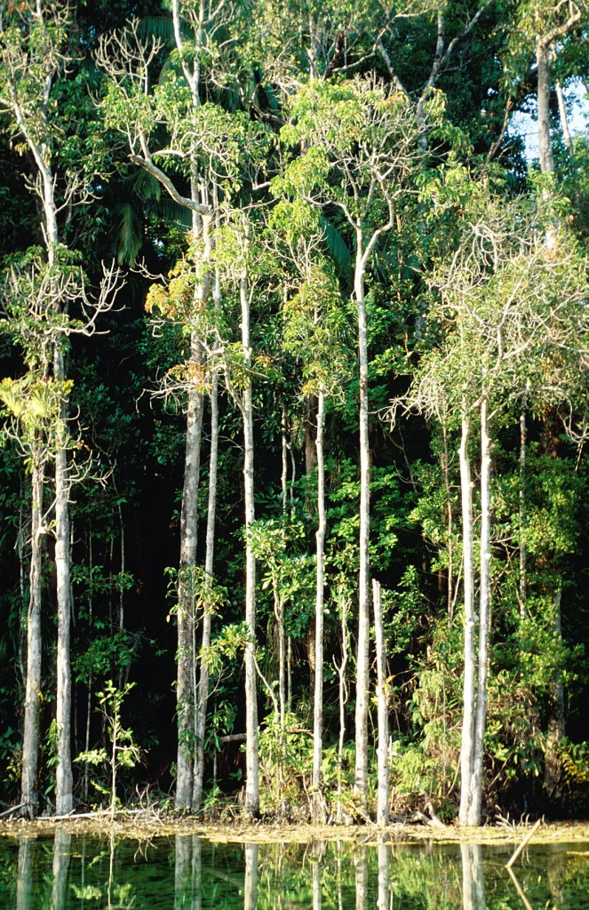
PNG
Scoping mission: Oct. 2008
Submission to UN-REDD Policy Board, March 2009
Regional CC conferences April-May 2009
Programming mission May 2009
Approval and signature August 2009
Notes:
In PNG, because of a desire to submit something to the 1st PB meeting, what was submitted was only a preliminary, or initial JPD. This means that the programming mission took place after PB approval of the initial JPD. It also means that most of the consultations only began following the submission of the initial JPD. We were able to take advantage of the 4 regional CC conferences held in PNG in April – May. These were very useful in guiding the detailed design of the programme. For example, it was very obvious that there is an enormous amount of mis-information available about REDD right down to the local level, and this led us to conclude that a significant part of the UN-REDD programme in PNG should focus on NGO-led awareness campaigns to ensure that correct information is available to all communities. During the Programming mission, we held further consultations, for example, with Eco-Forestry Forum and other NGOs, but the formal validation process for the initial JPD has yet to take place.
An important point in PNG is that, at the present time, we do not envisage that there will be on-the-ground demonstrations for two reasons. Firstly, the need for national-level capacity building is so great that our limited resources can be best utilized doing that (we feel), and secondly, as there has been so much controversy about projects in PNG, we worry that until the awareness raising campaign has been undertaken, trying to engage at any specific location might only make matters worse!

Slide 4

Indonesia
Scoping mission Nov. 2008
Programming mission Feb. 2009
Submission to UN-REDD Policy Board, March 2009
Expanded consultations April – June 2009
Submission to Bappenas Sept. 30, 2009
Notes:
Coordinated approach with key bilateral donors and FCPF. In Indonesia, we were able to hold a small 砺alidation meeting� before submission of the JPD to the PB. However, we were not happy with the meeting, as we felt it had been rushed and therefore did not have the broad-based participation we would have liked. Therefore, we proposed and the PB agreed that the JPD bee approved subject to broader stakeholder participation. We have therefore participated in various NGO-led fora in recent months (Tomo’s email describes some of these). An important point in Indonesia is that the exact location of our sub-national demonstration activities has yet to be determined. We have agreed with the GoI that they should take place in one of the three provinces of northern Sulawesi, but which of these provinces will only be determined after formal government approval of the proposal. Therefore we will still have to hold targeted consultations in the selected province as part of the inception process, probably early next year.

Slide 5

Viet Nam
Scoping/programming mission Jan 2009
Submission to UN-REDD Policy Board, March 2009
Local consultations (provincial CEMMA) June 2009
Approval and signature August 2009
Inception workshop Sept. 15-17, 2009
Notes:
Slide 4: In Viet Nam, the process has been very smooth. The scoping and programming missions were combined into a single mission; and the pilot province had been pre-selected by the government. It is Lam Dong, a province with a very high proportion of ethnic minorities, selected in part because the local authorities are quite forward-looking – it is, for example, one of the pilot provinces for Viet Nam’s PES policy. This meant that we were able to visit the province and some communities within the province during the scoping/programming mission. After PB approval, further consultations took place, for example, with the provincial CEMMA. The national inception workshop was held 2 weeks ago, and we plan to have a local inception workshop within the next month or so. Activities in Lam Dong will include capacity building to mainstream REDD into normal socio-economic planning processes, and designing a transparent, equitable, REDD-compliant benefit distribution system (the work is already underway).

Slide 6

Principles of engagement
Open-ended
Piggy-back, where possible
Use umbrella organizations, where possible
Consultations at local level dependent on government decisions
Notes:
Slide 5: Just a summary of some principles we have followed. Open-ended – obvious, but for example, one of the first activities in Vietnam has been the formal establishment of a REDD coordination mechanism (called the 哲ational REDD Network�), established through a ministerial decision, but designed to be open-ended – all interested stakeholders can participate, and the UN-REDD programme will also facilitate participation by non-Hanoi based stakeholders, though we obviously cannot fund everyone!
Piggy-backing: for example with the PNG regional CC conferences, and various AMAN events in Indonesia. Umbrella organizations, again ovious, e.g. Eco-Forestry Forum in PNG, AMAN in Indonesia, CEMMA in VN. Local consultations dependent on government – the example is Indonesia, where we have not yet been able to make a final selection of location for sub-national activities.

