Slide 1
Standards to mitigate risk and deliver multiple benefits from REDD
Steven Panfil
Climate, Community & Biodiversity Alliance

Slide 2
For the Project Level:
For Government-led Programs:
REDD+ Social & Environmental Standards
Notes:
2
One way of mitigating the risks and maximizing the benefits of REDD is through standards that assist project developers to use best practices in the design and implementation of their REDD activities, and through the promotion of these standards among investors in the REDD activities so that there is a preference among funders for projects that avoid the negative impacts that Ashish mentioned, and in fact generate positive social impacts. The CCBA is a group of led by a group of non-profit organizations that has developed this type of standards for project level activities, and is in the process of facilitating the development of another set of standards that can apply to government REDD programs. In this presentation I will describe both initiatives, and you will later hear from panelists who will describe different aspects of their experiences developing projects that are being designed to meet the project level CCB Standards.

Slide 3
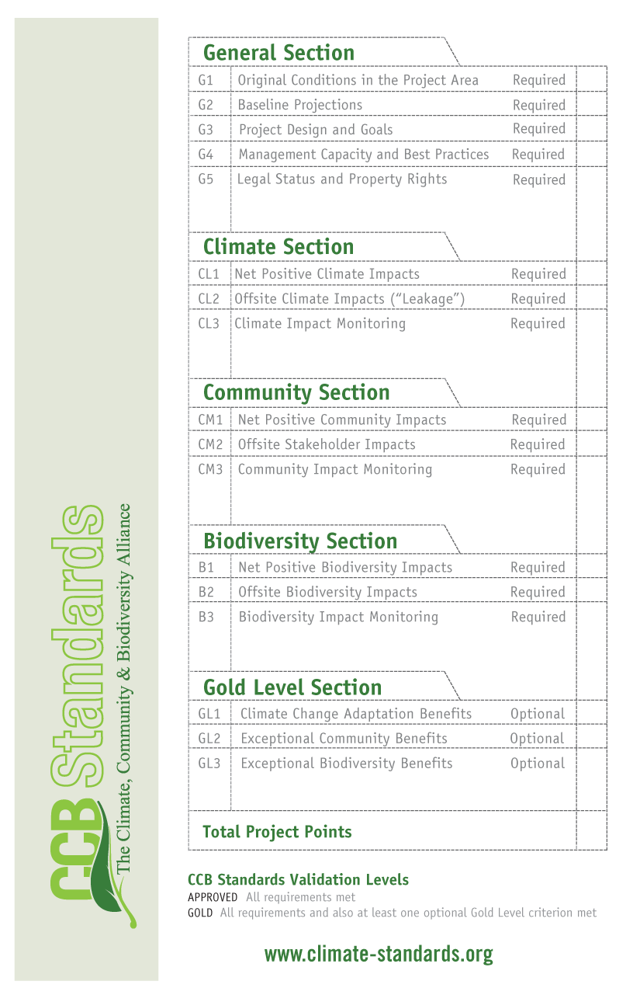
The Climate, Community & Biodiversity Standards
Criteria for climate, social and environmental impacts
Optional criteria for exceptional benefits
Highly transparent - Web and local
3rd party validation
Auditors address public comments
Verification at least every 5 years
Notes:
3
The CCB Standards are a set of rigorous criteria designed to determine the ability of a project to reduce greenhouse gas concentrations while delivering lasting benefits for local communities and for biodiversity.

Slide 4
Livelihood Criteria
Must create net benefits
Identify and maintain:
Critical ecosystem services
Basic needs
Cultural values
Identify all rights holders and stakeholders
Effective consultation
Free, prior and informed consent
Respect customary rights
Notes:
4
The CCB Standards are a set of rigorous criteria designed to determine the ability of a project to reduce greenhouse gas concentrations while delivering lasting benefits for local communities and for biodiversity.

Slide 5
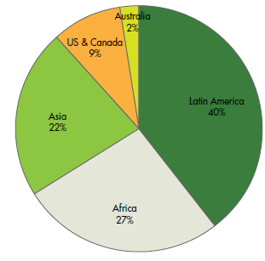
The CCB Standards – widely used in voluntary market
>89 Projects in development
39 Entered Validation
15 Validated
0 Verified
Notes:
5

Slide 6
For Government-led Programs:
REDD+ Social & Environmental Standards
Notes:
6
One way of mitigating the risks and maximizing the benefits of REDD is through standards that assist project developers to use best practices in the design and implementation of their REDD activities, and through the promotion of these standards among investors in the REDD activities so that there is a preference among funders for projects that avoid the negative impacts that Ashish mentioned, and in fact generate positive social impacts. The CCBA is a group of led by a group of non-profit organizations that has developed this type of standards for project level activities, and is in the process of facilitating the development of another set of standards that can apply to government REDD programs. In this presentation I will describe both initiatives, and you will later hear from panelists who will describe different aspects of their experiences developing projects that are being designed to meet the project level CCB Standards.

Slide 7
REDD+ Social & Environmental Standards
Assess social and environmental impacts of government-led REDD+ policies and measures
Define & build support for a higher level of social and environmental performance from REDD+ programs
Demonstrate and communicate transparent, inclusive and equitable process
Generate clear social and environmental benefits
Useful for funds or markets
Build support including preferential access to investment
Encourage improved performance in others
Enhance global support for REDD+ action

Slide 8
Standards development governance
A participatory and inclusive process
A ‘Standards Committee’ overseeing development & approves each draft
Standards Committee membership ensures stake-holder balance with a majority from the south:
REDD governments, IP organisations, community associations, social NGOs, environmental NGOs, private sector, developed country governments
CCBA and CARE are facilitators (secretariat)

Slide 9
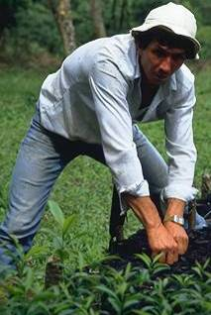
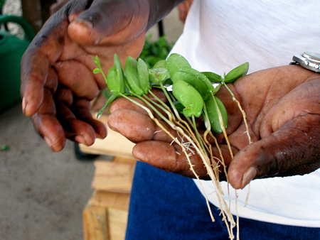
Lessons from Standards Use
Multiple benefits are attractive to all: forest users
developers
implementers
investors
buyers
Effective safeguards sought:
Moral reasons
Avoid reputational risk
Delivery and permanence of emissions reductions
Notes:
9

Slide 10
More information available from
www.climate-standards.org
Steven Panfil
spanfil@climate-standards.org

Slide 11
Principle 1: Respect rights to land and resources.
Principle 2: Benefits shared equitably
Principle 3: Contribute to long-term livelihood security and well-being
Principle 4: Contributes to broader sustainable development and governance
Principle 5: Maintains and enhances biodiversity and ecosystem services
Principle 6: Full and effective participation
Principle 7: Timely access to information
Principle 8: Complies with local and national laws and international treaties and agreements

Slide 12
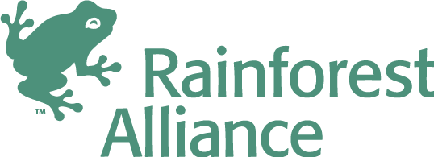
The Climate, Community & Biodiversity Alliance
Alliance Members
Advisors
Notes:
12
Recognizing the social and biodiversity risks and opportunities of forest carbon, the Climate, Community & Biodiversity Alliance (CCBA) was formed in 2003 as a partnership of international NGOs seeking to foster the development of forest protection and restoration activities around the world that deliver significant climate, community and biodiversity benefits.
To achieve this goal, the CCBA has developed and is promoting the Climate, Community & Biodiversity (CCB) Standards and is working towards the creation of a policy and market environment that supports multiple benefit forest protection, restoration and agroforestry activities around the world.

