Slide 1
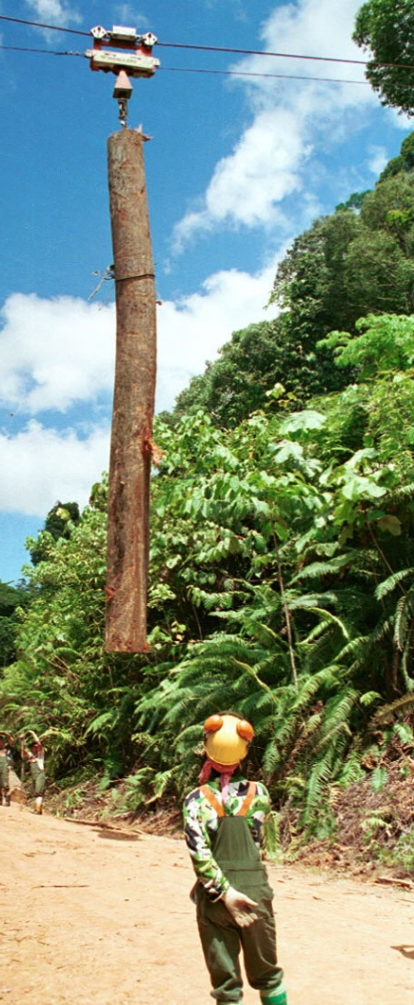
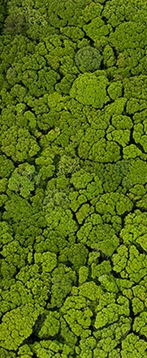
Rural electrification
Improvement of forest management unit management plan
Plantation of native species in timber harvested areas
Enhancement of forest carbon stocks
Sustainable management of forests
Conservation of forest carbon stocks
Reduction of deforestation
Reduction of degradation
?

Slide 2
Enhancement of forest carbon stocks
Sustainable management of forests
Conservation of forest carbon stocks
Reduction of deforestation
Reduction of degradation

Slide 3
Asses the forest resources through NFI to understand the extent of forest degradation and the available stock
Build capacity of the field staffs to actually manage the forest in and out of FMUs
Research on silviculture systems &species that grows better in different areas
Enhancement of forest carbon stocks
Sustainable managementof forests
Conservation of forest carbon stocks
Reduction of deforestation
Reduction of degradation

Slide 4
 |  |  |  |  |  | Enabling actions
Asses the forest resources through NFI to understand the extent of forest degradation and the available stock
Build capacity of the field staffs to actually manage the forest in and out of FMUs
Research on silviculture systems &species that grows better in different areas
Enhancement of forest carbon stocks
Sustainable management of forests
Conservation of forest carbon stocks
Reduction of deforestation
Reduction of degradation

