Slide 1
Participatory Governance Assessments (PGAs) for REDD+
Brainstorming Workshop
Lagos, 20 May 2011

Slide 2
Meeting objectives
To agree on:
→ The value-added of a participatory approach to assessing governance vs. other approaches
→ The ‘WHAT’
Some key elements to be included in the PGAs: types of methodology & governance risks to be assessed
→ The ‘HOW’
Draft ‘roadmap’: Steps & timeframe for PGAs until end of 2011
→ The ‘WHO’
Stakeholder involvement: Who should participate & when (management, research, stakeholder consultation)

Slide 3
Recap on the GUG assessment
Some GUG lessons of relevance for the REDD+ PGAs :
Buy-in from multiple stakeholders should be secured from the outset to ensure ownership of the assessment
A robust governance assessment methodology draws from multiple data sources, i.e. both administrative data (‘supply’ of governance) and citizen data – survey/focus groups (‘demand’ of governance)

Slide 4
Recap on the GUG assessment
Important to pilot test a methodology before starting data collection (unavailability of data, need to look for other sources, other issues to be assessed, etc.)
Communication is key – throughout the process (advocacy missions to states, stakeholders’ workshops to validate drafts, dissemination of results, etc.)
Start small – expand later (need for prioritization)
Sustainability – building institutional capacity

Slide 5
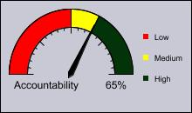
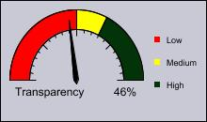
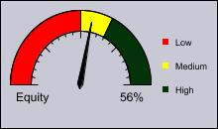
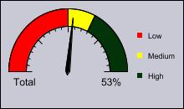
Dashboards

Slide 6
Nigeria REDD+ Readiness Programme: How can the PGAs support the 4 outcomes?
Improved institutional & technical capacity at national level
1.3 Policy, legal & institutional arrangements for REDD+ established
Framework for REDD+ expansion across Nigeria prepared
2.1 National REDD+ challenges & potential assessed
Institutional & technical capacity for REDD+ in CRS strengthened
3.4 CRS REDD+ forest monitoring system operational
REDD+ readiness demonstrated in CRS
4.3 CRS established as a centre of excellence & learning on REDD+

Slide 7
1. Why do ‘governance safeguards’ matter for REDD+
“The Social & Environmental Principles and Criteria will provide the UN-REDD Programme with a framework to ensure that its activities promote social & environmental benefits and reduce risks from REDD+”
Notes:
REDD+ can create new risks and opportunities for values of forest other than carbon. Safeguards were agreed at UNFCCC COP 16 in Cancun to address this issue.
Parties have agreed to ‘promote and support’ these safeguards and to provide information on how the safeguards are ‘addressed and respected’ throughout the implementation of REDD+ activities.
The UN-REDD Programme Social & Environmental Principles and Criteria have been further developed in response to this Decision.
The draft Principles comprise two on social issues, one on policy coherence, and three on environmental issues

Slide 8
Principle 1
Social and Environmental Principles and Criteria
Principle 1 – Democratic governance: The programme complies with standards of democratic governance
Criterion 1 – Ensure the integrity of fiduciary and fund management systems
Criterion 2 – Implement activities in a transparent and accountable manner
Criterion 3 – Ensure broad stakeholder participation
Notes:
8

Slide 9
Principle 2
Social and Environmental Principles and Criteria
Principle 2 – Stakeholder livelihoods: The programme carefully assesses potential adverse impacts on stakeholders’ long-term livelihoods and mitigates effects where appropriate
Criterion 4 – Promote gender equality
Criterion 5 – Avoid involuntary resettlement
Criterion 6 – Respect traditional knowledge
Criterion 7 – Develop equitable benefit distribution systems

Slide 10
Why do governance safeguards matter for REDD+?
If the allocation of forest or carbon rights is opaque and uncertain, or if corruption is perceived as high, stakeholders will not take the risk of forgoing the income they derive from their current uses of forest resources – and REDD+ will not work.
Current users need to have sufficient confidence in the REDD+ mechanism to change the way they use forest resources.

Slide 11
Why is it important to assess these governance safeguards?
Governance data needed to:
identify drivers of deforestation and forest degradation
design appropriate interventions to tackle these drivers
assess the effects of these interventions – rectify interventions if needed, etc.
→ Build confidence in the REDD+ mechanism
Without relevant and reliable information, there will be no REDD+:
“Assessing governance of the forest sector and of the REDD+ mechanism itself is as important as the system designed to monitor carbon.”

Slide 12
2. Why a country-led, participatory governance assessment?

Slide 13
A) What ‘kind’ of accountability do we want the assessment to strengthen?
External assessments / independent forest assessments | Country-led / country-owned assessments
‘Technocratic’ accountability to donors (‘top-down’ approach) | Meaningful accountability to domestic stakeholders (‘bottom-up’ approach)
To maintain the credibility of an international REDD+ mechanism | To maintain the credibility of a national REDD+ mechanism
Using international consultants or third party assessment | Led by national stakeholders and researchers
Alignment to international measuring needs (general indicator set applied to all countries) | Alignment to national measuring needs (indicators specific to country context)
Lack of ownership → lack of follow-up on recommendations | Strong ownership → More likely to follow-up on recommendations
Allows for cross-country comparisons (international rankings) | Allows for sub-national comparisons (peer learning / experience-sharing)
Notes:
making them different from "top down" approaches to assessing governance:
Ownership and local political backing were lacking for the donor-financed IFM system in Cambodia, leading eventually to the cancellation of the monitor‘s contract.Similarly, there is experience of the publication of many IFM reports, outlining incidences of forest crime and inadequate law enforcement, being delayed significantly by government agencies likely to be embarrassed by the information.

Slide 14
B) Why a participatory governance assessment?
By involving multiple stakeholders (government, private sector, civil society, forest-dependent communities) in both the design of an assessment system and in data collection, information is deemed more credible & relevant; a participatory process increases trust amongst the various actors (e.g. civil society & law enforcement agencies)
The need for such confidence-building measures is particularly strong in the forest sector, where relationships between various actors tend to be relatively adversarial
Notes:
Spaces for multi-stakeholder engagement can help address status-quo and power blockages, e.g. between large landowners and marginalized or vulnerable groups (indigenous peoples, women, the poor)
importance of bringing local communities and civil society actors together with law enforcement agencies in cooperative surveillance systems. This helps to build trust, accountability and a broad-based respect for rule of law.
opens spaces for engagement with stakeholders often absent from decision-making processes and dialogue, and

Slide 15
Steps
involved
in developing
An assessment
framework
Political level
Broad multi-stakeholder consultation
1
Agree on need, scope and users
2
Agree on principles
3
Agree on key sector issues
4
Agree on sub-issues
5
Agree on a results chain
6
Identify a basket
of indicators
Match indicators
with existing
sources
7
Develop data
collection
instruments
8
Technical level
Narrow expertise
9
Collect data
Produce
results
10
Broad engagement on results:
Evidence-based policy-making & advocacy
Institutionalization of the assessment

Slide 16
C) What are some useful outcomes we can expect from PGAs?
As a diagnostic / policy tool:
Provides a robust evidence base for decision-making
What are potential governance ‘risk areas’ for REDD+? What are possible safeguards to address these ‘risk areas’?
As an accountability tool:
To mobilize public opinion, to create demand for accountability
To assert the leadership of government in responding to this demand (by showing evidence of progress in governance outcomes)

Slide 17
C) What are some useful outcomes we can expect from PGAs?
Easier (and more constructive) to measure the ’opposite’ of bad governance / corruption → the effectiveness of anti-corruption mechanisms / good governance mechanisms
More useful to assess the effectiveness of the ’remedy’ than to assess the seriousness of the ’cancer’
More constructive to reward good practices

Slide 18
Corruption risk | Corrupt practice | Anti-corruption measure
Design of benefit distribution system | Undue influence (e.g. kick backs) on BDS which influences who receives REDD+ revenues & benefits | Multi-stakeholder body to oversee design and implementation of BDS (Staffed? Funded? No. complaints filed? No. investigations initiated? etc.)
Land administration | Bribery of land administration officials to overlook competing customary claims to land titles, or to create fraudulent land titles | Recourse mechanism (no. of complaints filed, no. of complaints treated, average response time, satisfaction of claimants, etc.)

Slide 19
Corruption risk | Corrupt practice | Anti-corruption measure
Spot rezoning of land to permit (or exclude) REDD+ activities in specific areas | Bribery of public sector officials to change the zoning of an area to allow or exclude REDD+ | Public notification & call for public submissions for all rezoning applications & rezoning decisions
Carbon rights | Bribery resulting in the loss of carbon rights for forest-dependent communities (e.g. to fraudulently create/register carbon rights) | All applications to register carbon rights and decisions to register rights to be made publicly available Recourse mechanism

Slide 20
3. Planning for PGAs in the context of REDD+

Slide 21
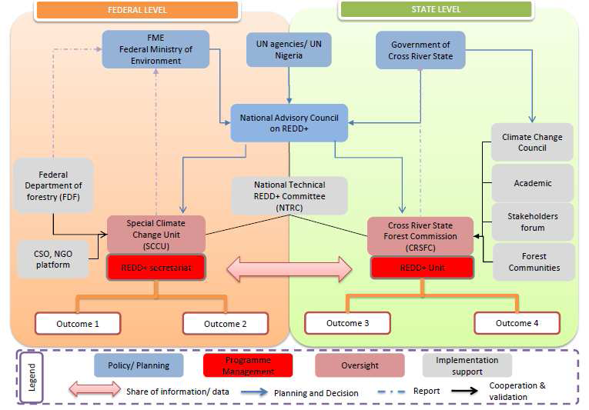

Slide 22
Stakeholder involvement
Geographical scope:
CRS (all 18 LGAs?), Taraba, Ogun, Lagos, Nasarawa
→ Who should participate & at what stage? (To be refined based on stakeholder analysis)
Management structure (at national level)
NTRC → Creation of a PGA sub-group
Draft a TOR (with concept note, roadmap, first draft of ‘key issues’)
Management structure (at state level)
Forestry Commission & State CSO Platform

Slide 23
Stakeholder involvement
Research – ‘Expert Group’
Methodology design at national level: State universities, research institutions / think tanks, NBS (household survey)
Data collection at national level: Concerned ministries/agencies, independent experts
Data collection at local level:
M&E units in State Govts
M&E units in LGs (e.g. forest charge offices)
Local communities: e.g. 45 active Forest Management Committees (FMC) & planning for 75 FMCs across CRS
Stakeholder consultation
National CSO Platform
State CSO platforms e.g. Cross-River State Stakeholders’ Forum

Slide 24
PGA for REDD+: A roadmap for Nigeria
June – July: Governance mapping on REDD+ (national expert)
REDD+ stakeholder analysis: Who (key institutions & actors) will be affected negatively or positively by REDD+ activities?
Map & critically review existing governance assessments (related to forests, NRM, local development)
Identify key ‘governance risks’ for REDD+ and identify possible safeguards (building on today’s exercise)

Slide 25
PGA for REDD+: A roadmap for Nigeria
August: Training workshop on governance assessment methodologies relevant to REDD+
Who:
National-level stakeholders: NTRC → PGA sub-group, expert group, national CSO platform
State-level stakeholders : CRSFC, CRS Stakeholders Forum
Objectives:
To debrief on mapping (above)
To learn about relevant methodologies
To agree on critical issues to be assessed in the PGAs & first cut of possible indicators

Slide 26
PGA for REDD+: A roadmap for Nigeria
September:
Refining the draft indicator set (follow-up on workshop)
By Expert Group
October:
Stakeholders’ consultations at state-level to seek feedback
Revise methodology based on feedback received
November – December:
Developing data collection instruments (survey questions, admin data collection forms, FGD guidelines)
Field-testing data collection instruments (verify data sources, etc.)

Slide 27
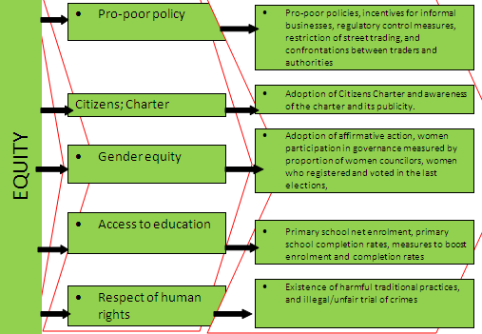
GUG ELEMENTS | INDICATORS | MEASURING VARIABLES

Slide 28
Laws & regulations related to governance of the forest sector
Ministry of Forestry regulations ensuring public access to forestry data, concession & revenue information
Whistleblower protection legislation
Freedom of the Press: laws protecting journalists & regulatory boards from interference
Regulations requiring the regular publication by the police & the judiciary of enforcement activities (e.g. rates of detection, arrest, charges, seizures, convictions, sentencing, penalties)
Annual audits (in line with international standards) throughout forestry-related ministries
Merit-based hiring & firing policies in forestry-related mministries

