Slide 1
Questions for Donna

Slide 2
Uganda’s FREL is national; however, implementation is subnational. • Can we work with a national FREL and if so, how then can we distribute the ERs to these subnational jurisdictions? • Do we need to develop a subnational jurisdictional FRL and what are the advantages and challenges of having a subnational FRL? •Do we have to go back to the UNFCCC for additional technical assessment if we make subnational RLs?

Slide 3
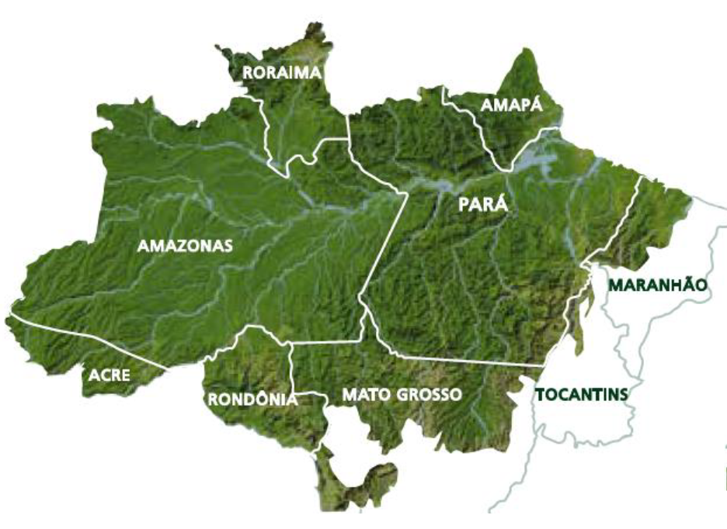
How to distribute national “ERs” to subnational jurisdictions: Challenge: Not all subnational jurisdictions are the same! Example: Brazil
State-level “performance” is estimated by the national government and is based on:
1) Conservation (% of forest area)
2) Reduced forest loss (% of Amazon ERs)
These two metrics are combined to provide each state with their allowed “results” for which they can generate finance.

Slide 4
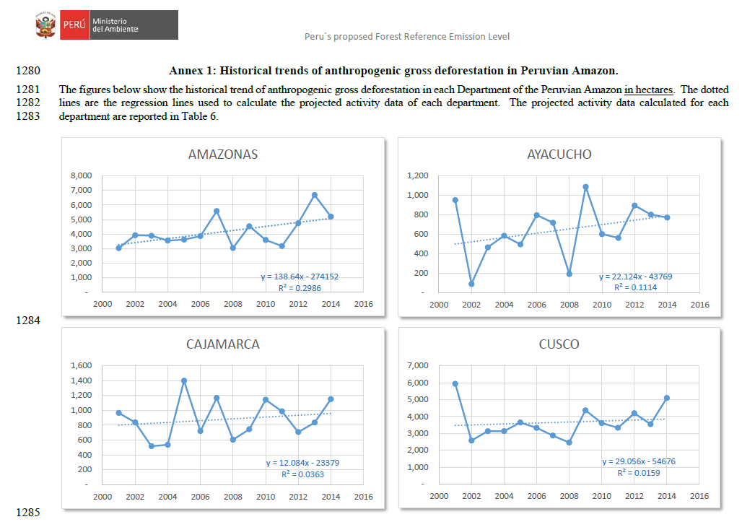
Developing subnational FRELs: Should we develop them? And if so… do we need to go back to the UNFCCC for additional technical assessment for the subnational FRELs?
Smart “stratification”?
When developing national data, a country may consider breaking down that data into subnational units, particularly if they wish to concentrate efforts in a particular subnational area.

Slide 5
Zambia has seen very successful implementation at project level (e.g. COMACO) with innovative and effective techniques to achieve REDD+ implementation (like premium prices). The project managed to create community markets for soil conservation creating carbon credits at the household level contributing to poverty alleviation. How can the government stimulate such successes and duplicate these in other regions in the country?

Slide 6
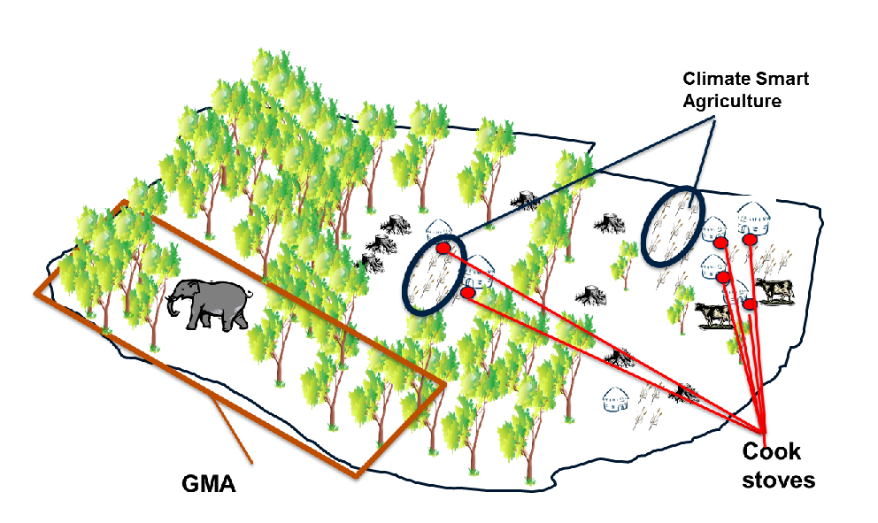
Carbon crediting for avoided deforestation compared to agricultural land management is very different
Agriculture projects (e.g. increasing soil carbon) are easier to align with national accounting
REDD+ project
There are more challenges to “nesting” avoided deforestation (RED) projects…
…but these also offer higher volumes of carbon credits.
Many countries also have existing cook stove projects that may cause double counting issues
(REDD+ project)

Slide 7
Challenge facing forest countries: 1) Warsaw Framework: REDD+ at national (or subnational) scale 2) Achieving NDCs under the Paris Agreement
Donor government finance
In order to help stimulate activities that generate emission reductions:
Develop a nested system
Regulate projects, including MRV and baselines to promote alignment in “accounting”
Create a registry to track projects and emission reductions that are issued and traded
NDC accounting
Access to project finance
cook stove projects
Zambia
Eastern Province (ISFL program)
Lusaka
Province
LZP project
CFP project
COMACO project

Slide 8
Congo is piloting REDD+ implementation at the provincial level. Successful REDD+ implementation is dependent on financial inputs. The donor is suggesting a jurisdictional approach but what if there are displacements? Is jurisdictional payment still guaranteed in this situation?

Slide 9
Project risks when nested within a jurisdiction
Negative performance
Positive performance
Donors will only pay if there is overall jurisdictional performance!
Project #1
Project #2
Project #1

Slide 10
DRC would like the national FREL to be the main reference • How can projects be aligned, and is this beneficial in case the project disposes of better quality (higher resolution) data? • What to do if the project includes more activities and pools than the national level?

Slide 11
Nesting projects: What if projects… … have higher quality data – how can they be aligned? … include more activities and pools than the national data?
Activities | Pools
 | AGB | BGB | Dead wood | Litter | Soil
Deforestation | √ √ | √ √ | √ | √ | √
Degradation | √
Reforestation | √ | √ | √ | √ | √
√ Included in national FREL
√ Included in project

