Slide 1
Work on Tenure
UN-REDD Policy Board Meeting 10
June 2013, Lombok
Tiina Vähänen
FAO/UN-REDD
Notes:
Under the UN-REDD SNA/Global Programme 2011 -2015, it was agreed that FAO would draw on its in-house capacity and experience to further advance the issue of tenure in the context of REDD+.
This work includes specific strategy, policy and technical advice to the implementation of output 2.5 "Land tenure for REDD+".
FAO is collaborating with UNDP and UNEP in this regard as well as with the FCPF and the broader REDD+ community.

Slide 2
Tenure issues in the context of REDD+
“Land tenure issues” are specifically mentioned in Cancun Agreement: UNFCCC Decision 1/CP16, para 72
Countries have identified tenure among the key issues in RPPs, UN-REDD NPDs and Country Needs Assessment
Lessons learned from work on tenure from existing REDD+ projects, PES, FLEGT, etc.
“Voluntary Guidelines” on tenure (Committee on World Food Security, May 2012)

Slide 3

Voluntary Guidelines on Tenure
Guide the rights to use, manage and control of land and forests
Help development of policy, legal and organizational frameworks that regulate tenure rights
Enhance transparency and functioning of tenure systems
Strengthen the capacities of national implementing agencies, including judicial authorities; local governments; and small-scale producers

Slide 4
Steps so far
PB 9 asked to develop a paper on tenure
Background paper: Options for addressing tenure
Expert Meeting “Options for addressing tenure in the context of REDD+” (February 2013)
reform of legislative frameworks, national land-use plans and institutional development
establishment of benefit-sharing systems
assurances of transparency and compliance with existing and emerging laws and regulations
  effective participation of stakeholders

Slide 5
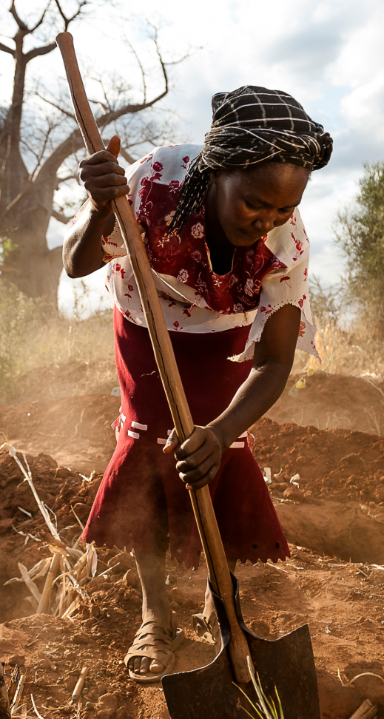
Key issues arising
Securing tenure rights is key to sustainable forest management and agricultural practices
Secure tenure is a basic prerequisite for equitable benefit sharing
Need to understand and consider multiple tenure rights and legal systems
Customary and traditional rights must be recognized
Stakeholder participation is required to recognise customary law and practices
Clarify the concept of carbon rights
© Lani Holmberg

Slide 6
Levels of action
Local communities and local authorities - supporting decentralized governance of tenure
National tenure reforms, transformational change
Cooperation & information-sharing between levels of intervention
International exchange of experience and learning from other processes
TENURE REFORMS ARE LONG TERM PROCESSES; WHAT IS REALLY NEEDED FOR REDD+ TO SUCCEED?

Slide 7

How to make use of the opportunities?
Inclusive national process to identify tenure needs in the context of REDD+
Possibilities for strengthening institutional capacity and improving tenure security
© Goran JK

Slide 8
What next?
Analytical paper on options and opportunities underway
  Draft to Policy Board comments by mid July
  Final paper by September, available at PB 11
Possible inclusion of tenure issues in future NPs / targeted support, upon request
  For more in-depth / detailed in-country activities

Slide 9

www.un-redd.org
Thank You
© Álvaro Vega Cubero
Tiina.vahanen@fao.org

