Slide 1
Framework to promote integrity in REDD+
Existing corrupt practices that enable/enhance deforestation and forest degradation
New corruption risks brought about by REDD+
Notes:
Drivers can for example include :
Turning a blind eye on illegal logging (felling, transport, certification) in exchange for a bribe
Falsely and illegally issued logging licenses and concessions
Elite capture of forests resources and benefits
Deliberate information retention about forest resources and harvest
2. New risks can for example include :
Risks related to fund management (embezzlement)
Risks related to distribution of benefits at local level (informal taxes, embezzlement)
Fraud related to MRV
Money laundering of REDD+ assets
At the intersection of these are corrupt practices that already exist and that could be enhanced by REDD+ (for example corrupt actions that facilitate land grabs, or Risks related to decisions about land rights or land use in the REDD+ context that can favor one powerful group over a marginalized group)

Slide 2
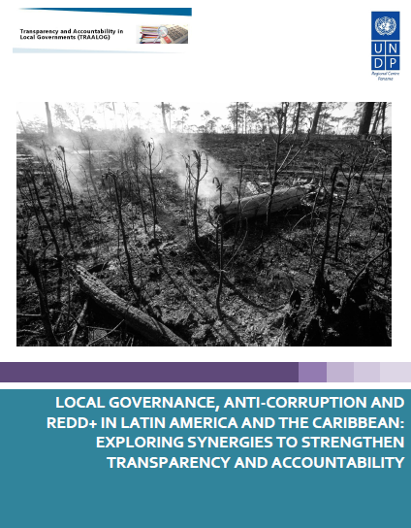
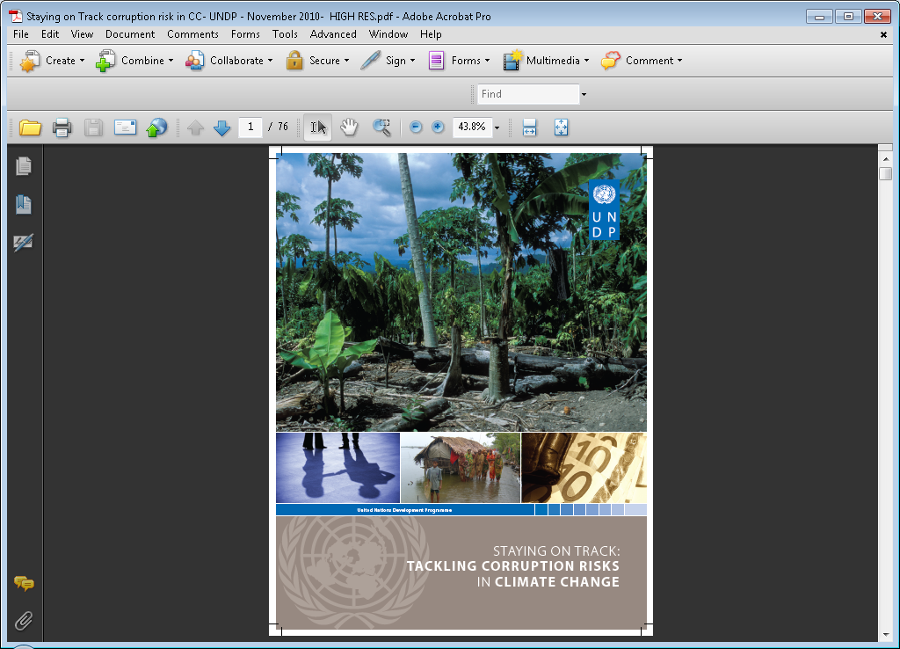
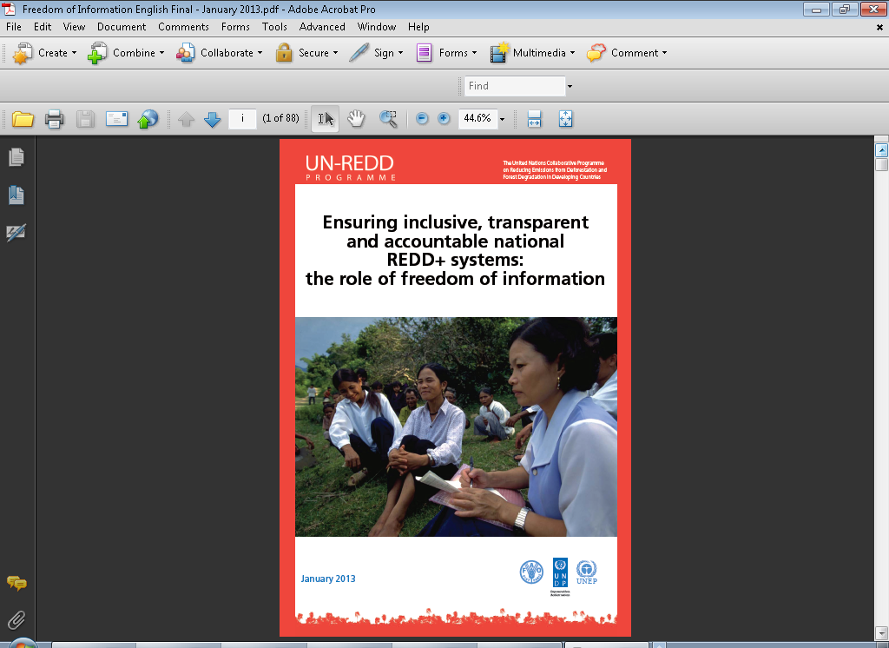
UN-REDD support
Studies
Tackling Corruption Risks in Climate change
Local governance, anti corruption and REDD+
Freedom of information in REDD+
Awareness and training
Regional workshops
Posters
Video
E-discussions
Fast Facts
Guidance and tools
Guidance on conducting REDD+ Corruption Risk Assessments (piloted)
Guidance on Mitigating Corruption Risks in REDD+ (upcoming)
Direct country support, e.g.
As part of PGA (Indonesia)
REDD+ Corruption Risk Assessment (Philippines, Peru, Bhutan, Bangladesh)
Institutional context analysis on anti-corruption in REDD+ (Kenya)

Slide 3
Early lessons learned
Anti-corruption in REDD+ is not a taboo
Builds on and aligns with a country’s readiness “stage” and legal and policy context
Perceptions differ… but not as expected
Appetite for South-South exchange

