Slide 1
Community level data collection and data management
Patrick Van Laake
UN-REDD Viet Nam Programme

Slide 2
Participatory Carbon Forestry
The management of local forest resources by organized community groups has proven to be very successful
Ownership
Long-term commitment
Social / Cultural pressure to protect the forest

Slide 3
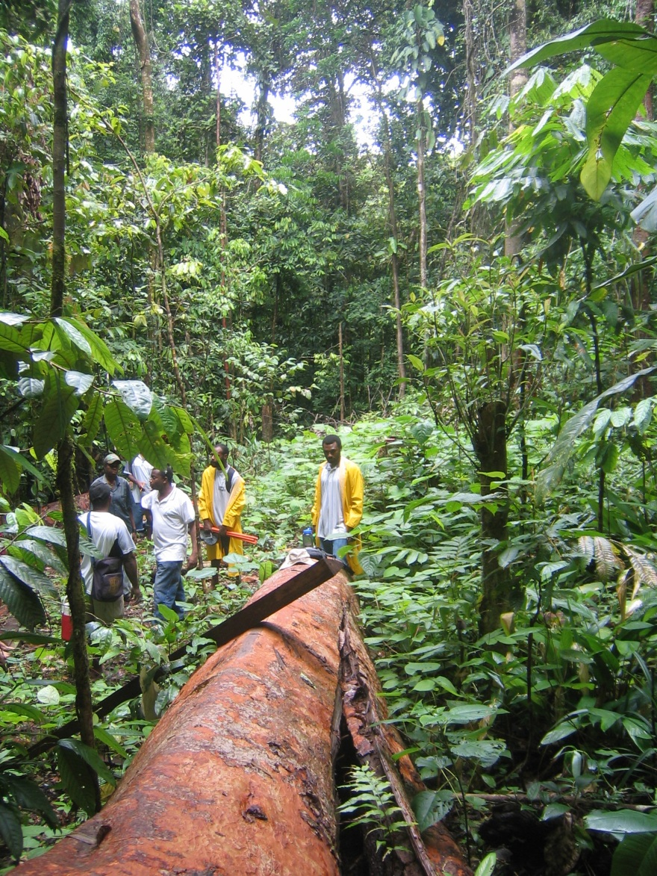
Secondary uses of the forest
Many communities rely on the forest for sustenance or livelihood
Such uses may be combined with REDD+
They may be complimentary – non-durable goods such as fruits, herbs, leaves
They can increase the “productivity” of the forest – higher total income from the forest
Together they can be a viable alternative for deforestation or forest degradation

Slide 4
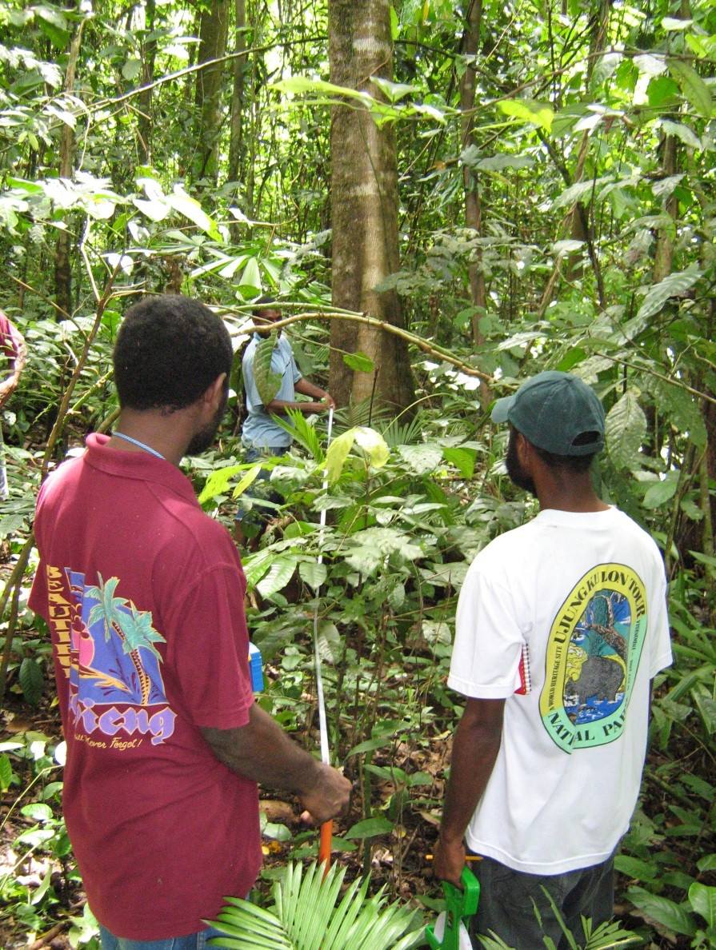
Carbon assessment by communities
With very little training and support, communities can accurately assess basic parameters of the forest
Tree count
Species identification
DBH measurement
Cost of assessment is between $1 ~ $4 per hectare per year
Potential for collecting large volumes of data

Slide 5
Supplementary data
The data that the communities collect is relatively basic
Supplementary services and data collection by a professional party can increase accuracy
Stratification of the forest, determination of number and location of sampling plots
Wood density, free branch height, total tree height
Development of allometric equations
Large-scale data collection opens up opportunities for statistical analysis and filtering of data

Slide 6
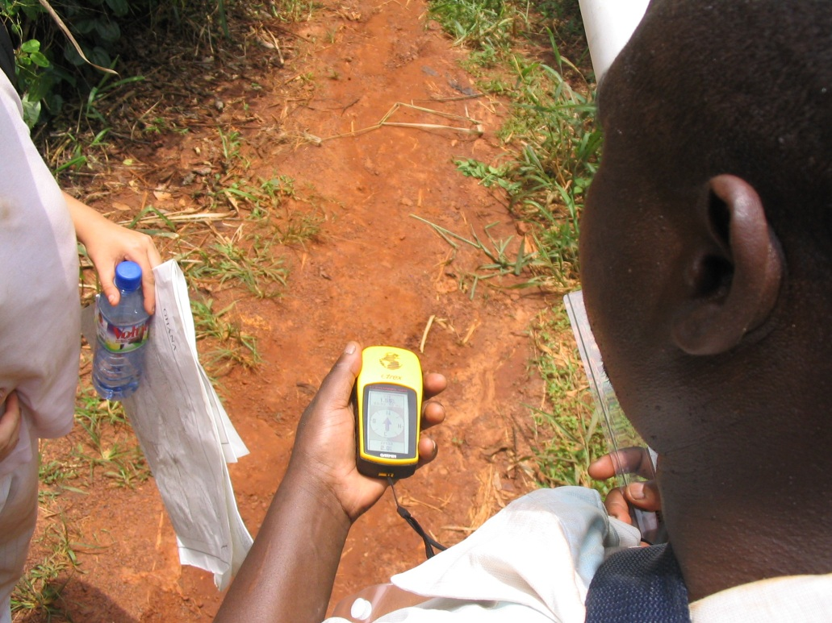
Data collection procedures
Communities do not need much training to collect data
Plot and data management requires support
Support can be provided by NGOs that serve multiple communities
Equipment to support data collection is ever more accessible and affordable: GPS, PDA, smart phone
NGOs can help share knowledge and equipment between communities

Slide 7
Data to be collected
Typical data are:
Diameter at breast height
Tree count
Tree species
Data should be collected in sampling plots to which the local community already has access
Provide labour in return for benefits – money, use of forest resources
This depends very much on land use rights, economic opportunity, etc
Data can be collected on a regular basis
It is preferable to do so more often than strictly required
Create awareness, maintain involvement and experience
Extra data can be used for quality control
Other data should be collected as well
Use of the forest resources by the local population
Substitution of non-renewable resources by forest products
Ownership, use rights, cultural and social importance

Slide 8
Managing data
The volume of data that will be collected on a national scale is likely to be enormous
Can be millions of samples per year for Viet Nam
MARD needs to set up professional computer and internet infrastructure to manage the data
Specially trained and dedicated staff will be necessary to operate the data management system
Unless the data management system is properly designed, analysis, quality assurance and reporting will be very difficult or impossible
UNFCCC will likely have stringent reporting guidelines and validation may require reviewing of raw data

Slide 9
Data delivery
Data will come from everywhere
Paper records
Process in a field office and send through internet
Field data computers
Upload through internet from field office
Smart phones
Direct upload in standard format
Standard forest inventory
This will be non-standard data that has to be dealt with in a special way
Different stakeholders will use different data delivery methods

Slide 10
Data analysis
The data that is being delivered from the field needs to be processed in order to be useful
This requires a very professional design of the data management system
Data analysis is a continuous process
Process data as it is received
Do not accumulate data until a report to the UNFCCC is due!
In Viet Nam data analysis can be in stages
Data quality control at the district level
Provincial level to analyze performance
National level for reporting and benefit distribution

Slide 11
Data quality assurance
Data has to be checked for consistency over time and spatially
Remove measurement or reporting errors
Check if there are consistent errors from a location
Is the stratification wrong?
Does the community receive support or training?
Data are grouped in large homogeneous units for reporting
Multiple measurements give indication of variability and accuracy of the measurement
If the accuracy is too low:
Refine the stratification
Add more measurements
Improve quality of measurements
Data coming from communities may be of low quality (completeness) but there is a lot of it, making data quality assurance possible

Slide 12
Access to data
Even if all the data is uploaded to a national database, access should be given to third parties to support their efforts
Provincial Forest sub-Department at DARD
Planning
Evaluation of performance
Distribution of benefits
Forest Protection Department
Planning of activities
Support for communities
Communities
Overview of performance
Insight in benefits
Society at large
Overview of achievements
Access can be provided through a web site or with brochures, newsletters, etc

