Slide 1
2014/2015 Outlook and Budget
Update to UN-REDD Management Group
Geneva, Switzerland
11 February 2014

Slide 2
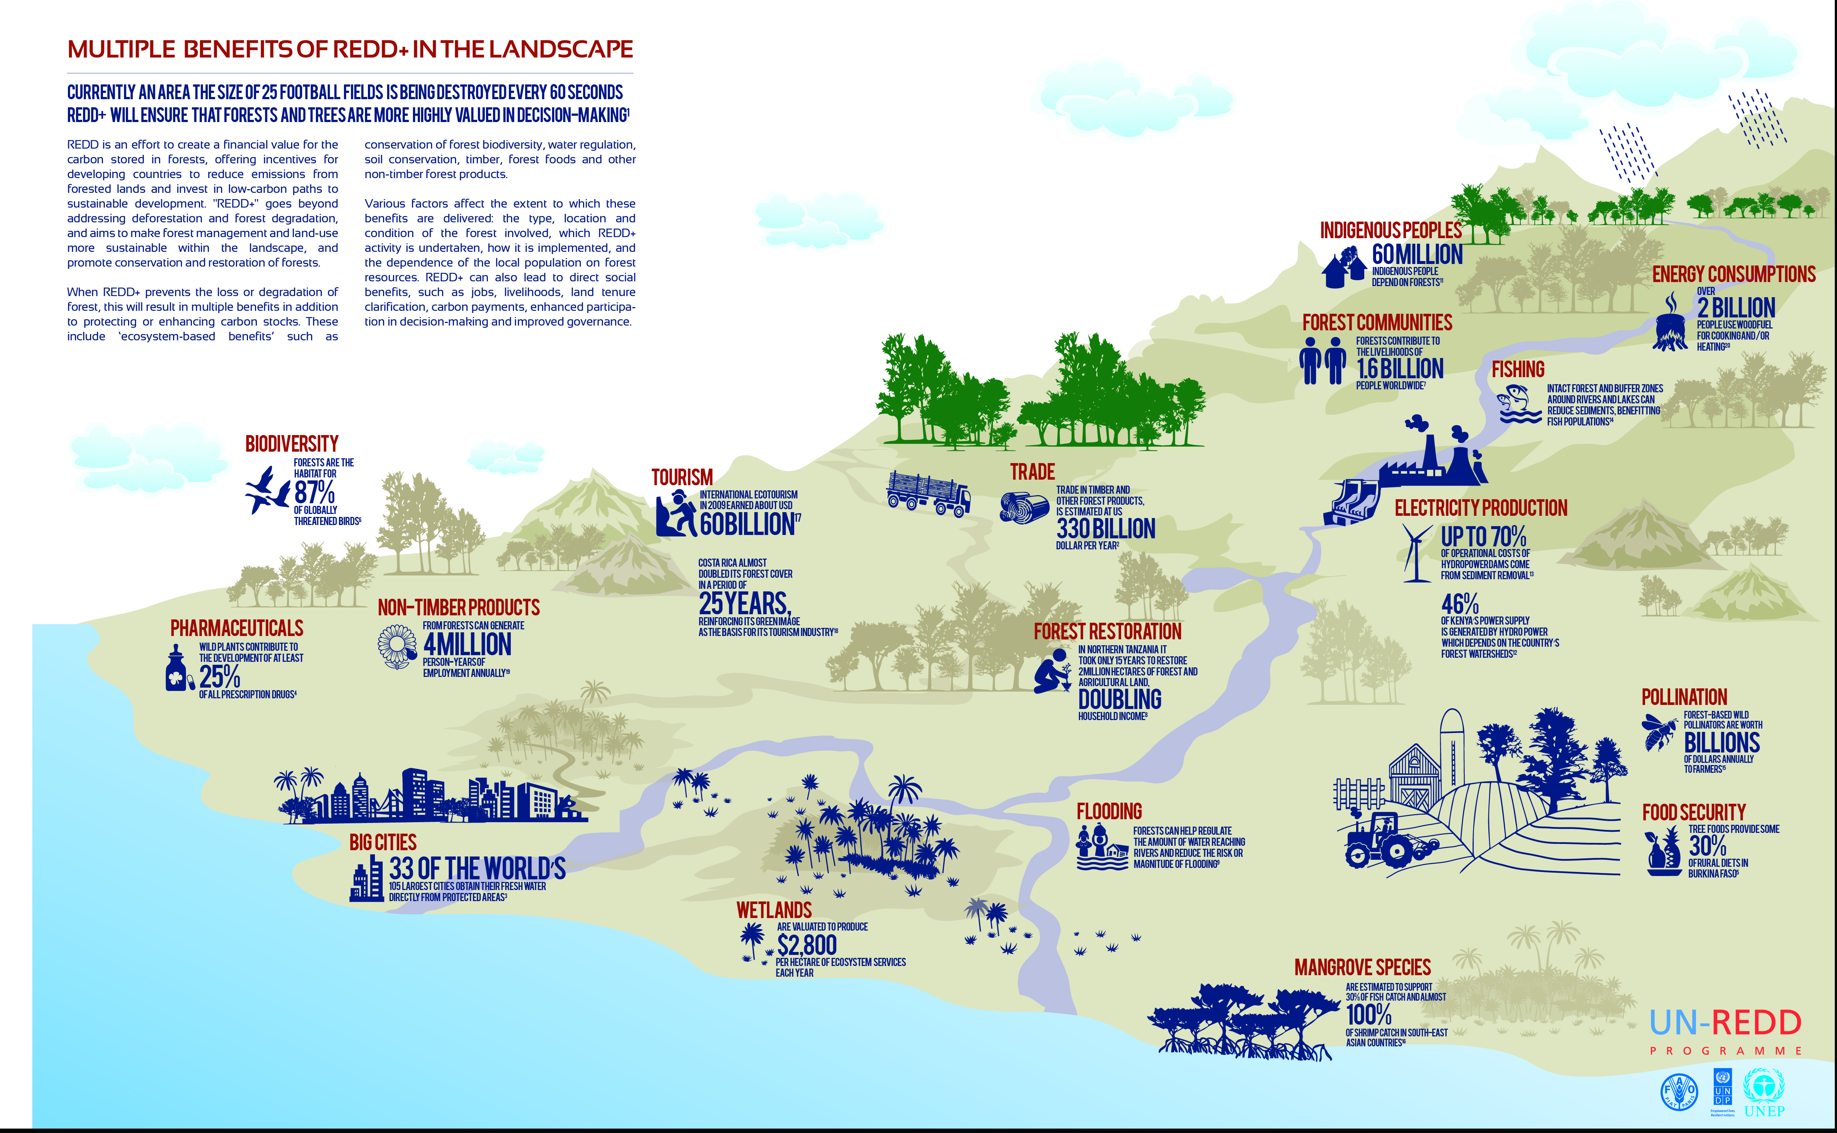

Slide 3
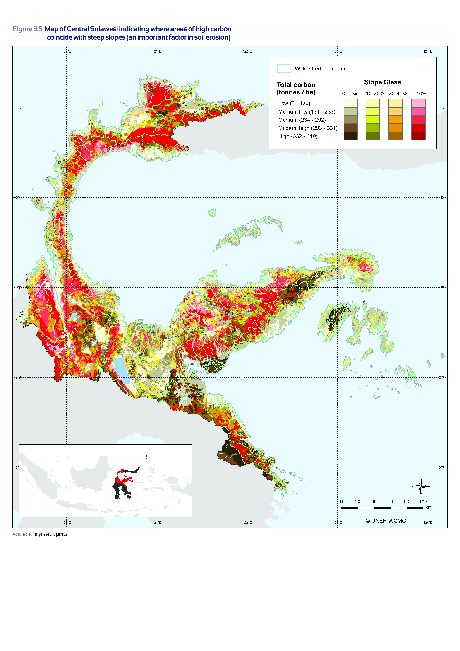

Slide 4
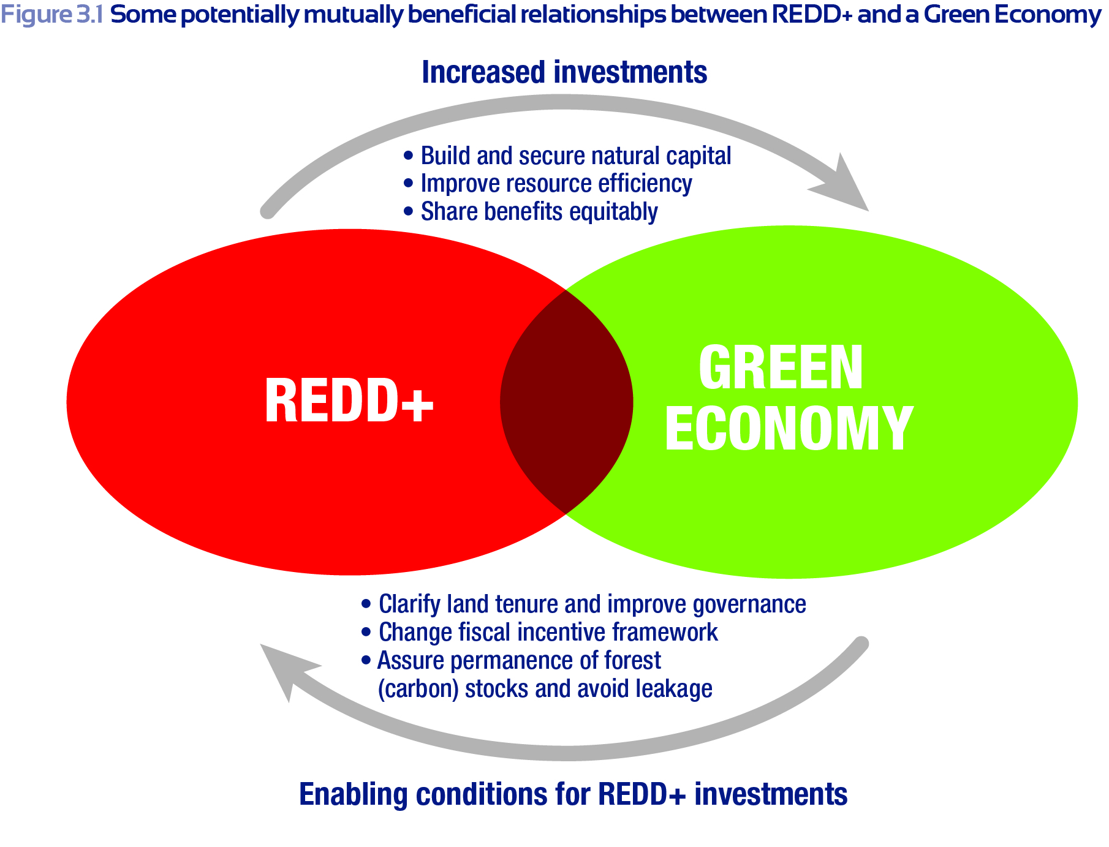

Slide 5
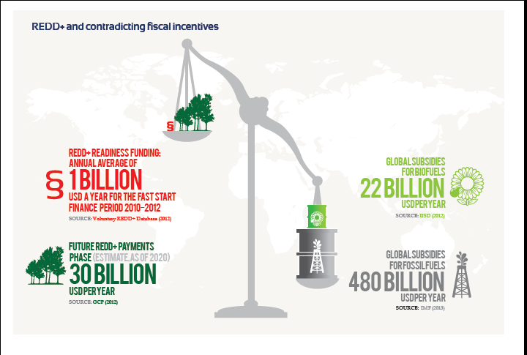

Slide 6
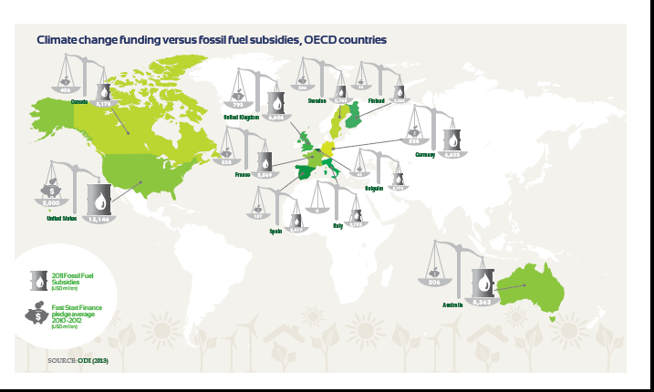

Slide 7
UNEP Priorities for 2014 and 2015:
Provide comprehensive and seamless country support on safeguards, spatial REDD+ planning, and Green Economy linkages
Build a clear socio-economic case for public REDD+ investments, with a focus on National Strategies and Funds, incentive frameworks, and SEEA
Build a clear business case for private REDD+ investments, and develop options for addressing private sector drivers of deforestation

Slide 8
Outcome 5 (national level):
Technical support to at least three UN-REDD partner countries on multiple benefits assessment for land-use planning
Provide technical support to two UN-REDD partner countries on valuation of forest biodiversity and ecosystem services at the sub-national scale
Undertake economics analysis on the cost of recent (10-50 years) deforestation in terms of ecosystem service and natural capital loss, and compare this with the economic gains
Provide technical support to at least four UN-REDD partner countries on safeguards and/or Safeguard Information Systems
Support Viet Nam in provincial scale mapping

Slide 9
Outcome 5 (regional/global level):
Regional workshop for experience sharing and capacity building in Latin America, in Quarter 2 of 2014
Global learning workshop in Quarter 3 to bring together REDD+ countries (and partner agencies)
Development of GIS modules and training materials to facilitate land-use planning
Scoping and drafting of visualization tool
Ongoing work on tools/ guidance to support countries on Safeguards
Work closely with UNDP and FAO to ensure coordination on the UN-REDD Programme’s approach to social and environmental issues, including on participatory monitoring

Slide 10
Outcome 5 (regional/global level):
Upgrade the multiple benefits website (online guide to relevant tools and resources)
Provide support to UNEP regional staff on Congo Basin issues and communication
Develop and communicate a shared understanding with UNDP and UNEP DEPI on the contribution of REDD+ to ecosystem-based (societal) adaptation to climate change
Provide written and oral (e.g. through presentations and updates) feedback and communication to UN-REDD Programme partner countries and collaborators at key junctures and global events
Provide technical support to the UN-REDD Programme on multiple benefits

Slide 11
Outcomes 4 and 6:
Develop a private sector engagement strategy for the UN-REDD Programme in consultation with the other UN-REDD Programme agencies (finalized strategy by November 2014)
Raise awareness of UNEP FI members about the scope and reach of REDD+ and to document their needs as they relate to national REDD+ policy frameworks
Scope and analyze the different ways through which UN-REDD Programme countries can engage and/or partner with the private sector for REDD+ readiness
Organize at least seven national workshops (upon country request) on the role of the private sector in the implementation and financing of REDD+/Sustainable land use activities in the context of national REDD+ programmes

Slide 12
Outcomes 4 and 6:
Organize at least two public-private policy dialogues at international level on successful economic incentives and related disincentives for reducing deforestation and forest degradation, and on mobilizing public and private REDD+ investment
Contribute to the organization of at least two public-private dialogues at a regional level (in the LAC Region) on successful economic incentives and related disincentives for reducing deforestation and forest degradation, and on mobilizing public and private REDD+ investment.
Prepare a programme of activities on REDD+ private sector engagement with a 2-3 year time horizon, building on the activities in this ICA

Slide 13
Outcome 7, REDD+ Academy:
Steering Committee (FAO, UNDP, UNEP, 3 regional and 1 IP representative), to be established
Advisory Group to be established March 2014: World Bank, IUFRO, IUCN, CI, WWF, CIFOR, GCP, UNORCID, Norway
Asia Design Workshop on 7 May, Jakarta
Africa Design Workshop on 16 May, Nairobi
LAC workshop date to be decided
Discussions with Yale University as main module developer
Nigeria and Indonesia offered to host first regional Academy sessions
First Academy sessions in January 2015

Slide 14
SNA highlights in coming 12 months
Product | Launch date | Summary
Using spatial information to support decisions on safeguards and multiple benefits for REDD+ - Step-by-step tutorials
Introduction to QGIS – the basics & Getting started with open source using QGIS 1.8 (Training mat.) | February 2014 | Open Source GIS software can be used to undertake spatial analysis of datasets of relevance to multiple benefits and environmental safeguards for REDD+. This tutorial provides a brief introduction to QGIS, a desktop GIS software, and will help users get started with using QGIS.
Creating an Open Foris Xubuntu live USB-The Basics & Getting started with open source (Training material) | February 2014 | How to prepare a Live Linux USB key with pre-installed GIS , image processing and other open source software. This provides a lightweight and standardized computing environment that can be particularly useful during training sessions.
How to georeference a scanned map or image with open source & using Xubuntu and QGIS 1.8. | February 2014 | How to georeference a scanned map or image in QGIS to enable it to be displayed with other spatial dataset and allows important information to be extracted.
Step-by-step tutorial: Extracting and processing IUCN red list species data using QGIS 1.8. | February 2014 | How to extract species data from the IUCN Red List website and further analyze the information alongside the IUCN spatial data using QGIS, an open-source desktop GIS software to create a species richness map.

Slide 15
SNA highlights in coming 12 months
Product | Launch date | Summary
Integrating Biodiversity and Ecosystem Services, and their impact on people, into REDD+ decision making: A manual for the UN-REDD spatial planning GIS toolbox (Training Material) | February 2014 | This manual contains information on how spatial analysis can be used for REDD+ planning. It aims to help technicians to undertake spatial analysis that can support REDD+ decision making, help policy makers under the need for spatial analysis for REDD+ and understand the resource requirements for spatial analysis that can support REDD+ decision making.
Supporting countries in integrating multiple benefits into their REDD+ strategies and development plans (Flier) | February 2014 | This flier outlines steps for integrating multiple benefits into REDD+ planning and describes the support that the UN-REDD Programme provides to countries in relation to planning for multiple benefits.
Using spatial planning software to support REDD+ decisions: an application of Marxan | March 2014 (French & English) | Illustrates how the spatial planning software Marxan can be used to identify priority areas for one potential REDD+ action (the expansion of forest protected areas) in the Democratic Republic of the Congo.
T21 model for DRC | 21 March 2014 | Sustainable development scenarios for DRC with and without REDD+

Slide 16
SNA highlights in coming 12 months
Product | Launch date | Summary
Building Natural Capital: How REDD+ Can Support a Green Economy | 21 March 2014 | Flagship publication for REDD+/GE linkages, and first in series of publications and support tools for national level REDD+/Green Economy synergies
Business Case for Sustainable Landscape Investments | March 2014 | Study with EcoAgriculture Partners on economic viability of integrated landscape management
Assessment of Carbon Pools and Multiple Benefits of Mangroves in Central Africa for REDD+ | March 2014 | This report presents research on carbon stocks and sequestration, as well as ecosystem services, of mangroves in Central Africa (Cameroon, DRC, RoC, Gabon); and makes recommendations for their inclusion in national REDD+ strategies.
Los Beneficios Múltiples de REDD+: Material Informativo para Comunidades (Booklet for communities) | March 2014 | This information booklet, designed for local communities in Ecuador, introduces REDD+ and some of the multiple benefits it can achieve.
REDD+ Legal Preparedness Manual | March/April 2014 | Basic guide for legal practitioners and Parliamentarians on REDD+ legal reforms
REDD+ Sourcebook | April 2014 | Course material for Universities on REDD+; to be used by UNEP’s 370 partner Universities

Slide 17
SNA highlights in coming 12 months
Product | Launch date | Summary
Beneficios múltiples de REDD+ en Ecuador | April 2014 | An overview of the work on multiple benefits that has been carried out in Ecuador under the UN-REDD NJP, within the context of the National REDD+ Programme. Also describes the uses of spatial information in supporting REDD+ planning.
Economic Analyses for REDD+ | April 2014 | Outlines why and how economic analyses of REDD+ options can support national planning that delivers multiple benefits.
Supporting land-use planning for REDD+ in Panama that integrates multiple benefits: the role of spatial analysis | April 2014 | This report presents spatial analyses that aim to support land use planning for REDD+ in Panama by helping to identify areas with potential to deliver multiple benefits from REDD+, as well as locations under pressure from deforestation.
Public Private Collaborations to Deliver REDD+ (Policy Brief) | May 2014 | This brief aims to better define PPCs (which includes PPPs) in the REDD+ context and will propose a framework for an objective understanding and analysis of the range of PPCs.
Multiple Benefits – Panama | May 2014 | The report identifies MBs from REDD+ in Panama and prioritizes areas under different development scenarios
Multiple benefits of REDD+ in Paraguay: incorporating spatial analysis into planning for REDD+ | June 2014 | This report presents spatial analyses that aim to support land use planning for REDD+ in Paraguay. Helps to identify areas with potential to deliver multiple benefits from REDD+ activities, which include reducing emissions from deforestation and forest restoration.

Slide 18
SNA highlights in coming 12 months
Product | Launch date | Summary
Opportunity costs and income flows from REDD+ to Panama | June 2014 | The report estimates the opportunity, implementation and transaction costs of REDD+ in Panama. It also provides estimations of net and gross income flows to Panama from a REDD+ programme
Land use change in Panama 2016-2032 | June 2014 | The report shows the estimated land use change in Panama according to different development scenarios identifying areas most at risk
Opportunity cost of REDD+ in Paraguay | June 2014 | The report estimates the opportunity, implementation and transaction costs of REDD+ in Paraguay
Bank and Investor Risk Policies for Soft Commodities | June 2014 | Report that will look at the status and best practices of financial risk policies in forest risk commodities and outline how deforestation in lending portfolios can affect financial risk
Forest and Agricultural Hidden Risks in REDD+: Scoping Study | June 2014 | Report that will apply the Carbon Tracker methodology, which looks at currently unpriced risks (such as stranded assets) to landscapes.
National forest ecosystem valuation studies | June – October 2014 | Zambia, Tanzania, RoC, Indonesia, Panama: making the economic case for REDD+ and forest conservation/SFM

Slide 19
SNA highlights in coming 12 months
Product | Launch date | Summary
Understanding the role of subsidies in driving investment in land-use change: a review of 4 commodities | September 2014 | The role of subsidies and incentives in climate finance is considerably better understood than in the land use space. This first report will attempt to categorise and quantify the key agricultural incentives that cause land use change using two forest countries as initial case studies.
Demystifying Private REDD+ Finance | September 2014 | This report will take a bottom up approach to REDD+ finance: what are the activities that need funding? do they require private sector finance? why are they not receiving it etc.?
The Business Case for REDD+ | November 2014 | This report will articulate the business case for REDD+ for both private sector and forest countries at national level and in the short term.
Forests for a Green Economy: Africa report | December 2014 | Building on UNEP Green Economy report/forest chapter: economic opportunities for Africa
Mapping Agricultural Supply Chains in Latin America (country TBD) | December 2014 | This report will map the main actors involved in financing the supply chain of forest risk commodities (commodities will be country dependent) identifying financing gaps and intervention points to transition to more sustainable land uses.
Subsidies Driving Land Use Change in Latin America (country TBD) | December 2014 | Report examining the compatibility of subsidies and other instruments of fiscal policy with REDD+ objectives (country to be decided). Report will build on earlier study.

Slide 20
SNA highlights in coming 12 months
Product | Launch date | Summary
Innovative Models for Results-Based Finance in REDD+ | December 2014 | Report will look at the Social and Development Impact Bond model which has caused a large degree of interest in the social and development finance world and ascertain if any lessons can be learnt for REDD+
Catalyzing Long-Term Smallholder Finance | December 2014 | Finance, in the form of the capital expenditure required to buy new stock or machinery is a real challenge for many farmers. This paper will look at different financing models for long term (>1 year) finance.
Mobilizing Capital to Deliver on REDD+: 'zero-net deforestation' equity indexes | December 2014 | A report outlining the methodology to develop a ‘zero-net deforestation’ equity investment index.
Uncovering hidden risk in forest risk commodity supply chains- equity portfolios | December 2014 | Builds on earlier paper with more case studies and a more quantitative slant to it.
Demystifying Finance for REDD+ Practitioners (videos) | December 2014 | Three short five minutes videos explaining core concepts in a visual, simple manner in multiple languages
Investment Grade Policy for REDD+ | December 2014 | Report examining what are the key policies that can attract finance and investment into REDD+ and sustainable land use.

Slide 21
SNA highlights in coming 12 months
Product | Launch date | Summary
Decision support on safeguards and multiple benefits of REDD+ | TBD | Safeguards and multiple benefits webpage.
Natural forest definitions and the REDD+ safeguards | Q.2 | A technical paper on natural forest definitions based on the experience in Tanzania

Slide 22
Highlights in Asia
Country | Milestone/Highlight
Cambodia | Draft review of safeguards for REDD+ (jointly with UNDP) Forest valuation work will start with an initial workshop in early April 2014
Indonesia | Multiple benefits brochures completed and downloaded over 10,000 times; one-day event on Indonesia and GE, held alongside GE Symposium
Philippines | Development of a safeguards framework and guidelines completed in April 2013. Follow up work by GIZ funded project.
Sri Lanka | Development of communication strategy and a variety of awareness-raising materials during the first quarter of 2014
Viet Nam (Phase II) | Development of framework and indicators for safeguards: 2nd draft roadmap for safeguards available (originally SNV took the lead on this, with UNEP and UNDP continuing) Strategy for awareness raising at provincial and national levels Enhanced Lower Mekong Sub-regional collaboration on enhancing biodiversity conservation through REDD+

Slide 23
Highlights in Africa
Country | Milestone
Uganda | Delivery of TS on multiple benefits/safeguards and support to NP development
Nigeria | Multiple benefits analysis undertaken; fully functional and supported Safeguards Task Team; Scoping study: Private sector REDD+ investment opportunities in Nigeria undertaken
DRC | Launch of T-21 model which demonstrated the potential for positive economic, social and environmental outcomes from applying REDD+/GE
RoC | Launch of Phases 1 and 2 of Economic valuation of forests contribution to the national economy studies
Kenya | 2nd phase of targeted support to further GE work and undertake spatial analysis
Cote d’Ivoire | Signed National Programme and begin implementation

Slide 24
Highlights in LAC
Country | Milestone/Highlight
Ecuador | (i) Completion of the combined work on multiple benefits, safeguards, costs of REDD+ and REDD+ scenarios. (ii) Integration of private sector and Green Economy policies in REDD+.
Paraguay | (i) Completion of the combined work on multiple benefits, safeguards, costs of REDD+ and REDD+ scenarios. (ii) Support to the government proposal for a local trading system for land compensation permits and its alignment with REDD+.
Costa Rica | Completion of the inter-agency targeted support on safeguards and SIS development
Panama | (i) Integration of the combined work on opportunity costs, multiple benefits and REDD+ scenarios into the National REDD+ Strategy. (ii) At least 2 REDD+ investment proposals to ANAM from private sector developed and agreed.
Colombia | Implementation of activities begins by the 2nd quarter 2014
Argentina | (i) Targeted support on Safeguards completed. (ii) Approval of NJP by June 2014 and implementation begins by 4th Quarter 2014.
Implementation rates | Overall rate of implementation for the portfolio above 75%

Slide 25
Example 1: REDD+ could achieve
important results

Slide 26
Example 2: REDD+ could provide
important incentives
Gross Income
Annual costs (+)
Annual costs (+/-)
Net income
Net income*

Slide 27
UNEP TS overview and pipeline
COUNTRY | DESCRIPTION OF TARGETED SUPPORT | Progress | SNA/GLOBAL PROGRAMME WORK AREAS | BUDGET (US$) | Other agencies with TS?
Argentina | Support to the incorporation of environmental and social safeguards for REDD+ Programme following a process of strategic environmental and social assessments and meet the standards set out in the “Social and Environmental Principles and Criteria. | In progress | 5 and 6. Multiple Benefits and Green Economy | 91,512 | FAO
Benin | General support on the development of REDD+ in country, with some specifics on work on multiple benefits and safeguards | Government sent concept note to UNEP as follow up to regional workshop | MB
Bhutan | Developing REDD+ Readiness in Bhutan – Ensuring Multiple Benefits of Forests | Completed | 5.MB (Ensuring Multiple Benefits of Forests) | 23,250 | UNDP and FAO
Bhutan | Development of a country appropriate safeguards approach | Request submitted on 28 January 2014 | 5.MB (Ensuring Multiple Benefits of Forests) | 45,000 | UNDP and FAO
Costa Rica | Development and implementation of a safeguard information system integrating the UN-REDD SEPC into the REDD+ strategy in Costa Rica. | In progress | 5.MB. | 115,000 | UNDP and FAO
Cote d'Ivoire | Request for support on PLR review for safeguards and potential for PES | In discussion with government following regional workshop, may be integrated into NP | MB |  | UNDP and FAO
Indonesia | Support on integrating REDD+ and GE into national development plans | Letter to be sent to the Secretariat | 6. Green Economy | 200,000
Kenya | First request/approval: Workshop and High-level Panel on Green Economy Investments in Forests. | In progress - workshop completed, part of resource efficiency study | 6. Green Economy | 55,800 | UNDP and FAO
Kenya | 2nd request for the rest of the resource efficiency study and for multiple benefits spatial analysis work | Letter to be sent to the Secretariat | 5. MB and 6. Green Economy | 1920,00

Slide 28
UNEP TS overview and pipeline
Mexico | Support on the development of indicators for SIS and linking to relevant international agreements | Inter-agency proposal agreed with government | 5. MB | 100,000 | UNDP and FAO
Mongolia | Support on planning for multiple benefits from REDD+ and support for green economy planning | Draft concept note discussed with government; discussions with government on GE work | 5. MB and 6. Green Economy | 95000 + GE work
Myanmar | Support to development of a National REDD+ Strategy. This is linked to the proposal in the line above. Strictly speaking this is not TS but Tier II. | Request submitted to the UNRC on 03 January 2014. | 5. MB and 6. Green Economy | 176,000 | UNDP and FAO
Nepal | Environmental Accounting | Request received on 15 January 2014 without a proposal. Proposal will have to be discussed further with UNDP and PEI | 6. Green Economy | 200,000 | UNDP
Solomon Islands |  | Government has indicated an interest in working on green economy. Work postponed as the government intends to focus on the development of a REDD+ road map | 6. Green Economy
Sudan (The Rep of the Sudan) | Support of capacity building on technical aspects of REDD+ and supporting the drafting of a roadmap for work to be undertaken in preparing for REDD+. | In progress - workshop to be held in February 2014 | 5 and 6. | 27,900
Uganda | Support on multiple benefits and safeguards | Letter sent to the Secretariat | 5. MB | 75,000 | FAO and UNDP requested in letter as well

Slide 29
New staff capacity (Regional staff)
Post | Incumbent | Main responsibilities | Reporting
Regional Technical Advisor, Africa, P4 | Daniel Pouakouyou | Coordinate support to African countries (National Programmes and Targeted Support) / Nairobi | Desta Mebratu (ROA) and Tim C.
Regional Programme Officer, P3 (temp. post) | To be recruited | Support NPs and TS in LAC / Panama City | Gabriel Labbate
Consultant (Quito) | Daniela Carrion | Support RTA in LAC, and support NP and TS (Tier 2) activities in Ecuador / Quito | Gabriel Labbate
Regional Programme Officer, P3 (temporary post) | To be recruited | Support NPs and TS in AP/Bangkok | Thomas Enters
Regional Programme Officer, P2 | Thais Narciso | Support NPs and TS in Africa and support Legal Preparedness and Special Events (HQ functions) | Daniel Pouakouyou and Tim C.
National Officer, Viet Nam | Phuong Ngyuen | Support Phase 2/Tier 2 project in Viet Nam | Thomas Enters
Programme Officer, P3 (temp. post) | To be recruited | Support NJP in Rep. of Congo; support regional activities / Brazzaville | Daniel Pouakouyou
Programme Officer, P4 (temporary post) | To be recruited | Support activities in Congo Basin / Nairobi | Daniel Pouakouyou
Senior Programme Officer, P5 | Johan Kieft | UNORCID staff (secondment): Head of Green Economy Unit | Satya Tripathi (Director, UNORCID)

Slide 30
New staff capacity (SNA staff)
Post | Incumbent | Main responsibilities | Reporting
Green Economy Advisor, P4 | To be announced | Lead Green Economy (Work Area 6) and support Private Sector Engagement / Nairobi | Tim C. and Pushpam Kumar (Ecosystem Econmics Unit)
Safeguards Coordinator, P4 (temporary post) | To be recruited | Coordinate UN-REDD work on safeguards / Geneva | Tim C.
Knowledge Management Officer, P3 (temporary post) | Suzannah Goss | Communicate Programme products and progress widely; coordinate knowledge management | Tim C.
Programme Officer, P3 (UNEP FI, temporary post) | To be recruited | Implement Private Sector Engagement work stream | Head, UNEP FI
Associate Programme Officer, P2 (UNEP FI, temporary post) | To be recruited | Implement Private Sector Engagement work stream | Head, UNEP FI
Programme Officer, P4(temporary post) | To be recruited | Coordinator, REDD+ Academy | Mahesh Pradhan
Finance Officer, P2 (temporary post) | To be recruited | Coordinate finance and HR | Tim C.
UNEP-WCMC |  | See update from UNEP-WCMC | Val Kapos/Lera Miles

Slide 31
UNEP-WCMC staff working > 30% on UN-REDD
Post | Incumbent | Main responsibilities | Focal Point for UN-REDD countries
Head of Programme | Valerie Kapos | Oversee all Climate Change and Biodiversity Programme work on REDD+ | Panama
Senior Programme Officer | Lera Miles | Oversee all UN-REDD work, lead GP-SNA work. SEPC, BeRT (Benefits and Risks Tool). Safeguards Coordination Group; Participatory Monitoring group. | -
Senior GIS Officer | Corinna Ravilious | Lead technical work on mapping | -
Programme Officer | Cordula Epple | Decisions/ mapping for multiple benefits; development of safeguards information systems | Ecuador, Indonesia, Peru
Programme Officer | Lucy Goodman | Coordinating regional workshops; developing and leading interactive workshop sessions, mapping and trialling Marxan. Support on UN-REDD project management. | Argentina, Nigeria, Philippines
Programme Officer | Lisen Runsten | Linking Aichi targets and multiple benefits/ safeguards; targetted support; NFMS links to SIS | Tanzania, Uganda, Kenya
Programme Officer | Robert Munroe | Benefits and Risks Tool (BeRT); regional workshop (Asia-Pacific). Safeguards coordination group alternate | Viet Nam

Slide 32
UNEP UN-REDD Team Map as of February 2014
DEPI Director (ad interim: Elizabeth Mrema) – Strategic Group member
Edoardo Zandri, Chief, TEU – MG Member
Tim Christophersen, UNEP UN-REDD Team Leader – MG member
Global Programme Coordination: Tim Christophersen (Collaboration with DTIE, DCPI and DEPI Units, in particular ESE and Adaptation)
Regional Teams (through UNEP Regional Offices)
National Programme Coordination: Julie Greenwalt
Work Area 2: Governance (Legal Preparedness)
Work Areas 4 and 6: Green Economy & Private Sector
Work Area 5: Multiple Benefits and Safeguards
Latin America and Caribbean
Asia-Pacific
Africa
Environmental Economist
(to be recruited)
Julie Greenwalt
Gabriel Labbate (Panama)
Thomas Enters
Regional Advisor (to be recruited)
John Prydz
Temporary PO (Safeguards Coordinator)
Diego Martino (Uruguay)
Regional Officer (P3)
Thais Narciso
Thais Narciso
Tim Christophersen and Niklas Hagelberg
Daniela Carrion
(Ecuador)
Phuong Nguyen (Viet Nam)
Temporary PO, Congo Basin
John Prydz
UNEP WCMC (Lead: Val Kapos and Lera Miles)
UNEP FI (I. Mulder, Iain Henderson and Jacinto Coello)
Johan Kieft (Senior Officer, UNORCID)
National Officer, Brazzaville
← Cross-cutting →
Communications and Special Events
Monitoring/Reporting
Admin/Finance and HR Liaison
REDD+ Academy and Capacity Building
Synergies with GEF and UNEP Forest Network
Global Initiative on Illegal Wildlife and Timber / UNODC
Suzannah Goss
Julie Greenwalt
Florence Kahiro
Temporary PO
Niklas Hagelberg
Niklas Hagelberg
Thais Narciso
John Prydz
Noella Muribora
Jaime Webbe (consultant)
Isabelle Pierrard
Intern
(to be recruited)
Florence Kahiro
Mwanaisha Hassan
Consultants (to be recruited)

Slide 33
2015 Budget
Work area | Amount | Already secured (Norway 2014) | Required
4.5 | 1.2 | 0.7 | 0.5
5 | 2.6 | 0.2 | 2.4
6 | 2.6 | 0.3 | 2.3
7 | 1.5 | 0.5 | 1.0
Total | 7.9 | 1.7 | 6.2

Slide 34
Edoardo Zandri
Tim Christophersen
Edoardo.Zandri@unep.org
Tim.Christophersen@unep.org
Thank You
Website: http://www.un-redd.org

