Slide 1
Getting Initial Readiness Underway
Forest Day 3, Sunday 13 December 2009
Notes:
Co-hosts – World Bank, Environmental Defense Fund
Role of emerging lessons from current initiatives in informing the scope of the global climate agreement.
-”scope” has a particular meaning in the negotiations
-UN-REDD programme currently has been assisting countries with initiating readiness processes
-This can be relevant for whatever is the final scope of the agreement

Slide 2
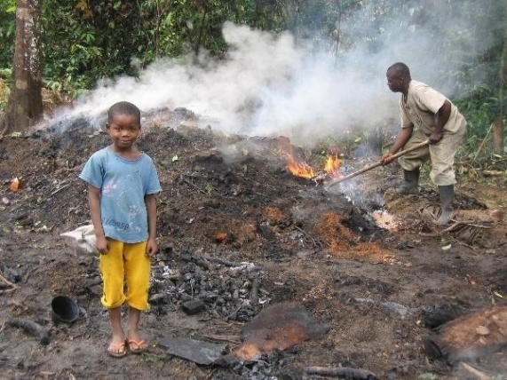

What is the UN-REDD Programme?
  Collaborative partnership
  Pledges of $106m
  First phase:
      9 ‘Quick Starts’
      Global Programme
  Second phase after COP15
Notes:
Policy Board with full membership of CSOs and IPs
Secretariat

Slide 3
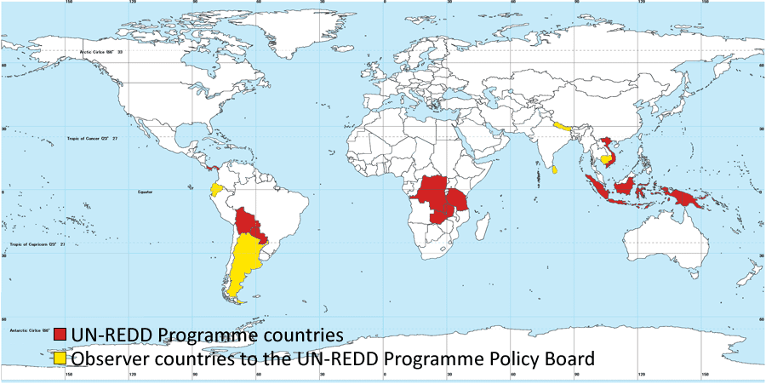
Participating Countries
Notes:
9 pilots : all making progress in considering a national approach; 6 approved; 4 under implementation
5 accepted at Policy Board – Cambodia, Nepal, Sri Lanka, Ecuador, Argentina
4 additional requests - Congo- Brazzaville, Nigeria, Solomon Islands, Costa Rica
More interest to join

Slide 4
Early Insights
Getting Organized
Developing REDD+ Strategies
MRV for Carbon
Notes:
3 main areas where UN-REDD Programme is actually providing assistance through national programmes
$24 million released
$9 million ready to be released

Slide 5
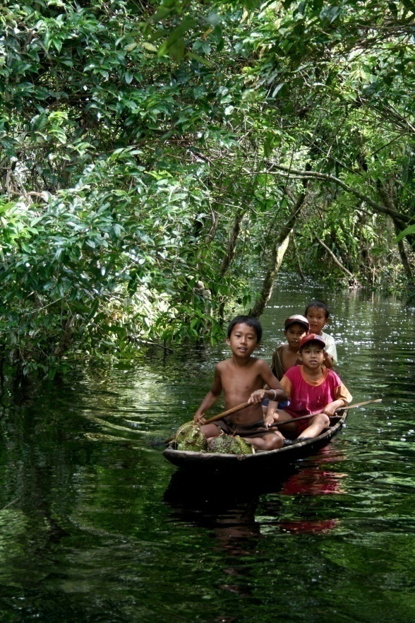
Readiness Management Arrangements
Start-up Activities
The formulation of REDD “roadmaps” has greatly helped to clarify required interventions, and those for which UN-REDD has a comparative advantage.
This has been done in PNG and Viet Nam and Zambia
Strong emphasis on stakeholder engagement mechanisms
Notes:
Provide assistance for
Focus on immediate steps as well as broader readiness plan
Provide initial support to initiating readiness process : preparatory support through the Global Programme $ 600,000; approve national programmes
Initial National Programmes
PNG and DRC
Really focused on the immediate steps
Eligible to receive additional assistance once the process is up and running

Slide 6
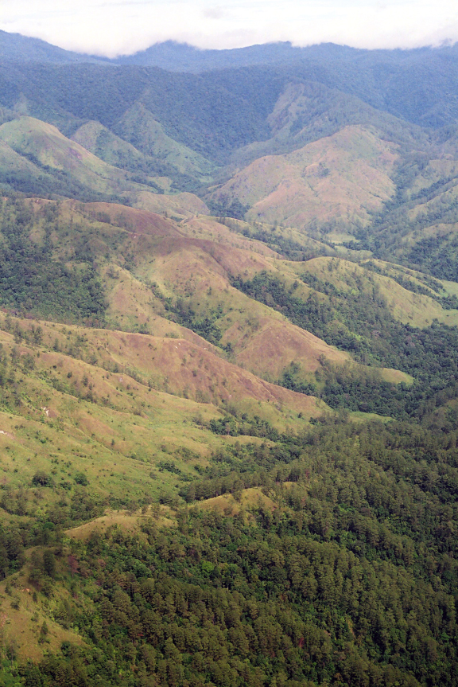
Organizing and Consulting
Stakeholder Engagement
The establishment of engagement mechanisms early in the process is very important. Validation meetings before submission of proposals support this process
The establishment of a broad-based multi-stakeholder consultation mechanism can dramatically increase confidence in the process among all stakeholders.
This has been the experience, for example, in Viet Nam
Notes:
DRC Process : factors contributing to success
Engaging civil society: Best Practice in the DRC, available on UN-REDD web site
1)
Joint missions with FCPF, bilateral partners, international NGOs, local civil society and led by DRC government (40 reps)
Participatory process highlighted as pivotal
Established a civil society working group, which selects representatives for National REDD Committee and interacts with UN-REDD and FCPF
REDD Decree establishes National Coordination, Interministerial Committee and National REDD Committee
National REDD Committee has 12 reps, 4 of which come from civil society and Ips
2)Capacity Building to civil society and IPs, awareness raising, support to establishment of networks and involvement in the UN-REDD Programme governance process
3)Development of Operational guidelines for engagement, helps to establish the process and instill trust

Slide 7
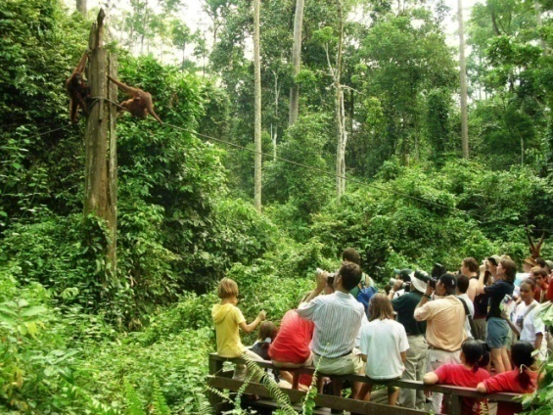
Preparing REDD+ Strategies
Consensus Building
The process of developing a REDD+ Strategy is as important as the end product
Identifying the drivers of deforestation needs to be done in a way that leads to national consensus; otherwise no strategy or implementation plan will work.
DRC is devoting time to ensure the assessment of drivers of deforestation serves to unite stakeholders around forest issues
Notes:
Corollary/consequence of the emphasis on engagement in early readiness management, we are also recognizing the importance of consensus building.
REDD has highly significant implications on how a country uses its forest resource assets. In many forested developing countries these assets form a primary means of development.
Developing national REDD strategies are an opportunity to involve stakeholders and ensure there is confidence in the outcomes and ownership of the process.
Important to learn from the decades of development experience – both good or bad - to ensure that national REDD strategies achieve sustainable and meaningful outcomes.

Slide 8
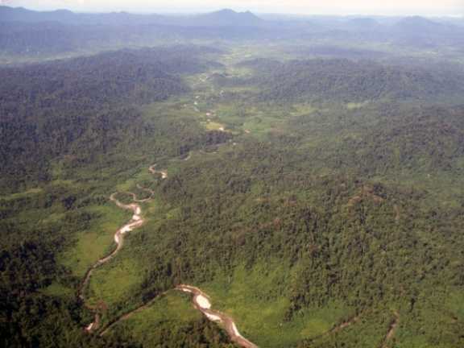
Preparing REDD+ Strategies
Strategy Options
It is important to position a REDD strategy in the context of a broader process.
For example, in PNG a low-carbon development strategy is being prepared;
in Viet Nam, REDD is contained within the “National Target Programme” to address CC
Notes:
Point raised by Benoit
Ground truthed, if you like, by our initial progress with national programmes
Emphasized by Sir Nicholas Stern in his comments to the sub plenary just now
Corresponds with what is emerging from the pilot countries.

Slide 9
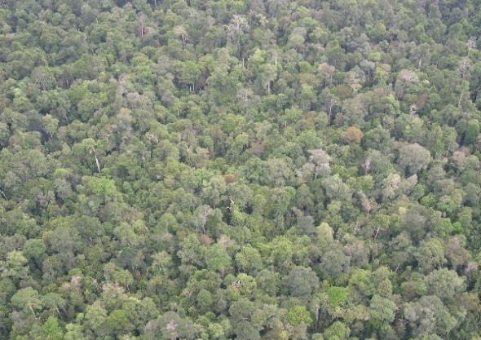
Designing a Monitoring System
MRV
Early action on MRV is critical
Key initial elements are:
- remote sensing for forest area data
- the role of the national forest inventory with regards to the emission factor
In DRC, both components would in turn support the country’s national greenhouse gas inventory.
Notes:
Identified by most countries as a critical initial area where support is required
Initial national programmes for DRC and PNG
Also identified as a need for follow up support to implement national MRV systems
Looking at how to support strengthening the link

Slide 10
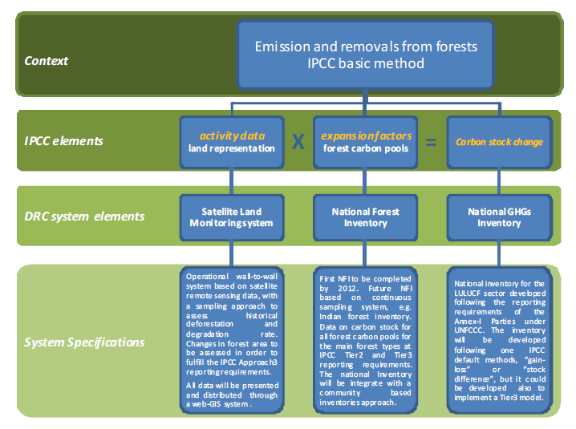
Proposed MRV System for DRC
Notes:
More from Vincent
Highlights: consistency with IPCC elements; role for both remote sensing and ground based inventory
Lack of national GhG inventory- national forest inventory + GhG inventory (under National Communications)

Slide 11
Emerging Areas of Focus for 2010
Benefit Distribution
MRV for Governance
Environment & Social Principles
Notes:
From our experience in assisting countries to organize their readiness process, can also say a word about issues that are emerging as key areas of focus moving forward
1) Building National Institutions to receive and distribute REDD resources
Transparency
Fiduciary quality
Equity, poverty and social impacts
2) Governance
Institutional strengthening
Confidence and involvement of stakeholders
Assessment measures
3) Principles or safeguards

Slide 12
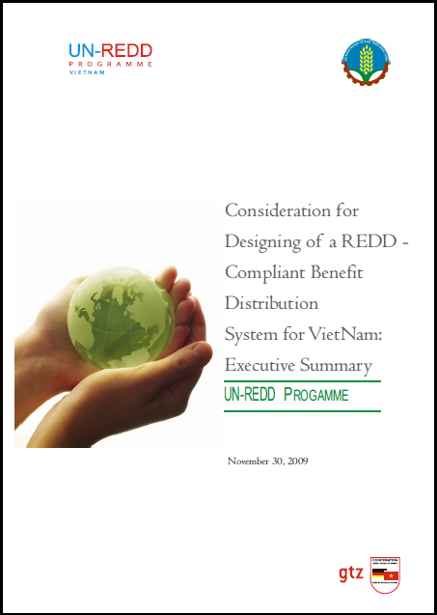
Benefit Distribution
Notes:
Area UN-REDD Programme is already supporting
Viet Nam has identified issue as a key priority and is already studying how REDD benefits relate to existing social benefits and ecosystem services systems
Ecuador and Socio Bosque
Paraguay and the work of UNDP’s Poverty Center

Slide 13
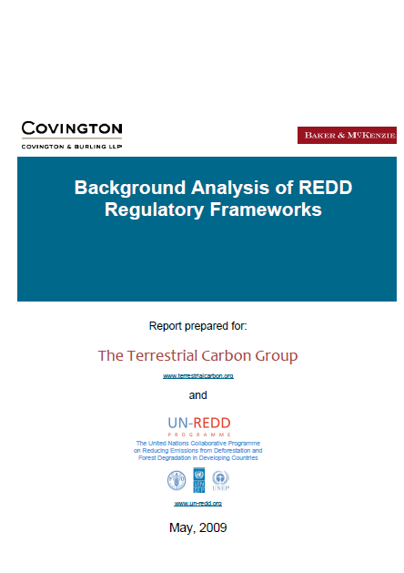
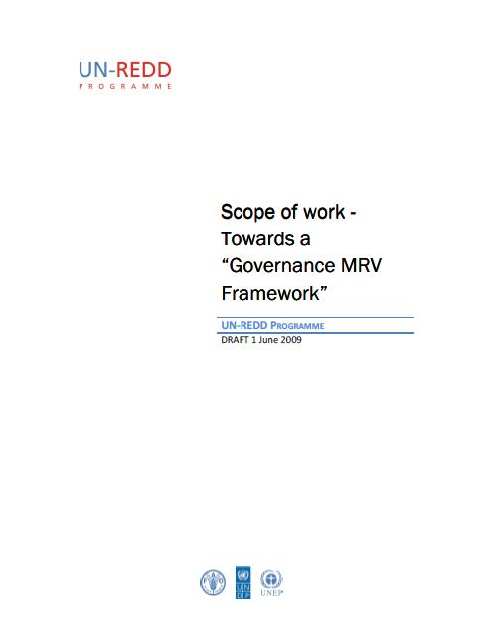
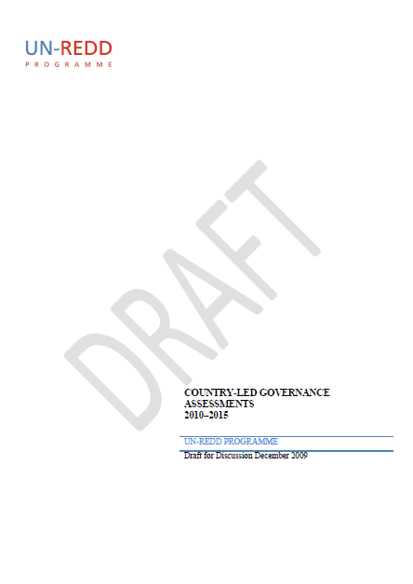
Governance Structures
Notes:
Focus on carbon monitoring
But UN-REDD programme has continued to advocate for a broader consideration that takes into account governance elements
Depends on the application of safeguards currently being considered in the negotiations but will still be important for countries to be able to assess their programmes and performance

Slide 14
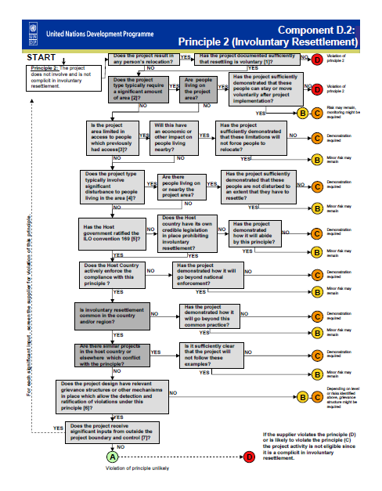
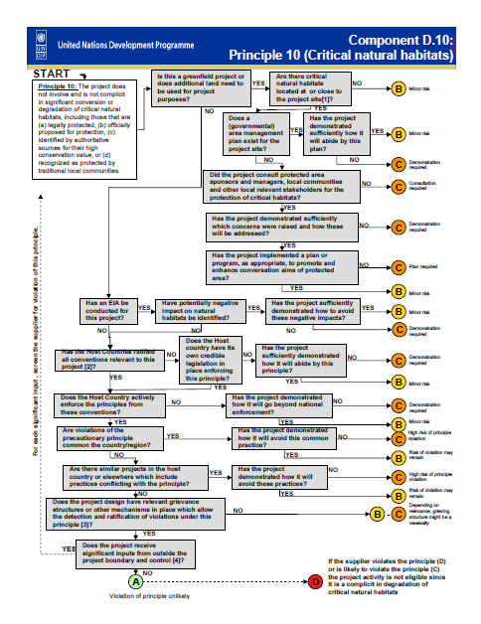
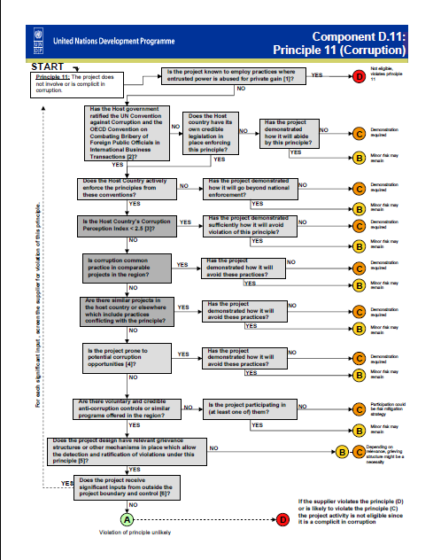
Environment and Social Principles
Notes:
Recognition of safeguards in the negotiations
Just want to make the point that it will be important to ensure we apply safeguards that have been designed appropriately for REDD + and not inherited safeguards that have been designed for other purposes
UN often not assumed to have safeguards – just want to highlight that we have developed due diligence measures specifically for carbon finance. These can be reviewed and designed appropriately for REDD+
(Gender, IPs and CSOs, corruption, biodiversity)

Slide 15
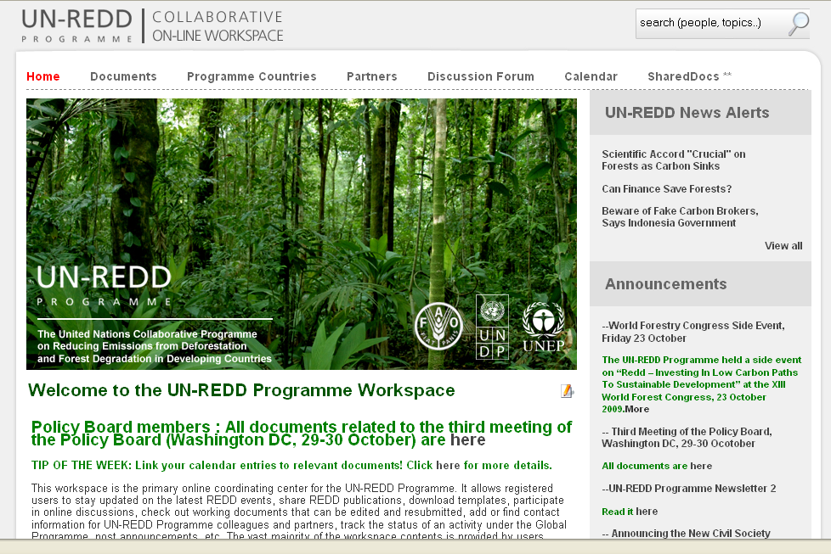
Knowledge Network:
UN-REDD Workspace
Notes:
Management and dissemination of early experiences and knowledge is critical
UN-REDD has established a community of policy and practice around REDD+

Slide 16
Notes:
1. Perspectives – bonds – have we started to think of using these instruments
2. Faizal: What are the main constraints for coordinated and consistent inputs from civil society and IPs
3. Evelyn Trimes
-Brazil have their own plans
-Negotiations tilting towards experts process
→ timing issue
?will state overcome the timing process
? Is there a chance f corruption or is the Amazon Fund process robust enough?
4. A/R got stuck in procedure – what will make REDD different?
5.
Legal work going on; SFM work going on; Carbon work going on :
Not much coordination on stakeholder consultation – is this being considered? How to avoid stakeholder fatigue?

