Slide 1
Approaches to REDD+ Nesting: Lessons Learned from Country Experiences
Donna Lee
Geoff Roberts
Pablo Llopis
Rob Waterworth
Tim Pearson
October 2018

Slide 2
Contents
Introduction What is nesting? Why nest? Providing incentives through design of a nested system Ex-ante finance vs. ex-post rewards? Rewards: Finance or ERs? National vs. local actions? Stand-alone generation of ERs? Technical issues: What are the key MRV challenges of nesting Alignment of MRV systems Baselines Simplifying with proxies Conclusions

Slide 3
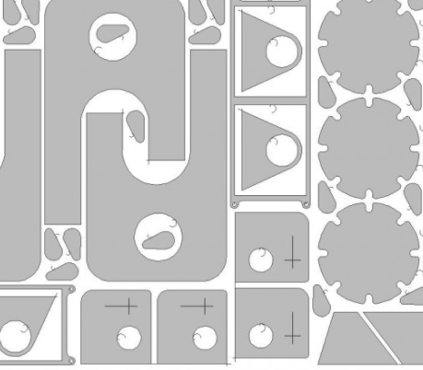
What is nesting?

Slide 4
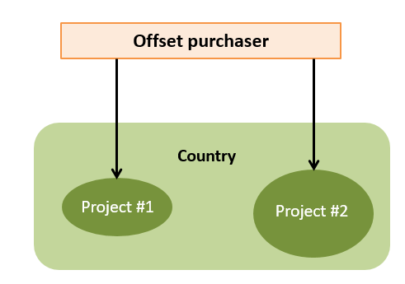
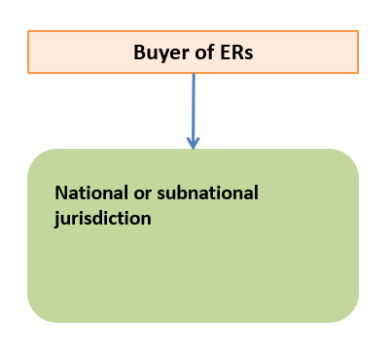
The evolution of forest carbon crediting…
In the beginning…
But this changed under the UNFCCC and Warsaw Framework…

Slide 5
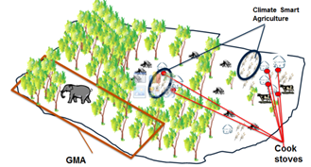
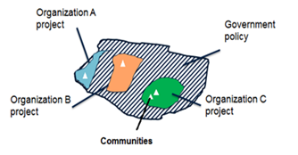
…however countries are finding that they still need to catalyze actions at multiple levels to achieve results...
In most countries, drivers vary requiring multiple types of activities…
…as well as the participation of multiple stakeholders
…which requires engagement of multiple actors, operational capacity and finance.

Slide 6
…this has led many countries to consider “nested” systems.
Buyer of ERs
Buyer of ERs
Jurisdictional + Projects
Jurisdictional only

Slide 7
The Paris Agreement and Nationally Determined Contributions (NDCs)…
Country achievement of emission reductions at national scale
ERs used for achievement of the (unconditional) NDC
Remaining ERs
Sold to raise finance?

Slide 8
Key decisions in building a nested system

Slide 9
Four fundamental design decisions
#1 - Ex-ante finance or ex-post rewards?
Are local actions better catalyzed through ex-ante finance (to generate future ERs) or through ex-post rewards (for past performance)?
#2 - If ex-post rewards: Allocate finance or ERs?
If a country generates ERs and wishes to reward projects or subnational units, is it better to provide finance or ‘pass through’ a portion of ERs?
#3 - National versus local effort?
What are the relative contributions of national vs. local actions?
#4 - Stand alone projects?
Are there instances where it is beneficial to allow smaller-scale units the ability to generate ERs separately?

Slide 10
#1 – Ex-ante finance or ex-post rewards?
Are local actions better catalyzed through ex-ante finance (to generate future ERs) or through ex-post rewards (for past performance)?
Country sells ERs
Allocation of funds
Two basic models:
Ex-ante finance to local actors to achieve future reductions
Ex-post finance to reward past reduction

Slide 11
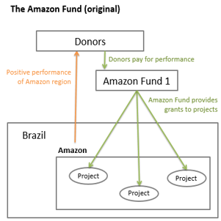
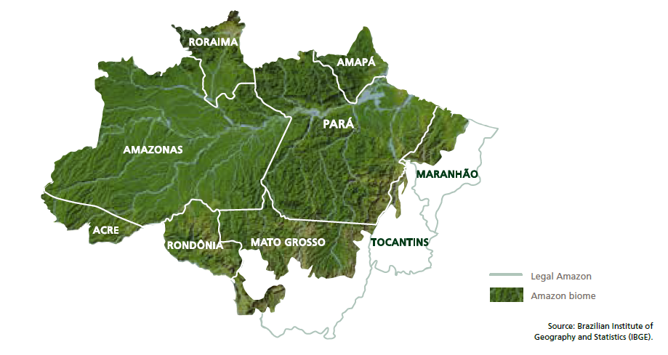
Example: Brazil
Providing incentives in the Amazon region
The original Fund was an ex-ante finance system (for projects)…
…but is moving to an ex-post reward based system (for states)
New system for the Amazon – defines ‘payment collection limits’
Each state is provided a share of the overall results based on individual state performance

Slide 12
#2 – Ex-post rewards: Finance or ERs?
If a country generates ERs and wishes to reward projects or subnational units, is it better to provide finance or ‘pass through’ a portion of ERs?
Allocation of ERs
Country sells ERs
Allocation of funds
Use of ERs to reward past performance
Use of finance to reward past performance
Use of finance to provide ex-ante grants
Ex-post rewards
Ex-ante finance

Slide 13
Example: Mai Ndombe ER Program
Mai Ndombe’s ER program may result in both the allocation of ex-ante finance, plus financial rewards for ex-post performance, plus possibly allocation of ERs for ex-post performance.
Mai Ndombe province generates and issues ERs for jurisdictional performance
Carbon Fund ERPA
(purchase of X% of ERs achieved)
In-Kind ERs
(remaining Y% of ERs achieved)
Allocation of funds
Possible distribution of ERs to projects
Category 1 payments (senior rights)
Category 2 payments
Fixed costs
Provincial govt
PMU
Variable costs
Indigenous peoples
Local Communities
Finance window to support new community projects
Ex-post performance based
REDD+ projects
Timber concessions
Providing different types of incentives (ex-ante finance and ex-post rewards) is complex, but allows the most appropriate incentives for different actors

Slide 14
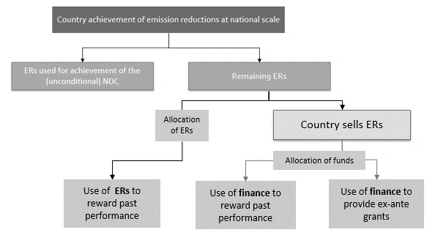
#3 – National versus local efforts?
What are the relative contributions of national vs. local actions?
% of ERs to higher level jurisdiction
% of ERs to smaller scale units
% of $ to higher level jurisdiction
% of $ to smaller scale units
% of $ to higher level jurisdiction
% of $ to smaller scale units

Slide 15
Examples: Government vs. Local actors
Different national circumstances will result in different “sharing” of the benefits between the national government and subnational/project units.
Amazon
Mai Ndombe
Various source of carbon finance
Mai Ndombe province generates and issues ERs for jurisdictional performance
Brazilian government sets limitations on ER payments received by the federal government and states
Carbon Fund ERPA
(purchase of X% of ERs achieved)
In-Kind ERs
(remaining Y% of ERs achieved)
Federal government
(40%)
Amazon States
(60%)
Costs to administer the program
Payments to stakeholders or programs designed to benefit stakeholders
CAFI support to province

Slide 16
#4 – Allowing stand-alone projects
There may be instances where projects are allowed to generate ERs separately – not as part of a benefit sharing, or allocation, system
Country achievement of emission reductions at national scale
ERs used for achievement of the (unconditional) NDC
Remaining ERs
Separately issued and traded ERs may need to be debited from national registry
Finance
(e.g. from carbon taxes, government budget)
There are different implications of allowing projects to issue ERs within a domestic system vs. allowing international trading.
Projects issue ERs and engage in international trading
Domestic system that rewards projects

Slide 17
Example: Australia (domestic system)
Australian government:
KP target and NDC
Projects contribute to national achievement of commitment
The government strives to align MRV at national and project scales
Emission Reduction Fund
Land owner generates carbon credits
Land owner generates carbon credits
Land owner generates carbon credits

Slide 18
Putting it all together…
Flow of ERs
Flow of finance
Country achievement of emission reductions at national scale
“Nested” activities feed back, or contribute, to national emission reductions
ERs used for achievement of the (unconditional) NDC
Remaining ERs
Separately issued and traded ERs may need to be debited from national registry
Country sells ERs
Allocation of ERs
Allocation of funds
Finance
(e.g. from carbon taxes, government budget)
Use of ERs to reward past performance
Use of finance to reward past performance
Use of finance to provide ex-ante grants
Ex-post rewards
Ex-ante finance
Stand alone projects
Projects issue ERs and engage in international trading
Domestic system that rewards projects
% of ER to higher level jurisdiction
% of ER to smaller scale units
% of $ to higher level jurisdiction
% of $ to smaller scale units
% of $ to higher level jurisdiction
% of $ to smaller scale units

Slide 19
Brazil Amazon Fund (original)
Flow of ERs
Flow of finance
Country achievement of emission reductions at national scale
“Nested” activities feed back, or contribute, to national emission reductions
ERs used for achievement of the (unconditional) NDC
Remaining ERs
Country sells ERs
Separately issued and traded ERs may need to be debited from national registry
Allocation of ERs
Allocation of funds
Finance
(e.g. from carbon taxes, government budget)
Use of ERs to reward past performance
Use of finance to reward past performance
Use of finance to provide ex-ante grants
Ex-post rewards
Ex-ante finance
Stand alone projects
Projects issue ERs and engage in international trading
Domestic system that rewards projects
% of ER to higher level jurisdiction
% of ER to smaller scale units
% of $ to higher level jurisdiction
% of $ to smaller scale units
% of $ to higher level jurisdiction
% of $ to smaller scale units

Slide 20
Brazil Amazon (new)
Flow of ERs
Flow of finance
Country achievement of emission reductions at national scale
“Nested” activities feed back, or contribute, to national emission reductions
ERs used for achievement of the (unconditional) NDC
Remaining ERs
Country sells ERs
Separately issued and traded ERs may need to be debited from national registry
Allocation of ERs
Allocation of funds
Finance
(e.g. from carbon taxes, government budget)
Use of ERs to reward past performance
Use of finance to reward past performance
Use of finance to provide ex-ante grants
Ex-post rewards
Ex-ante finance
Stand alone projects
Projects issue ERs and engage in international trading
Domestic system that rewards projects
40% of ERs to federal government
60 % of ERs shared by states
% of $ to higher level jurisdiction
% of $ to smaller scale units
% of $ to higher level jurisdiction
% of $ to smaller scale units

Slide 21
Mai Ndombe ER program
Flow of ERs
Flow of finance
Country achievement of emission reductions at national scale
“Nested” activities feed back, or contribute, to national emission reductions
ERs used for achievement of the (unconditional) NDC
Remaining ERs
Country sells ERs
Separately issued and traded ERs may need to be debited from national registry
Allocation of ERs
Allocation of funds
Finance
(e.g. from carbon taxes, government budget)
Use of ERs to reward past performance
Use of finance to reward past performance
Use of finance to provide ex-ante grants
Ex-post rewards
Ex-ante finance
Stand alone projects
Projects issue ERs and engage in international trading
Domestic system that rewards projects
% of ER to higher level jurisdiction
% of ER to smaller scale units
% of $ to higher level jurisdiction
% of $ to smaller scale units
% of $ to higher level jurisdiction
% of $ to smaller scale units

Slide 22
Australia
Flow of ERs
Flow of finance
Country achievement of emission reductions at national scale
“Nested” activities feed back, or contribute, to national emission reductions
ERs used for achievement of the (unconditional) NDC
Remaining ERs
Country sells ERs
Separately issued and traded ERs may need to be debited from national registry
Allocation of ERs
Allocation of funds
Finance
(e.g. from carbon taxes, government budget)
Use of ERs to reward past performance
Use of finance to reward past performance
Use of finance to provide ex-ante grants
Ex-post rewards
Ex-ante finance
Stand alone projects
Projects issue ERs and engage in international trading
Domestic system that rewards projects
% of $ to higher level jurisdiction
% of $ to smaller scale units
% of $ to higher level jurisdiction
% of $ to smaller scale units
% of ERs to higher level jurisdiction
% of ERs to smaller scale units

Slide 23
KP Joint Implementation
Flow of ERs
Flow of finance
Country achievement of emission reductions at national scale
“Nested” activities feed back, or contribute, to national emission reductions
ERs used for achievement of
Kyoto Protocol QELRO
Remaining ERs
Country sells ERs
Separately issued and traded ERs may need to be debited from national registry
Allocation of ERs
Allocation of funds
Finance
(e.g. from carbon taxes, government budget)
Use of ERs to reward past performance
Use of finance to reward past performance
Use of finance to provide ex-ante grants
Ex-post rewards
Ex-ante finance
Stand alone projects
Projects issue ERs and engage in international trading
Domestic system that rewards projects
% of $ to higher level jurisdiction
% of $ to smaller scale units
% of $ to higher level jurisdiction
% of $ to smaller scale units
% of ERs to higher level jurisdiction
% of ERs to smaller scale units

Slide 24
Technical challenges

Slide 25
MRV mismatches
Data and information at the national versus project scales…
National |  | Project
Uses (medium resolution) Landsat to measure forest cover change |  | May use higher resolution imagery to measure forest cover change
Carbon stock estimates from national forest inventory or default values |  | Often collects and uses own site-specific carbon stock estimates
Stratification based on national forest classes, may combine (i.e. fewer strata) to reduce uncertainties |  | Typically many more strata than national GHG inventory due to use of data with finer spatial scales
Often only includes above and below-ground biomass and excludes non-CO₂ gases |  | May choose or be obligated to measure deadwood, litter, soil and non-CO₂ gases
Because subnational jurisdictions tend to use national data, nesting such units is easier than nesting projects

Slide 26
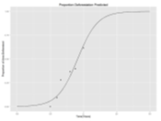
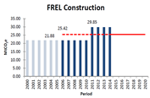
Baseline setting
Zambia example:
BioCarbon Partners project | COMACO project | National FREL
Ref. period: 1984-2009 Method: Logistic function | Ref. period: 2002-2013 Method: Modeled emissions Expected deforestation estimated based on distance to settlements and roads and topography. | Ref. period: 2006-2014 Method: Historical average
Baseline challenges are much greater for avoided deforestation and forest degradation than A/R and forest management.

Slide 27
Technical challenges depend on the nested design: Some systems are easier than others
Nested systems
Allocating finance,
ex-ante grants
Allocating finance,
ex-post rewards using proxy measures
Allocating finance,
ex-post rewards based on GHG performance
Allocating ERs based on GHG performance
Stand-alone projects with own MRV in domestic only systems
Stand-alone projects with own MRV and trading ERs
Requires aligned MRV
Examples
Amazon Fund (original)
Mai Ndombe ERPD
Kyoto Protocol Joint Implementation
COMACO
GRIF
Amazon Fund (new)
Australian ERF

Slide 28
Simplifying through use of proxies
COMACO uses simple metrics to rate the performance of chiefdoms, and use the scoring to provide premium off-take prices, 10-20% above market.
While this model is not currently used to allocate carbon finance, one can see how it may be adapted as a carbon finance model
Goods are sold at premium price
Farmers improve
practices that include forest and soil conservation
Profits are distributed back to farmers based on scoring
The use of simple, proxy measures that are easily understood by communities is one option for allocating carbon benefits (finance or ERs).

Slide 29
CONCLUSIONS There is no “one size fits all” model of nesting. The design of a nested system will be different from one country to another. Experience with nesting is still in its infancy. The concept will continue evolving, and we will continue to learn what works—so it’s good to be flexible and adaptive. Nesting can contribute to the sustainability of a jurisdictional program. Incentivizing local action supports achievement of large-scale results. From a technical perspective… It is easier to nest subnational to national, than to nest projects Nesting of A/R or forest management is easier than, e.g. avoided deforestation Allocation driven systems are technically simpler Allowing stand-alone projects to trade Internationally is more challenging and requires extra capacity and effort Proxies may be worth consideration, due to their simplicity

Slide 30
Comments or questions? Email: donnalynettelee@gmail.com

