Slide 1
Communicating about REDD+ in Nigeria
Presented by
Bridget Nkor
CRSFC

Slide 2
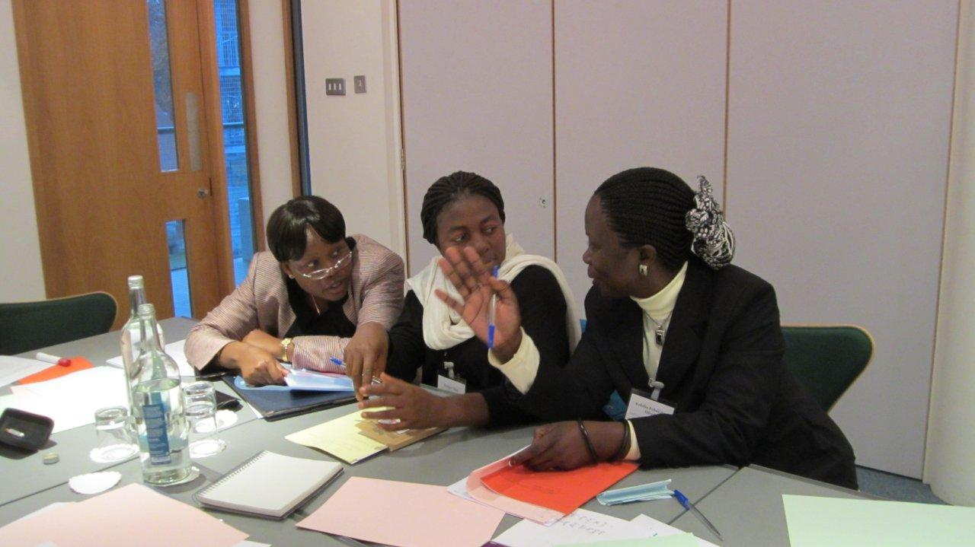
What is communication
Exchange of information between people,
By means of speaking,
Writing,
Using a common system of signs or behavior.

Slide 3
What is REDD+
Reducing Emissions from Deforestation and Forest Degradation
REDD+: includes conservation of forests, Sustainable Forest Management, and the enhancement of Carbon stocks
An international mechanism that intends to compensate countries
for demonstrated efforts in reducing deforestation and forest degradation.

Slide 4
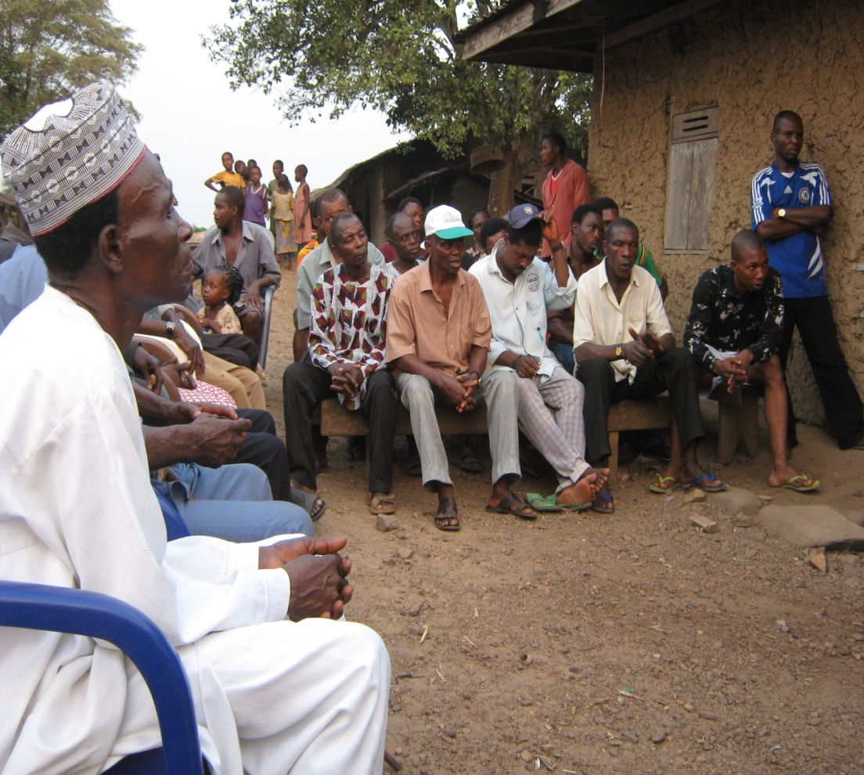
Target Audiences for REDD+
Government Officers
Local forest communities
General public, including anti-REDD group
International community, donors

Slide 5
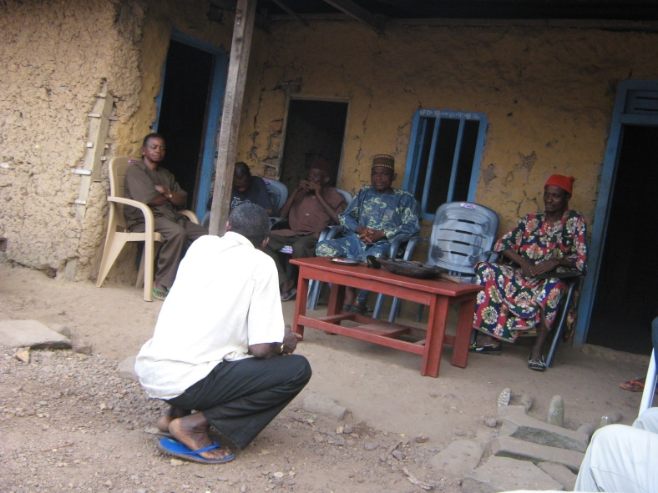
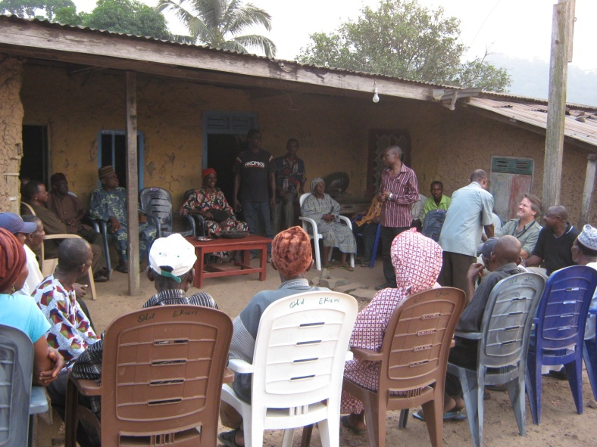
Ways of communicating REDD
Government
conferences, workshops, training, website;
Local communities
village meetings; direct messaging through posters, brochures, radio/TV; and school involvement;
General public
public service announcements (TV and radio); competitions; and opinion/editorial articles;
International community/donors
lessons learned materials (brochures/videos); reports and international conferences.

Slide 6
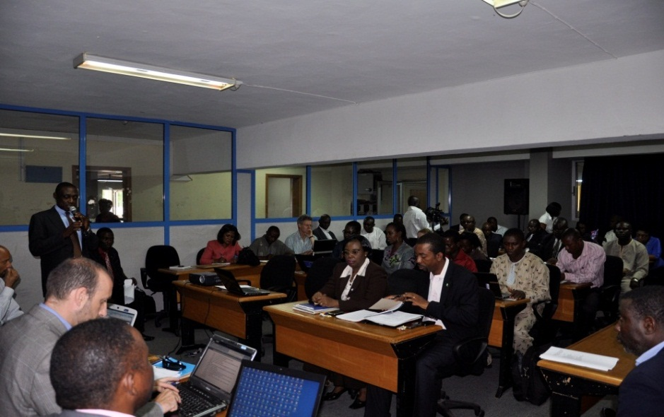
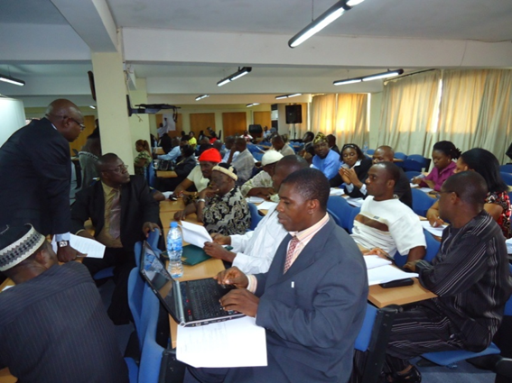
Importance of Audiences
Government is important because they will be implementing REDD+
Forestry sector is important because real change within it will go a long way to helping achieve REDD+ goals
Local pilot communities are important because they will be providing the real-world information about how REDD+ operates

Slide 7
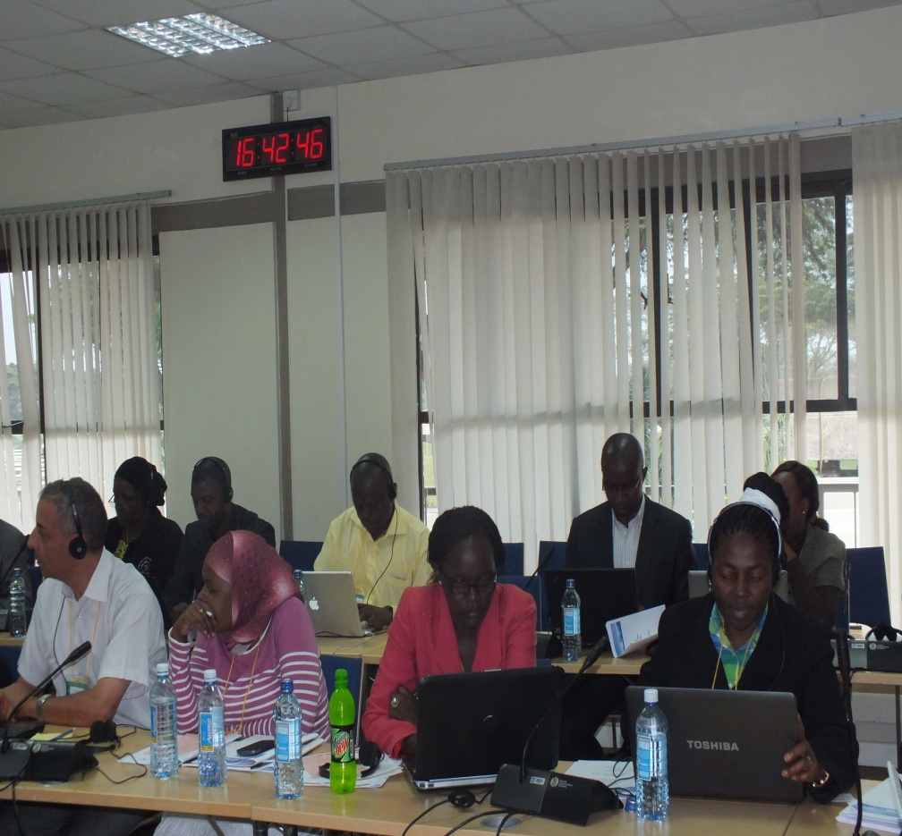
Importance of Audiences Cont.
General public is important because its support for action on climate change and REDD+ is an important factor in ensuring continued political support
International community and donors are important because they will ultimately decide whether or not REDD+ will continue

Slide 8
Communication materials
Some of the materials used for
communicating REDD includes but not only the following:
Map
Handbills
Posters
Brochures

Slide 9
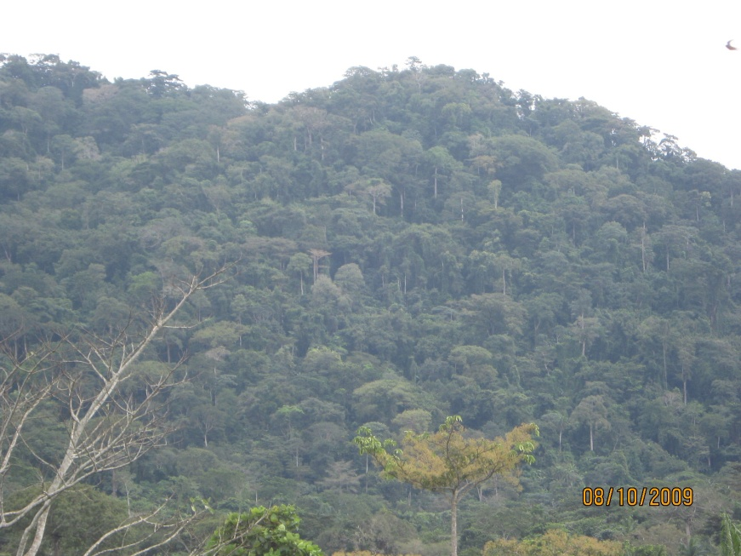
What should we communicate about
UN-REDD+ Programme has six interlinked work areas.
MRV and monitoring
REDD+ governance
Stakeholder engagement
Multiple benefit
Transparent, equitable and accountable management
Sector Transformation

Slide 10
Further Questions
How best should we communicate Safeguards and Multiple Benefit to:
Government
Local communities
General public

Slide 11

THANK YOU

