Slide 1
Scaling up climate and forest efforts in Central Africa

Slide 2
Why scale up forest and climate efforts in Central Africa?
OPPORTUNITY: 2nd world's biggest rainforest, commercial drivers of deforestation are still limited
PROBLEMS:
Donor efforts have much to gain through coordination, strategic focus and long term approach.
Countries need reforms, a focus on multiple drivers within and outside the forestry sector, and cross-sectoral leadership to address these
SOLUTION: Coalition of willing countries working with countries of the region to patiently build capacity, drive strategic reform agendas and address multiple interconnected drivers.

Slide 3
Regional and multi-donor initiative
Regional: DR Congo, Republic of Congo, Gabon, Central-African Republic, Cameroon and Equatorial-Guinea (HFLD countries)
Multi-donor: European Union, France, Germany, Norway and United Kingdom
South-South Partner: Brazil
Joint Declaration signed in New York on 29 September 2015

Slide 4
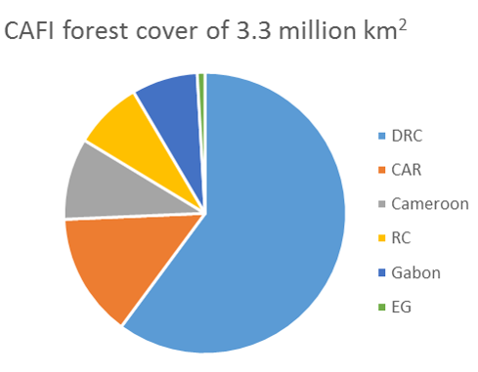
Source: www.globalforestwatch.com

Slide 5
Mission
Recognize and preserve the value of the forests in the region to mitigating climate change, reducing poverty, and contributing to sustainable development;
Implement country-led, holistic low emissions development investment frameworks that include national policy reforms and measures addressing drivers of deforestation and forest degradation

Slide 6
South – South Cooperation
CAFI encourages and is open to support South-South and triangular cooperation programmes.
Brazil has joined CAFI and other interested third party countries and international organizations are welcome to participate by offering support for capacity building and exchange of experiences and expertise in the implementation of policies that contribute to fulfilling CAFI objectives.

Slide 7
CAFI
Platform for tight donor coordination
Substantially scaled-up support to national REDD+/LEDS investment frameworks (minimum 500 million USD)
Optional funding mechanism through UNDPs Multi-Partner Trust Fund Office, MPTF
Open to public and private donors
Implementing partners: UN, WB, international cooperation agencies (in a first phase)

Slide 8
Complementarities and synergies with the Green Climate Fund
The Initiative will be complementary to the Green Climate Fund, for which donors cannot earmark their contributions to specific countries and sectors
The Initiative can leverage increased GCF investments to REDD+ in the region: Possibility of contributions from or co-finance with the GCF

Slide 9
Latest developments
Preparatory grants to RoC and CAR approved in January 2016 to develop their national investment frameworks
Letter of intent signed with DRC (200 mill USD) in April 2016. National Investment Plan implemented through National REDD+ Fund

Slide 10
Central African REDD+ Fund - governance and program framework
Cameroon
CAR
DRC
EG
Gabon
RC
Strategic Investment Framework
Strategic Investment Framework
Strategic Investment Framework
Strategic Investment Framework
Strategic Investment Framework
Strategic Investment Framework
Approves allocations
Secretariat
Board
Instructs
MPTF (trustee)
Supports

Slide 11
Thank You
For more information :
berta.pesti@undp.org or www.cafi.org

