Slide 1
ZAMBIA’S SAFEGUARDS INFORMATION SYSTEM
Draft Design - Version 1.0
(2017-2020)
Victor Chiiba
20 September, 2017 | Nairobi

Slide 2
SIS objectives – v1.0
1. UNFCCC requirement of demonstrating Cancun safeguards have been addressed and respected throughout the implementation of REDD+ actions
2. Design of REDD+ actions and National REDD+ Strategy/Investment Plan implementation is improved
3. Safeguards information informs evidence-based policy, legal and regulatory (PLR) reform, implementation and investment priority identification
Notes:
Objectives for SIS v1.0 only, other objectives proposed for v1.1, post-2020:
4. Improve existing information systems’ institutional capacity and operations
5. Implementation of international conventions and obligations

Slide 3
INFORMATION STRUCTURE – v1.0
How the anticipated information will be aggregated and organised in the SIS
Demonstrating how existing national policies, laws and regulations (PLRs) might address and, through their implementation, respect the Cancun safeguards
Completing the table on national level information structure as the first priority
Notes:
You might need to define ‘address’ and ‘respect’, as per international good practice:
Addressing safeguards
Ensuring that a coherent body of policies, laws, regulations (PLRs), and associated institutional arrangements, are in place to deal with the potential benefits and risks associated with REDD+ actions, enabling the application of the Cancun safeguards, in accordance with national circumstances
Respecting safeguards
Ensuring effective implementation of relevant PLRs in practice, through associated institutional (and individual) mandates, procedures and capacities, such that real and positive outcomes are affected on the ground.

Slide 4
Information structure – subnational-level info. on OUTCOMES
REDD+ Action | Anticipated benefit/risk | Probability 1=low 2=medium 3= high | Anticipated impact 1=low 2=medium 3= high | Benefit/risk level (probability x impact) Range: 1-9 | Actual outcome | Relevant national safeguards criteria
Strategic Intervention 1.1 - Improving effectiveness of institutions and governance of the protected national and local forests through appropriate reforms
Strategic Intervention 1.2 - Enhancing participatory approaches to local forest management
Strategic Intervention 2.1 - Enhancing participatory approaches and traditional authorities’ role in forest management and monitoring in high value forests in open areas
Notes:
Subnational information provided by REDD+ implementers:
Government agencies
REDD+ projects
Private sector
Civil society
Local communities/households
Structure to be refined through national interpretation of Cancun safeguards (informed by environmental and social benefit/risk assessment of National REDD+ Investment Plan) – next step…!

Slide 5
NATIONAL INSTITUTIONAL ARRANGEMENTS
Coordinating body:
Host institution:
Primary institutions:
Secondary institutions:
liaison and integration of SIS into future national safeguards system
information compilation and management
supporting host institution; priority information, dissemination and financing of SIS operations
information on PLRs (addressing safeguards) and PLRs implementation (respecting safeguards)
Tertiary institutions
additional information on addressing and respecting safeguards for possible inclusion (v2.0)
Notes:
Using same colour coding as next figure

Slide 6
2⁰
3⁰
Ministry of Agriculture
Climate Change Dept.
Analysis/interpretation
Coordinating Body
Ministry of Chiefs and Traditional Affairs
Ministry of Mines
Ministry of Gender
Department of National Parks and Wildlife
Ministry of Local Government
Energy Department
ZEMA
Planning & Info. Dept (Host)
- coordination
- information compilation
- analysis and interpretation
- national & international dissemination
Research and academic institutions
Water Resources Management Authority
Private associations
Department of Water Affairs
Zambia Farmers’ Union
Chamber of Mines
Forestry Department
NFMS
(ILUA II + FLES)
national dissemination (web portal)
Central Statistics Office
- National dissemination
Ministry of Finance)
Financing operational costs
Notes:
Overall proposed (national) institutional arrangements for Zambia’s SIS
Need to stress that this is not SIS v1.0. This is full picture of national institutional arrangements for the SIS in the fullness of time. Note that subnational institutional arrangements are not shown for clarity (and not covered in the ppt due to time constraints).

Slide 7
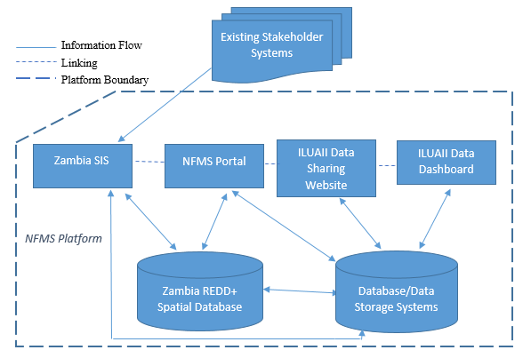
ONLINE SYSTEM REQUIREMENTS
As part of NFMS as an interim measure (transfer to ZEMA for v1.1, post-2020
Identifies end users; functional requirements; performance requirements; design constraints
Presents information workflows, user interface requirements and preliminary database design to support information structure
Proposed information technology architecture for Zambia’s SIS v1.0

Slide 8
Thank you!
Victor Chiiba |

