Slide 1


Webinars
Guidelines for Presenters

Slide 2
Foreword
We are delighted to count you among the presenters of the UN-REDD webinar series! The field of REDD+ has grown substantially in the past six years, and continues to evolve. This rapid expansion has generated new knowledge and a global network of REDD+ practitioners eager to learn from fellow practitioners, technical advisors, and scientific experts.
Webinars are an efficient and cost effective mechanism to reach UN-REDD staff and partners and share lessons learned and best practices. These guidelines concentrate on a few points that will assist you in preparing your presentation. Please remember, the UN-REDD Knowledge Management Specialists are here to support you before, during and after the webinar.
Thank you for making your REDD+ knowledge visible to the UN-REDD community!
Lessons Learned
UN-REDD Programme
Social and Environmental Benefits
Forests
FREL/FRL
Policies and Measures
Gender Equality
REDD+ Finance
UN-REDD
UNFCCC
Tenure
NFMS
Governance
Safeguards
Impact
Stakeholder Engagement

Slide 3
Contents
Define the Purpose of the Webinar
Plan and Promote the Event
Develop the Presentation
Prepare Space for Engagement
Rehearse
Setup Environment
Webinar
Follow-up
Further Information and Contacts
Annexes
3

Slide 4
Define the Purpose of the Webinar
REDD+ readiness and implementation under UNFCCC guidelines
As a starting point you should spell out the reason why you are holding the webinar and the technical area(s) you will focus on. If the purpose is to present best practices and lessons learned, be factual. Share tangible evidence of positive outcomes and conditions for replication, i.e. “How” to adopt/adapt.
Learning objectives
Define what the audience should know or be capable of doing after the webinar. This will drive the development of the entire presentation and interactions. The learning objectives can be referred also in the announcement message. In addition you should identify criteria that will be used to evaluate the success of the event.
Target audience
UN-REDD webinars do attract diverse audiences –national partners, donors, NGOs, etc.- with varying levels of technical knowledge and ability to attend a presentation in a foreign language. Technical jargon or UN acronyms should be avoided. Messages should be conveyed clearly and in a positive manner.

Slide 5


Plan and Promote the Event
Collaborate with the UN-REDD regional KM specialist or local technical staff to prepare the announcement message. The title of the webinar should be clear and value oriented. The announcement should indicate what participants should expect, e.g. “You will learn…” or “You will see…”.
The webinar should be promoted at least 3 weeks before the event. Surveys show that Tuesdays, Wednesdays and Thursdays are the preferred weekdays to hold a webinar and mid to late morning is the preferred time.
After the initial announcement message you should plan launching 2 reminder messages. A reminder 2-3 days before the event should be sent to participants along with instructions on how to log in to the system.
Source: GoToWebinar
What is the most popular webinar day of the week?
Source: GoToWebinar
How many email messages to promote a webinar?
Source: GoToWebinar

Slide 6
Develop the Presentation
What engages you on a webinar?
The webinar should be short, to the point, contained to 45 min. including time for interaction and Q&A. Do not overload slides with information. If speakers spend five minutes on a static slide, they will lose audience attention. The presentation will be more dynamic and engaging if each slide has few bullet points and more graphics. Visuals (pictures and graphics) will replace your body language.
You should count 60 to 90 seconds per slide, so a 20/30 min. presentation will imply up to 30 slides. Recommendations are to follow the rule of approximately 10 slides for a 15-20 min presentation, and allow the same time for questions and clarifications.
Shorten the introduction and avoid long descriptions of your organization, national partners, stakeholders. Develop as much as possible a participative agenda with enough balance of capacity building/information and general background presentations (usually UN agencies and experts) and experiences from the countries. Concentrate the presentation on the most important content. Always keep in mind that attendees will wonder “what’s in it for me?”. Dropping out from a webinar presentation is much easier than in leaving a meeting room.
Source: GoToWebinar
What is your preferred webinar duration?
41%
44%
5%
10%
Source: GoToWebinar
20
Min.
60
Min.
30
Min.
45
Min.

Slide 7


Prepare Space for Engagement
How many webinars use Q&A for interaction?
The UN-REDD webinar platform is GoToWebinar. It comes with 2 key mechanisms to interact with the audience. Polls provide an opportunity to bring the audience into the presentation as active participants. You will need to account for the time needed to wait for the responses and discuss the results. Q&A is another vital element of a webinar. You can either wait till the end of the presentation to open a series of Q&A or you can set a couple of breaks in the presentation to collect questions. Make sure you have defined with the regional KM specialist a number of seed questions in case the audience would be quiet.
GoToWebinar includes also a “Hand Raising” function that participants can use to request the floor.
Source: ON24
Do attendees find Q&A useful?
Source: GoToWebinar
What other interactivity tools?
Social media
Polling
Source: ON24

Slide 8
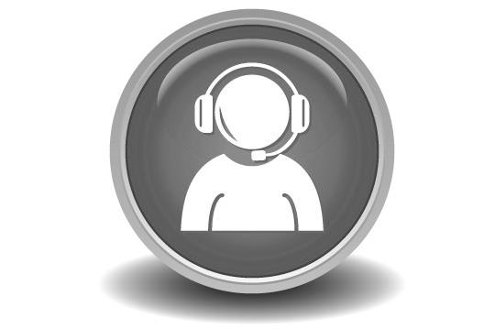
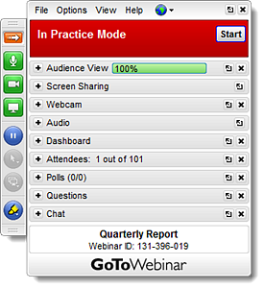
Rehearse
Local technical staff or the regional KM specialist will provide you all information to install and register to GoToWebinar. The platform offers a “Practice Mode” that will help you getting familiar with key functions.
Plan to rehearse at least once. The regional KM specialist can attend the rehearsal and share feedback in addition to preparing the introduction of the webinar with you.
Presenting virtually is not most natural. Rehearsal will help you to adjust the pace, volume, tone, and will tell you how long the presentation will take.
GoToWebinar offers several guides that show how to use the platform. We recommend that you take 10 min. to review the “Organizer Quick Start Guide”:
http://support.citrixonline.com/en_US/webinar/documents

Slide 9
Setup Environment
About 30min. before the webinar check audio volume and clarity with the regional KM specialist or technical support. Remember to turn off your cell phone, put landline on voice mail, mute computer sound if appropriate, close the office door, and have a slide printout.
Prior to the webinar you may have written down the introduction, opening remarks, and technical instructions to the audience. Keep the instructions as brief as possible. You don’t have to mention every feature of GoToWebinar. Just give the most critical basics and be ready to move quickly into the substance of the event.

Slide 10
Deliver the Presentation
100 registered
At least 5 min. before the start of the webinar login and be ready to receive requests for support from participants as they join. During the webinar it will be necessary to have someone giving logistics support to answer questions online, organize questions from audience, handle presentations in the platform, etc. It may also be needed to communicate with typed chat if a participant has audio problems.
Research shows that a significant proportion of prospective participants will not join the webinar. Therefore it is good practice to start the event on time without waiting for latecomers. After having shared your screen with attendees do not forget to start recording the session.
Be energetic and enthusiast while presenting. Most likely the audience will be multitasking and perform other work while attending the webinar. You should do an extra effort to catch the attention, i.e. ask questions in the middle of the presentation, maintain audience engaged with tone of voice, graphics, examples, etc.
42 will attend
Source: ON24
100 attend
31 will respond to polls
7 will ask a question
Source: ON24

Slide 11
Follow-up
25% of registrants view the replay of the webinar
Within two days of the webinar, make the webinar content available to participant audiences and broadly if useful, along with a brief information note. Recordings and materials should be stored in the UN-REDD Collaborative Workspace.
GoToWebinar allows users to answer a simple survey before leaving the virtual space. This is very useful to gather initial satisfaction information. The regional KM specialist can share examples of surveys to complement those proposed by GoToWebinar.
Follow up on any actions items that have come up after the webinar, in terms of further content, exchange, or knowledge needs.
Source: ON24

Slide 12

Further Information and Contacts
Asia/Pacific:
Heang Thy
UN-REDD, Bangkok
heang.thy@undp.org
Africa:
Ela Ionescu
UN-REDD, Nairobi
ela.ionescu@undp.org
Latin America & Caribbean:
Patricia Toquica
UN-REDD, Panama
patricia.toquica@undp.org
Global address:
UN-REDD Secretariat, Geneva
un-redd@un-redd.org
Resources:
www.unredd.net
http://support.citrixonline.com/en_US/webinar/documents

