Slide 1



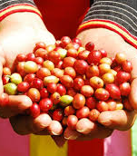






Leveraging Business Investment for REDD+ Implementation
Vietnam’s Experience
Chi Nguyen Phuong - Deputy Director of International Cooperation, Vietnam Bank for Social Policies
Fabien Monteils - Chief Technical Advisor, UN-REDD Vietnam
Bangkok, Oct. 11 2017

Slide 2

Set priority areas and pilots
National REDD+ Action Programme
Agriculture commodities
Support and establish commodity forums
Pilot and replicate sustainable models
Support producers’ organization
Plantations and timber industry
Support research on long-rotation models
Pilot and replicate, develop guidelines, incentivize
Support access to assistance and certification
Natural forests goods and services
Monitor, assess and develop business models
Pilot cooperation and integration of supply chains
Financial services
- Cross-cutting to the three sectors above: design adapted financial mechanisms (directly with financial sector, or by promoting adequate legislation)
Integrated commodity-REDD+ action plans
1
Rubber (VRA, VRG…)
Aquaculture pilots
V. Cashew Association
2
Cost benefit analysis
Forest certification
3
CBFM
Expert group/ forum
VietRap
4
Fargreen/ICRAF
ITDR (tourism)
Collaboration with PFES

Slide 3
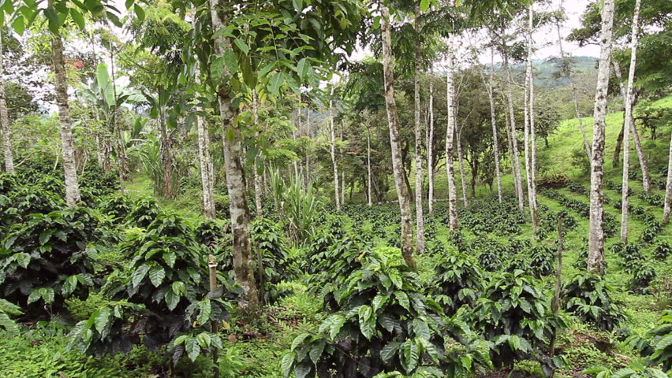
Illustration from the coffee sector
I. Identifying and piloting sustainable models
1.1 Technical and financial assessment of existing sustainable models
1.2 Development of technical guidelines for best practices (and test with stakeholders)
1.3 Identification of potential area for pilot activities, sites, partners, beneficiaries, and deployment of pilot sustainable models (capacity building, support and monitoring evaluation)
Facilitate dialogue and coordination (VCCB), integrated planning (Sust. Coffee 2020…)
Collaborate with other sectors to leverage potential synergies (ex. Cashew)
Collaborate with business association to integrate agroforestry in training manuals/campaigns
Implementing demonstration farms (Nestle…)

Slide 5
Illustration from the coffee sector
II. Traceability systems development
2.1 Assessment of existing/past initiatives on traceability and existing standards
2.2 Analysis of supply chains (actors and association/ cooperation models) and recommendations for piloting
2.3 Identification of potential area for pilot activities, sites, partners, beneficiaries, and deployment of pilot traceability models (capacity building, support and monitoring evaluation)
2.4 Develop guidelines for traceability
Develop information system (with GCP…)
Encourage broad stakeholders’ engagement on real-time monitoring pilots (Di Linh)
Collect experience directly from individual private companies (ACOM)

Slide 6
Illustration from the coffee sector
Exploit existing laws and regulations (40.000ha reallocation)
III. Monitor and control the evolution of coffee surface
3.1 Strengthen systems to monitor surface and expansion of coffee surface, including spatial monitoring using satellites and other relevant technologies
3.2 Control that evolution of coffee surface complies with official targets
3.3 Support conversion of coffee land back to forest where relevant or required by law
IV. Financial mechanism development
4.1 Review and evaluation of existing incentives for sustainable coffee vs market trends
4.2 Develop proposal for financial incentives relevant for sustainable models identified (green credit, subsidies, premium price with buyers, taxes exoneration, PES, etc.)
4.3 Conduct extensive consultation process to set up partnerships to pilot financial mechanism
4.4 Pilot mechanism with stakeholders identified in component 1 and 2 (Capacity building, support
and monitoring evaluation)
4.5 Develop guidelines
Connect with integrated land use planning initiatives and dialogue platform
Review and monitor enterprises’ plans for activities and investments
Pilot joint implementation of REDD+ allocation and PES
Coffee Development Fund?

Slide 7

Focus on the financial sector in Vietnam
Fast credit expansion to support economic growth (>15%/year)
Low access to financial services (21% adult pop. In 2013)
Overall under-capitalized + fast expansion: little appetite for new markets and constraints for sustainability
Green finance estimated about 1% (SBV)
Recent policies to implement relevant plans (Paris’ Agreement, Green Growth…)
03/2015: Directive 03/CT-NHNN from SBV: Requests credit institutions to promote green credits and social and environmental risk management in credit supply. Voluntary basis, mandatory report.
09/2015: Decree No. 55/2015 /ND-CP: Reduces reserve ratios obligations of financial institutions for medium-size credits to agriculture and rural development
12/2016: Circular 39/2016/TT-NHNN: Requests lending transactions conformity with regulations and relevant laws, including the legislation on environmental protection
  But yet no mention of green banking and related instruments in the Law of Credit Institutions
Notes:
Forthcoming researchby ODI (financed by UNEP FI as part of the UN-REDD Programme) shows that the role of subsidies are not considered in 32 UN-REDD countries researched

Slide 8
Focus on the financial sector in Vietnam
Illustrations/initiatives:
$240M Green credit line from SBV for financial institutions lending to SME (based on JICA grant); $100M similar in discussion with KfW on renewable energy
Green bond market being established. First green bonds expected In 2018 (HCMC and Ba Ria – Vu Tau)
Guidelines developed to assess social and environmental risks in 10 sectors (SBV/IFC)
Launch of Vietnam Sustainability Index (20 companies in HCMC stock exchange)…
Support to relevant credits (concessional…) from VBSP, Agribank…)
Provisions from the NRIP (draft, in progress):
1. Develop and implement a green credit scheme for REDD+ activities
2. Improve deforestation and forest degradation risk assessment in financial institutions’ credit analysis systems and pilot implementation
3. Strategic dialogue and capacity-building activities on private and financial sectors engagement and green credit for REDD+
Notes:
Forthcoming researchby ODI (financed by UNEP FI as part of the UN-REDD Programme) shows that the role of subsidies are not considered in 32 UN-REDD countries researched

Slide 9
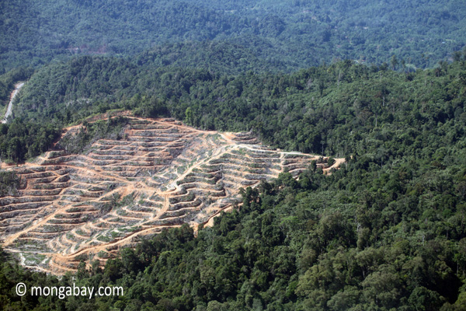
Illustration from the Bank for Social Policies
Profile:
VBSP: public not-for-profit policy bank
1st microfinance institution in Vietnam (7M household clients)
Assets: $8 billion; Outstanding loan: $7 billion
28M individual loans to individuals and business/producers
Contribution to massive social progress (country’s poverty rate: 20% in 2004, 4.5% in 2015)
Serving poor, near-poor and vulnerable people, ethnic minorities…
Assets: local network, local governance arrangement, and specialized approach to understand and serve a risky market
  From 63 provinces branches down to 200.000 points of service at village/hamlet level
  21 credit schemes for targeted groups
  Risk-management system based on collaboration with local mass organizations and people’s committees (peer control), procedure disclosure
  Non-performing loan rate: 0.87%
Notes:
Forthcoming researchby ODI (financed by UNEP FI as part of the UN-REDD Programme) shows that the role of subsidies are not considered in 32 UN-REDD countries researched

Slide 10
Illustration from the Bank for Social Policies
Forest rehabilitation & sustainable forest management - KfW6
Approx. $3.5M (grant)
Approach: Diversifying forest products to stabilize income
Method: Transfer $200/250 to farming households and rural communities through deposit accounts; Result-based withdrawal upon verification
Impact: >14.600 beneficiaries/accounts created; Forest restoration and sustainable management of 32.700ha
Forest Sector Development Project - WB
>$38M loan (revolving fund) – 2005-2034
Approach: Switch from subsidizing plantations to lending to small-holders; Forest-based socio-economic improvement, poverty reduction, job creation, food security and fight against climate change
Method: Provide loan directly to borrowers. Loan from 1 to 15 years. Current interest rate at 6.6%. No required guarantee for households (<$2.200)
Impact: 76.500ha conserved special use forests and sustainably managed plantation forests. Current portfolio: $21M
Accounted for in Vietnam ER-Programme to FCPF Carbon Fund ($23M)
Notes:
Forthcoming researchby ODI (financed by UNEP FI as part of the UN-REDD Programme) shows that the role of subsidies are not considered in 32 UN-REDD countries researched

Slide 11
cảm ơn!

