Slide 1
Mapping public land-use finance: the case of Côte d’Ivoire
Adeline Dontenville
EU REDD Facility
UN REDD Regional Knowledge exchange
Bangkok, 11 October 2017

Slide 2
Mobilising domestic resources effectively
Are key sectoral policies integrating climate change and forest committments?
Is the enabling environment for sustainable investments in place?
How does BAU spending compare to and affect climate investments?
Notes:
International climate finance is limited and should not replace domestic spending. How can we ensure that GCF funding requests for instance bring a clear added value to the existing financing landscape and catalyse change that otherwise could not have occured?
Analysing existing land-use finance enables to identify key funding gaps, bottlenecks in delivering finance at scale and the reasons behind those.
For climate-related policy goals to be achieved, domestic budgets for land-use investments need to reflect the systematic integration of climate change considerations into policies and planning. Yet mechanisms to ensure that policy priorities are reflected in public expenditure programmes are often missing.
To ensure that sustainable investments achieve the best outcome, enabling conditions also need to be in place. Underlying factors of success for REDD+ are linked to broader governance conditions, such as clear legal frameworks, law enforcement, land use planning, public financial management, etc…which are complex factors to value, but can be incentivized through prospects of financial access
Finally, how does BAU spending affect land-use? Policy and spending coherence need to be ensured for climate finance to be effective. Understanding the “brown” side of land-use finance is key to identify and correct perverse incentives, policy incoherence, investment barriers etc… which are undermining the efforts of climate finance.

Slide 3
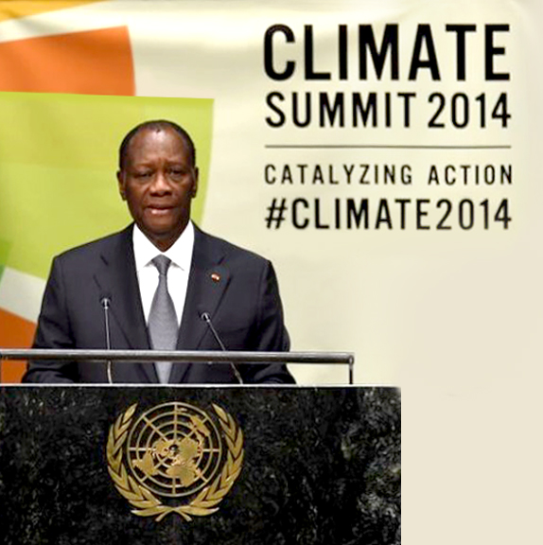
Do financial means match political ambition?
Strong political committments in Côte d’Ivoire:
Reduce GHG emissions by 28% by 2030 (NDC)
Zero deforestation cocoa production as from 2017
Restore 20% of forest cover by 2030
National REDD+ Strategy drafted in 2016 and REDD+ Investment Plan under development
Notes:
- Côte d’Ivoire is a West-African country which has lost the majority of its primary forests over the last century. At present, Côte d’Ivoire ’s forest cover amounts to only about 2% of the territory and it estimated that the country could loose its entire forest cover by 2034.
To address this rapid loss, the Government of Côte d'Ivoire has announced commitments to achieve its growth goals while reducing deforestation; in particular
Through its NDC commitment of reducing GHG emissions 28% (NDC (Marc will later tell us more about where these objectives stand)
In the land use sector this translates,
In the commitment to decouple cocoa production, which is one of the main drivers of forest cover loss, from deforestation,
As well as to restore the forest cover to 20% by 2030
These ambitious commitments are framing the National REDD+ strategy and investment plan currently being finalised.
But the central issue is: do financial means available in Côte d’Ivoire match this ambition?

Slide 4
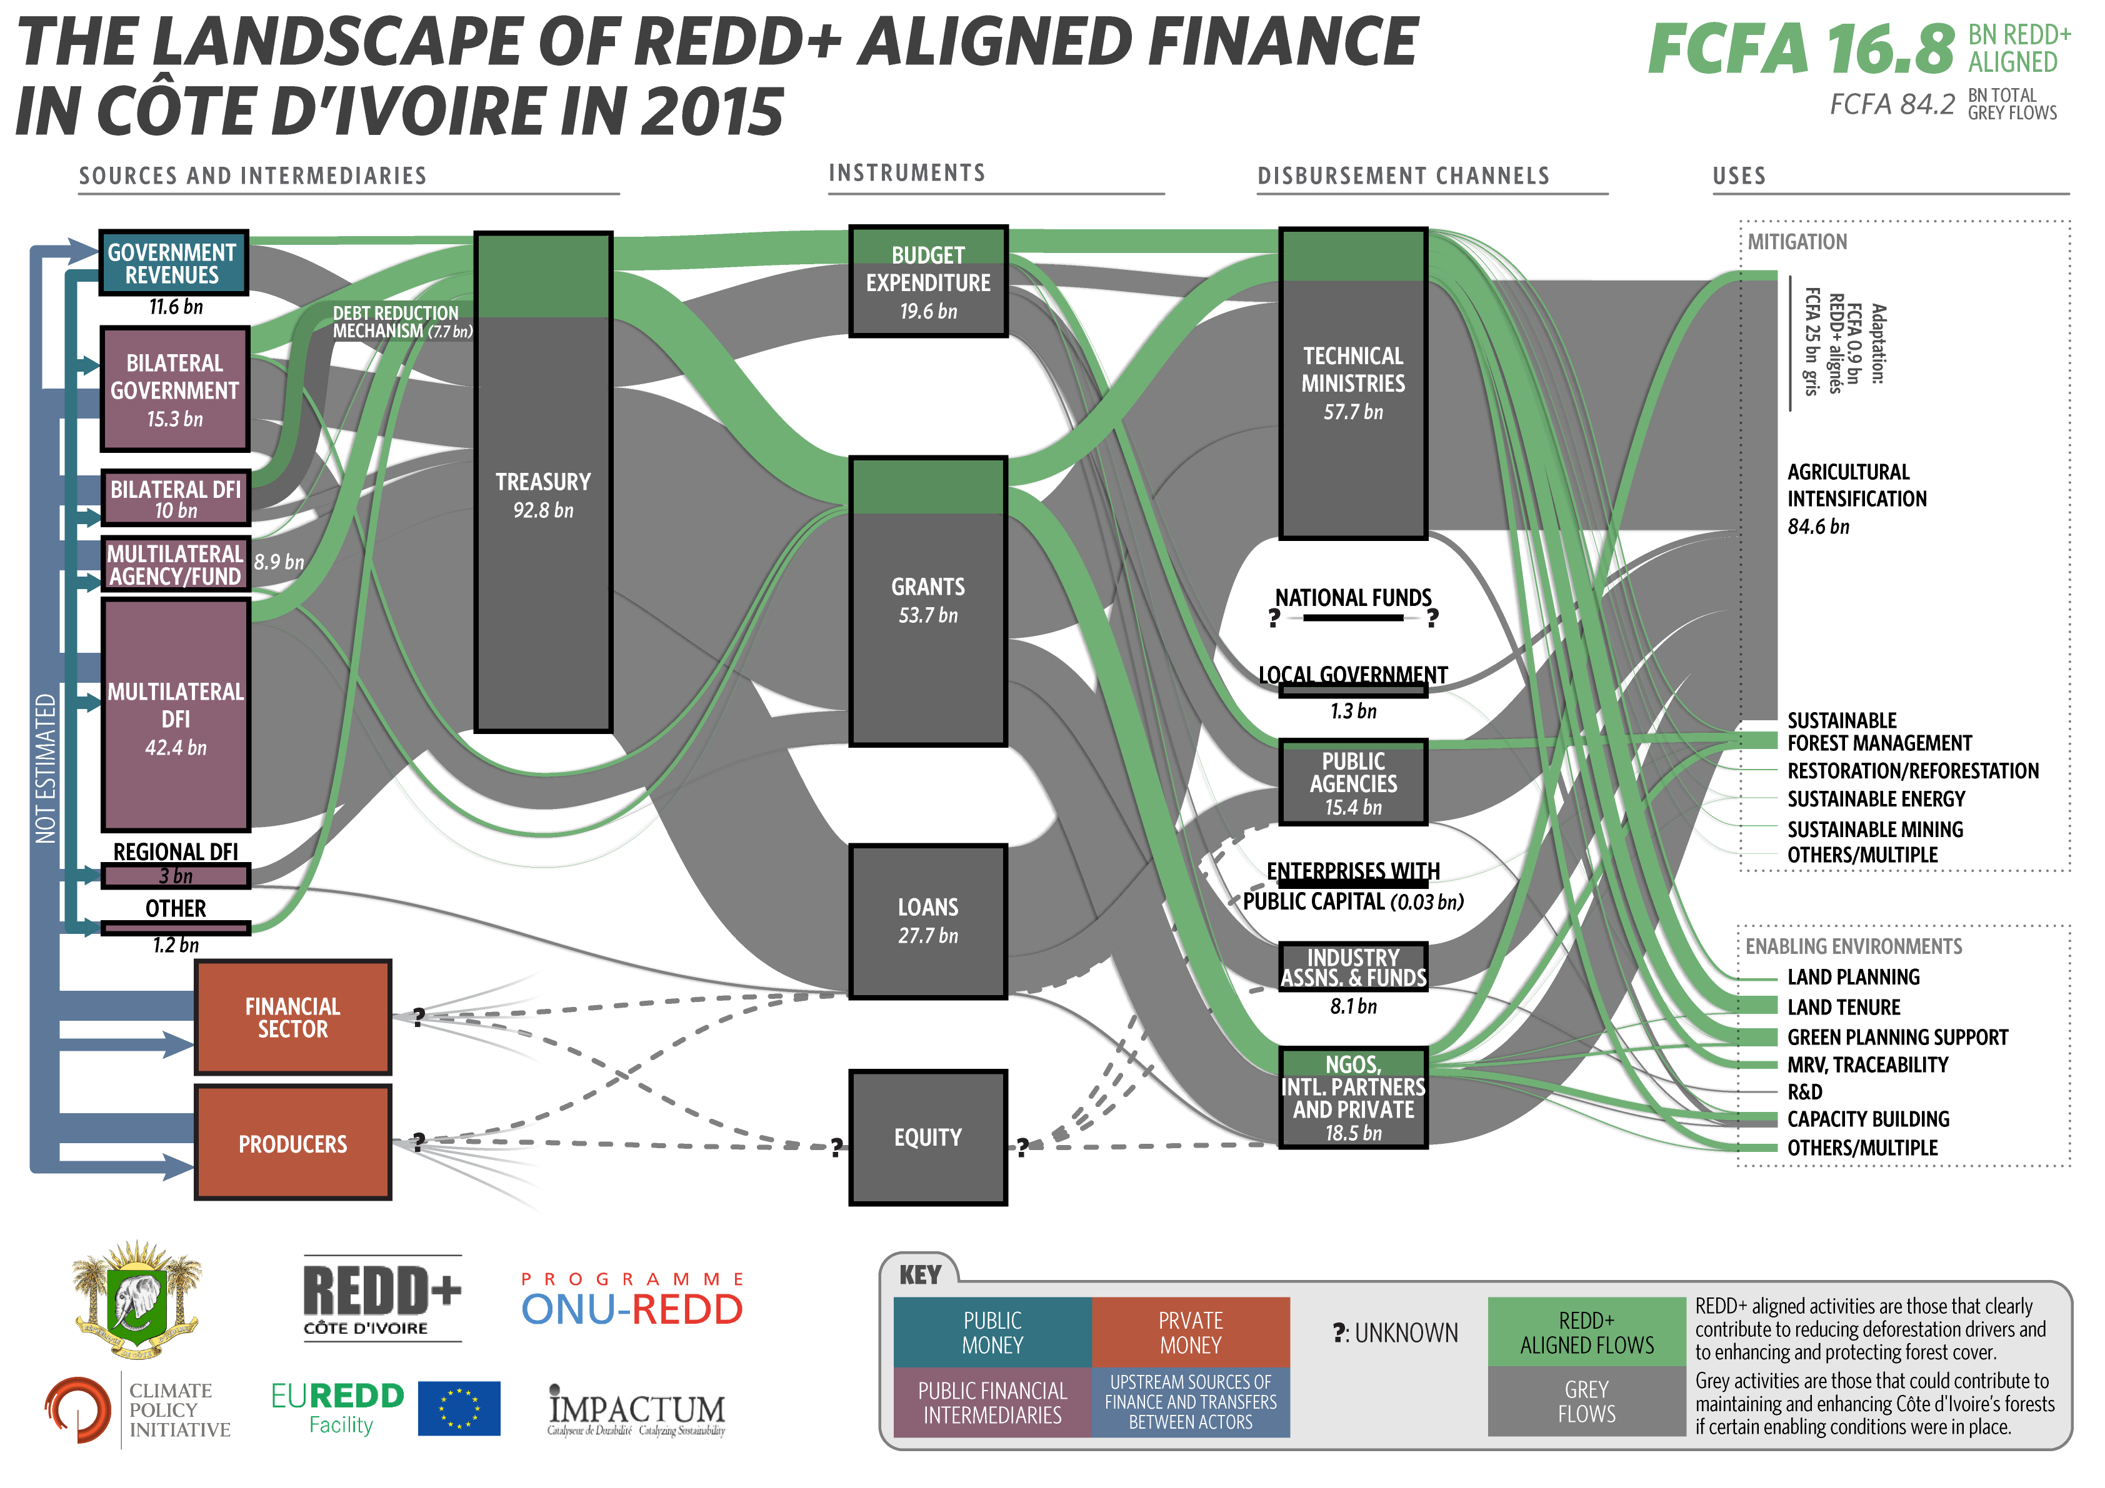
Notes:
These were the key questions that Côte d’Ivoire was asking while developing its REDD+ strategy.
- We have been working with the government of Côte d’Ivoire in 2016 to map its land-use finance from public international and domestic sources as part of the REDD+ strategy development. The full study was published in January this year. Côte d’Ivoire is the first country to do a financial landscape focused on land-use sectors, This work was conducted in partnership with the government, the UN REDD program, CPI and local consultants,.
- Beyond applying the climate finance landscape approach to land-use sectors, this study was really innovative because it not only looked at climate finance (financed aligned to REDD+, in green on the diagram) but also at the “grey” flows, i.e. investments in BAU activities which did not explicitly account for deforestation risks and may have contributed to deforestation and forest degradation.
- This analysis helped shed some light on key issues and incoherences in land-use spending.
Firstly, it demonstrated that key land-use sectors were severely underfunded. For e.g;. Forest sector, with barely any funding going to forest restoration in a country which has committed to restore its forest cover from 2 to 20% of the territory by 2020. CdI and its partners spent 55 times more on (unREDD aligned) agricultural activities than in the forest sector, mostly due to a lack of political ownership and forest vision. This study contributed to raising this concern amongst donors, which have since then taken the initiative of establishsing a a donor-government dialogue to discuss the future funding of the forest policy.
Secondly, the analysis showed the underfunding of key enabling measures for sustainable land-use investments, such as the complete absence of budget for land-use planning in the country
This has clear consequences in terms of deforestation risk. As you can see, the volume of grey funding, defined as BAU land-use investments which might have led to deforestation, is five times higher than “green”/REDD+ aligned funding. The opportunity to green this spending is huge, and support should focus on shifting these existing agricultural investments rather than increasing finance. (see next slide)
- Clearly, this study was a first step in Côte d’Ivoire, which is being used to inform the REDD+ investment strategy and the GCF proposal under development. It shed some light on the role of agricultural finance and opportunities to redirect it to better uses, which the MinFin now wants to pursue. We need to better understand domestic public subsidies and the role of industry associations and private flows to get the full picture. Clearly the next frontier in CdI, as data is very sensitive.

Slide 5
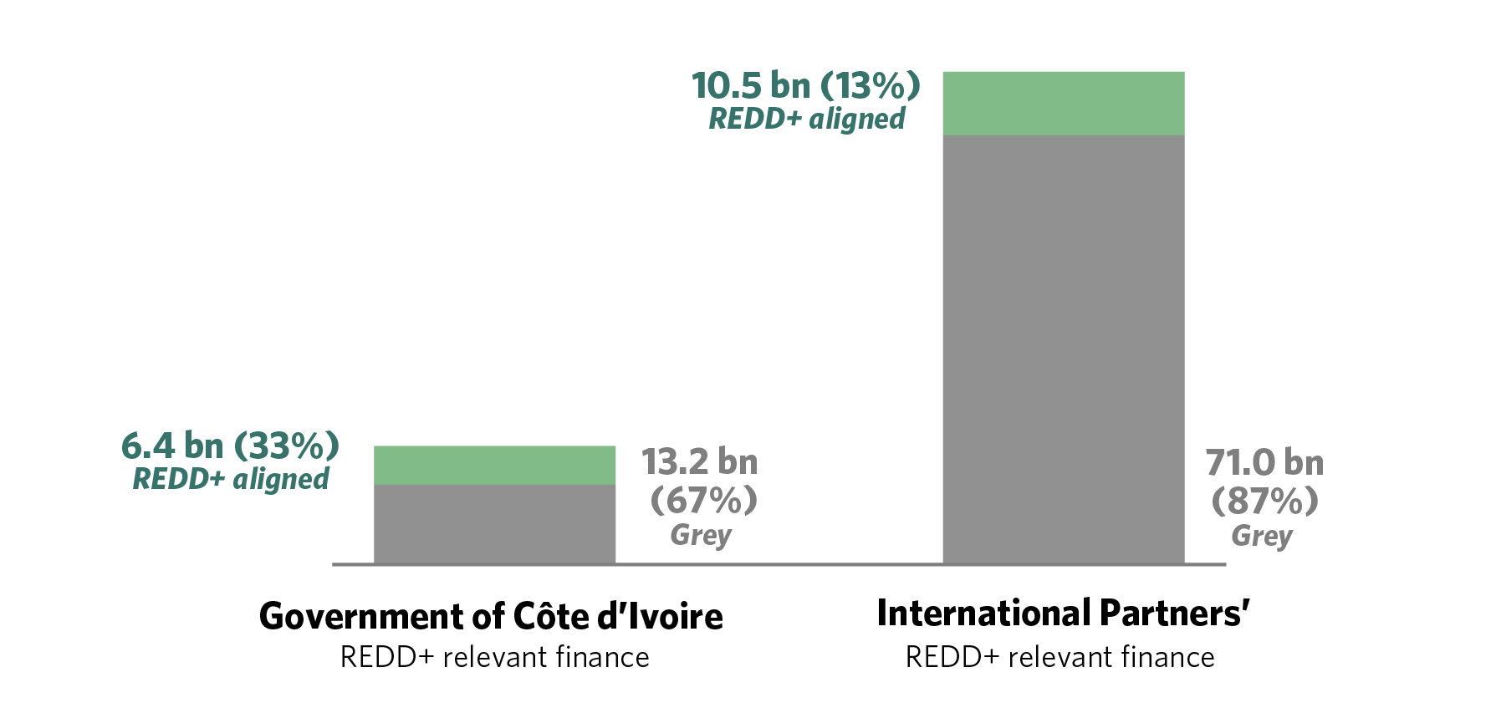
Côte d’Ivoire and its partners have an opportunity to green significant shares of existing finance
Notes:
major opportunity to green existing finance flows and mainstream sustainable land use in the investment plans of relevant sectors, in particular energy and agriculture.
As you can see here, both the government of cote divoire’s budget and development partners’ budgets are not yet explicitly accounting for deforestation risks and may have contributed to deforestation and forest degradation, due to lack of strong land use planning and secured land tenure.
Greening existing agricultural finance from domestic, and especially international sources, could increase REDD+ aligned finance by over five times up to FCFA 101 billion (USD 168.8 million).
Increased finance for enabling environments is needed to
….mainstream REDD+ objectives in sectoral spending, including strong land use planning, addressing land tenure risk and building robust enforcement and measurement systems as well as capacity building.
Maybe add…
As a minimum, priority should be given to ensuring that existing “grey” flows do not contribute to deforestation and forest degradation. Ideally, these flows should help to enhance and restore forest cover in line with REDD+ objectives.

Slide 6
Financial mapping as a key tool for NDC implementation
Reality-check on coherence of sectoral policies and instruments with climate objectives
Entry point for multi-sectoral and multi-stakeholder discussion on resource allocation and climate mainstreaming
Advocacy tool for domestic and international fundraising
Accountability and benchmarking tool
Notes:
What I wanted to illustrate through this example is that the potential of land-use finance mapping and tracking therefore goes way beyond informing investment strategies about funding gaps.
Taking a critical look at domestic and international resource allocation helps to assess coherence of sectoral spending with climate objectives and the impact of existing financial instruments and incentives, learn lessons from existing funding instruments, evaluate taxation of activities that drive deforestation, etc…. A basis for REDD+ countries to be able to formulate investment strategies and funding proposals which maximize the leverage effect of international public finance and ensure consistency with broader development financing.
→ dialogue between donors and gov on forest vision and support emerging
The financial lens is a practical and strategic entry point to raise interest from relevant ministries and engage the discussion with important actors, such as ministries of Finance, Budget or Planning, which will eventually be key for the mainstreaming of climate objectives in domestic policies. Analysing and interpreting data, in particular with regards to the end uses and impact of finance, can also trigger and inform essential multi-sectoral discussions on the contribution of each sectors to climate goals and related policies and measures
→ acknowledgment by Ministry of Planning and workplan to mainstream REDD+ in PND and sectoral policies
Mapping land-use finance is also a great tool to help countries build stronger cases for value added of international support as well as domestic resource mobilisation and REDD+ investment planning
Eg. REDD+ investment plan, GFC proposals, Several countries have understood that and are analysing land-use finance to prepare GCF proposals (VN, PNG)
Finally, having a level of reference of finance contributing to REDD+ implementation and being able to track progress and report over time, REDD+ countries are able to submit transparent information on gaps, needs and support received through their Biennial Update Reports
·

Slide 7
More information: http://www.euredd.efi.int/publications/mapping-financial-flows-to-support-redd-efforts
adeline.dontenville@efi.int
Notes:
If you would like to learn more about the approach and/or the example of Côte d’Ivoire, don’t hesitate to look at our results or get in touch.
Thank you for your attention and I’ll be happy to answer questions, if any.

Slide 8
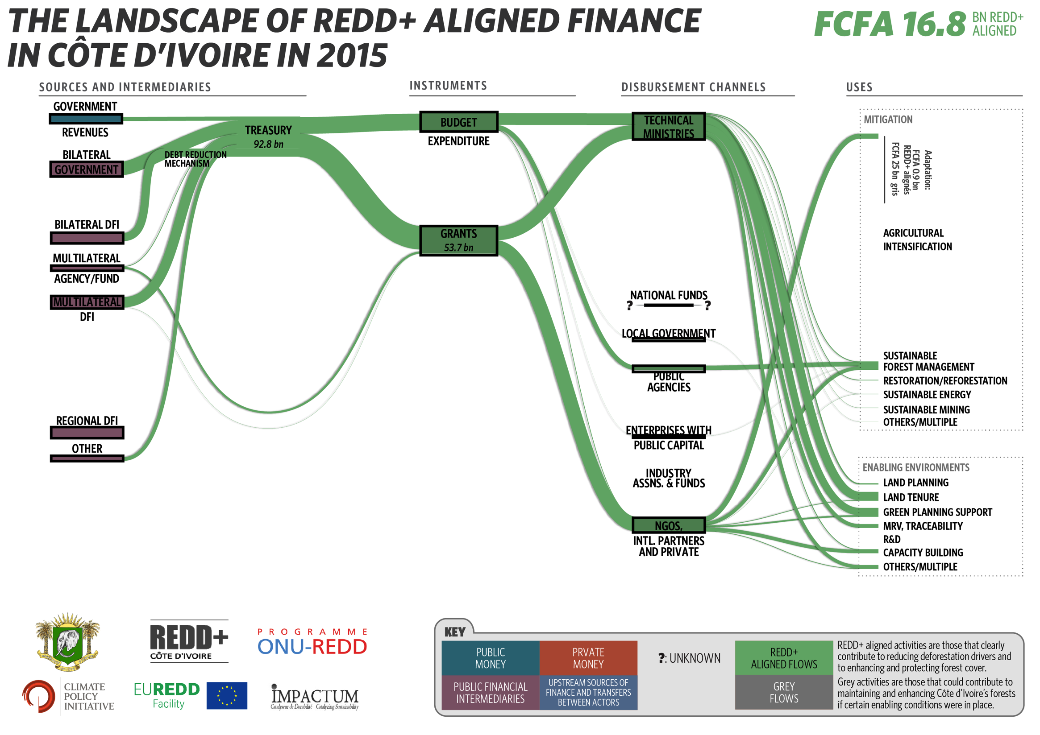
Notes:
Let me break this down a little and give some examples.
On this slide you can see REDD+ aligned activities in green. These are activities that clearly contribute to reducing deforestation drivers and to enhancing and protecting forest cover, including sustainable forest management, land planning etc. on the right.
So, for instance, if we look along the top of the chart, from left to right, we can see most funding is channelled through the treasury as budget expenditure by technical ministries or as grants and goes mostly to enabling environment activities at present, with little going to sustainable agricultural intensification for example.
Overall, we identified FCFA 16.8 billion (USD 28.1 million) of investment by the Ivorian government and its partners in 2015 which contributed to achieving REDD+ objectives. This is a small fraction of expected investment needs to implement the country’s National REDD+ Strategy and NDC objectives. Those needs are still being quantified. In our study we looked at on particular policy area to get an idea of the potential gap.
Estimates suggest that more than FCFA 173 billion (USD 289 million) per annum is needed to meet Côte d’Ivoire’s
2030 20% forest cover objective alone. Only about 2% USD 6.3 million (FCFA 3.8 billion) of this amount went to reforestation and sustainable forest management in 2015.
While enabling environment spending is higher than direct spending, just USD 750,000 or FCFA 447 million was spent in 2015 by the Treasury only (no international donors) on sustainable land-use planning. Meanwhile FCFA 3.3 billion (USD 5.5 million) went to support land tenure in the context of wider programs but addressing land tenure issues across the country will require a significant increase of funds.
We can therefore see that enabling environments are still underfunded in Cote d’Ivoire; mainstreaming REDD+ objectives in sectoral spending will require considerable additional investment in building strong enabling environments, including strong land use planning, addressing land tenure risk and building robust enforcement and measurement systems as well as capacity building.
Probably skip…
We can see that investments aligned to REDD+ were provided most through budget expenditures and grants.
Most investments were channeled to enabling activities
Some money flew in the forest sector (SFM) and green agriculture, but virtually nothing for restauration, wood energy etc…. (identification of gaps)

Slide 9
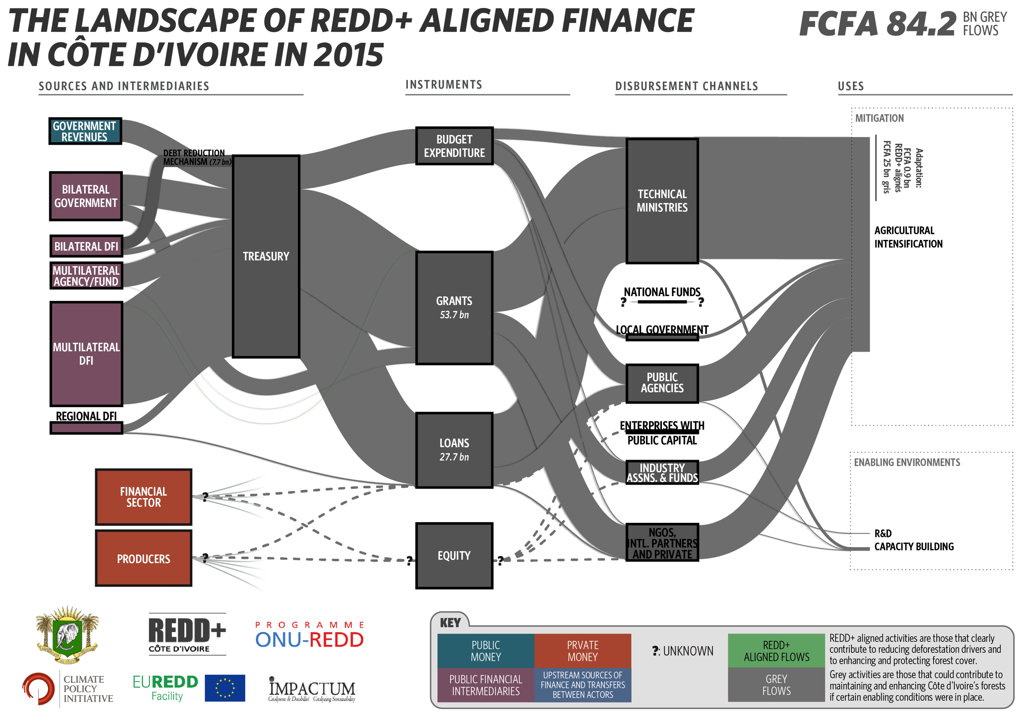
Notes:
In the same year we identified FCFA 84.2 billion (USD 140.7 million) of public money was invested in “grey”, ‘business- as-usual’
agricultural intensification which did not explicitly account for deforestation risks and could potentially have contributed
to deforestation and forest degradation, due to lack of strong land use planning and secured land tenure, showing the need to ensure that sustainable land use objectives are also integrated with investment planning in many sectors such as agriculture and energy.
Probably skip…
- “Grey” activities are those that could potentially contribute to emissions reductions but only in the presence of other supporting conditions. They are agricultural intensification activities that may be driving deforestation and require additional policy measures to ensure that forests are not converted
In 2015, at least USD 140.7 million of public money was invested in “grey”, ‘business- as-usual’ agricultural intensification which did not explicitly account for deforestation risks and may have contributed to deforestation and forest degradation, due to lack of strong land use planning and secured land tenure.
This grey investments were channeled through all actors and instruments and mostly channeled to the agricultural sector, for agricultural intensification and irrigation.

