Slide 1



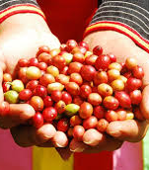






Vietnam Resource Mobilization Framework for REDD+
Pham Hong Luong
Director of Planning and Finance at VNFOREST - MARD
Bangkok, Oct. 11 2017

Slide 2


Current status
1
State budget
National financial resources
2
Private sector investments
FINANCIAL RESOURCES FOR THE FORESTRY SECTOR
3
Loans, concession credits, entrusted funds, cooperation and partnership funds
4
PFES, forest environmental lease, afforestation alternative after conversion of forest resources
1
Official Development Assistant (ODA) and INGO
Inter-national financial resources
2
Foreign Direct Investment (FDI)
3
Payments for REDD+, selling of carbon credits/ CDM based on voluntary carbon markets
New financial commitments for addressing climate change (FCPF, GCF, CF)
4

Slide 3
Some new financial mechanisms in forestry sector
1
Payment for Forest Environmental Services (PFES): Decree 99/2010/ND-CP, Decree 147/2016/ND-CP
2
Forest Environment Lease:
Decree No. 117/2010/ND-CP, Decision No. 24/2012/QD-TTg
3
Offset replanting mechanism:
Decree No. 23/2006/ND-CP, Circular No. 24/2013/TT-BNNPTNT
4
Payments for REDD+/Selling carbon credits:
Decision No. 1775/2012/QD-TTg, Decision No. 799/2012/QD-TTg,
Decision No. 419/2017/QD-TTg
5
Green Credit in Forestry:
Decree No. 55/2015/ND-CP, Decree No. 210/2013/ND-CP,
Decree No. 75/2015/ND-CP, Directive No. 03/2015/NHNN

Slide 4

Objectives and content
4 key objectives
Identify and consolidate existing resources
Identify the financing gaps for NRAP implementation
Promote dialogue to bridge the gap with relevant stakeholders
Support management and coordination of REDD+ implementation through many financing sources
Table of content
Executive summary
Introduction: context, methodology
NRIP finance secured
Financial gaps, barriers and opportunities
Strategy and action plan
Monitoring and evaluation

Slide 5
Key scoping questions…
Timeframe? (2017-2020, total and detail per year)
Investments (vs. current expenditure, with blur lines)
Approved programmes only (not yet approved = opportunities)
Source of funding:
  Domestic public finance (starting with the comprehensive Medium-Term Public Investment Plan 2016-2020)
  ODA
  Private finance
Main challenges
Executive summary
Introduction: context, methodology
NRIP finance secured
Financial gaps, barriers and opportunities
Strategy and action plan
Monitoring and evaluation

Slide 6
Challenges faced in Vietnam
Scattered information and need to access information on funding sources at project level in relevant sectors to assess what really contributes to NRAP implementation
A comprehensive view on ODA also requires long process of data collection
Little history of collaboration and transparency with private sector
Dissociating what is confirmed finance, and what is unsecured target quoted in cascading policy documents
Information sources are not always reliable, some contradict each other or overlap and could lead to double-counting (particularly with ODA)
Secured finance are not always fully relevant to REDD+, or follow approaches and methodology that partially meet REDD+ needs

Slide 7
Solutions to address main challenges…
Access to data: need to build collaborative approach with various sectors, and with the private and financial sector etc.
Set consistent methodology to cross-check information sources and handle dataset at consistent level of details
Collaborate not only for data collection, but also for data analysis and exploring opportunities for bridging gaps (align…)

Slide 8
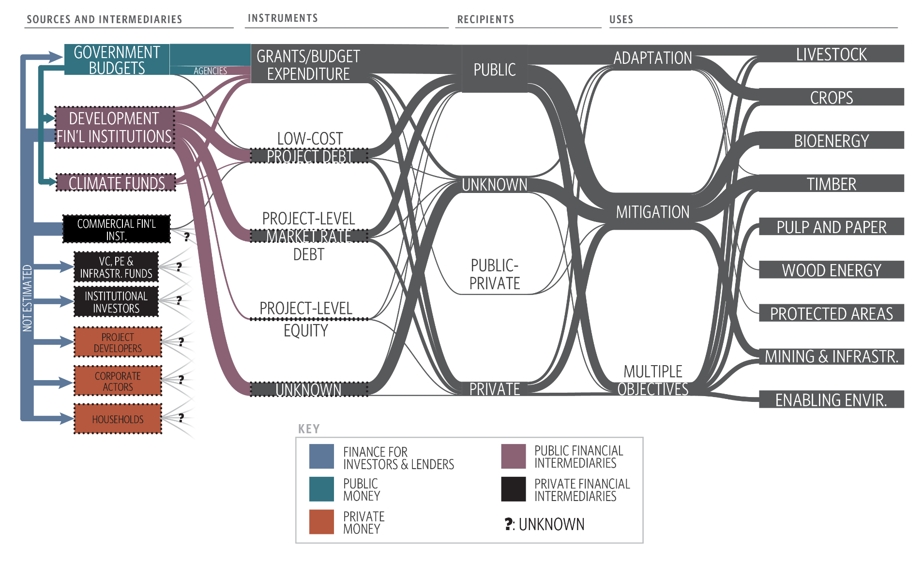
Illustration 1: Mapping financial flow
Coordinated initiatives for mapping land-use/REDD+ financial flows at national level (UN-REDD) and for Central Highlands region (EU-EFI).
Challenges: echoing the broader issues (scattered data, lack of details, private sector data…)
Critical steps: scoping, building typologies, collecting and analyzing data
Further development: harmonize classification of typologies with other tracking initiatives (CPEIR…), and set system for labeling and quick/recurring monitoring of REDD+ finance

Slide 9

Resource mobilization strategy (first draft…)
Over-arching strategy: Strengthen Vietnam REDD+ Office’s capacity to advocate, leverage, monitor and coordinate finance in three main directions:
Harness political leadership to align domestic public finance and policies with REDD+ objectives and implementation.
Attract international REDD+ finance through positioning, fundraising and coordination / alignment efforts
Build stronger partnerships with the private and financial sector.
Building on new arrangements (intersectoral National Steering Committee chaired by Deputy-Prime Minister, required annual reporting from sectors…)
Turned into a detailed work plan integrated to the Implementation Plan (staffing, organization, com., dialogue, networking, accountability…)
Start from what you control. Vietnam taking an ambitious approach to pilot and replicate environmental fiscal and financial instruments
Notes:
Forthcoming researchby ODI (financed by UNEP FI as part of the UN-REDD Programme) shows that the role of subsidies are not considered in 32 UN-REDD countries researched

Slide 10
Illustration 2: public instruments
National Target Programme on Sustainable Forest Development (June 2017)… to direct and guide State budget
Direct and guide domestic and foreign direct investments from the private sector through regulation
Opportunities associated with innovative environmental fiscal and financial instruments
Payment for Forest Environmental Services
  Piloted in 2008, scaled up since 2011, Expanded in 2017
  US$60M annually… Expected $100M from 2017 on
  Covers 42% of national forests (5.9Mha)
  More than 500.000 beneficiaries, with approx. 100$ annual payment in average
  Pilots to improve forest impacts (joint REDD+ local fund, local revolving fund…)
Offset replanting mechanism
  Since 2013: 68.200ha eligible; 40.600ha replanted; fees collected approx. $45M
Forest environmental lease
  Piloted in some national parks.
  Example: Son Doong cave marketed by Oxalis; $660 per visitor paid to NP
REDD+ payments
  UN-REDD Phase 2: $12M to province/local level activities
  ER-Programme to be assessed by FCPF CF board in Dec. 2017 ($48M programme)
  Green credit in forestry, green bonds, domestic carbon market…
Notes:
Forthcoming researchby ODI (financed by UNEP FI as part of the UN-REDD Programme) shows that the role of subsidies are not considered in 32 UN-REDD countries researched

Slide 11
Current challenges 1/2
PFES
Revenue generated is lower than potential, mainly from 3 types of users;
Level of payment is different amongst watersheds;
Level of payment is still low, not adequate to offset labor invested;
Payment remission is slow, delays in payments still occur;
Monitoring and evaluation (M&E) of the FES quality is still limited.
Reforestation progress is slow; money generated from forest re-plantation after conversion of forest resources has not been fully disbursed;
Regulations on management and use of money generated from conversion of forest resources is not clear;
Level of PFES payment is different, not meeting the requirement for restoration;
The value of forest ecosystems has not been calculated sufficiently.
Offset replanting
REDD+
REDD+ requires higher level of forest governance;
Opportunity cost for REDD+ implementation is high;
Conditions for payments have not been sufficiently secured;
Financial commitments are unclear;
Forest use tenure and forest carbon rights are still unclear.
Notes:
Forthcoming researchby ODI (financed by UNEP FI as part of the UN-REDD Programme) shows that the role of subsidies are not considered in 32 UN-REDD countries researched

Slide 12
Current challenges 2/2
Inventory and valuation of forest environment services requires substantial resources;
Procedures for forest environmental lease is complicated (requiring proposals, preparation of projects and options);
Rental price for forest environmental lease has not been specified; price framework not yet completely defined;
Controlling and assessment of environmental impacts is still limited.
Forest Environ-mental Lease
Forest owners live in remote and mountainous area, with limited educational level;
The access of financial resources is limited (lack of support services);
Procedures to apply for loans are complicated (requiring ensured assets, mortgages);
Performance of forest protection depends on natural conditions, facing high risks;
Production cycle is long (5 – to as many as 15 years);
Green Credits
Notes:
Forthcoming researchby ODI (financed by UNEP FI as part of the UN-REDD Programme) shows that the role of subsidies are not considered in 32 UN-REDD countries researched

Slide 13
cảm ơn!

