Slide 1



Developing a Financing Stategy
Ecuador
Regional knowledge exchange:
“Operationalizing and financing National REDD+ Strategies: from programming and financing implementation to Results-based payments”
Bangkok, 10th October 2017
Patricia Serrano Roca

Slide 2
REDD + Financing Strategy
The Ecuadorian REDD + Financing Strategy is part of the process for the implementation of the REDD+ Action Plan.
The Strategy should, based on the quantification of revenues and expenditures, estimate the financing gap that will be generated for the implementation of the REDD + Action Plan in the country.
REDD+ Financial Strategy
OBJECTIVE: To provide a financial planning framework in order to obtain the necessary financing for REDD+ implementation
Revenues
Financial Gap for REDD+ AP implement-ation
Expenditures

Slide 3
Investment Planning Process
1) PAMs cost estimation
2) Identification of possible incomes
3) Definition of financial gap and possible income sources
4) Identification of financial needs
5) Evaluation of legal and institutional feasibility
Financial Feasibility
6) Short & long term action plan development
Notes:
La Estrategia de Financiamiento se compone de seis niveles de análisis

Slide 4
Financial Feasibility
1) PAMs Cost Estimation
Current Expenditures: recruitment expenses, basic services, consultancies, travel expenses, etc.
Investment Expenditures: based on the REDD+ implementation costs study, the main costs of the implementation of REDD + PAMs were established for the prioritized areas.
  Set of policies and measures to be implemented in prioritized areas
  Over a period of 30 years at a present value
  The total amount required for REDD+ implementation is $283.2 million
  Average expenditure of $1,168 per hectare or $3 per e-tCO2
  The average investment cost for the analysis period represents 95.5% of the total estimated expenditure.

Slide 5
Financial Feasibility
2) Identification of possible incomes
A potential emission reduction revenues estimate was calculated, quantified by zones and their carbon content.
Two scenarios were considered:
  Conservative scenario with a price of USD 6
  Optimistic scenario with a price of USD 10
In average income for the 30-year period will come:
24% from the "Southern Amazon”
20% of the "Central Amazon”
18% of the "Northern Amazon" and "Esmeraldas Sur and Manabí Norte" each
12% of the "Esmeraldas Sur and Manabí Norte";
8% of the "Dry forests and valleys of the south".
Notes:
24% of revenues will come from the "Southern Amazon”
20% of the "Central Amazon”
18% of the "Northern Amazon" and "Esmeraldas Sur and Manabí Norte" each
12% of the "Esmeraldas Sur and Manabí Norte";
8% of the area "Dry forests and valleys of the south".

Slide 6
Financial Feasibility
3) Definition of financial gap and possible income sources
Prioritization of PAMs that will be implemented to attend DD and to achieve the goals of the REDD+ AP (current and investment expenditures)
Quantify the possible incomes associated with the RBPs that the country could receive
Based on the estimated incomes and expenditures for the next 30 years , the financing gap for the implementation of the REDD+ AP was estimated.
Notes:
24% of revenues will come from the "Southern Amazon”
20% of the "Central Amazon”
18% of the "Northern Amazon" and "Esmeraldas Sur and Manabí Norte" each
12% of the "Esmeraldas Sur and Manabí Norte";
8% of the area "Dry forests and valleys of the south".

Slide 7
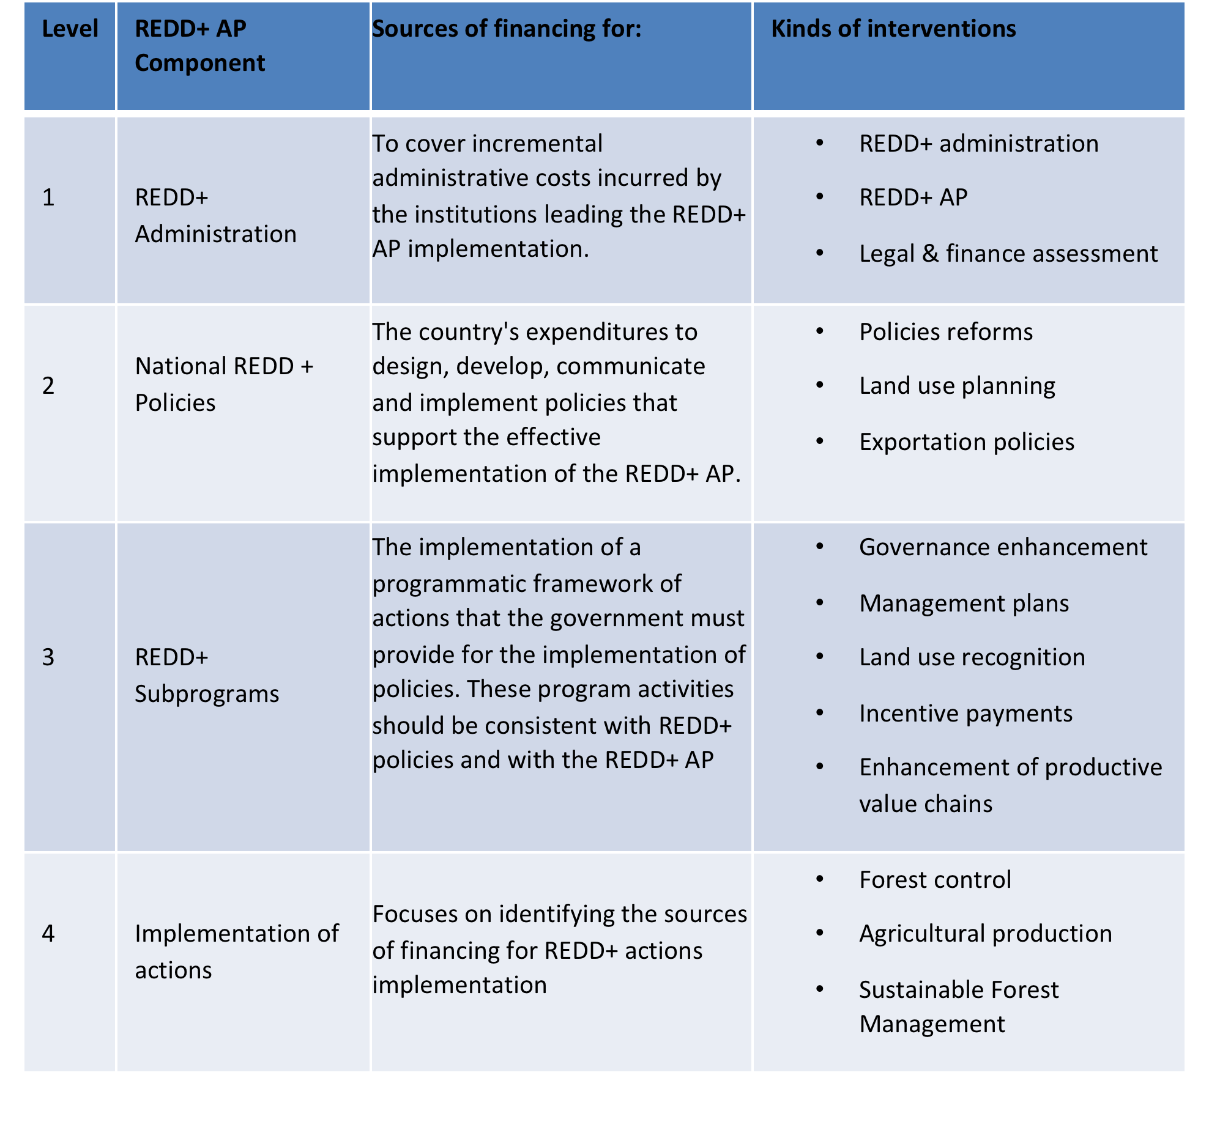
4) Levels of financing needs for REDD+ implementation

Slide 8
Sources of Financing
The financing needs of the REDD+ AP require different funding sources, mechanisms and instruments to be identified and mobilized to ensure its implementation.
It could come from public or private sources, the main of them are: fiscal resources (curents assignments, inventives, subsidies), loans – national & international (Contingency Credit Credit lines, Debt Swaps, Concessional credits, Commercial credits, Guarantees), grants (Non-reimbursable funds for technical assistance), resuls based payments
Notes:
24% of revenues will come from the "Southern Amazon”
20% of the "Central Amazon”
18% of the "Northern Amazon" and "Esmeraldas Sur and Manabí Norte" each
12% of the "Esmeraldas Sur and Manabí Norte";
8% of the area "Dry forests and valleys of the south".

Slide 9
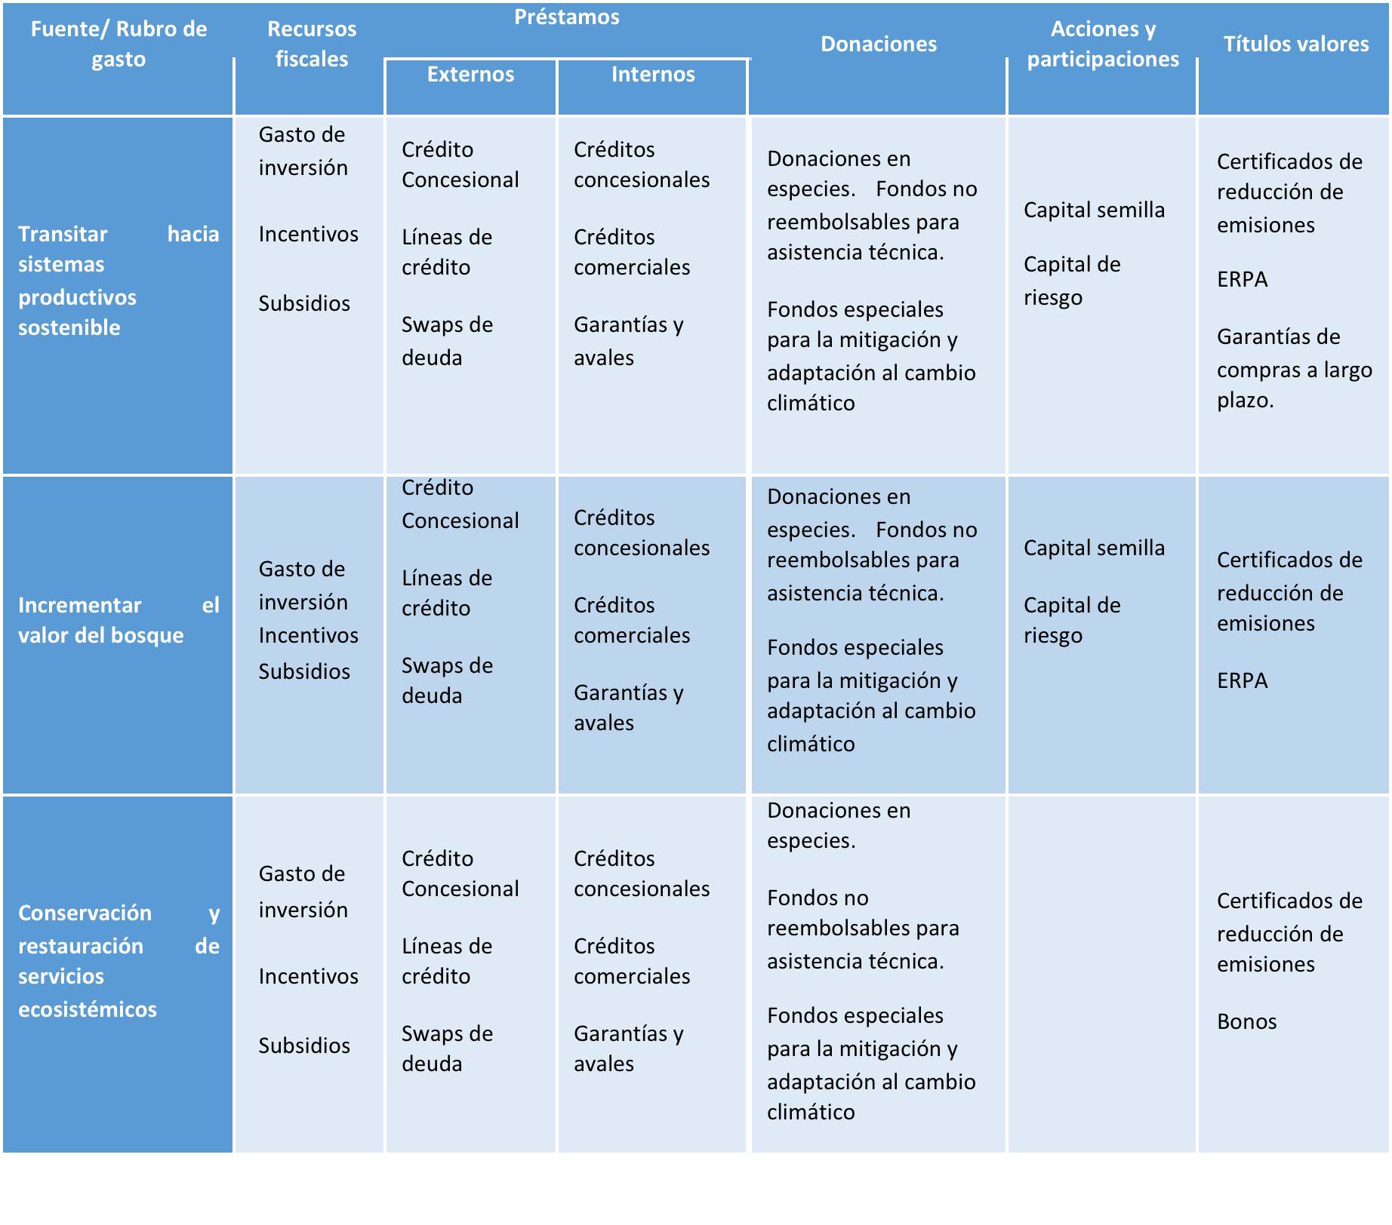
REDD+ Subprogammes possible financing sources: investment expenditures, that can be financed by almost all the financial instruments identified as follows:

Slide 10
The success of REDD + depends on:
  The identification of the funds
  The establishment of the financial mechanisms, and,
  The definition of the implementation mechanisms for the prioritized PAMs.
Only in this way users and resource managers will be effectively encouraged to reduce deforestation and forest degradation on a scale that generates net emissions reductions over time.

Slide 11
Legal , political & institutional framework
Funding
Financial Mechanisms
Implementation Mechanisms
REDD+ Policies & Measures
What types of funding are available?
How to channel the resources?
Through which means the funds reach forest users /beneficiaries for PAMs implementation?

Slide 12


