Slide 1
National Strategy on Climate Change and Vegetation Resources Financial Strategy(ENCCRV)
Angelo Sartori
Head of Climate Change and Environmental Services Unit (UCCSA)
Notes:
La fotografía de fondo está editable, es decir, que se puede modificar el espacio visible dentro de la lámina.
Cómo hacerlo:
Seleccionar la imagen
Ir a la pestaña “Formato de la Imagen”
Seleccionar “Recortar”
Modificar espacio de acuerdo a la necesidad de la información

Slide 2
Financial Strategy
01
ENCCRV Phases
^{Phase} ^{1 Preparation 2010 - 2016}
^{Phase 2 Implementation}
^{2016 onwards}
Phase 3 Payment based on results
^{Eventually 2018 onwards}
Finalized and validated design of the ENCCRV
Implementation of activities that address the causes of deforestation, forest degradation, devegetation and promote restoration and sustainable management of vegetation resources
Forest Reference Emission and Removal Levels, xerophytic formations and other vegetation resources
Multi and Bilateral International Funds
State incentives
National Forest Monitoring System
Plan for the implementation of social and environmental safeguards
Private Sector Funding
USD 60,492,810
USD 5,215,000
Unconditional Total
USD 279,426,240
USD 69,252,000
Conditional Total
Total
USD 339,919,050
Measuring and Monitoring System (SMM)
USD 4,100,000
USD 6,015,061
= USD 10,115,061
Safeguard Information System (SIS)
USD 594,000
USD 7,909,601
= USD 8,503,601

Slide 3
Financial Strategy
02
Estimation of costs for implementing actions
Table of Values of Law No. 20,283
on Native Forest Recovery and Forest Promotion
Demonstrative experiences in the territory of the early implementation phase of the ENCCRV
Table of Costs of D.L. No. 701 of Forest Promotion
Formulation Studies and Workshops of the ENCCRV Readiness Phase
Prior processes of formulation of laws and national public consultations
Costs of Direct Action Measures
Costs of Facilitating Action Measures
Afforestation
Ecological Restoration
Forest Management
Preventive Forestry
Buffer Strips
Legal Amendments
Education
Supervision
Research
Production Chain
Institutional Management
Promotion
Land-use Planning
Operational
Regulatory
Supervision
Education
Research

Slide 4
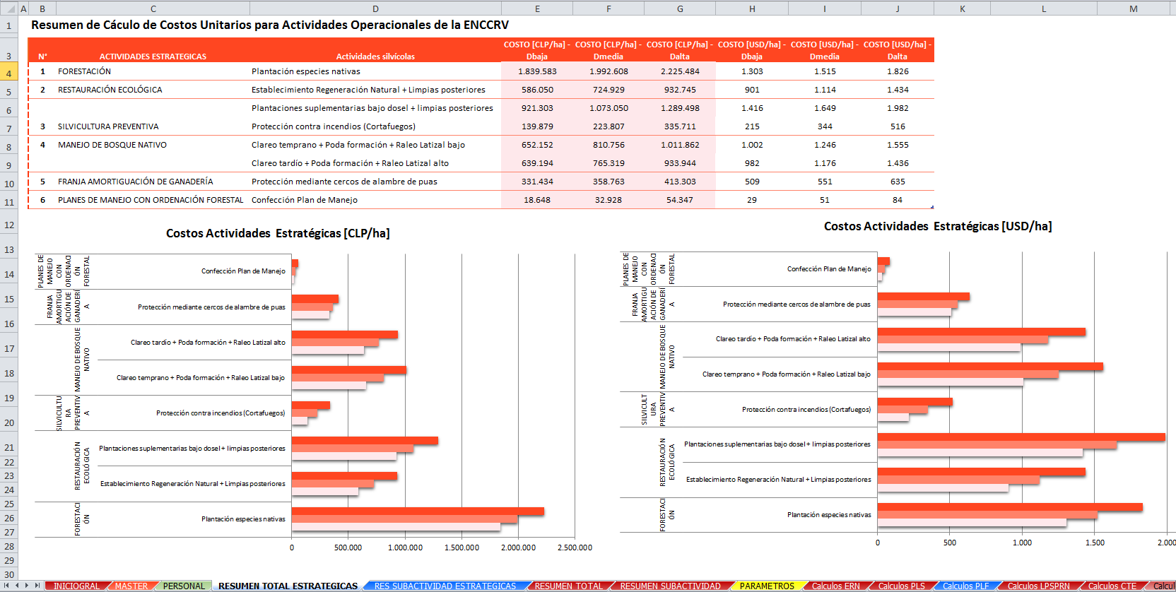
Financial Strategy
03
Costs model by activity
Unitary Cost Calculation Summary for ENCCRV Operational Activities
Cost of Strategic Activities (CLP/ha)
Cost of Strategic Activities (USD/ha)

Slide 5
Financial Strategy
04
Types of contributions
National and international private contributions
International Bilateral contributions
Based on management with national and international companies in order to obtain funding for the implementation phase and results-based payment phase of the ENCCRV.
Bilateral negotiations are taking place with developed countries, with international obligations to support developing countries in forest and climate change issues for them to access financial contributions for the implementation and results-based payment phases.
Contributions from international multilateral bodies
Incremental and non incremental tax contributions
We are applying to most of the existing funds, which will allow access to financial resources, which will then translate into grants, aligned with the tasks to be implemented within the framework of the action measures of the ENCCRV.
It is based on promoting and achieving the enhancement and reallocation of national fiscal resources through the enactment of new laws -or amendments to existing ones- as proposed by various action measures.

Slide 6
Financial Strategy
02
Financial Strategy Timeline
2017 2018 2019 2020 2021 2022 2023 2024 2025
Scenarios
Very Optimistic
100% chance of conditional-source financing
Periodically updated, based on inputs and modifications to existing and leveraged budgets.
Optimistic
75% chance of conditional source financing
Average
50% chance of conditional source financing
Pessimistic
25% chance of conditional source financing
Very Pessimistic
0% chance of conditional source financing

Slide 7
Forecasts
05
Do you think it is critical for a country to have a financial strategy in order to leverage financing of forests or REDD+?
It is an instrument for defining concepts, budget elements, unitary and general costs and for identifying and characterizing financing alternatives, which -in practice- translate into the development of inputs needed for planning.
Detailed definition of what and how much will be done and the cost structure of each one of the actions.
The dynamism of these current topics demand having analysis tools that integrate new technical, budgetary and financial situations in an agile manner in order to provide an answer to these changes or adaptations as soon as possible.

Slide 8
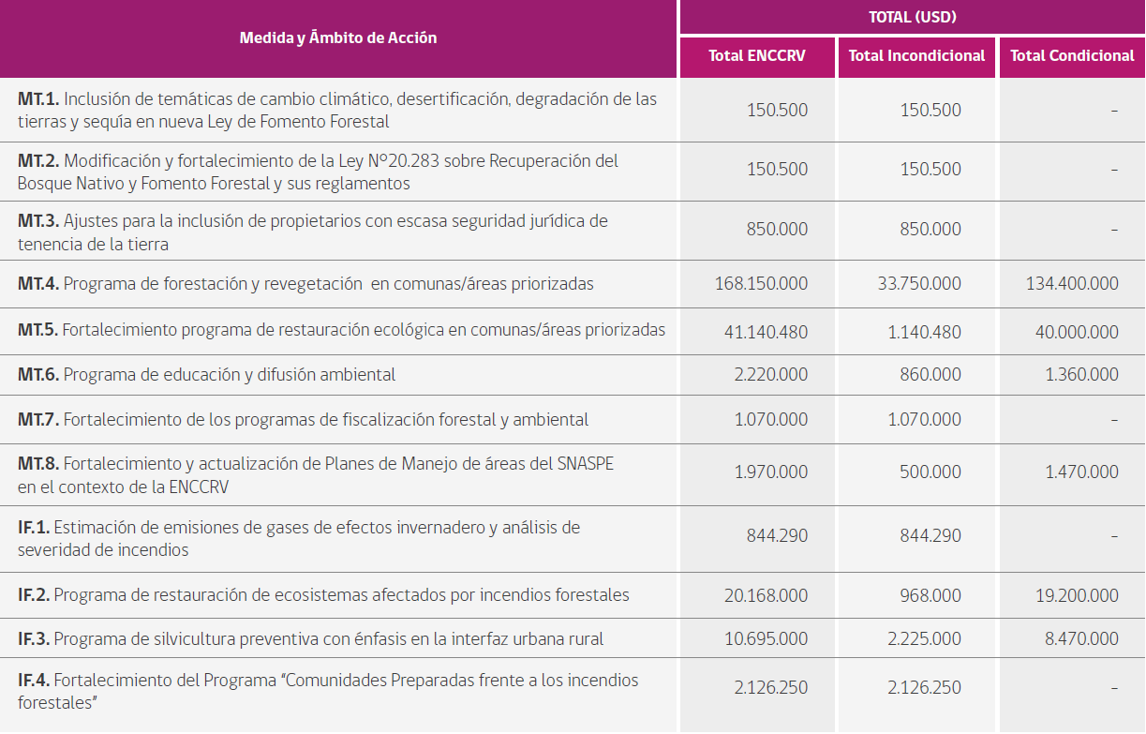
Budget
06
[…………]

Slide 9
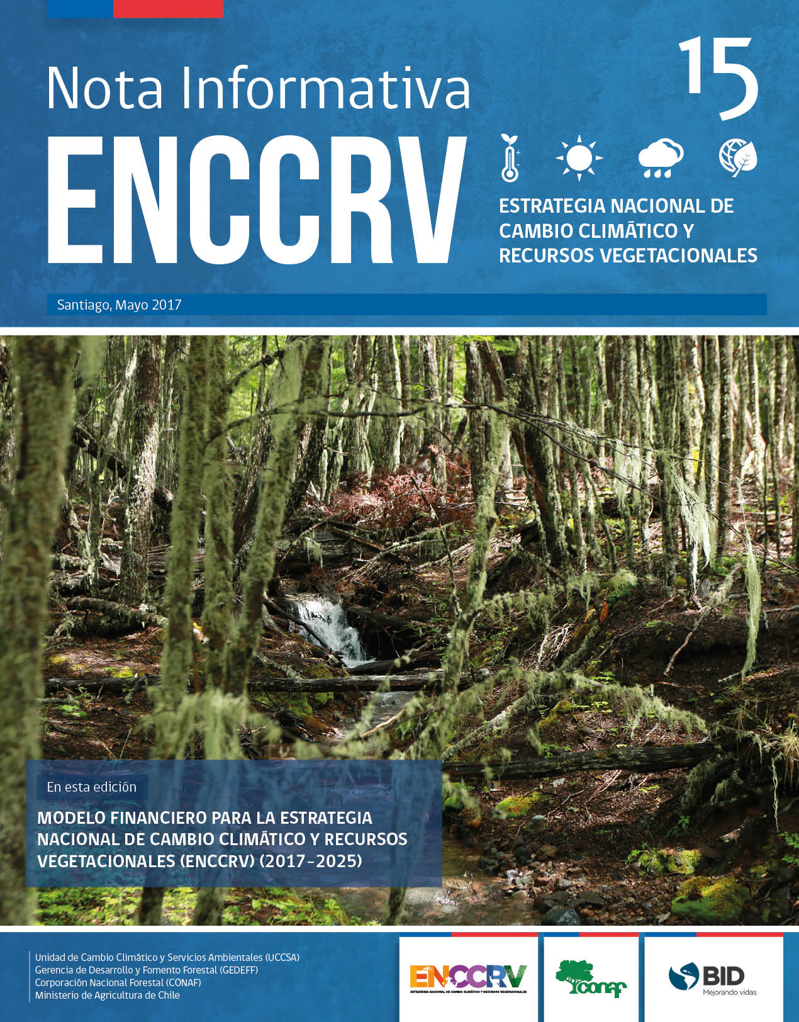
Forecasts
03
Informative Note 15

Slide 10
National Strategy on Climate Change and Vegetation Resources
2017-2025

