Slide 1
Country case study
By: ECUADOR
Regional knowledge exchange:
“Operationalizing and financing National REDD+ Strategies: from programming and financing implementation to Results-based payments”
10th October 2017
Patricia Serrano Roca

Slide 2
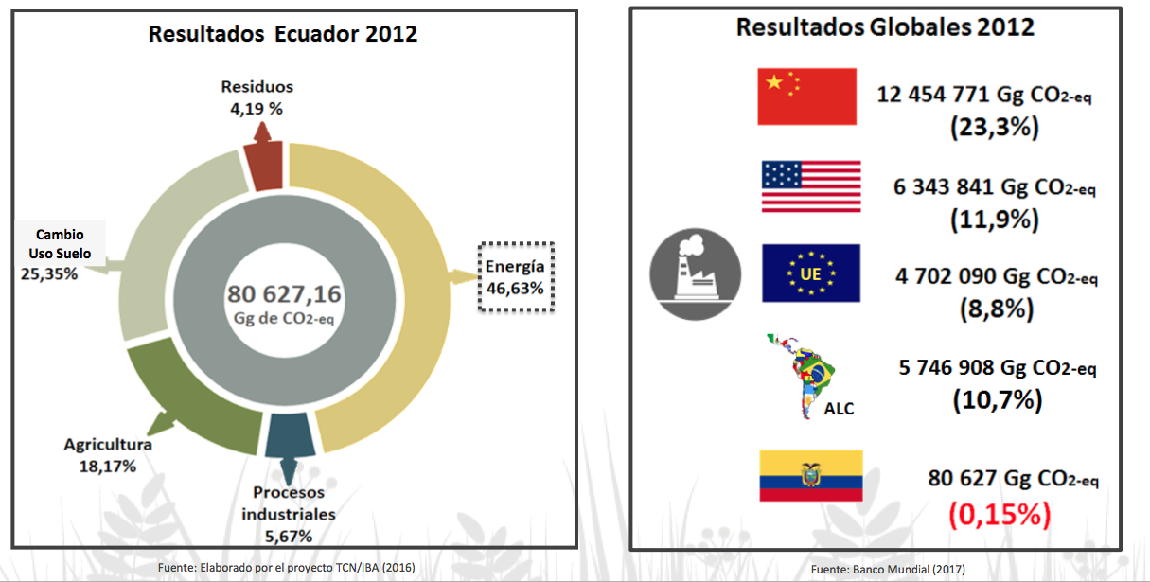
2012 National Inventory
2012 Global Results
Notes:
According to National GHG Emissions Inventory from 2012, after Energy sector, AFOLU sector is the one with more GHG emissions at national level contributing with a 30%, followed by agriculture sector with a contribution of the 18% of GHG emissions.
If we compare country rusults with the global results for the same year we can see that Ecuador contributes only with 0,15% of the global GHG emissions.

Slide 3
REDD+ phases
Phase 1:
Readdiness
Phase 2:
Implementation
Phase 3:
Results based payments
Ecuador
Complete elements from Warsaw Framework for REDD+

Slide 4
Ecuador progress through REDD+
National Strategy or Action Plan
National Forest Reference Emissions Level (NFREL)
Activity: Deforestation
National Forest Monitoring System (NFMS)
MRV proceses strenghtened
Safeguard Information System (SIS)
REDD+ Action Plan developed and issued by ministerial decree
First Summary of Information (SoI) presented to UNFCCC on march, 2017 with a national approach
Institutionality and proceses stablished
National approach
Succesfully evaluated by UNFCCC on october, 2015
National Approach
SIS proceses identified and stablished
Notes:
In addition, Ecuador has made notable progress in REDD+, which comprises the submission of the Forest Reference Emission Level for Deforestation to the UNFCCC, calculated at a national level; the development and strengthening processes leading to a robust and transparent national forest monitoring system, and the construction of an information system for addressing and respecting safeguards, based on the national approach and scope.
Likewise, transparent processes were promoted to allow the inclusive participation and involvement of stakeholders, politicians and technicians.
This is exemplified by the functioning of the REDD+ Working Group, a dialogue space involving stakeholders from civil society, communities, peoples and nationalities of Ecuador.
Considering these advances, Ecuador is ready to implement REDD+ in 2017.

Slide 5
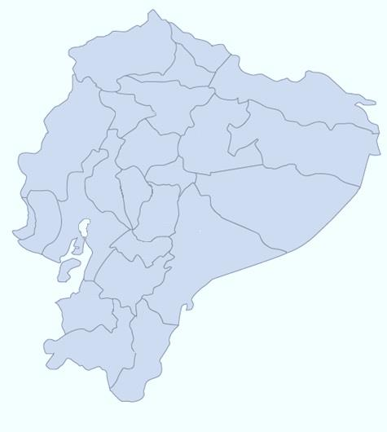
Net Deforestation in Ecuador for periods: 1990-2000; 2000-2008 Y 2008-2014
Average rate per period:
PERIOD 1990 - 2000
- 0,65 %
5.476
74
Esmeraldas
Carchi
246
Imbabura
Deforestación neta anual
679
408
5.416
92.742 ha/año
Santo
Domingo
Pichincha
Sucumbíos
1.411
599
Manabí
1.619
Napo
3.087
PERIOD 2000 - 2008
Cotopaxi
Orellana
- 0,58 %
395
487
Los Ríos
2.939
Tungurahua
Bolívar
2.846
Deforestación neta anual
-90
42
Pastaza
2.570
Chimborazo
77.748 ha/año
Santa Elena
Guayas
365
7.925
Cañar
Morona Santiago
TOTAL
PERIOD 2008 - 2014
1.309
Deforestación neta anual promedio
Azuay
- 0,37 %
6.274
47.497
El Oro
hectáreas por año
Deforestación neta anual
1.277
1.815
Zamora
Chinchipe
47.497 ha/año
Loja
Notes:
Ecuador has a deforestation rate that results in the deterioration of biodiversity, water reserves and environmental services, as well as in greenhouse gas (GHG) emissions.
The continental surface of Ecuador has an approximate area of 24,898,059 hectares. Native forests, 74% of which are located in the Amazon region, cover 51.2% of the national territory (MAE 2015).
Between 1990 and 2014, around 2.2 million hectares of natural forest were lost in the country. Even though deforestation has significantly reduced if we compare 1990-2014 period against 2008-2014 period, where deforestation decresead from 92,742 ha/year to 47,497 ha/year

Slide 6
Percentage of area under different land uses from deforested area between 2008 and 2014
Notes:
Ninety-nine percent of the deforested area in the period between 1990 and 2008 was transformed into agricultural land, mainly for pastures. However, this process is also influenced by various political, economic, social and environmental aspects.
The clear political will of Ecuador to combat climate change and reduce emissions from the forest sector has positioned the country as a pioneer in preparing for REDD+, under a national approach that considers the implementation of REDD+ measures and actions inside and outside forests.

Slide 7
2017-10-08 PPT 3_ Ecuador
Some elements of a Strategy and some of an Action Plan
Political document with some operational aspect
Period: 2016-2025
It has 4 Strategic and 5 crosscutting Operational Components
To address deforestation and contribute to the transition towards sustainable production, among other objectives, Ecuador has developed the REDD+ Action Plan “Forest for Good Living (2016-2025)
Policies and institutional management
Transition to sustainable and deforestation- free productive systems
Sustainable forest management
Conservation and restoration
crosscutting Operational Components
Notes:
To address deforestation and contribute to the transition towards sustainable production, among other objectives, Ecuador has developed the REDD+ Action Plan “Forest for Good Living (2016-2025).
The fight against deforestation and forest degradation contemplated by the REDD+ Action Plan is linked to the country ́s sustainable development model. This approach seeks to contribute to the national efforts towards poverty reduction, the transformation of the energy and production matrices, reforestation and conservation of biodiversity. The Plan entails four strategic components that frame the deforestation reduction measures and actions. These are:
Policies and institutional management
Transition to sustainable and deforestation- free productive systems
Sustainable forest management
Conservation and restoration
In addition to its strategic lines, the REDD+ Action Plan has five crosscutting operational components, which facilitate its implementation:
Coordination between institutions
Measurement of results
Addressing safeguards and respect for rights
Capacity building and knowledge management
Involvement of stakeholders and communication

Slide 8
ECUADOR National REDD+ ACTION PLAN
STRUCTURE:
Introduction
Reference Framework
Forest context in Ecuador
Legal, political & institutional framework
Technical and participative development of the REDD+ AP
REDD+ in Ecuador
Approach
Principles
Objectives, goals
Social and environmental benefits of REDD+ implementation
REDD+ AP Components
Geographic prioritization
Incentives
Stakeholders engagement & Gender approach
Strategic & Operational components
Annexes
National Consultation Guide for REDD+ implementation on collective property lands
Ecuador`s National approach to Safeguards
Notes:
To address deforestation and contribute to the transition towards sustainable production, among other objectives, Ecuador has developed the REDD+ Action Plan “Forest for Good Living (2016-2025).

Slide 9
How will the REDD+ AP be implemented?
Set of measures and actions
Linked to national agendas and sectoral policies
Addressing drivers of deforestation both inside and outside the forested areas.
The measures and actions to address deforestation and forest degradation are linked to land use changes and productive development.
Technical & Participative construction
Collaborative construction with implementation partners
Sectoral
Implementation
Plans
Activities in detail
Geographic scope
Strategic partners
Beneficiaries
Institutional arrangements
Schedules
Budgets
Financial mechanisms
Strategic Components
Policies & Measures
Operational Components
GCF Project: Priming financial and land use planning instruments to RED
Notes:
The execution of the REDD+ Action Plan will take place through the Implementation Plans of REDD+ Measures and Actions, along with other projects that are currently under development. The Action Plan will be gradually implemented with the participation of different stakeholders and levels of government.
The Implementation Plans of REDD+ Measures and Actions are instruments developed in collaboration with a diversity of partners, and will define in detail activities, geographic scope strategic partners, beneficiaries, institutional arrangements, schedules, budgets and financial mechanisms.

Slide 10
Sectoral Plans – REDD+ Implementation Plans 1/2
Sectors / Themes | Implementing Partners
Land Use planning Instruments | Nathional planification authority, local governments, Indigenuos people, communitties
Conservation, restoration, reforestation and products from biodyversity | Socio Bosque Programe
Agroforestry systems with cocoa, coffee and sustainable livestock | Ministry of Agriculture & Livestock
Traceability, deforestation free certifications and responsible procurement for deforestation free agricultural products (commoditties) | Ministry of Agriculture & Livestock Ministry of Commerce and Foreign Affairs

Slide 11
Sectoral Plans – REDD+ Implementation Plans 2/2
Sectors / Themes | Implementing Partners
Traceability, deforestation free certifications and responsible procurement for deforestation free forest products (timber and non timer poducts) | Ministry of Environment Undersecretariat of Natural Heritage National Forest Direction
Sustainable & deforestaction free palm oil | Ministry of Agriculture & Livestock

Slide 12
Investment
REDD+ Implementation plans & REDD+ financial strategy - ready
GCF project starting its implementation
Additional financing mobilization: (preparation of proposals, design of a funding mechanism)
REDD+ National AP & other Warsaw framework requirements- ready

Slide 13
