Slide 1
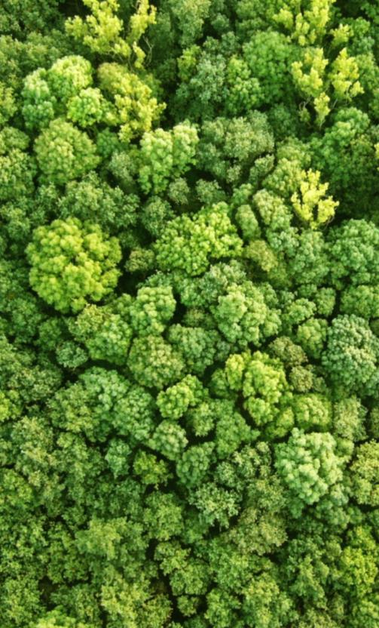
Safeguard information systems and summaries of information
Status overview with a view to results-based payments
Steve Swan
20 September 2017 | Nairobi
Notes:
Guidelines:
Limit text as much as possible, in favour of visuals, graphics (clean and simple), and photos that highlight your speaking points, rather than repeat them. If people are busy reading, they won’t be listening to your presentation!
Powerpoints should add value to your presentation. If information isn’t relevant or important, don’t include it.
Create your powerpoint with your live audience in mind, not as a publication for sharing afterwards. This will keep you from filling it up with too much information/text.
If you are going to insert charts, make sure they will be quickly and easily understood. Many times, complicated visuals are only meaningful to those who created them.
Avoid using animations or other outdated ‘special effects’. Keep your presentation clean and professional (i.e. no drop shadow lettering, 3D text, spinning transitions etc.)
Choose powerful images that illustrate your work. If you don’t have original photos, check out the UN-REDD Photo Bank on Flickr, or use creative commons photos (try pixabay.com for example).

Slide 2
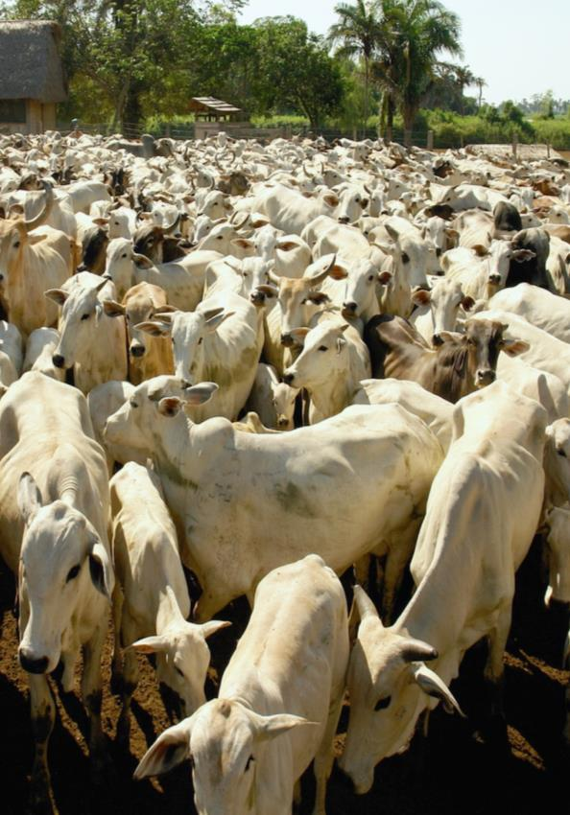
Outline
Phase I - global progress SIS / summaries of information
Phase II – safeguards requirements for implementation
Phase III safeguards requirements for results-based payments

Slide 3
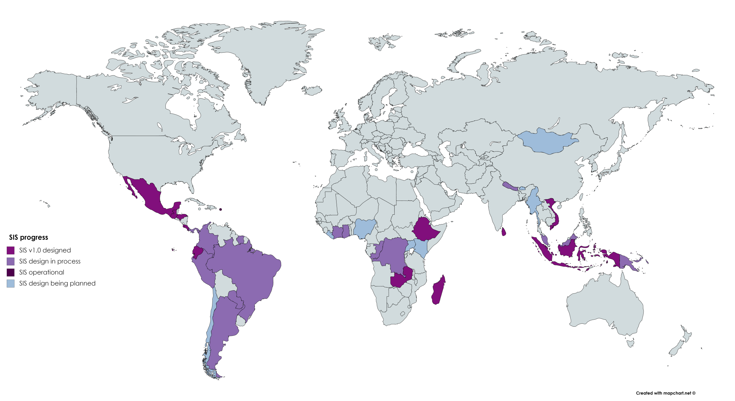
?
SIS

Slide 4
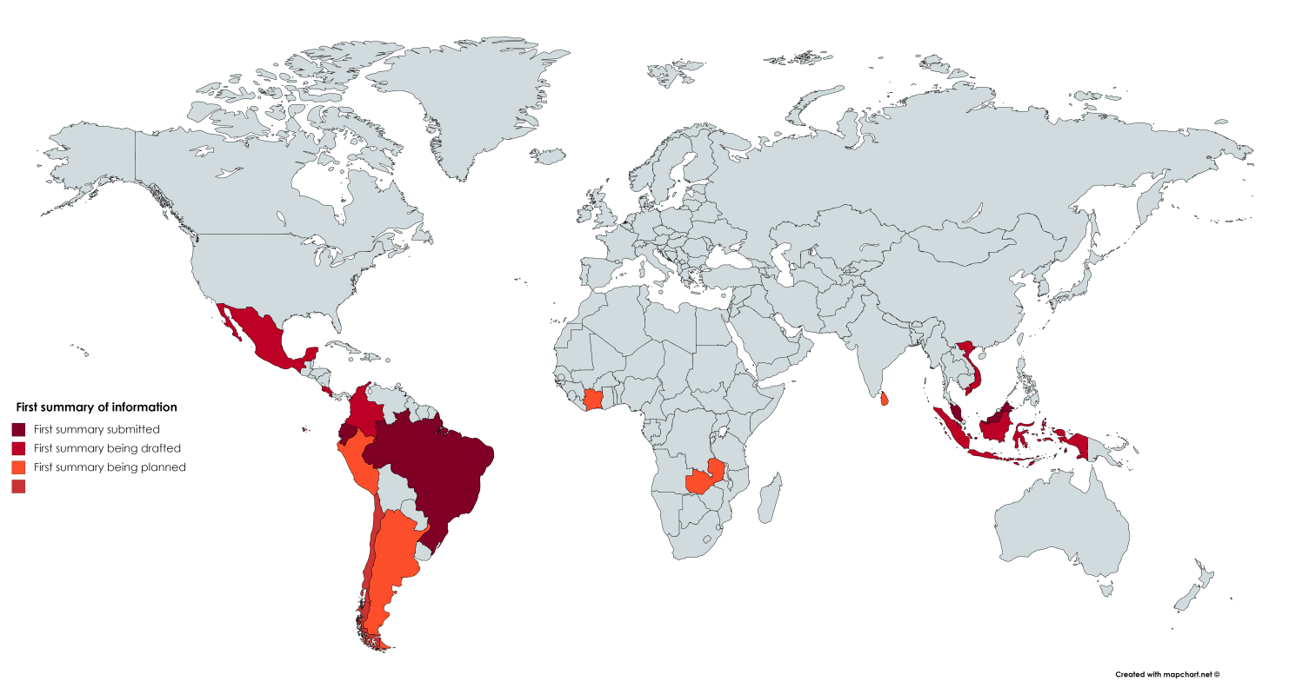
?
1st summary

Slide 5
Phase II safeguards requirements for implementation
UNFCCC
Addressing and respecting Cancun throughout implementation
Operational SIS (monitoring above)
Most recent summary of information (demonstrating above)
Investor
e.g. WB Operational Policies + Common Approach + Carbon Fund
e.g. GCF interim Environmental & Social Safeguards (IFC PS)
e.g. private sector industry standards; finance sector standards

Slide 6
Phase III - safeguards requirements
for results-based payments
SIS developed
designed?
Most recent summary of information
demonstrating safeguards addressed and respected…throughout REDD+ implementation…
operational?

Slide 7
Phase III- safeguards requirements
for results-based payments
Eligibility criteria
SIS and summary of information
Categories
RBP proposals categorized to determine type of assessment report
Information disclosure
summary of information provided by countries
env. and soc. assessment provided by accredited entities
Assessment
scorecard for summary of information (following 17/CP.21)
Scorecard for RBP proposal (how RBAs comply with ESS)
Use of proceeds
RBPs should be reinvested in line with, inter alia, GCF ESS
countries must provide a plan to reinvest the proceeds

Slide 8
Thank you!
Steve Swan| steven.swan@un-redd.org
Connect with us online:
www.un-redd.org
www.unredd.net

Slide 9
Safeguards - Day 1
Challenges
Designing a SIS before clarity on PaMs
Parallel processes: NS/AP and investment plans; SIS
Linking NFMS, PaMs monitoring and SIS
Opportunities
Assessing benefits/risks of PaMs can inform SIS structure
Pioneering subnational efforts can inform national SIS
NFMS / PaMs monitoring: informational/institutional synergies
Lessons
Need to invest in capacity before/during process
SIS ≠ web interface (…more to it than that…)
Need to cost SIS operations in plans (cost are not high)

Slide 10
Safeguards - Day 2
Challenges
Estimating SIS operational costs (ex ante)
Engaging, capacitating and sustaining institutional arrangements
Different requirements of different donors/investors
Opportunities
Pioneering subnational efforts can inform national SIS
Iterative approach - opportunities for continual improvements
As a region we know how to design a SIS (but need FA/TA)
Lessons
Need more South-South exchange on safeguards/SIS
Multi-stakeholder working group is essential to guide process
Need to analyse safeguards requirements of different donors

