Slide 1
TOWARDS INVESTMENTMENT PLANNING FOR REDD+ IMPLEMENTATION:
OVERVIEW AND STRATEGIC DIRECTIONS
Presentation by Elsie G. Attafuah
Senior Regional Technical Advisor, UNDP
20th September, 2017
Nairobi, Kenya

Slide 2
Outline
IP in the REDD+ planning pathway
Objectives of the Investment Plan (IP)
IP versus a National REDD+ Strategy
An example of IP development process
Experiences and lessons learned

Slide 3
What is an Investment Plan (though can be called anything else relevant for the country…)
An Investment Plan is to generally help to …
Facilitate the implementation of policies and measures identified in national REDD+ Strategy;
Mobilize the requisite financing and investments associated with the implementation of the strategy;

Slide 4
Define, scope and prioritize key investments as well as the associated costs;
Encourage programmatic investments aimed at transformational change in the forest sector and other sectors that affect forests.

Slide 5
Developing a robust national REDD+ Investment Plan, includes:
A robust theory of change.
A detailed action plan, including leading and contributing agencies and stakeholders, scope and scale, volume of activities and timeline, quantified targets, expected carbon and multiple benefits, risk assessment and provisions to respect and monitor REDD+ safeguards, financial needs and respective sources and modalities.
Overarching resource mobilization framework.
A robust monitoring and evaluation framework.

Slide 6
The Place of IP in the REDD+ Planning pathway:
From strategic planning to implementation
→ From a NS/AP to actual investments in the field, intermediate steps are likely to be required
More strategic
More operational
UNFCCC Warsaw Framework
(requirement for access to RBPs)
Optional programming intermediate steps
(likely necessary, though
depending on country context)
Implementation
REDD+
National Strategy
REDD+ national Action Plan
& (or)
National Investment Plan
&/or
Sectoral Plans (?)
Investments
(National &/or subnational
Programmes
National level
or
NRIP
&/or
Subnational Action Plans (?)
Subnational level
Resource
mobilization
Resource mobilization
Resource mobilization

Slide 7
National REDD+ Strategy vs. Investment Plan
Some general distinctions (though varies…)
Strategy | Plan
Political document Medium/long-term vision (e.g. 10y or open-ended) General strategic priorities to achieve vision and goals (list of PAMs) | Operationalizes the Strategy (detailing it) (Semi-political / Semi-technical) Shorter/medium-term (e.g. 5y) clear quantitative objectives… …over a specific timeline… …through packages of interventions… …that have been costed… …with (some) financial resources identified &/or secured/ and/or pulled …M&Ed using a clear results framework with performance indicators… … with risks identified & managed.
Not a new “Policy” → “Framework” to ensure coherence & cost-effective implementation, reaching multiple objectives

Slide 8
NRIP: Pulling resources
REDD+ Investment Plan
Norway
phase 2 & 3
International REDD+ Finance
(GCF, bi/multilaterals)
ERPD
RBPs
(UNFCCC)
ODA
Agriculture
Forestry
Energy
….
Non-REDD+
Finance
(but REDD+ relevant)
Private sector
Agriculture
Forestry
Energy
….
National budget
NRIP: Pooling & coordinating investment

Slide 9
Financial instruments
Depending on PAMs:
Best financial instruments? (e.g. grants, loans, guarantee)
Recipients? (e.g. governmental entities, private sector, households)
Intermediaries? (e.g. Investment banks, etc)
Mechanism? (e.g. Inter-governmental transfer)
Impacting
Financial mechanism(s)
Entities that need to be involved in design

Slide 10
Results Framework
Develop the results chain / indicators / targets (C / NCB) based on the TOC
Results chain
Relevance to REDD+
MRV
(Forest cover / GHG)
Impact
Assess results (Carbon + Non-carbon benefits)
Outcome 1
M&E:
essential for effective implementation
not just MRV!
But NFMS contributes to M&E
Contributes to SIS
Useful to link with monitoring of Drivers
NFMS
M&E
Output 1.1
Monitor implementation
(e.g. A/R)
Input 1.1.1
= PAMs
Level of control
Notes:
10

Slide 11
PAMs implementation and M&E
Define tools, systems & processes to collect, aggregate, transfer, analyze & report on data
Data transfer, aggregation & analysis
National level
Data
Collection
Oversight
Implementation
Need to clarify what info needed at which level(s)
Integrate with Government systems / assess gaps
Define if/how to address gaps cost-effectively
Ensure aggregation (incl. cross-sectorial coherence!)
Includes safeguards (part of “SIS”)
Provincial level
Oversight
Implementation
Local level
Implementation

Slide 12
An Example from DRC

Slide 13
Ensuring coherence & synergies in implementation (e.g. DRC)
National REDD+ Strategy
2012
Nat. REDD+ Investment Plan
2015-2020
2013
2015
FIP
2016
CAFI LoI
GCF proposal
ERPD
REDD+ Strategy / Investment Plan
Coordination
Important
tools!!
National
REDD+ Fund
Fundraising

Slide 14
Investment Plan Structure (e.g. DRC)
Main document
Introduction (REDD+ process)
Objectives & Principles
Implementation framework
Alignment with wider national priorities
NDP, Governance matrix, INDC
Context
Drivers, stakes
TOC (narrative + graph)
Types of investments
Enabling/Sectoral – Thematic/Integrated
Complementarities / Alignment
Matrix – contribution prog to drivers
Geographical priorities
Results framework
Budget
Risk management framework
Appendix
Programs profiles
Consultations
Priority areas (details)
Alignment of existing investments (details)
Mapping of existing interventions
Local communities, IPs & role of civil society
Role of private sector
NFMS
etc
Context
ToC
Approach
Notes:
14

Slide 15
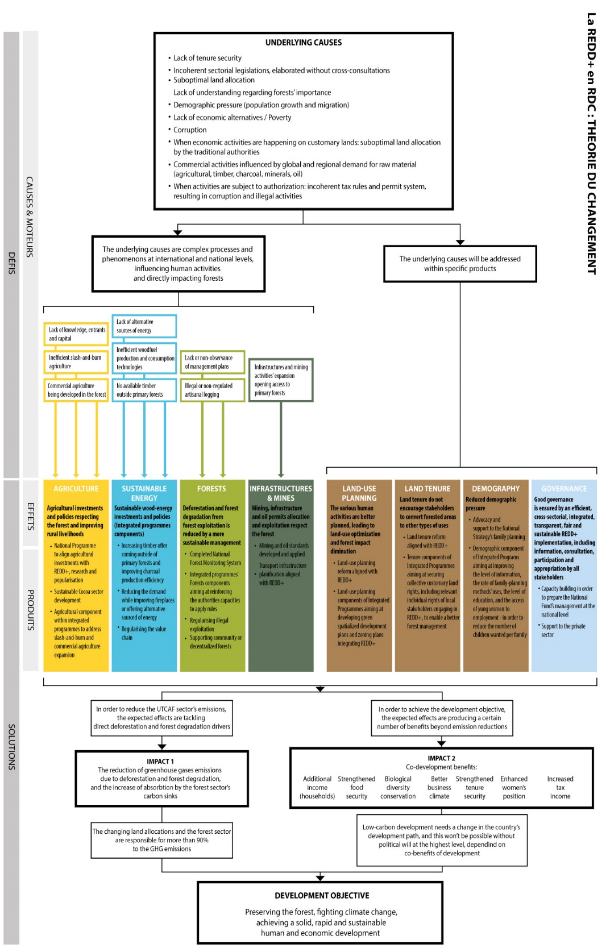
Theory of change (e.g. DRC)
With a narrative…

Slide 16
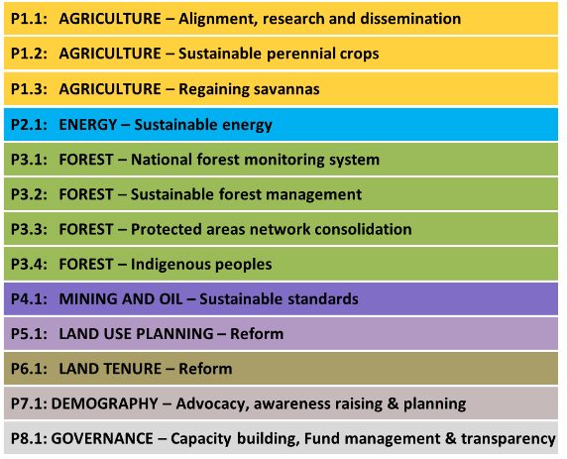
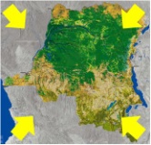
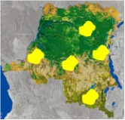
Approach of intervention (e.g. DRC)
A coherent set of PAMs
Principle of territorial complementarity for effectiveness/efficiency
National sectorial programmes
(incl. reforms)
2 main approaches
→ Ensuring synergies between programmes:
Geographically
Thematically
…while managing inter-dependency (risk)
Zone A
Governance
Demography
Land Use plans
Tenure
Agriculture
Energy
Forest
Zone B
Large-scale subnational programmes
Governance
Demography
Land Use plans
Tenure
Agriculture
Energy
Forest

Slide 17
Need for strong political commitment and stakeholder engagement
Ensure key decision makers are aware and involved
Ensure key stakeholders including CSOs and private sector are involved
Define clearly the objectives and scope of the IP:
Taking into account existing initiatives, institutional structure of the country etc
Ensure that the name used (investment / implementation / operational Plan) is well understood and consensual…

Slide 18
Ensure a strong work stream on financial strategy
Goes beyond “costing” into actual identification of potential financial sources (domestic/international, public/private), and defining priorities + strategies to actually engage these sources
Should look at the broad spectrum of financial instruments, depending on the type of costs/actors involved/opportunities
If GCF is one of the sources identified, its requirements may a good way to structure and push for a high quality process (linking GCF/Investment planning processes to save costs)

Slide 19
Important to clearly prioritize investment, even if keeping the whole scope of the NS/AP:
Should take into account the financial strategy
Important elements for implementation to think of/work on in parallel (beyond WF), ensuring the essential linkages:
M&E system for REDD+ implementation (integrated into existing government systems, including relevant linkages with SIS/NFMS)
Financial mechanism (if relevant, depending on financing strategy, objectives for RBPs, etc)

Slide 20
TALK SHOW ON INVESTMENT PLANNING WITH COTE ‘IVOIRE, ETHIOPIA, GHANA AND ZAMBIA
Hosted by Wahida Shah, Technical Specialist, UNDP
20th September, 2017
Nairobi, Kenya

Slide 21
Guiding Questions
Cote d’Ivoire: How have you ensured coherence between developing your National REDD+ Strategy, the National Investment Plan and the development of an investment proposal to GCF? How have these processes benefitted from each other in terms of synergies?
Zambia: Kindly share Zambia’s experiences, lessons and key messages on how you worked with various stakeholder and partners in defining your investment priorities? More, specifically, how did your coordinate multi-lateral development partners efforts in the investment plan development? What is the outlook in terms of facilitating the implementation of the investment plan including mobilizing resources?

Slide 22
Guiding Questions
3. Ethiopia: Ethiopia has gone through investment planning through the CRGE Strategy and CRGE Facility, and most recently the Forest Sector Development Programme and the Investment proposal submitted to the Government of Norway under the bilateral Agreement with Norway. How did you go about prioritizing investments amongst the many priorities Ethiopia has, how you worked with various stakeholder and partners in defining these priorities, and how did you cost and budget for these investments?

Slide 23
Guiding Questions
4. Ghana: Ghana intends to develop an Investment plan in the coming months? How does the country intend to go about this, drawing lessons from other countries?

Slide 24
Asante Sana
For more information, contact:
Elsie Attafuah, Senior Regional Technical Advisor, UNDP
Elsie.attafuah@undp.org
Acknowledgements:
Bruno Hugel, REDD+ Technical Advisor, UNDP
bruno.hugel@undp.org
Wahida Shah, Technical Specialist, UNDP
Wahida.shah@undp.org
Ela Ionescu, Country Support Specialist, UNDP
Ela.ionescu@undp.org

