Slide 1
South-South Knowledge Exchange Cote D’Ivoire-Costa Rica

Slide 2
First South-South Knowledge Exchange of Cote D’Ivoire to Costa Rica
With facilitation from UN-REDD, Cote d’Ivoire has reached out to Costa-Rica to explore the interest of entering a strategic partnership on REDD+, sustainable agriculture and PES
The first stepping stone - South-South Knowledge Exchange with Cote D’Ivoire delegation visiting Costa Rica in September 2016
The strategic partnership was aimed to act as a framework to intensify technical and political cooperation, to share ideas, experiences and lessons learnt, and accelerate their respective REDD+ processes.
The South-South Knowledge Exchange primary goal was to capacities that can contribute to the finalization of the National REDD+ Strategy in Cote D’Ivoire

Slide 3
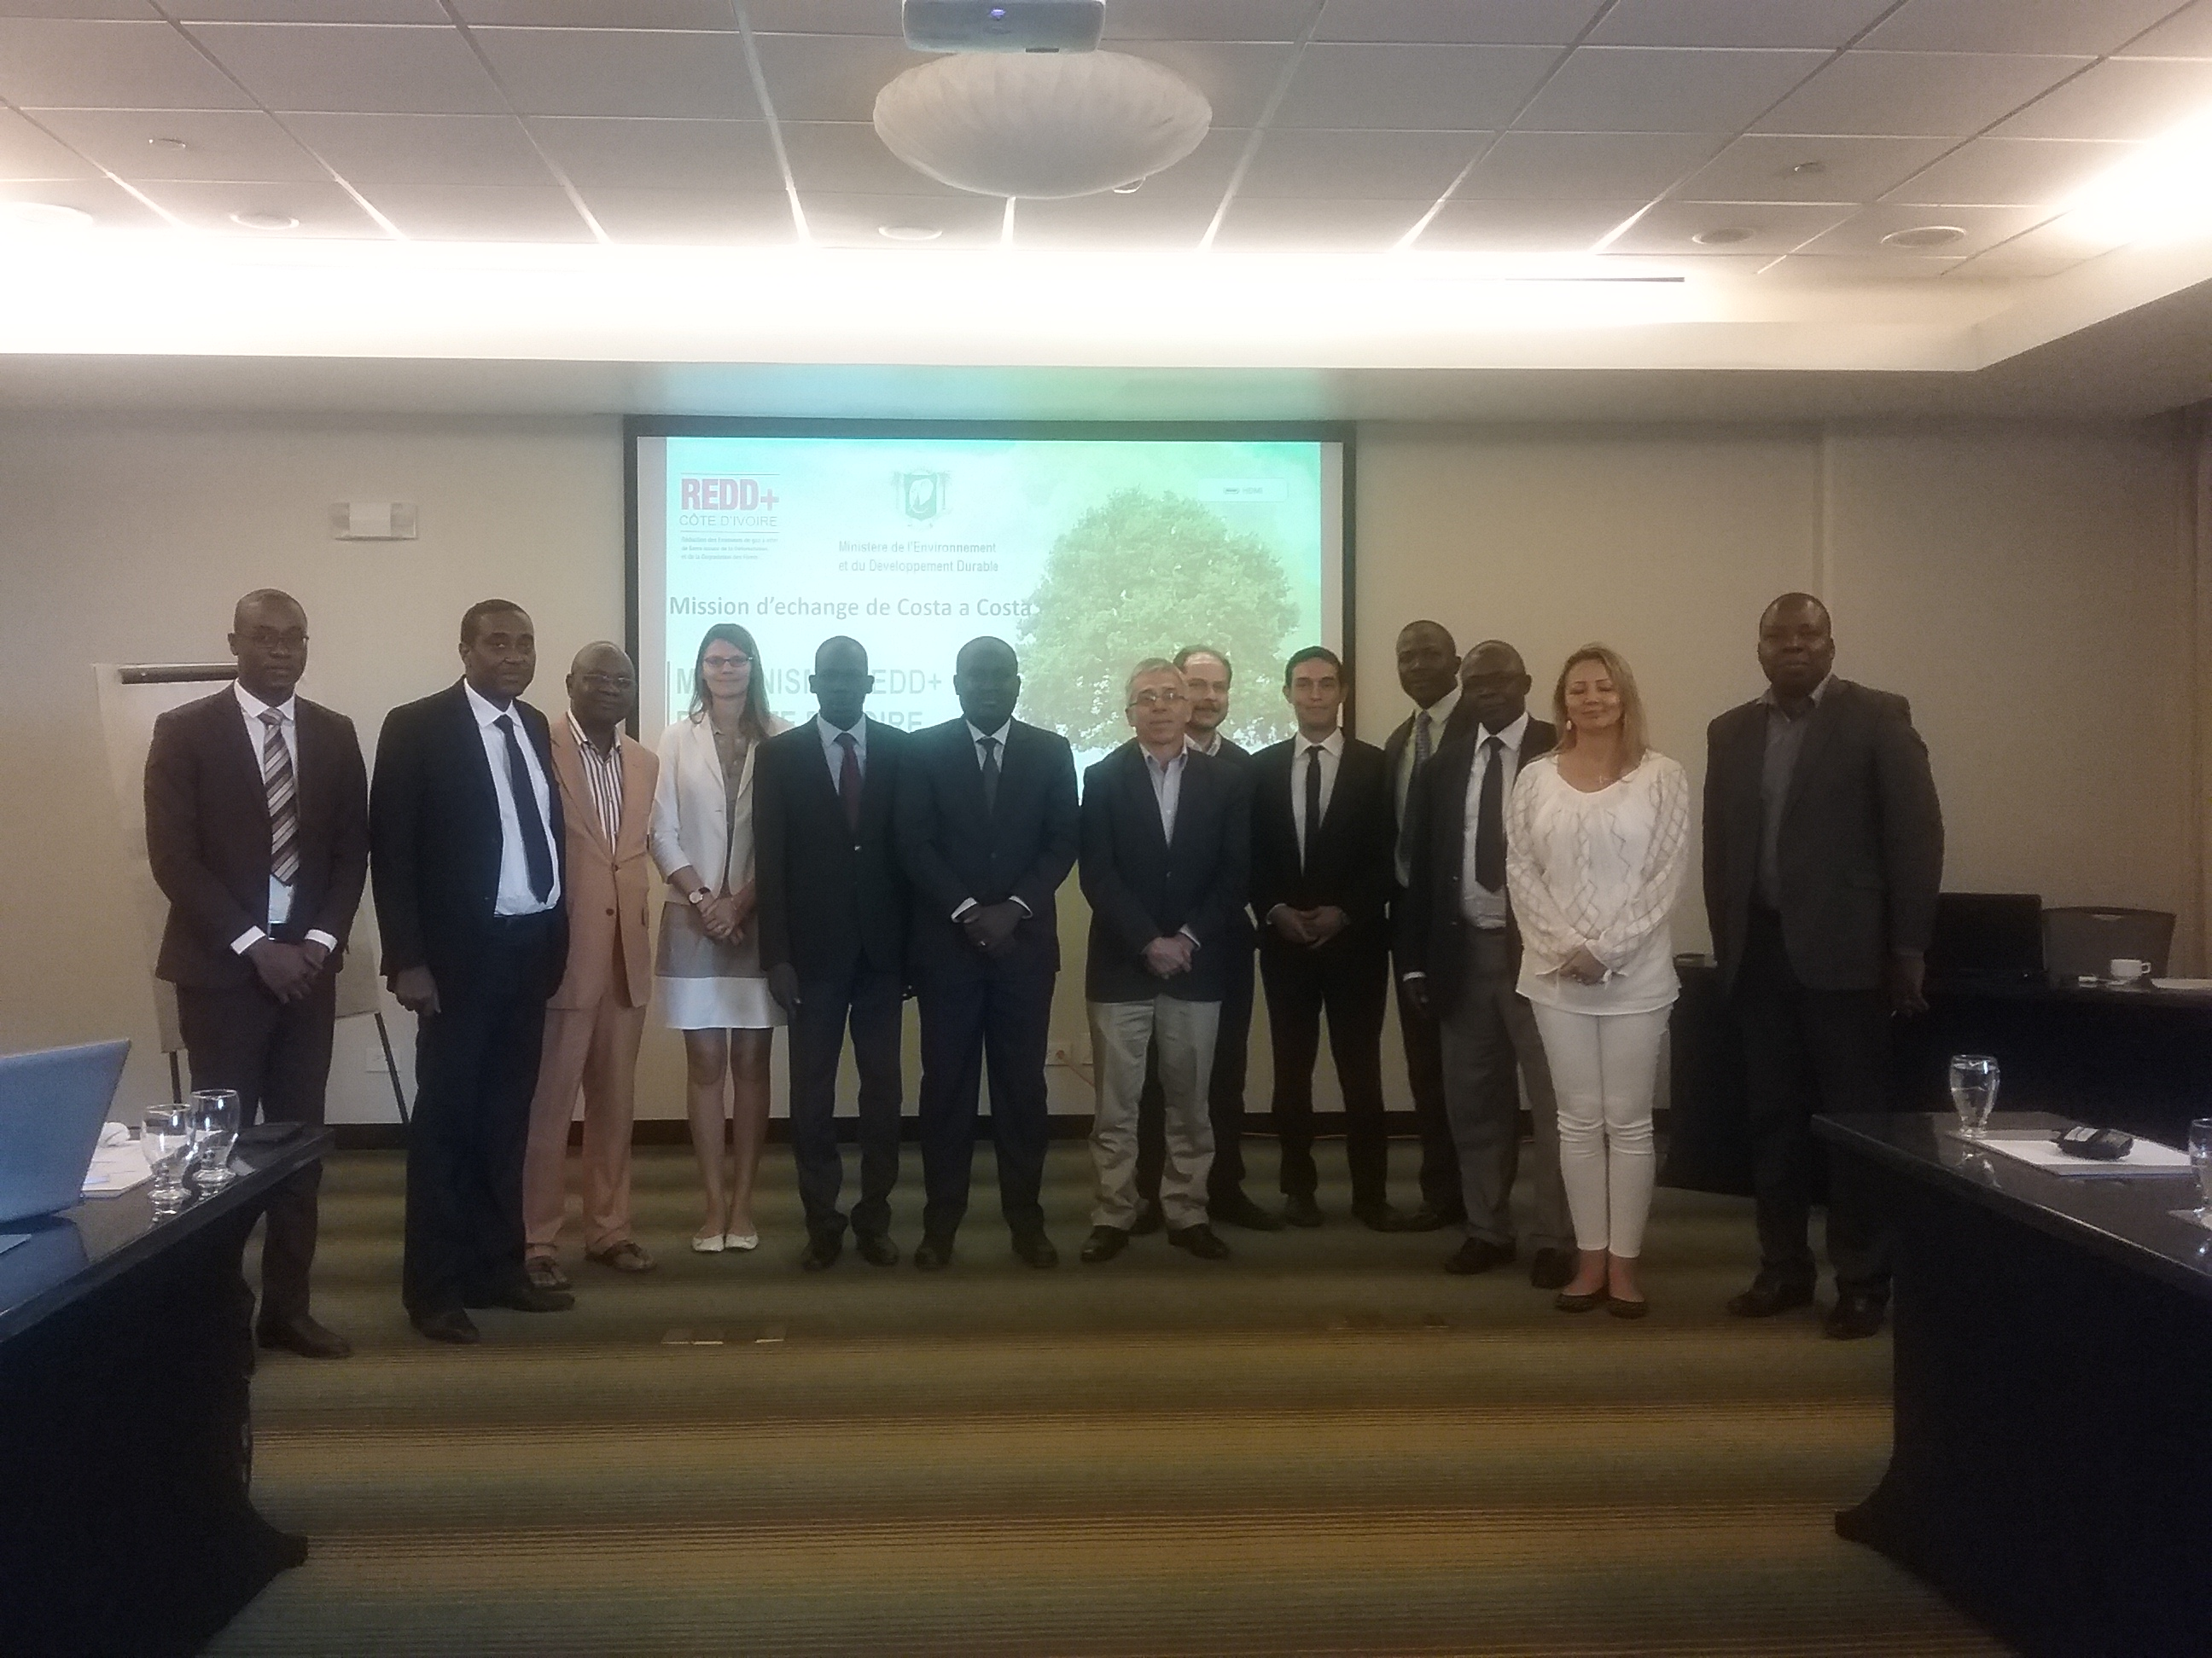
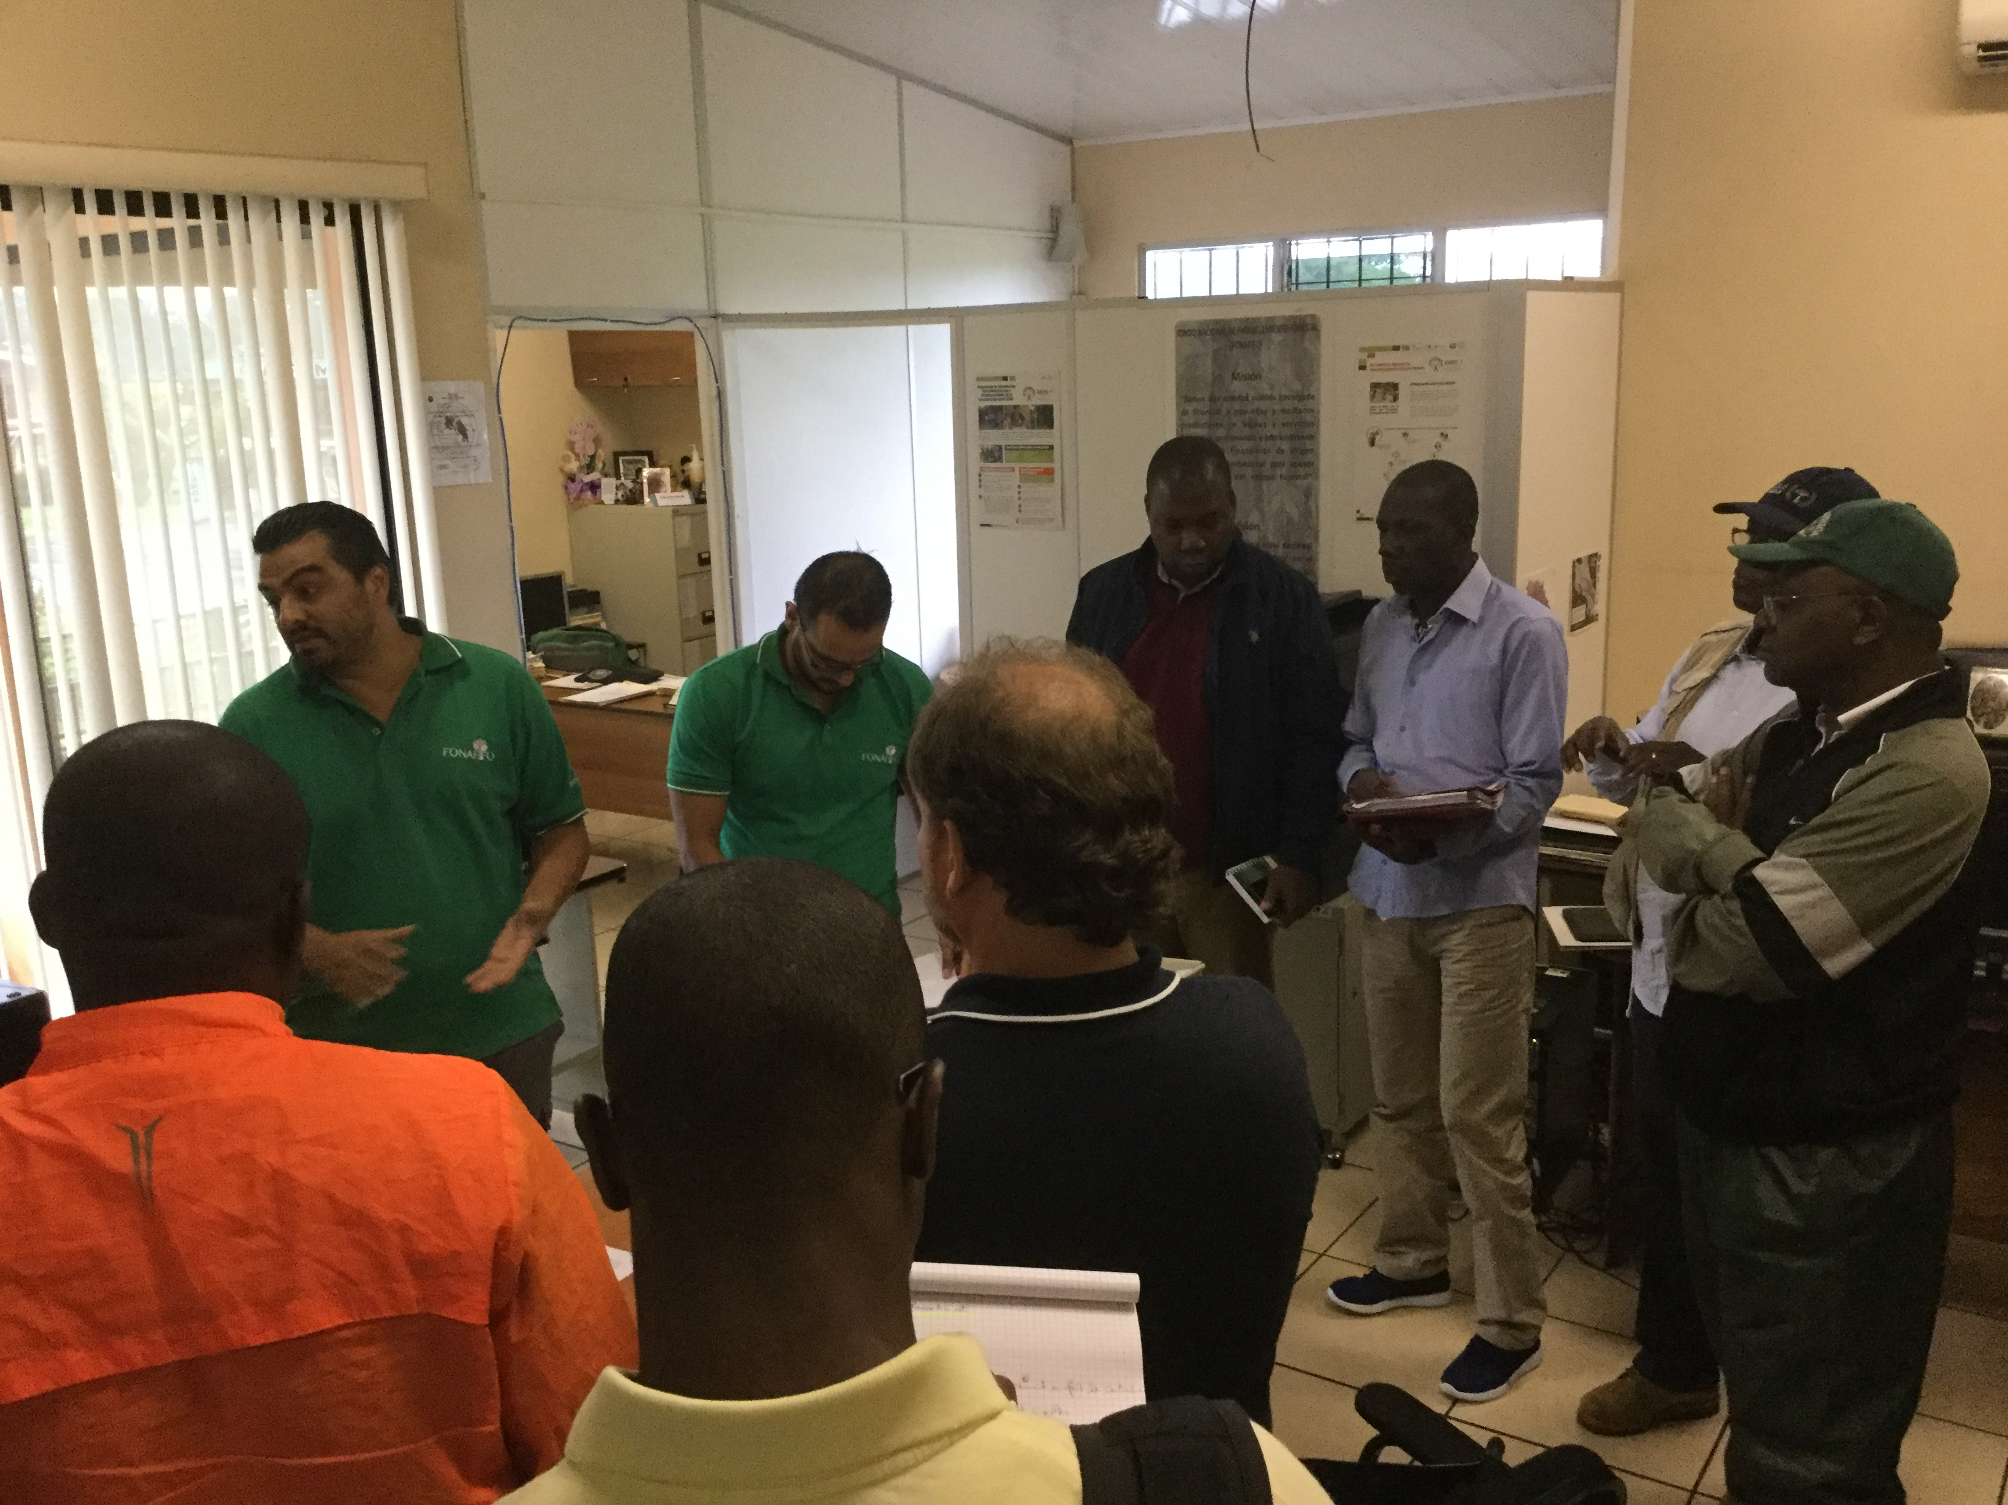
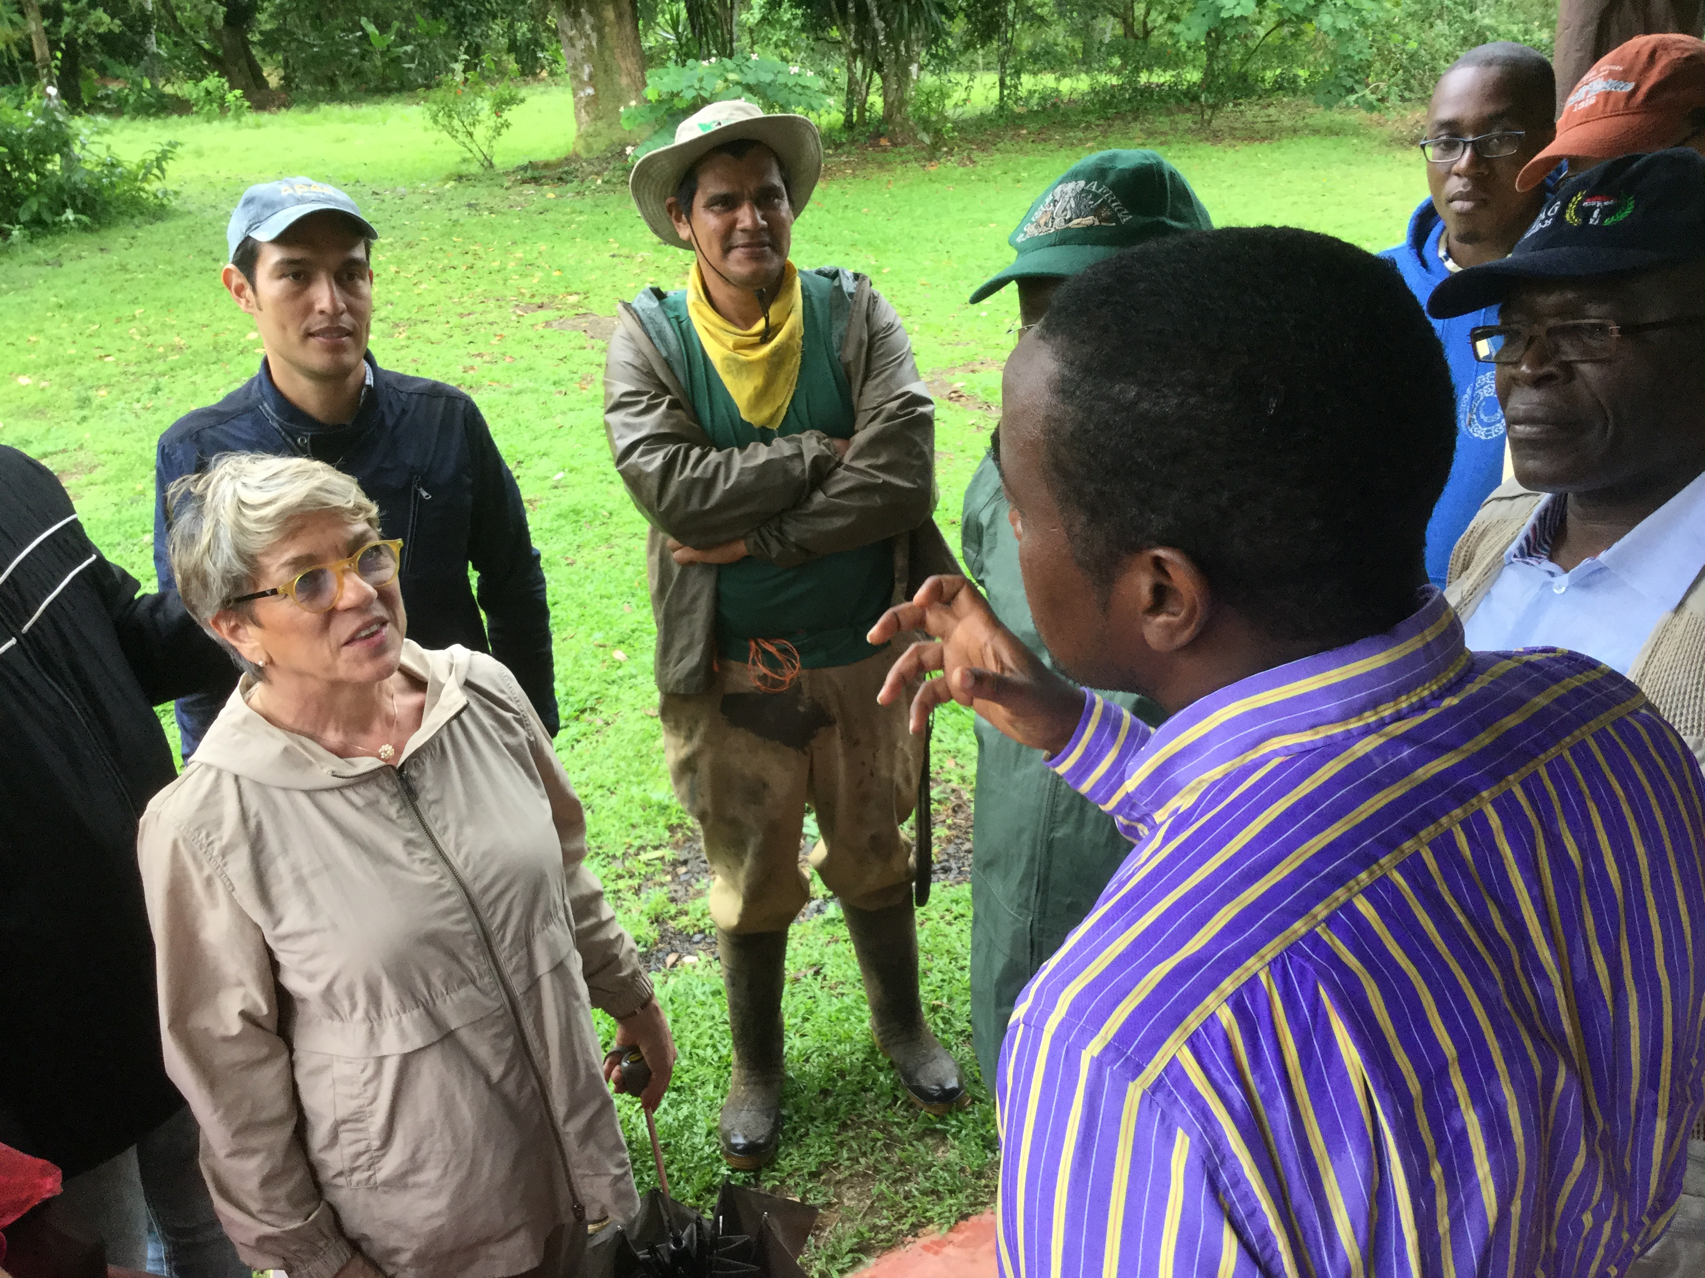
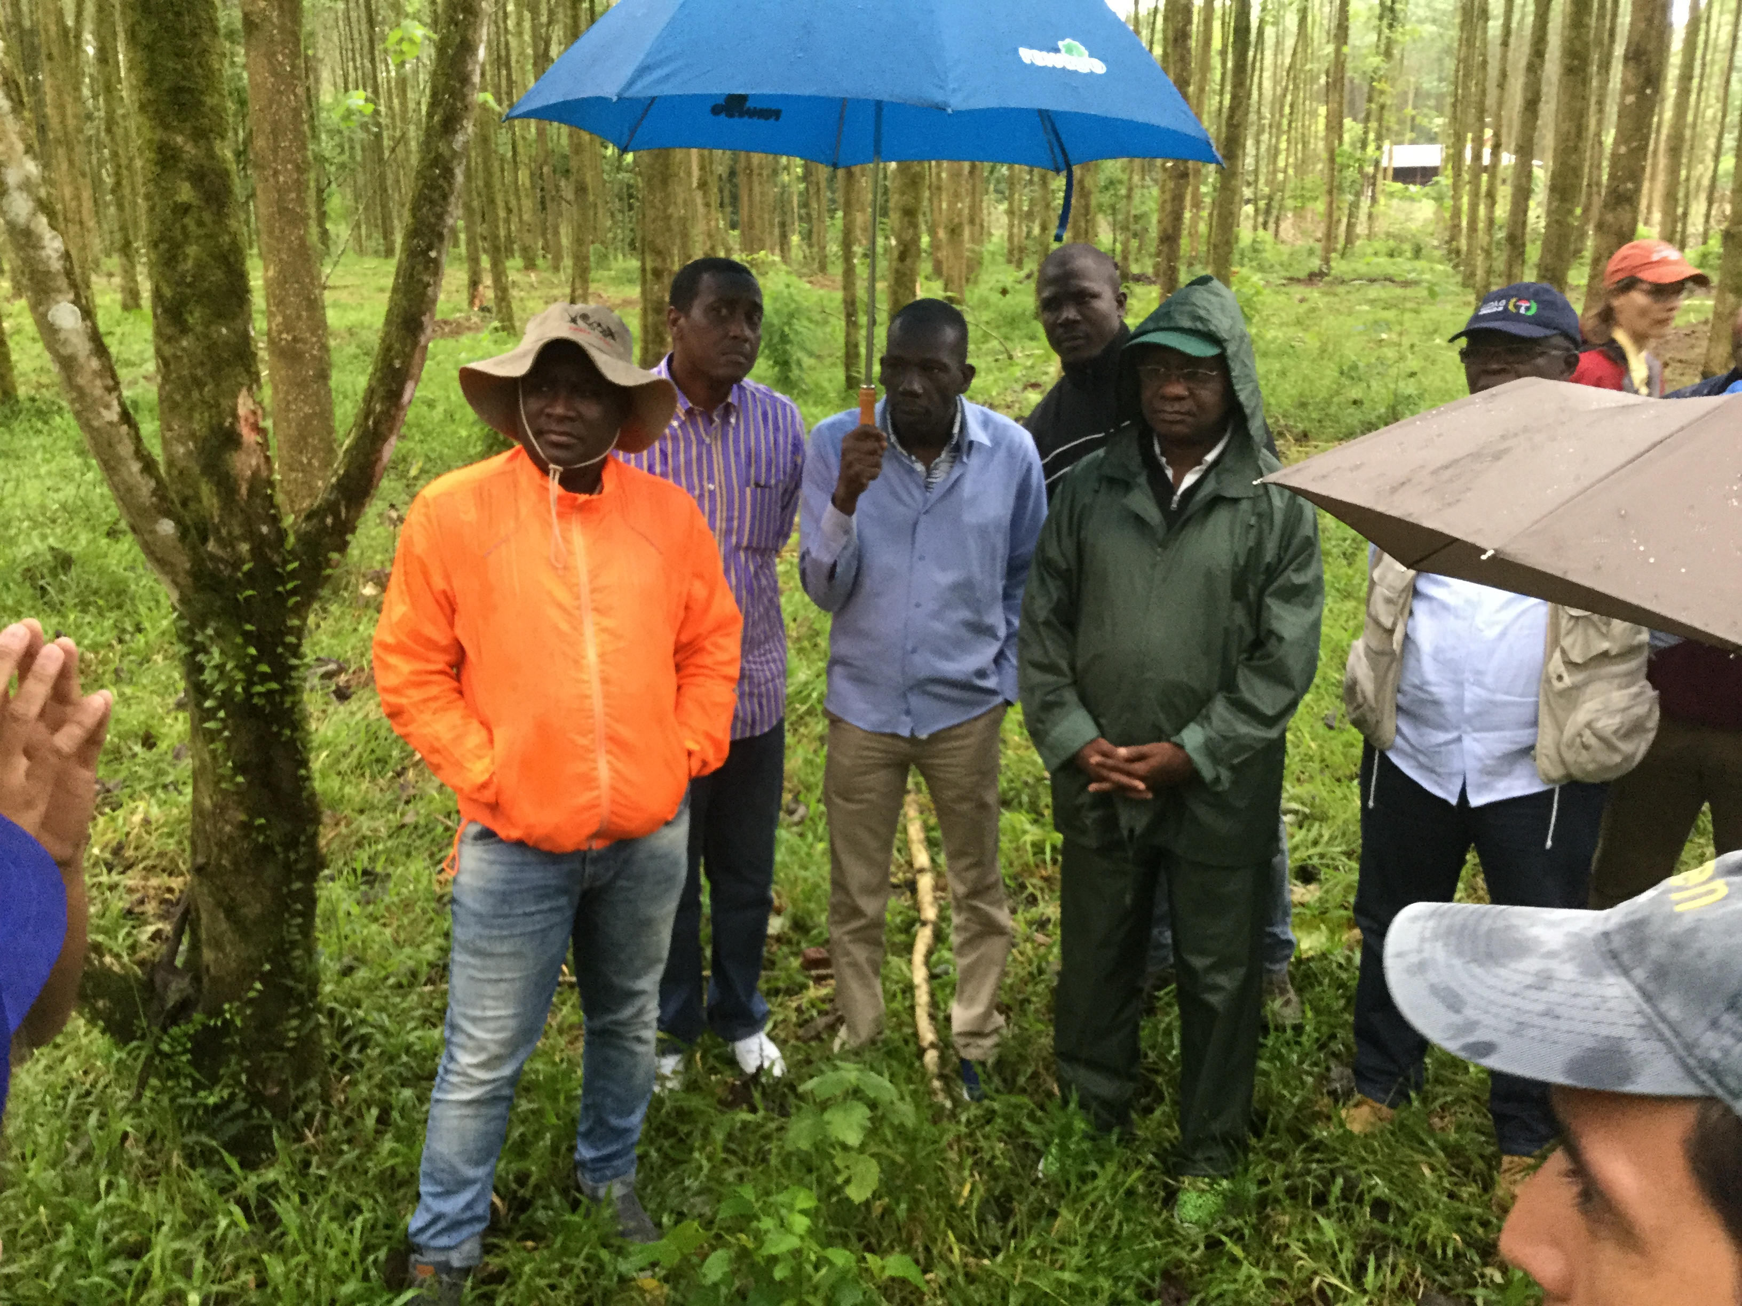
South-South Exchanges in the Context of South-South Cooperation

Slide 4
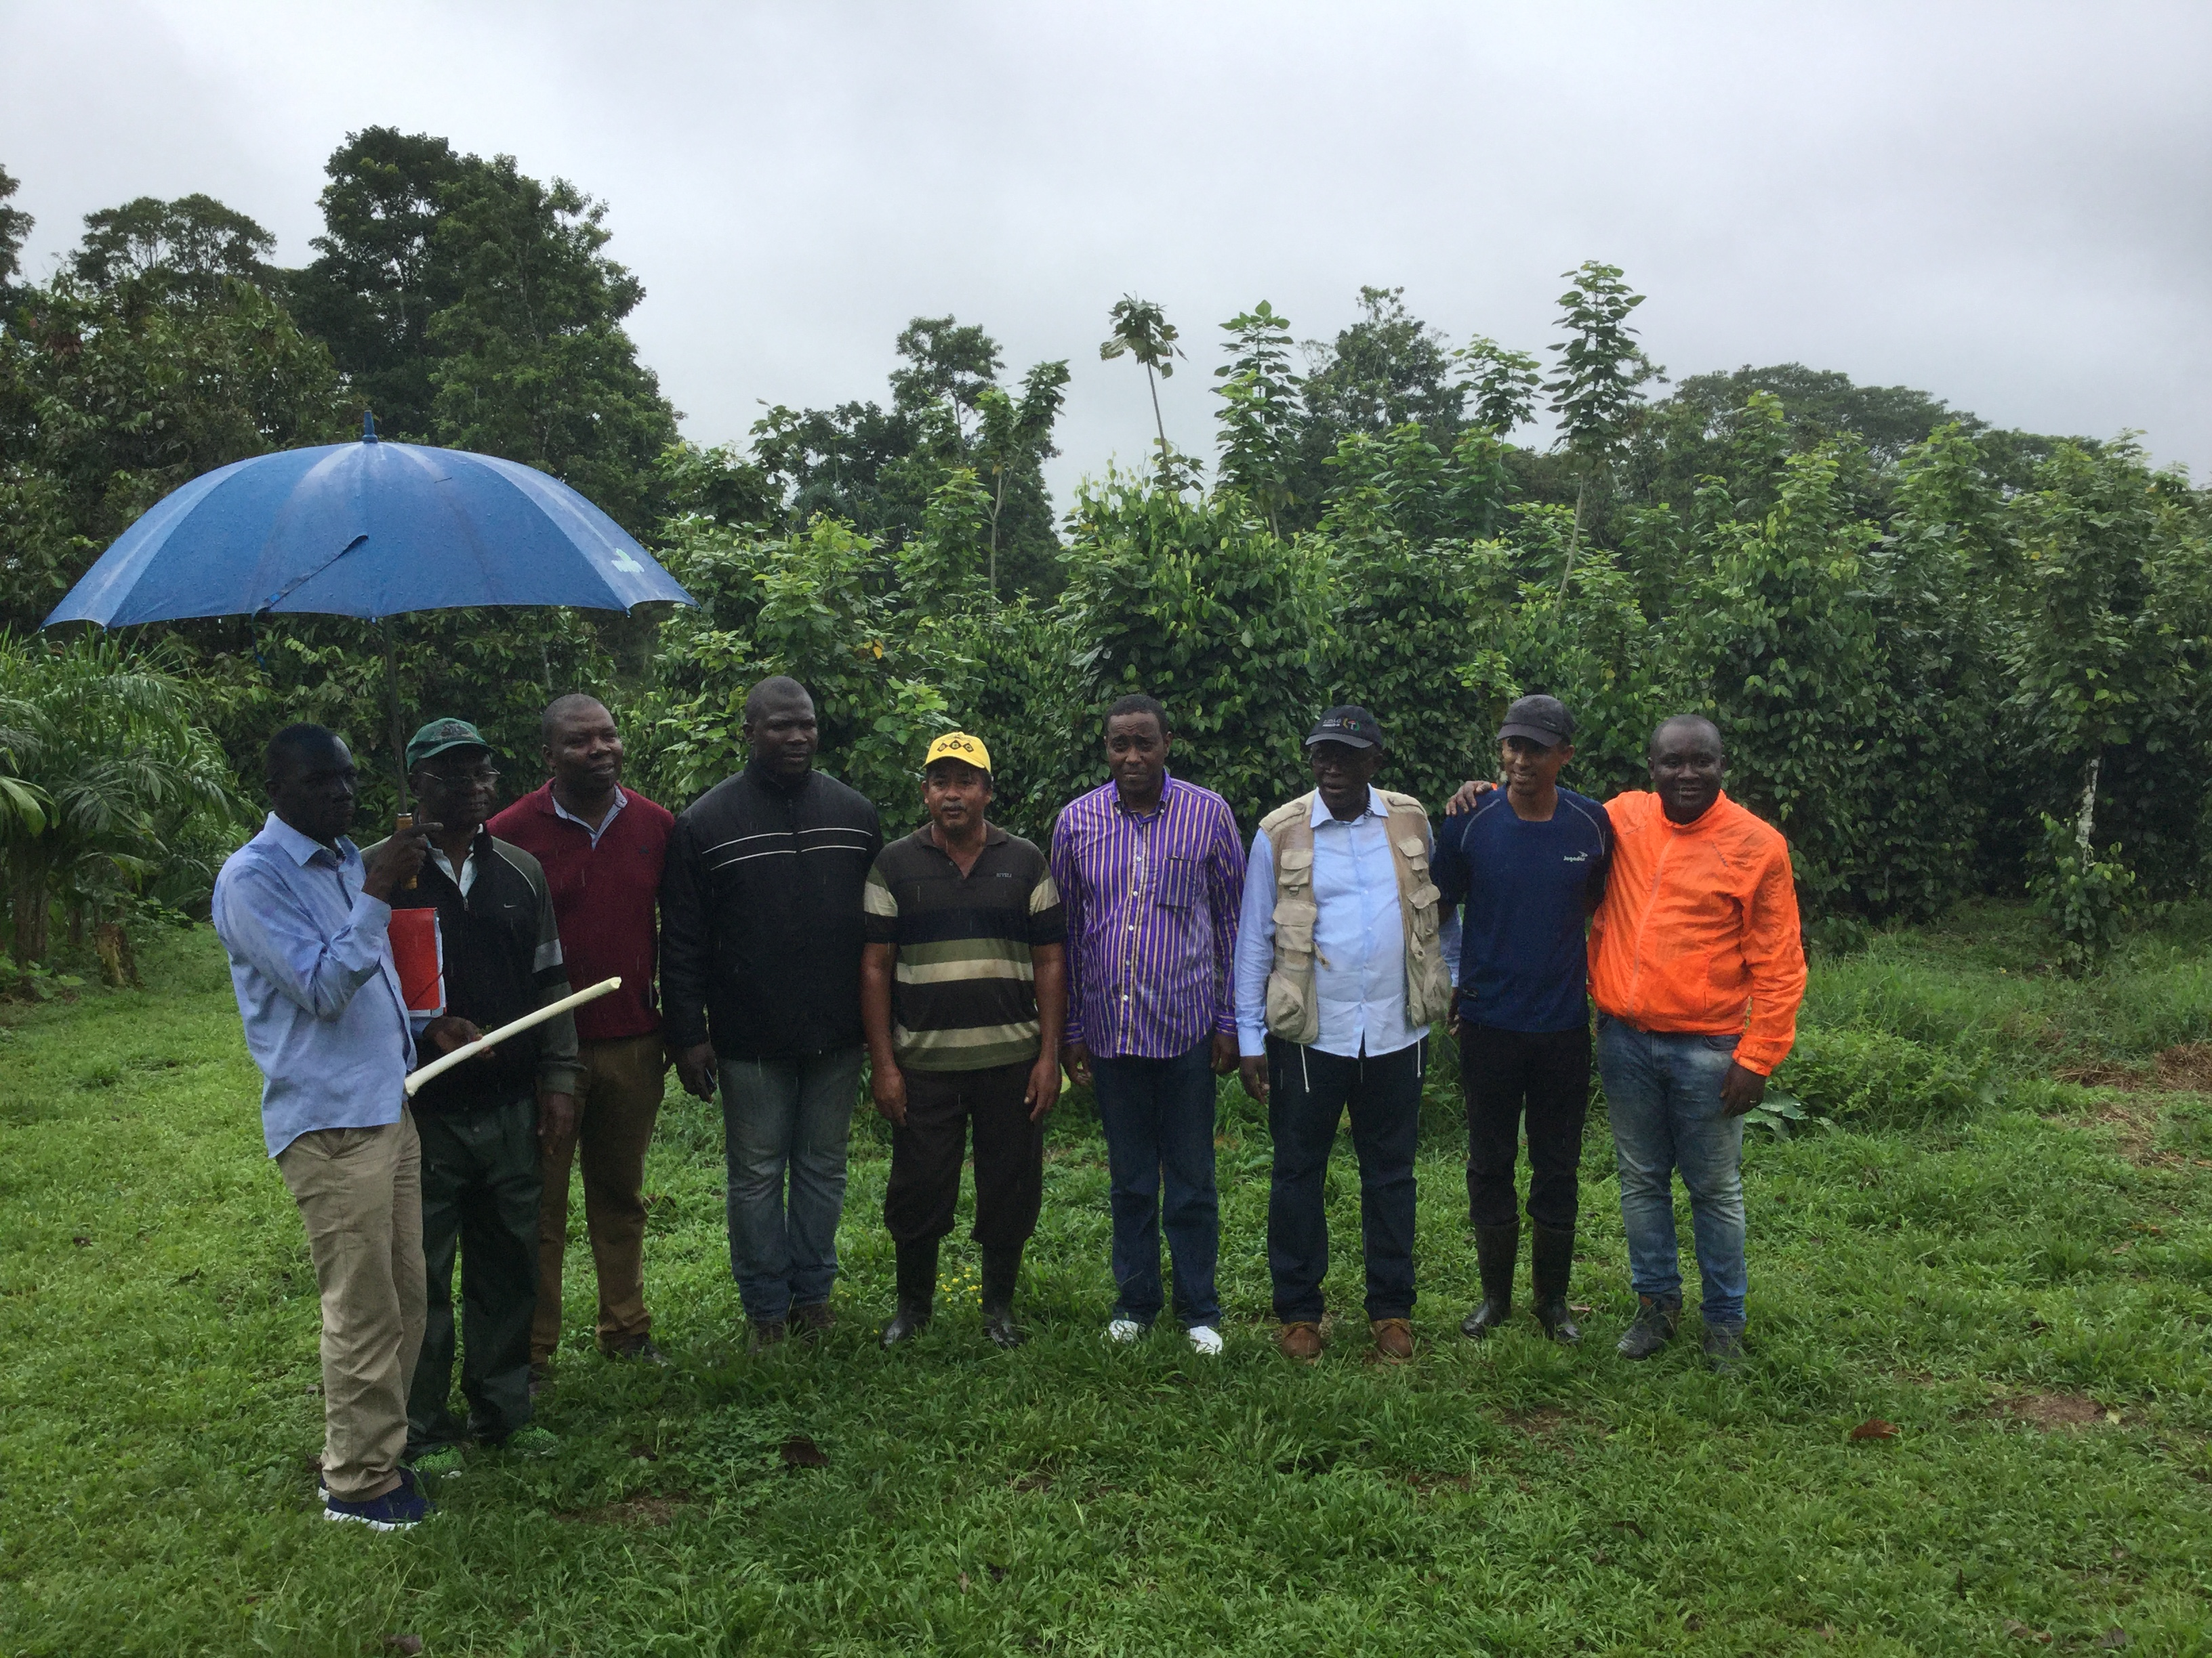
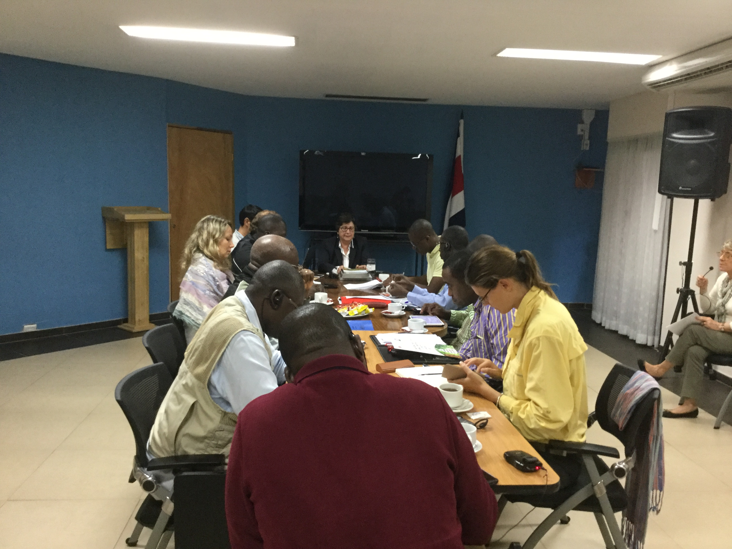
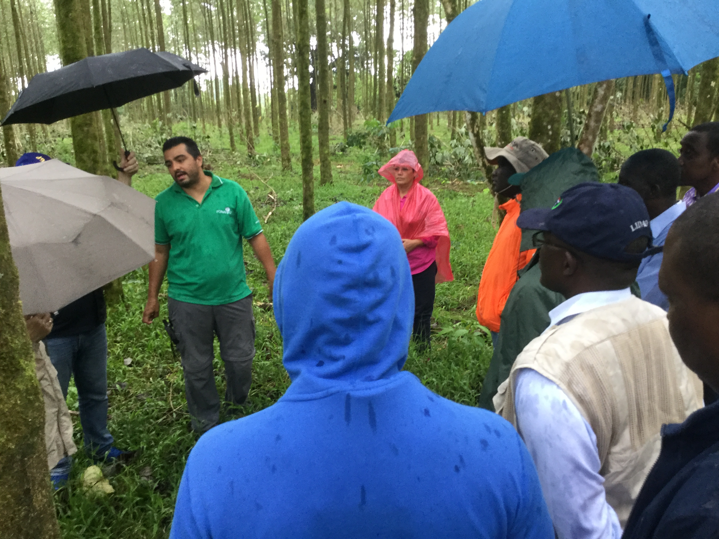
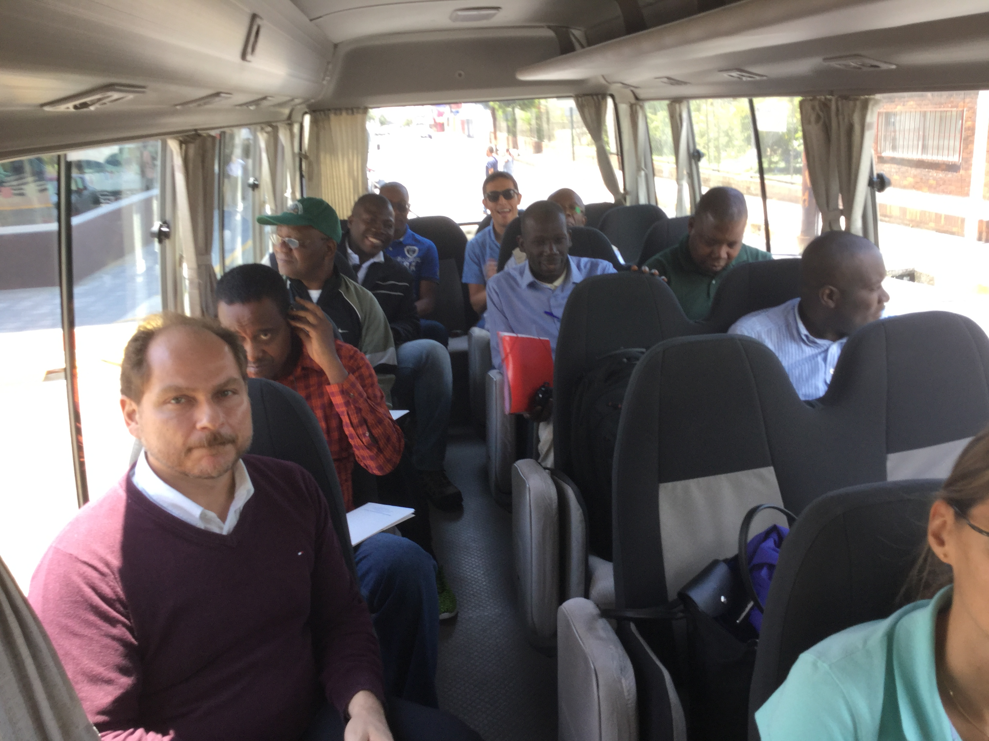
South-South Exchanges in the Context of South-South Cooperation

Slide 5
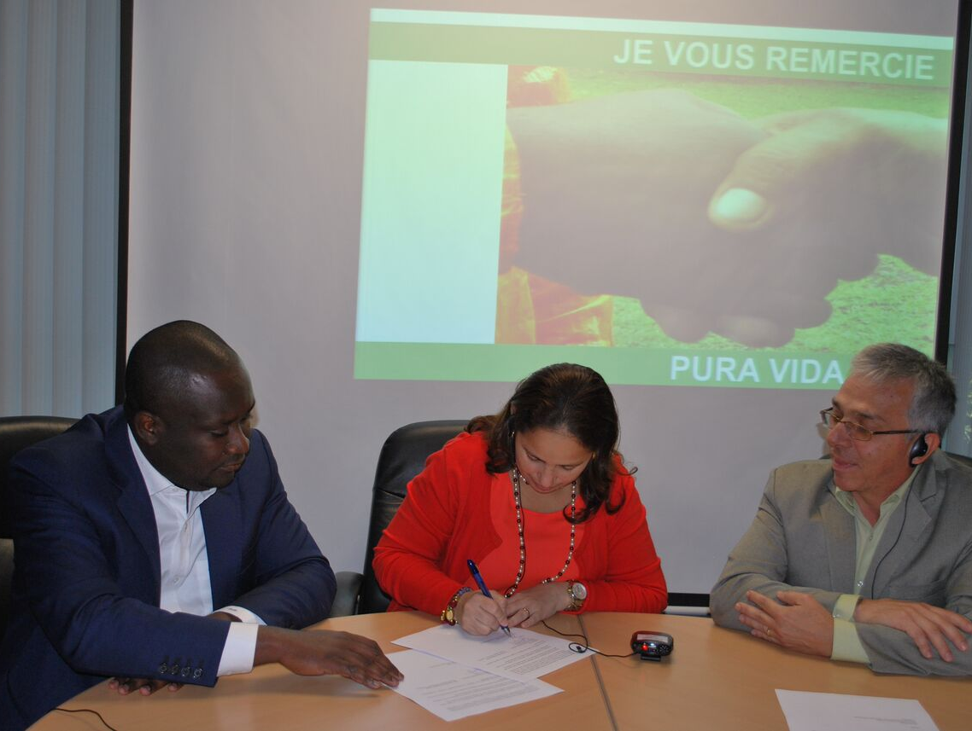
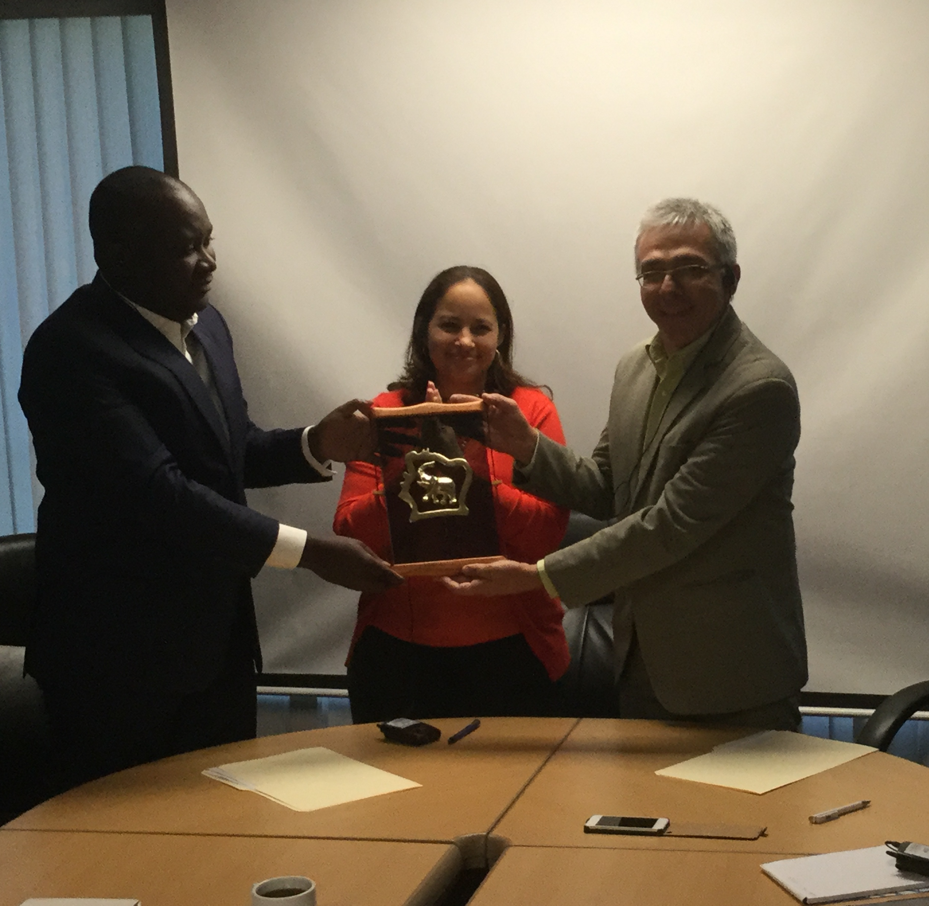
Initial Partnership Established between Cote D’Ivoire and Costa Rica in 2016
Letter of Intent signed outlining key areas of engagement aimed at being expanded upon in an MOU signed at an international conference
At COP 22 in Marrakech an MOU has been signed between Minister of Environment and Sustainable Development of Cote D’Ivoire and Minister of Environment and Energy of Costa Rica
It was an engagement of further cooperation on clear identified areas defined by Letter of Intent

Slide 6
Programme for the Operationalization of MOU
Cote D’Ivoire REDD+ Strategy successfully implemented through technical cooperation, training, research and technology transfer from partner countries
There is an impressive experience in forest development, in forest conservation and expansion from Costa Rica. Bilateral cooperation aimed at improving the implementation process of the forestry targets included in the National REDD+ Strategy-
Build Capacity for International Cooperation in the Forestry Sector
Implement on a larger scale policy dialogue, knowledge exchange, piloting at scale through crossed immersion of experts from one country to another or learning visits on priority themes

Slide 7
Programme for the Operationalization of MOU
Design a workable results-based finance systems and payments systems for emissions reduction under the National REDD+ Strategy- capacities for financial management to access and manage results based finance- to attract funding to engage into investment phase
Support efforts in the building of Cote d’Ivoire PES system to conserve and regenerate ecosystem in Cote d’Ivoire- National PES System supported by a National REDD+ Fund
Coordinate negotiation of public-private partnerships and agreements with international corporations involved in commodities supply chain- investor roundtables to jointly identify investment opportunities and possible partner countries to participate in further discussions.

Slide 8
Programme for the Operationalization of MOU
Increased technical capacities through conducting national and regional knowledge sharing workshops
Promote evidence-based learning through the development of joint knowledge products
Promote Knowledge solutions and establish a jointly managed knowledge-sharing platform to impart good development practices to encourage and facilitate the effective and simple exchange of best practices, skills, knowledge transfer
BUDGET: $350,000

