Slide 1
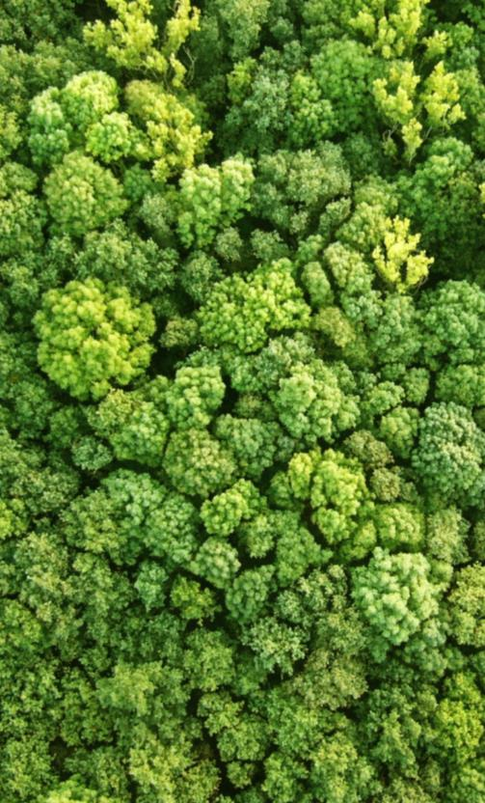
Stock-taking on lessons learned in the Africa knowledge exchange and next steps
Mihaela Secrieru
21 September 2017 | Nairobi

Slide 2
Part 1: Setting the scene: readiness stock-taking
General progress across first 3 pillars
Opportunities
Warsaw pillars need to be interlinked and coherent!
All countries completed NS/APs through multi-stakeholder participatory process, providing the framework for REDD+
NS/APs as basis for dev/implementation of investment plans
Learning from others => detailed NS/APs and costed PAMs
Most countries have started developing NFMS and submitted FRELs
Not only forests! DD outside of forest sector (mostly agriculture). So anchor issues of deforestation within CC & Ag. strategies.
Choose forest definition carefully considering existing definitions (CDM, project, etc.) for different purposes
Looking towards the private sector for funding of REDD+ activities
Notes:
While general progress across first 3 pillars, some challenges for Safeguards:
NS/APs developed
Most countries have also started developing their NFMSs, and several submitted their FRELs to the UNFCCC.
However, as most countries had to wait until the identification of PAMs, the development of SIS have lagged a little behind.
Opportunity: Anchor issues of deforestation within two main strategies: CC strategy & agriculture strategy : Similar comments from Kenya, Ethiopia, DRC, Uganda

Slide 3
Part 1: Setting the scene: readiness stock-taking
General progress across first 3 pillars
2. Challenges
Coordination of multiple sectors & key role of gov.
Mitigation potential of REDD+ activity may be high but not always possible to MRV with available data
Level of implementation not always well reflected in national data
Challenges of implementing REDD+ at scales w/n a federal state
Land use management issue, esp. for planning around mining activities
Notes:
Challenge 2: Mitigation potential of REDD+ activity may be high but not always possible to MRV with available data
-> eg Uganda has biomass inventories since as far back as 1980s, however these were not always in line with IPCC principles and it is challenging for the country to take advantage of the existing data for the specific REDD+ purpose
Challenge 3: Level of implementation not always well reflected in national level data – E.g. Uganda wants to recognize efforts by small landholders but the level of detail is not reflected in national data (scale issue, how to balance capturing action and cost-effective MRV)
Challenge 4: Nigeria

Slide 4
Part 1: Setting the scene: readiness stock-taking
General progress across first 3 pillars
3. Lessons
Importance of securing political will at highest levels
Integrating of REDD+ into national dev plans and policies
Managing community expectations of REDD+ crucial
Implementation phase has to consider short-term needs at local level
Many PAMs targeted to community management of natural resources
Benefit sharing is difficult area but needs to be addressed taking into account social and economic issues and the PLR framework within the REDD+ context
Involvement of communities in FLR development => country ownership
Importance of costing the entire investment plan
Notes:
Lesson on Involvement of communities in FLR development => country ownership: Nigeria on Involvement of communities in FLR development
Lesson on Importance of costing the entire investment plan: Uganda

Slide 5
Part 1: Setting the scene: readiness stock-taking
(iv) Safeguards Information System (SIS)
Opportunities
Assessing benefits/risks of PAMs can inform SIS structure
Pioneering subnational efforts can inform national SIS
NFMS / PaMs monitoring: informational/institutional synergies
Challenges
Designing a SIS before clarity on PAMs
Parallel processes: NS/AP and investment plans; SIS
Linking NFMS, PAMs monitoring and SIS (e.g. Institutional arrangements for SIS development given SIS/MRV linkages but different government entities handling them)
Lessons
Need to invest in capacity before/during process
SIS ≠ web interface (…more to it than that…)
Need to cost SIS operations in plans (cost are not high)
Notes:
Challenge related to linking NFMS, PAMs monitoring and SIS (e.g. Institutional arrangements for SIS development given SIS/MRV linkages but different government entities handling them): Ethiopia

Slide 6
Part 2: Transitioning from readiness to implementation
(i) Investment Planning
Opportunities
Build on substantive participatory work for NS/AP as basis for investment planning
Tap into all funding windows REDD+ implementation (GCF, Biocarbon Fund, bilateral sources)
Respond to cross sectoral drivers so to enable long-standing issues around land ownership & transformative change
Challenges
Funding and capacity to develop investment plans and access resources
GCF increasingly difficult requirements and hurdles to access funding
Progress with finalizing the four pillars – and funding for readiness
Securing political and strategic buy in at the highest political level
Lessons
Integrate REDD+ into national policy and planning processes => overarching investment plans
Enable capacity and resources for land use planning as a primary tool to address drivers and achieve objectives
Notes:
Ethiopia: development of an overall Climate Resilient Green Economy Strategy and creation of accompanying Facility to fund this.
Zambia brought many Partners together to build a REDD+ Investment plan which can be presented to many potential donors. It went through a stakeholder engagement process to review the core investment priorities in light of potential risks and benefits.

Slide 7
Part 2: Transitioning from readiness to implementation
(ii) Access to REDD+ Finance
Opportunities
Upcoming RBPs window not only option under the GCF
GCF funding for Phase 2 (investment/implementation): for mid-forest cover countries/ less competitive ER potential
Pilot project experience crucial for positioning in terms of planning, but also acceding to REDD+ finance
Challenges
Cross-sectoral coordination for implementation
Predictability of finance & Managing expectations (communities, gov. and partners)
Investments needed from onset to compensate local communities for not deforesting
Balancing advantages of being a pioneer in finalizing UNFCCC assessment and analysis processes for REDD+ results vs. Ensuring full stakeholder involvement and in-country capacity development
Lessons
Management of expectations to access REDD+ finance
Planning financing schemes to start with local priorities
Build cohesive voice before donors and the GCF by strengthening REDD+ community of practice
Anticipate needs, not wait for each phase to be completed
Notes:
• The upcoming RBPs window is not the only option under the GCF, African countries should make use of all windows: Readiness, Project Preparation Facility (PPF), Concept note review, fully fledged proposals. There will be other RBPs pilots under the GCF.
• GCF funding for Phase 2 (investment/implementation) is particularly relevant for countries with mid-forest cover that are less competitive in terms of emission reduction potential. African countries with this type of forest cover should lobby for a cap in this space. Predictability of GCF funds for Phase 2 in African countries should be discussed.
• Pilot project experience is crucial for positioning in terms of planning, but also acceding to REDD+ finance

Slide 8
Part 2: Transitioning from readiness to implementation
(iii) SIS: design, operation and application
Challenges
Estimating SIS operational costs (ex ante)
Engaging, capacitating and sustaining institutional arrangements
Different requirements of different donors/investors
Opportunities
Pioneering subnational efforts can inform national SIS
Iterative approach - opportunities for continual improvements
As a region we know how to design a SIS (but need FA/TA)
Lessons
Need more South-South exchange on safeguards/SIS
Multi-stakeholder working group is essential to guide process
Need to analyse safeguards requirements of different donors

Slide 9
Part 2: Transitioning from readiness to implementation
(iv) Reconciling REDD+ monitoring at scale
Opportunities
Benefit sharing is key opportunity moving forward
Ethiopia: simple solution to issue of leakage: others to emulate?
Importance of unified approach to managing sub-national and project level programs with regards to the establishing FRELs and/or baselines
Challenges
Developing higher-level guidelines for reconciling REDD+ monitoring
Leakage: need to develop set of guidelines?
Integrating cook stove (CDM) projects into the REDD+ process
Implementation of unified accounting systems by federated states
Lessons
Need for centralized registry to manage credit generation and trading within a country
National scale FRELs to be informed by sub-national implementation of FRELs
Notes:
Opportunities:
No real consensus on the best implementation of a benefit sharing scheme, but still seen as a opportunity for future work
Ethiopia : simple solution to the issue of leakage
Côte d’Ivoire/Madagascar: approach to managing sub-national and project level programs with regards to the establishing FRELs and or baselines. But also difficulties associated with the unified guidelines .
Challenges:
OK Gov’s to take the lead with regards to implementing guidelines, but need more (UN-REDD) support to develop higher-level guidelines for reconciling REDD+ monitoring.
Leakage: examples from Mada and Ethiopia

Slide 10
Part 2: Transitioning from readiness to implementation
(v) From reference levels to results reporting
Opportunities
Countries that are developing their FREL/FRLs now can take into account the scorecards which are being negotiated at the GCF to ensure their FREL/FRL lives up to donor expectations and will be eligible for RBPs
Difference between FCPF and UNFCCC vs. VCS review process
Linking FREL & PAMs especially with regards to reporting results
Challenges
Finding balance between forest definition that is operational/practical in terms of MRV and also represents forest conditions in the country
Accurately capturing all performance under REDD+ with sufficiently robust data in the FRL
Assessing emissions from fire distinguishing b/w fire resulting in deforestation and fire resulting in forest degradation while recognizing fire to be an endemic feature in some forest types
Lessons
Countries should be realistic in what they put forward in their FRELs as monitoring component may become debilitating with regards to costs
Notes:
Opportunities:
No real consensus on the best implementation of a benefit sharing scheme, but still seen as a opportunity for future work
Ethiopia : simple solution to the issue of leakage
Côte d’Ivoire/Madagascar: approach to managing sub-national and project level programs with regards to the establishing FRELs and or baselines. But also difficulties associated with the unified guidelines .
Challenges:
OK Gov’s to take the lead with regards to implementing guidelines, but need more (UN-REDD) support to develop higher-level guidelines for reconciling REDD+ monitoring.
Leakage: examples from Mada and Ethiopia

Slide 11
Reflections and Next steps
Post-event reflections
Ideas on technical areas/issues on which UN-REDD can support moving forward, including through South-South exchanges
Knowledge management: Explore options for a UN-REDD online community of practice (or moderated mailing list) to allow continuous and fruitful knowledge sharing among African countries
Notes:
Share new reflections you haven’t thought of before the event. New linkages, issues, ideas?
Areas of UN-REDD Global Programme on which you need more support: technical support, knowledge mngm, etc.

Slide 12
Thank you!
Mihaela Secrieru | Mihaela.Secrieru@unep.org
Connect with us online:
www.un-redd.org
www.unredd.net

