Slide 1
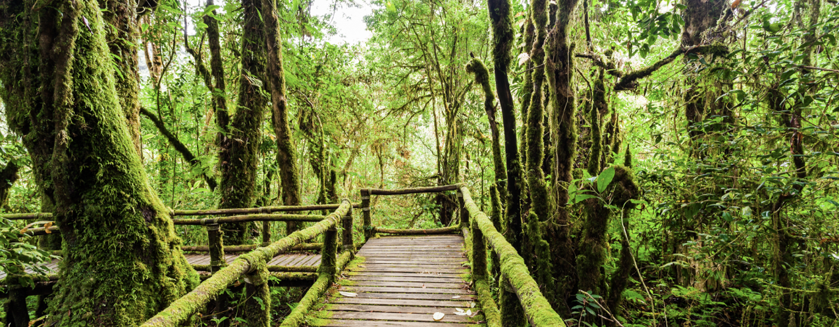
Safeguard Information Systems (SIS)
Key design considerations
Ugo Ribet
Policy and Legal Advisor
Regional South-South Learning Event (Asia)
Hanoi, 26-27 of October 2017

Slide 2
Safeguard Information System (SIS)
Key design considerations
Presentation outline
International SIS requirements
Key considerations for designing a SIS
Country presentations and group activity

Slide 3
UNFCCC REDD+ safeguards requirements
Implement REDD+ activities in a manner consistent with the Cancun safeguards
Develop a Safeguard Information System (SIS)
Provide the most recent summary of information
1
2
3
Yesterday
Today session 1
Today session 2

Slide 4
Requirement 2:
Develop a system for providing information on safeguards
Developing countries are required to develop a ‘system for providing information on how [all] the safeguards … are being addressed and respected throughout the implementation of [REDD+] (Decision 1/CP.16, para 71(d))
The SIS should be in place for accessing results-based payments (Decision 9/CP.19, para 3)
Guidance from UNFCCC for the SIS:
Provide transparent and consistent information … accessible to … stakeholders and regularly updated
Flexibility to allow improvements over time
Be country-driven and for the national level
Build upon existing systems, as appropriate
2

Slide 5
The initial challenge with designing a SIS is…
Little guidance from the UNFCCC
Different safeguard requirements of different donors/investors
No blueprint for designing a SIS

Slide 6
General considerations
SIS design and operation will be different in each country due to different national circumstances
The SIS should be regarded as country-driven and country-tailored
Iterative and learning-by-doing process with a step-wise approach allowing for improvements
Developing a SIS may not require an entirely new system or entirely new components to be established
A SIS is more than a web interface
A SIS provides a strong basis for developing summaries of safeguards information.
SIS design will be influenced by a country’s REDD+, and safeguards approach

Slide 7
Important SIS design considerations
While SIS design features will be country-specific, the experiences thus far of REDD+ countries indicate key design considerations:
1. Defining the objectives and scope of the SIS
2. Determining the SIS information needs
3. Assessing existing information systems and sources
4. Determining the institutional arrangements of the SIS
Why is the SIS being designed?
What type of information should the SIS gather/provide?
Where will this information be drawn from?
Who will collect, analyse and disseminate this information and how?

Slide 8
1. Defining the objectives and scope of the SIS
The objective of a SIS, from a UNFCCC requirement perspective is to provide information that is accessible by all relevant stakeholders to demonstrate how the seven Cancun safeguards are being addressed and respected throughout REDD+ implementation
The objectives the SIS could therefore be to meet the UNFCCC requirements (demonstrate how the Cancun safeguards are being addressed and respected), as well as any other donor reporting requirements (such as FCPF)
The scope of the SIS depends on the scope of safeguards application (i.e. if the safeguards apply strictly to REDD+, to Forest sector activities as a whole, or even across multiple sectors)
The objective and scope of the SIS could be defined in a preliminary manner when crafting a SIS ToR or planning document

Slide 9
2. Determining the safeguard information needs
The UNFCCC does not offer guidance as to what type of information should be gathered and provided by SIS. The process of identifying ‘what type’ of information is needed to demonstrate how the Cancun safeguards are being addressed and respected is usually referred to as the identification of the ‘ SIS’ information needs’.
Serves as an essential input to be able to 'assess' to what extent existing information systems and sources can be used to provide information on the application of the country-specific safeguards
A first step towards developing reporting templates for the various REDD+ PaMs/Interventions to be completed by the different systems/sources
To determine information needs, countries can rely on:
National interpretation/ clarification of REDD+ safeguards;
Assessment of the country’s governance framework that is used to address and respect the safeguards;
Understanding the potential benefits and risks of REDD+ actions in the country
Notes:
The SIS is expected to provide information on how the Cancun safeguards are being addressed and respected. However, the UNFCCC does not offer guidance as to what ‘type of information’ needs to be provided to demonstrate how the Cancun safeguards are being addressed and respected.The process to identify these types of information is usually referred to as the identi cation of the ‘ SIS’ information needs’.
It is important to note that many countries have highlighted that it is very challenging to determine the SIS’s information needs without any clarity and considerations of the PaMs. As such, preliminarily identified SIS information needs and structures are likely to be revised as the detailed PaMs for REDD+ are elaborated.
These information needs can then be mapped against information collected and reported by existing information sources and systems, to determine which environmental and social information is already available for reporting on safeguards. Information gaps can then be identified, and ways to fill them
can be discussed and developed. This may include the possibility of collecting information from local stakeholders, as desired and appropriate.

Slide 10
3. Assessing existing information systems
According to UNFCCC guidelines, countries should to the extent possible, build upon 'existing systems' that are deemed relevant for providing information on the REDD+ safeguards.
Countries usually have a range of information systems and reporting mechanisms which can be built upon to provide information on how the Cancun safeguards have been addressed and respected
In order to be able to articulate the SIS it is necessary to inventory and assess these systems. This includes two elements:
Existing domestic information systems that gather information that is relevant to the safeguards; and
Existing reporting mechanisms under international conventions and agreements applicable to the country

Slide 11
4. Determine the Institutional arrangements for the SIS
Determining the institutional arrangements for the SIS means determining who will carry out the various functions of the SIS and how, such as:
Who will collect relevant information from new and existing information systems and sources.
How will this information be collected? Specific institutional arrangements may be required (information sharing agreements)
Who will compile, manage and store collected information (using what technological platform)
Who will analyse the collected information
Who will produce the national summaries of information
Who will disseminate safeguards relevant information, both domestically and internationally, and how (consider various technological platforms)
Notes:
The way information will be structured/organised under the SIS will likely be informed by the functions/scope/objectives of existing information systems and sources.
It is important to note, countries that have progressed to preliminary SIS design have highlighted that determining how information is to be structured in the SIS should be in accordance with the country circumstances, be cost-efficient and sustainable in the long term. In particular, countries should feel free to choose what suits them best. Whether that is a structure based on PCI frameworks, a narrative description, or a hybrid approach.
Through SIS design experiences to date, and drawing on lessons learned from information and monitoring systems beyond REDD+, a number of generic functions have been identified for possible consideration in SIS design (Figure 2): • Information compilation and management How will the necessary information for the SIS be sourced, brought together and managed? • Information analysis and interpretation What does the information tell us about how safeguards have been addressed and respected, and how outcomes can be attributed to REDD+? • Information quality assurance and validation Is the information and analysis accurate, and has it been validated? • Information dissemination and use How will information be communicated to, and used by, different stakeholders to meet their different needs?
Is important to note, countries that have progressed to preliminary SIS design have highlighted that determining how information is to be structured in the SIS should be in accordance with the country circumstances, be cost-efficient and sustainable in the long term. In particular, countries should feel free to choose what suits them best. Whether that is a structure based on PCI frameworks, a narrative description, or a hybrid approach.
The articulation will largely be based on the findings of the inventory and assessment of existing information systems
Building upon existing platforms (platforms among institutions in charge of the relevant information systems and sources);
Ensuring the institutions in charge of existing systems and sources become familiar with the proposed REDD+ actions, to ensure information can be effectively collected in the context of the application for the REDD+ actions; and
Templates, guidelines and technological solutions to ease the information provision and management burden will facilitate a workable arrangement with them

Slide 12
Country experiences with the SIS design and group activity
No blueprint for SIS design
Learning by doing process
Important to hear from other country experiences
We will now hear from 2 countries currently in the process of developing their SIS :
GHANA CAMBODIA
Notes:
That is a general overview; and I’ll repeat it because its important:
No blueprint for meeting safeguards requirements, but rather require for country-tailored processes and approaches
Iterative and learning-by-doing process with a step-wise approach allowing for improvements
Split into groups, like yesterday
Then session for group sharing
Conclusions

Slide 13
Country experiences with the SIS design and group activity
Groups discussions on the SIS to discuss and share country experiences and lessons learnt:
Challenges
Opportunities
Lessons learnt

