Slide 1



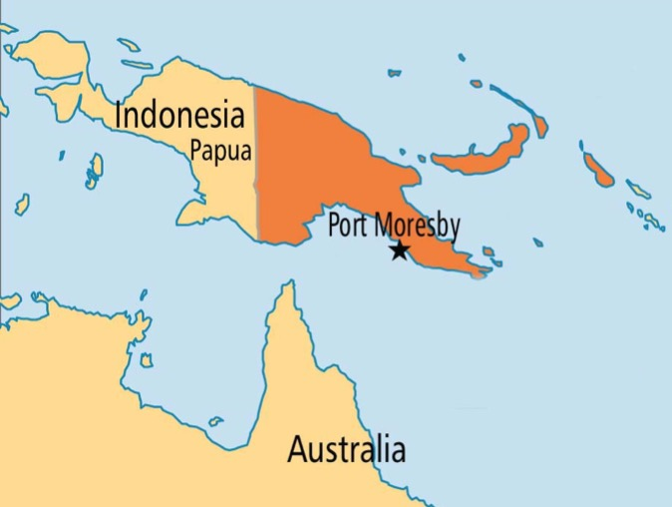
Papua New Guinea
REDD+ Supporting Green Development
in Papua New Guinea
Gwendoline Sissiou
Director, REDD+ and Mitigation
Climate Change and Development Authority
COP23 Side Event

Slide 2

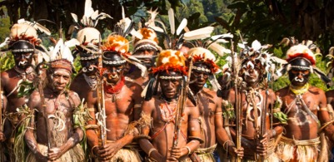
Introduction to Papua New Guinea
Papua New Guinea (PNG) is a tropical country and comprises the eastern half of the island of New Guinea in the South-West Pacific and includes 600 smaller islands;
The country is very divers in landscapes, terrestrial and aquatic habitats, flora and fauna. The cultural diversity is equally large with probably over 800 different languages.
Over 85% of the nation’s 7.3m population are based in rural areas and rely primarily on subsistence agriculture;
High levels of customary land ownership (over 97% of the country’s land area) which is a major development challenge in the country;

Slide 3
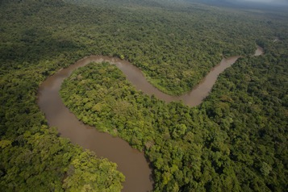
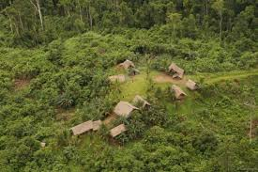
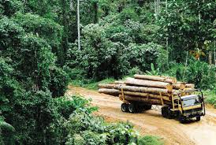
Introduction to Papua New Guinea
PNG has a significant intact area of tropical forest covering 77.8% of the country’s 46.9m ha of land. Together with the forest of West Papua (Island of New Guinea) they represent one of the largest areas of intact tropical forest in the world;
PNG’s forests are also highly diverse, including 12 distinct forest types, with carbon-rich lowland tropical forest constituting over 50% of forest area;
Main Drivers: Commercial Logging, Subsistence Agriculture and Commercial Agriculture
Notes:
Drivers of deforestation and forest degradation are not negative
Drivers play a key role in economy and society of PNG
Target is to ensure that PNG is utilising its resources in most effective way to maximise development impacts and reduce long term costs
Responsible and Sustainable Development (STaRS

Slide 4
Important Note – Future Drivers
Population growth and changing national and international economies will causes changes in drivers
Population increasing by 3% - over 9mill by 2020, 13mill by 2030 will create increasing pressure on resources
Family farming including collection of fuel wood
Commercial agricultural expansion will also be relevant with Increasing demand for development and international demand for agricultural commodities
Notes:
While logging is the big driver at the moment and increased interest in agricultural expansion and a growing population will increase the impact of these drivers

Slide 5
Overview of the REDD+ Programme/PNG
Start of UN-REDD National Programme in PNG
CCMA approved
Start of FCPF Project
Submission of FRL to UNFCCC
NRS Endorsement
OCCES Establishment
2008
2011
2015
2017
2010
2014
2016
OCCD established
Climate Compatible Development Strategy
FRL and CE
Passing of StaRS
CEPA Act
Climate Compatible Development Management Policy approved
Launch of NFI
Transition from OCCD to CCDA

Slide 6
Overview of the REDD+ Programme/PNG
National REDD+ Strategy
Forest Reference Level (FRL)
Safeguards Information System (SIS)
National Forest Monitoring System (NFMS)
NRS developed and approved by NEC
FRL submitted and close to final
NFMS developed
http://png-nfms.org
Terra PNG and Collect Earth Labs
Assessment of domestic safeguards completed

Slide 7

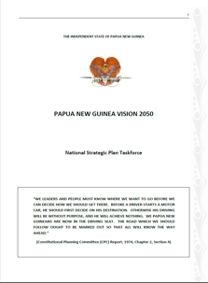
REDD+ and the NDC
The GoPNG, through its StaRS has committed PNG to a low carbon green growth pathway, in line with the targets of Vision 2050 and the Development Strategic Plan 2010-2030.
As per StaRs and Vision 2050 PNG has a target to reduce 50% of GHG emissions by 2030 and reach a point of carbon neutrality by 2050.
PNG NDC’s lays out a set of actions for addressing GHG emissions across sectors but do not include specific actions within the forest and land use sector, only acknowledging its importance in PNG and the need to develop both accurate estimates of emissions and potential actions.

Slide 8



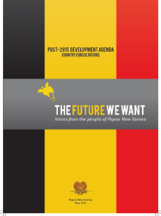
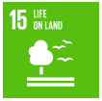
REDD+ and the SDG’s

Slide 9
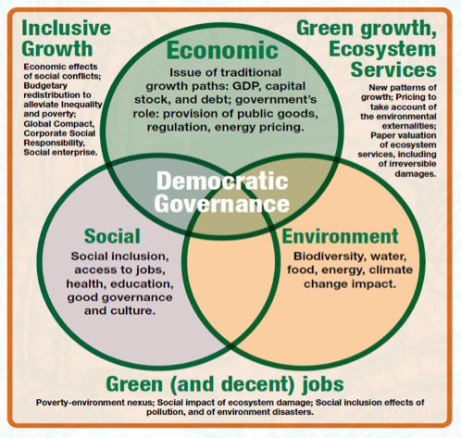
REDD+ in Green Development Strategy
Integrated into the second Medium Term Development Plan (MTDP) 2016-17 ‘A Pathway to a Responsible Sustainable Future’ which includes Forests and Biodiversity, Agriculture and Eco-tourism within its priority economic sectors based on their value as strategic assets.

Slide 10
REDD+ in Green Development Strategy
Mainstreaming of Responsible & Sustainable Development & Climate Change
National Planning Framework
Part of PNG’s national drive towards Responsible and Sustainable Development
Sits within broader response to CC
Opportunity – through coordinated action and financing – to contribute to:
Sector and national development goals
Climate Change adaptation and mitigation
Vision 2050
Mitigation
DSP 2030
MTDP
REDD+
Constitution and StaRS
CCMA / Paris Agreement Act
Adaptation
Sector / Subnational Planning
Notes:
Floyd lala will talk more on this later

Slide 11
Results/Progress/Achievements
National REDD+ Finance and Investment Plan
    Climate Compatible Development Action Plan and Policy
    Climate Change (Management) Act
    UN Paris Agreement (Implementation) Act
Initiation of access to GCF Finance both on CC Adaptation and Mitigation
    National REDD+ Strategy for 2017-2027
Notes:
Floyd lala will talk more on this later

Slide 12
Key Lessons
National REDD+ Strategy
Forest Reference Level (FRL)
Safeguards Information System (SIS)
National Forest Monitoring System (NFMS)
Cross-sectoral coordination and high level Buy-In towards development of RFIP to build stronger ownership and continued commitment of the leading government agencies
REDD+ alignment with sectoral legislation and action plans
Stakeholders engagement at subnational level on REDD+ discussions, capacity building and awareness raising
There has to be a better engagement with the private sector as it is a major contributor to the economy;
Consider merging the GIS/Remote Sensing laboratories – seeking financial sustainability and continue inter-agency dialogue on refining modalities for data sharing, privacy and use policies.
National Guidelines on FPIC and GRM is followed during the development of RFIP
Notes:
Strengthening coordination across ministries and agencies; – there has been significant progress in coordinating action at the technical level but this work needs to be taken up to the higher level to strengthen these linkages and increase inter-ministerial coordination to ensure that other ministers have a clear understanding of the challenges and opportunities relating to climate change and their support for our work. This will be critical in mobilizing domestic finance for REDD+ and other climate change action.
Engagement with development partners – progress has been made to engage with development partners to help identify areas of support for REDD+ finance. Once the Finance and Investment Plan has been developed it is anticipated further support from the minister will be required to ensure development partners are able to fully support the plan.
Engagement of Private Sector – taking into account that private sector is a major contributor to the economy of the country, the work on climate change and REDD+ needs with private sector needs to be strengthened;

Slide 13

Thank You
Ms. Gwendoline Sissou
Director, REDD+ and Mitigation
Climate Change and Development Authority
http://www.pngreddplus.org.pg/

