Slide 1
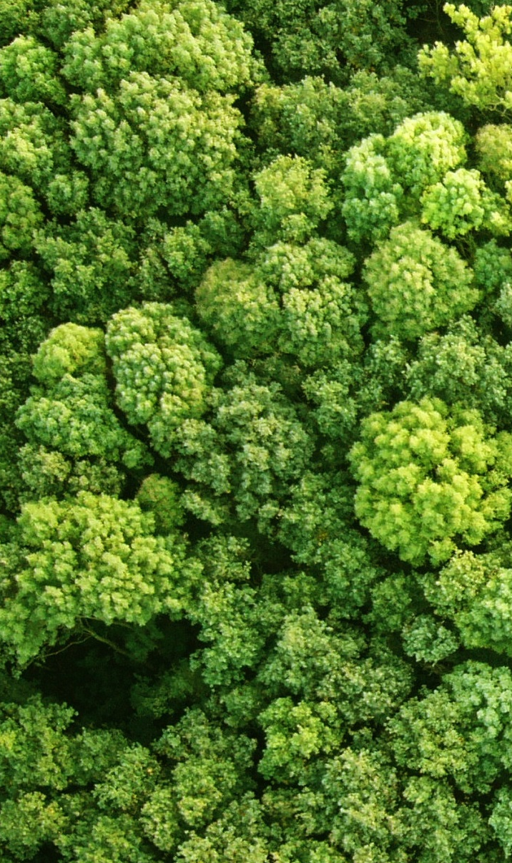
Forest Reference Levels and REDD+ results submitted to the UNFCCC;
An overview
MARIEKE SANDKER
FREL/FRL lead REDD+ FAO
21 Sept 2017

Slide 2
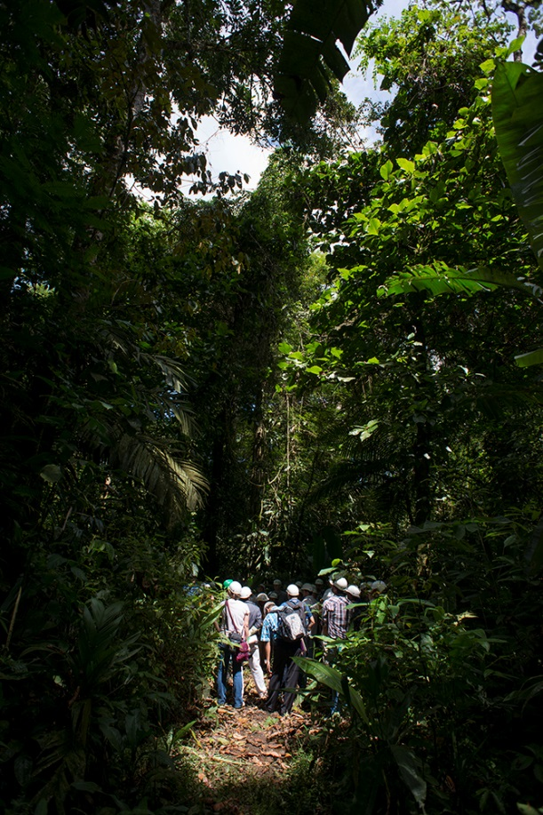

Momentum REDD+
REDD+ in Article 5 of the Paris Agreement
26 FREL/FRLs, 5 REDD+ results submitted
>70% NDCs mention forest and LU mitigation measures
Green Climate Fund: RfP on REDD+
Key next step:
Maintain momentum, overcome barriers,
scale up REDD+ action
Notes:
REDD+ is a success story both under the UNFCCC and beyond. UNFCCC REDD+ modalities are complete and enshrined in Article 5 of the Paris Agreement.
REDD+ has significant political and financial backing with over 70 countries actively engaged. Technological and institutional barriers to REDD+ have centred on countries being able to measure, report and verify REDD+ actions – but – as conveyed in this publication – there is progress and momentum.
The Key next step for everyone involved in REDD+ is to maintain this momentum, overcome barriers and scale up REDD+ actions as a key pillar to global climate action. In the context of climate action, which is SDG 13, REDD+ also contributes to SDG 15 life on the land, and indirectly to several other SDGs.

Slide 3
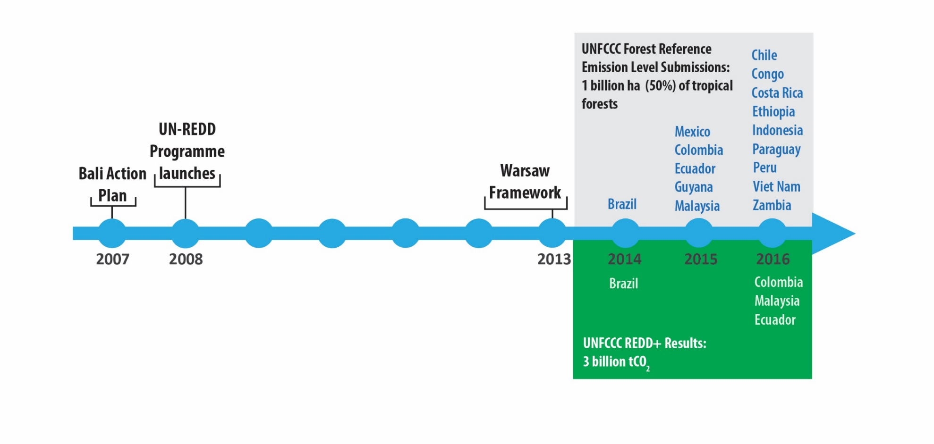

Global progress
Brazil (Cerrado)
Cambodia
Côte d’Ivoire
Ghana
Honduras
Madagascar
Nepal
Papua New Guinea
Sri Lanka
Uganda
Tanzania
Brazil (Amazonia)
2017
Brazil
2011-2015
2006-2010
6
Notes:
REDD+ actions in the forest sector have significant mitigation potential. As conveyed in this publication - Five countries have now submitted REDD+ results to the UNFCCC, with two submissions from Brazil, totaling over six billion tonnes of CO₂ equivalent. To put this in context - this equates to 10% of global emissions estimated in the IPCC 5th Assessment Report – And while a majority of emission reduction is from Brazil, it is still a highly significant result –

Slide 4
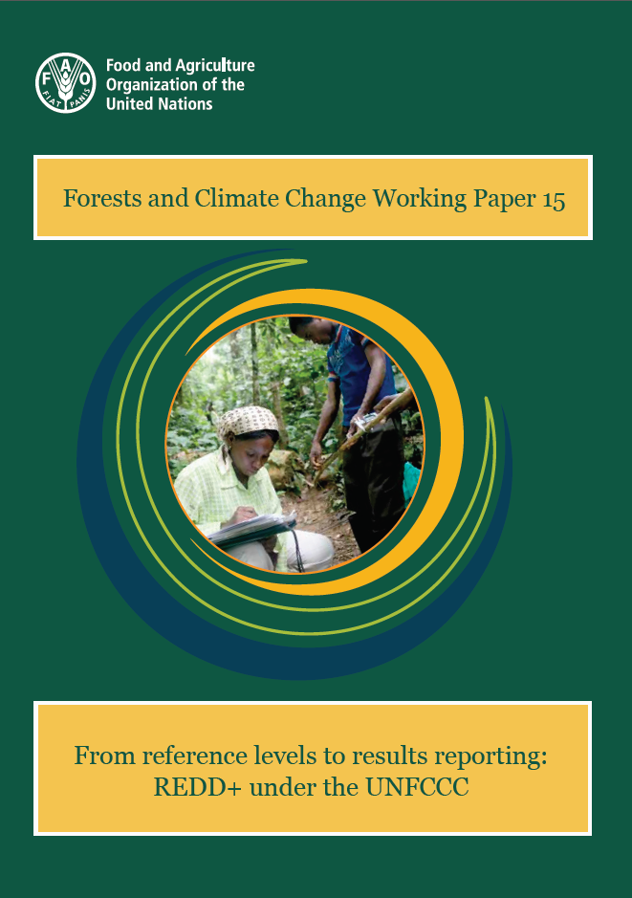
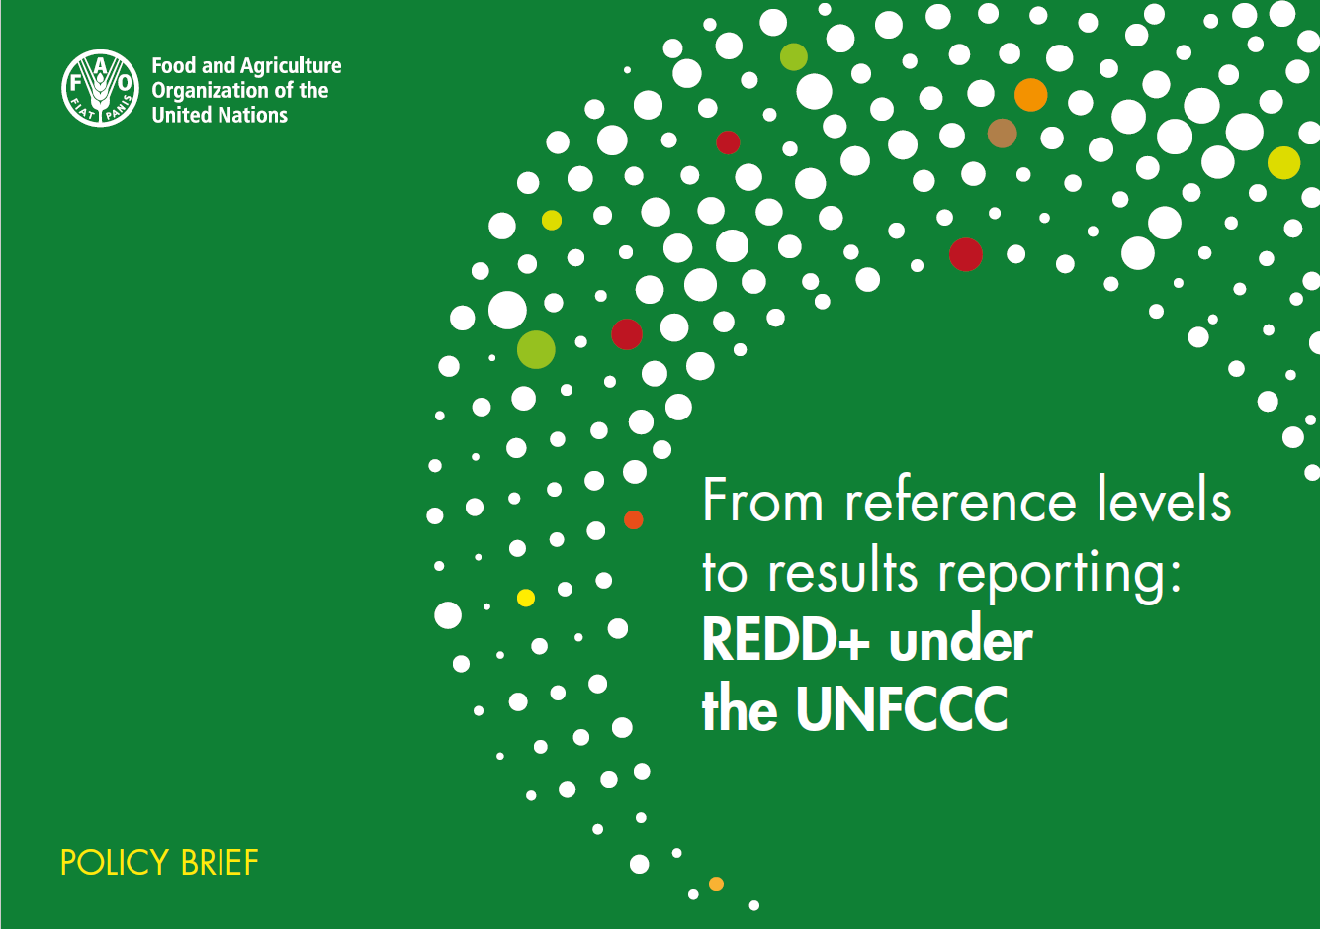
FAO publication:
From reference levels to results reporting
Report on the significant country progress on measurement, reporting and verification (MRV) of REDD+ actions
Stock-take of 26 Forest Reference (Emission) Levels, and 5 REDD+ results submitted to the UNFCCC
Summary of experiences in the technical assessment process under the UNFCCC
http://www.fao.org/3/a-i7163e.pdf
http://www.fao.org/3/a-i7352e.pdf
Notes:
The objectives of the publication are to:
I will use the abbreviation FREL rather than saying Forest Reference Emission Level in full.
You can find limited hardcopies of the publications just outside the room – but we encourage you to access the digital versions in the FAO document repository with the links provided here.

Slide 5
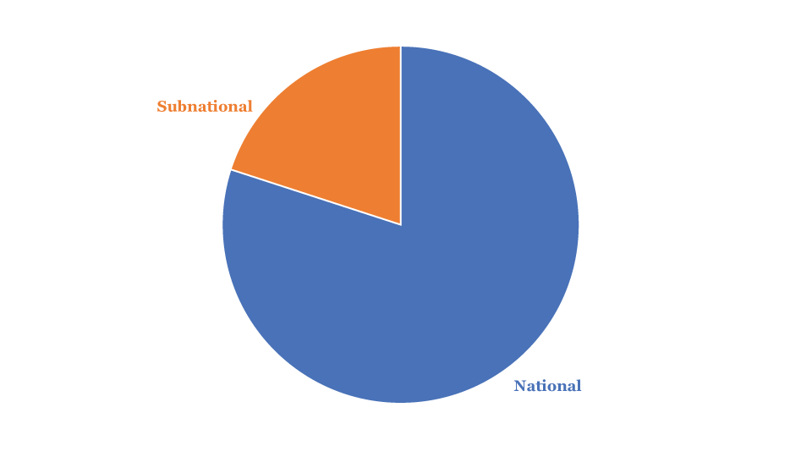
Stock take of FRL submissions - scale
National
Subnational
Paraguay
PNG
Sri Lanka
Tanzania
Uganda
Viet Nam
Zambia
Brazil (2x)
Chile
Colombia
Peru
Cambodia
Congo
Costa Rica
Côte d’Ivoire
Ecuador
Ethiopia
Ghana
Guyana
Honduras
Indonesia
Madagascar
Malaysia
Mexico
Nepal
Notes:
Some technical observations from the publication:
With regards scale of the FREL - although UNFCCC decisions allow for sub-national FREL as an interim measure, it is interesting to note that a great majority of submissions have been at the national scale suggesting that countries are approaching FRELs in the context of their national level policies and plans. Sub-national submissions have been mainly due to distinct biomes such as the Amazon.

Slide 6
FRL scope: activities
by region
 | Deforestation | Degradation | Enhancement |  | SMF | Cons.
 |  |  | A/R | Restor.
2014
2015
2016
2017
Latin America & Caribbean
Asia & Pacific
Africa
Notes:
UNFCCC decisions suggest that major emitting activities should not be omitted from the submission, and for this reason, a great majority of countries include deforestation. Methodologies for collecting data for deforestation are also mature – hence – most countries are able to report this activity. Other REDD+ activities such as degradation, require more advanced methodology to report and are subject to higher uncertainties, which has created a technological barrier for countries to report on the activity.

Slide 7
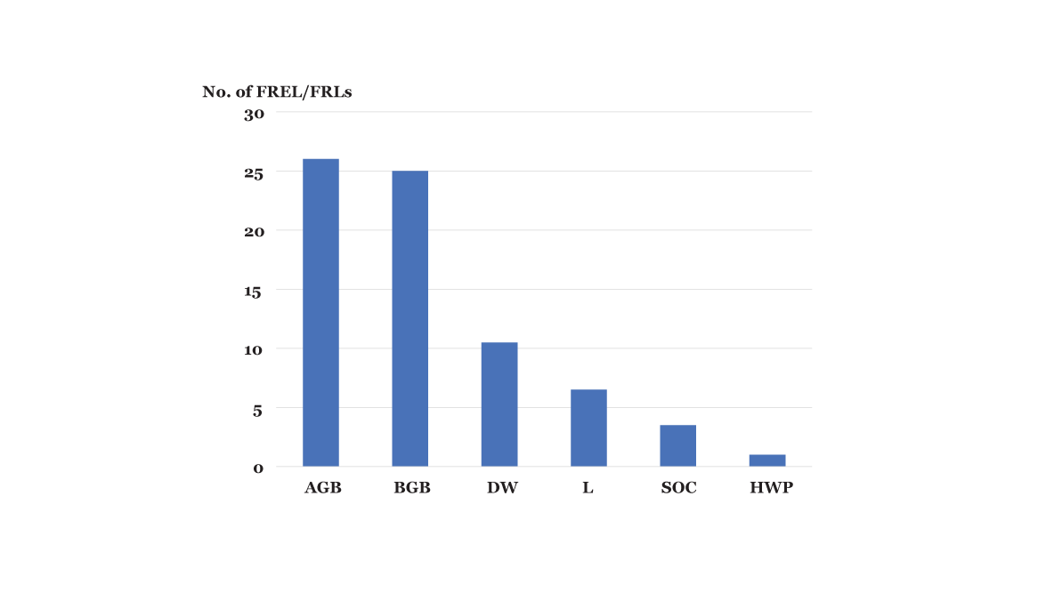
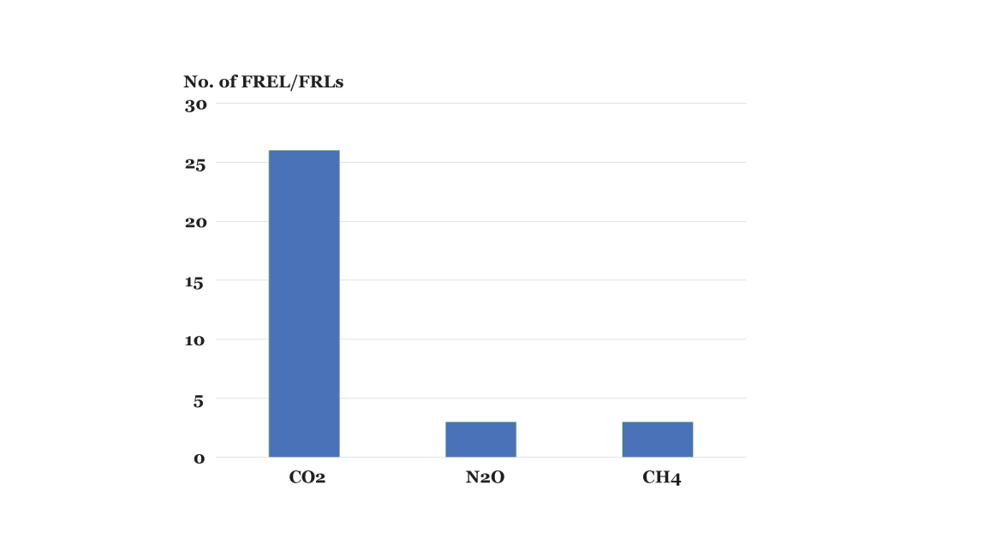
FRL scope: pools & gases
Carbon pools
Gases
Notes:
With regards scope of the FREL which refers to which REDD+ activities, carbon pools and gasses are included.
UNFCCC decisions also suggest that major carbon pools and gases should not be omitted – and for this reason most submissions include the large forest carbon pools such as above ground and below ground biomass, and the major Gas which is CO₂. Additional pools and gases take more effort to measure and report, hence most countries are unable to include them.

Slide 8
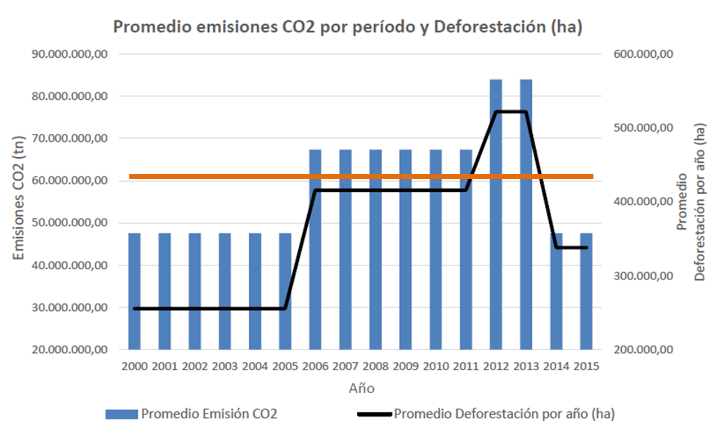
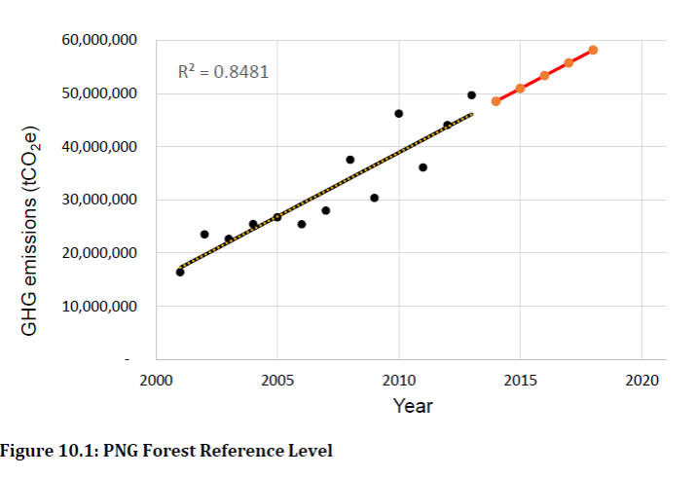
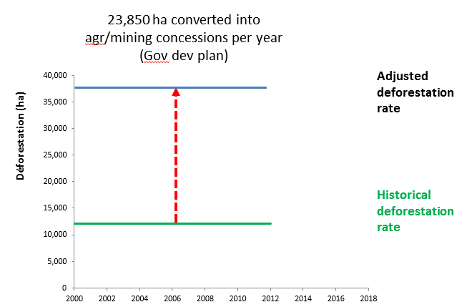
FRL construction approaches
Simple historical average
Linear projection
Adjustment
Madagascar
Malaysia
Mexico
Nepal
Paraguay
Sri Lanka
Tanzania
Uganda
Zambia
Ghana
Peru
PNG
Colombia
Congo
Guyana
Viet Nam
Brazil (2x)
Cambodia
Chile
Costa Rica
Côte d’Ivoire
Ecuador
Ethiopia
Honduras
Indonesia
Notes:
With regards the FREL construction approach – most countries have opted for a simple historical average in their submission – simply an average emission across a reference period – in this case the FREL is a single number of tonnes of CO₂ equivalent per year – which is simple and clear – such as this example for Paraguay where the red line represents a FREL of just over 60 million tonnes of CO₂ equivalent per year.
Fewer countries have used a linear projection, which is only suitable when there is a clear trend that a simple average cannot represent – such as this example for Papua New Guinea.
Fewer countries have used an adjustment – where data across the reference period is adjusted due a national circumstance such as government plans for new mining concessions such as this example for the Congo or for countries transitioning out of conflict situations that can expect increased development and economic activity which affects the forested land base.

Slide 9
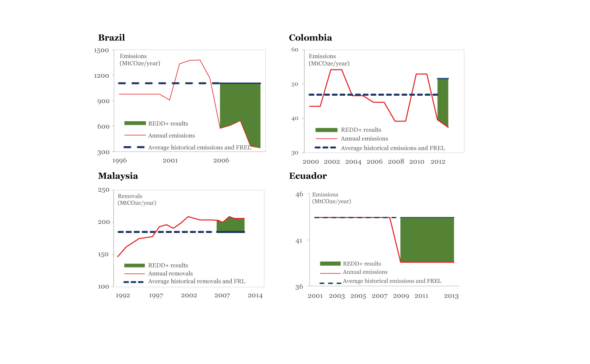
Stock take of REDD+ results
Notes:
With regards to REDD+ results - as previously mentioned – we have five submissions for four countries, with Brazil submitting two sets of REDD+ results, but of all the submissions, only the technical analysis for Brazil’s first submission has been published on the UNFCCC website.
As defined by the modalities of the UNFCCC, the methodology for the REDD+ results needs to be entirely consistent with the methodology of the FREL.
Brazil, Colombia and Ecuador all report REDD+ results for deforestation – while Malaysia report REDD+ results for Sustainable Management of Forests. Hence the green area representing REDD+ results are emission reductions in the case of reducing deforestation, and emission removals for enhancing Sustainable Management of Forests in the case of Malaysia.

Slide 10
Key challenges
Clarity required – how REDD+ results trigger results based payments (GCF meeting Cairo?)
Country data and the quality of submissions need to improve overtime to meet donor expectations for payment
Further investment in REDD+ MRV readiness is necessary to improve country data and facilitate broad country participation in REDD+
Again: Key next step:
Maintain momentum, overcome barriers,
scale up REDD+ action.
Notes:
Key challenges identified in the publication:
There is clarity required on how REDD+ results trigger results based payments. However, there is progress, currently this an active agenda item at the Green Climate Fund, and we have should clarity toward the end of 2017.
REDD+ submissions often represent the first country experiences with UNFCCC submissions, and it is clear that in some instances, that the quality of country data and the submissions needs to improve to meet donor expectations for results based payments.
Although we are in the age of REDD+ implementation, clearly, there is a need for further investment in REDD+ MRV readiness to improve country data and ensure that all interested countries are able to voluntarily participate in REDD+.
To return to the Key Next Step – we need to maintain the momentum conveyed in this publication, continue to overcome barriers (in this case the technical and institutional barriers to REDD+ MRV), and scale up REDD+ actions to ensure it becomes a key pillar to global climate action.

Slide 11
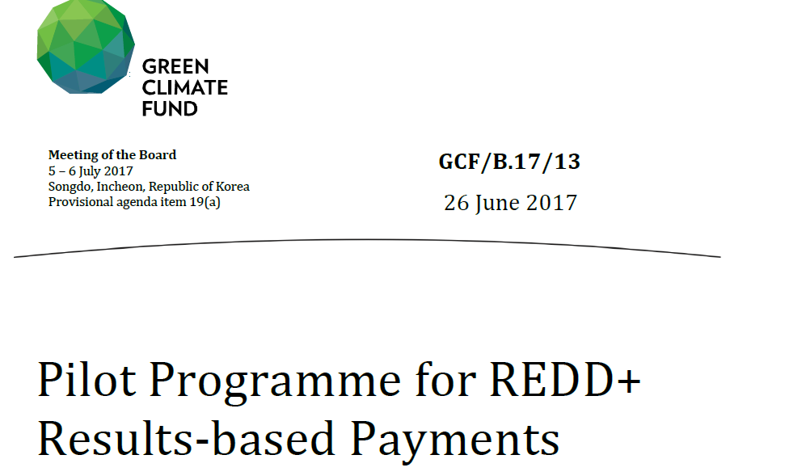
From FRLs to RBPs
p 30 FREL/FRLs and REDD+ results:
The GCF will employ a scorecard in order to create a bridge from UNFCCC Technical Analysis processes to GCF RBP.
Notes:
Document prepared for consideration by the Board.
Look out for “Draft request for proposals for the pilot programme for REDD+ RBP” – draft for consideration GCF Board meeting in Cairo 30 sept-1 Oct

Slide 12
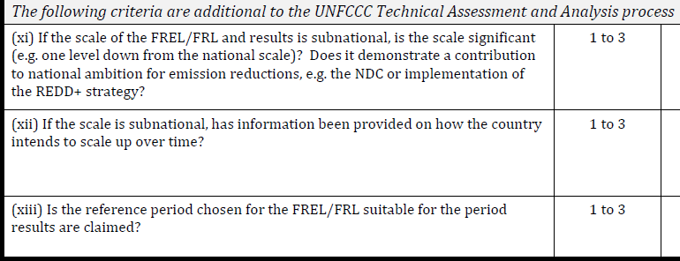
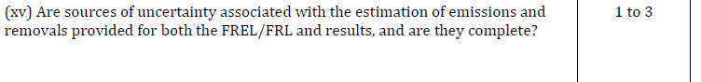
Scorecard snapshot:

Slide 13
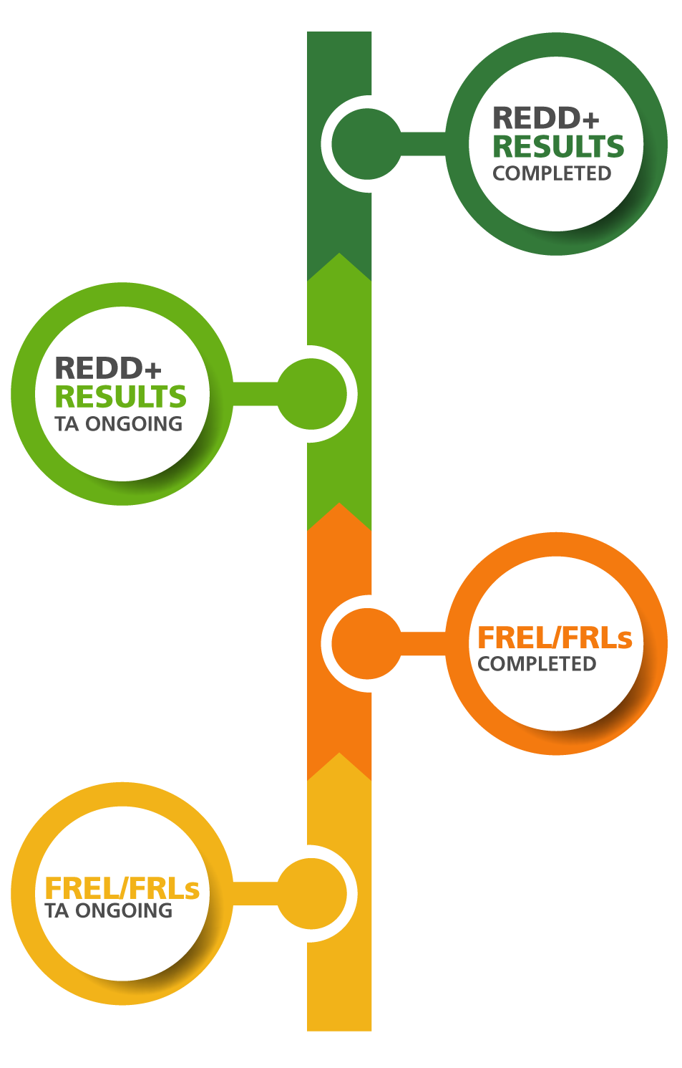
MRV of REDD+ country progress
UNFCCC process

Slide 14
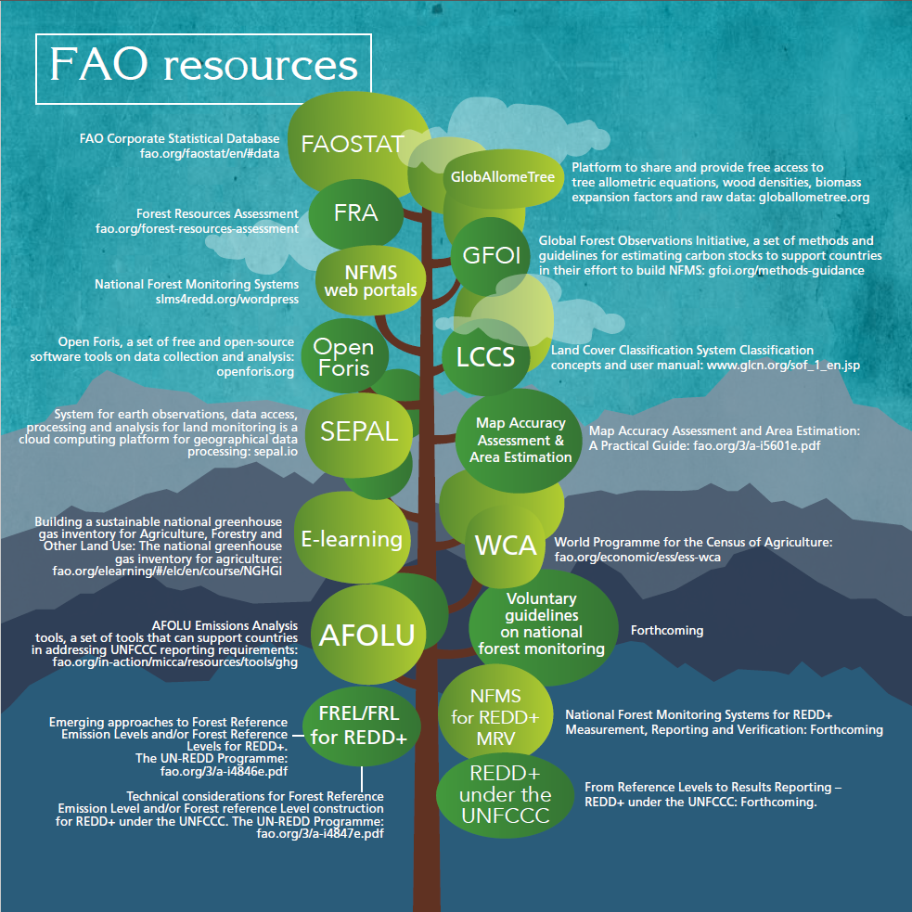
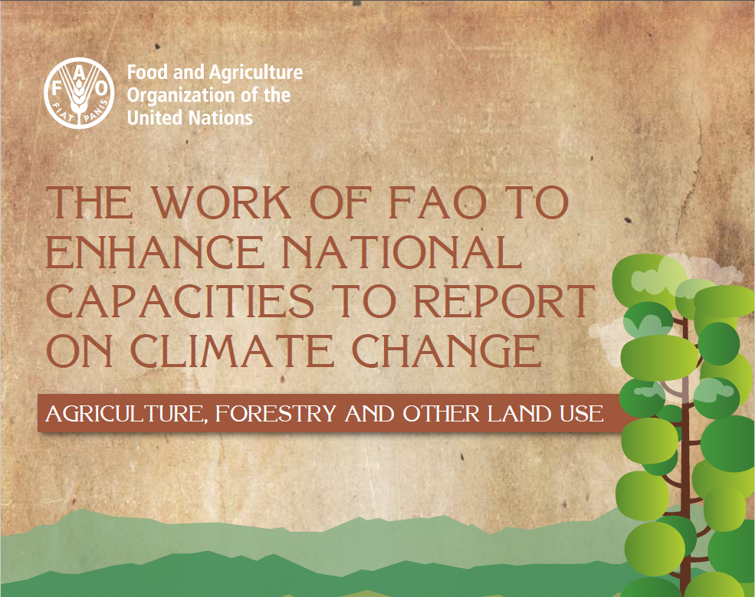


FAO support
http://www.fao.org/3/a-i7210e.pdf
Notes:
I would like to briefly mention a related FAO publication – The work of FAO to enhance national capacities to report on climate change
The publication is an excellent illustration of how FAO is using a range of resources, tools and approaches (which are fittingly represented in this tree) to support our member countries in their efforts to report on their climate change actions to the UNFCCC. I encourage you to have a look. A key set of tools are the Open Foris suite of free, open source technical solutions that can enable countries to collect, analyze and report information on their forests.

Slide 15
FRL summary:
Republic de Côte d’Ivoire
Mr Abraham Yoa Kra Bio

Slide 16
FRL summary: Republic de Côte d’Ivoire
Scale: National
REDD+ activities: Deforestation, Reforestation
Duration: 2000-2015
Pools: AGB, BGB, L, DW
Adjustment: No

Slide 17
Résultats des NRF/NERF
National et ERP
Notes:
ERP 18 605 391,80
National 76 751 725,60

Slide 18
FRL summary:
Federal Democratic Republic of Ethiopia
Mr Solomon Zewdie Zeweldemariam

Slide 19
FRL summary:
Federal Democratic Republic of Ethiopia
Scale: National
REDD+ activities: Deforestation, Afforestation/reforestation
Duration: 2000-2013
Pools: AB, BB, DW
Adjustment: No

Slide 20
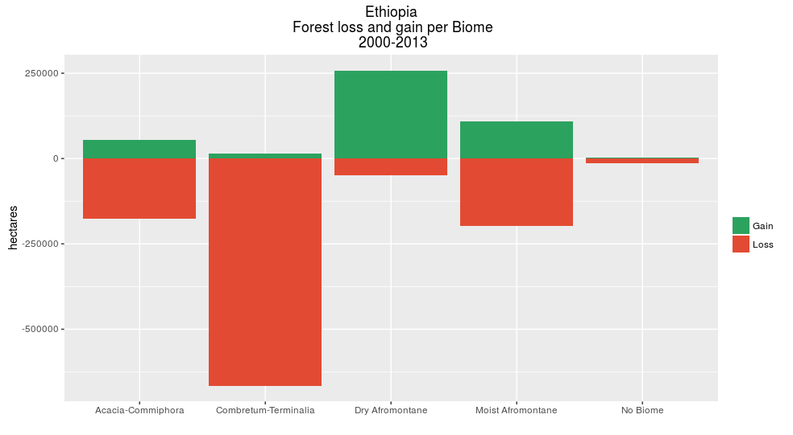
Ethiopia

Slide 21
Emission: 17.9MtCO2e
Ethiopia
Removal: 4.8MtCO2e
Emission Factor: NFI
Activity Data: Landsat image multi-temporal stack

Slide 22
FRL summary:
Republic of Ghana
Mr Raymond Kofi Saky

Slide 23
FRL summary: Republic of Ghana
Scale: National
REDD+ activities: Deforestation, Degradation and Enhancement
Duration: 2001-2015
Pools: AB, BB, DW, soil, Litter, (All pools)
Adjustment: No

Slide 24
Ghana

Slide 25
FREL summary:
Madagascar
Mrs Rakotosoa Andrianina

Slide 26
FREL summary: Madagascar
Scale: National
REDD+ activities: Deforestation, Degradation
Duration: 2005-2013
Pools: BA, BS, bois mort
Adjustment: No

Slide 27
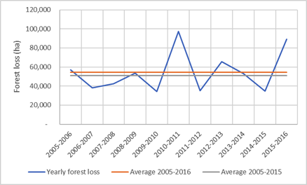
Madagascar

Slide 28
FREL summary:
Republic of Congo
Mrs Fabéna Divine Niemet Gampika

Slide 29
FREL summary: Republic of Congo
Scale: National
REDD+ activities: Deforestation, Degradation
Duration: 2000-2012
Pools: AB, BB, DW
Adjustment: Yes

Slide 30
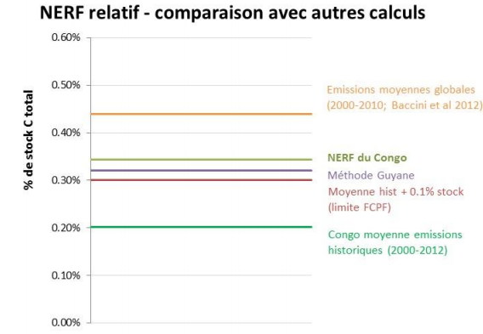

Slide 31
FRL summary:
Uganda
Mr Xavier Mugumya Nyindo

Slide 32
FRL summary: Uganda
Scale: National
REDD+ activities: Deforestation, Enhancement
Duration: 2000-2015
Pools: Above GB, Below GB
Adjustment: No

Slide 33
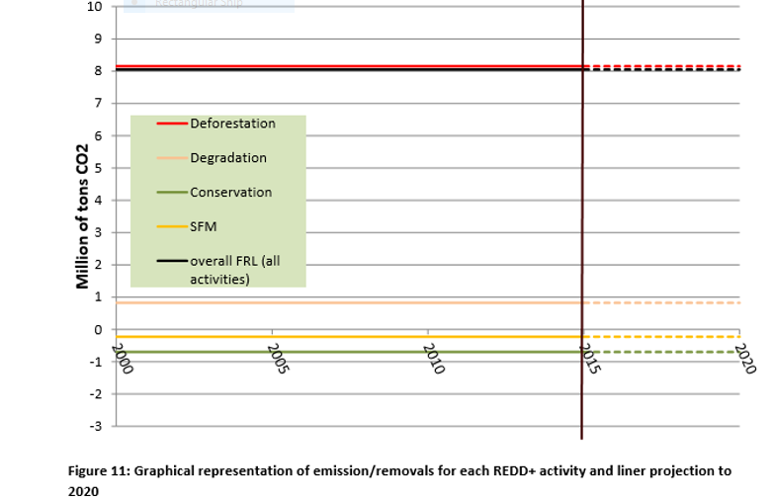
Uganda
Notes:
20 out of 26 submissions (76%) is national

Slide 34
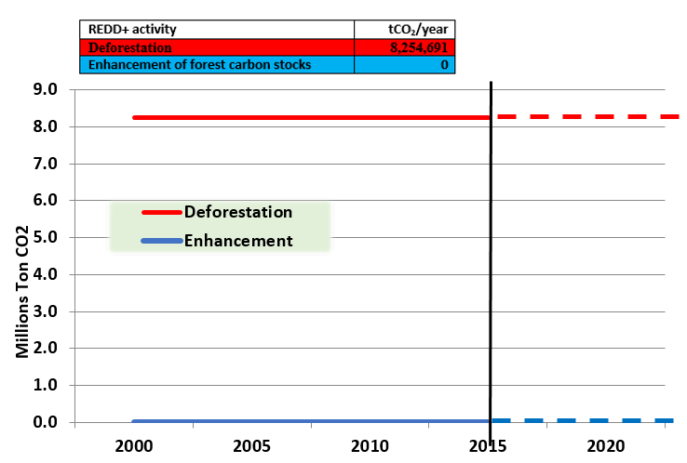
Graphical representation of emission/removals for each REDD+ activity and liner projection to 2020
Notes:
20 out of 26 submissions (76%) is national

Slide 35
Key building blocks for FRL construction.
Key building blocks for FRL construction | Ugandan decision and submission
Forest Definition | A minimum area of 1 Ha, minimum crown cover of 30% of trees able to attain a height of 4 metres and above
Scale | National scale
Scope Activities | Deforestation, Enhancement of forest carbon stocks
Scope Gases | CO₂
Scope Pools | AGB, BGB
Construction Methodology | Historical average based on 15-year reference period (2000-2015), 5-year rolling average.
Notes:
20 out of 26 submissions (76%) is national

Slide 36
FREL summary:
Zambia
Mr Victor Chiiba

Slide 37
National FREL summary: Zambia
Scale: National
REDD+ activities: Deforestation
Duration: 2006-2014
Pools: AGB, BGB, DW
Adjustment: No
Notes:
Zambia’s Forest Reference Emissions Level was developed with inputs from technical partners and submitted to the UNFCCC in January 2016
Briefly the FREL was submitted with a National Scale, Deforestation was the only REDD+ activity, although Zambia does seek to include Degradation in future iterations of the FREL. The duration of the reference period is 2006 – 2014, Pools included Above Ground Biomass, Below Ground Biomass, and Dead Wood. No additional adjustments were made to the FREL
The first iteration of the FREL made use of a number of innovative approaches to quantifying both activity data and emissions factors which do indeed differ from those used by projects.
Lets have a closer look at the differences between the construction methodologies and the data used. This will provide a good base to understand the difficulties involved in reconciling REDD+ projects at various scales

Slide 38
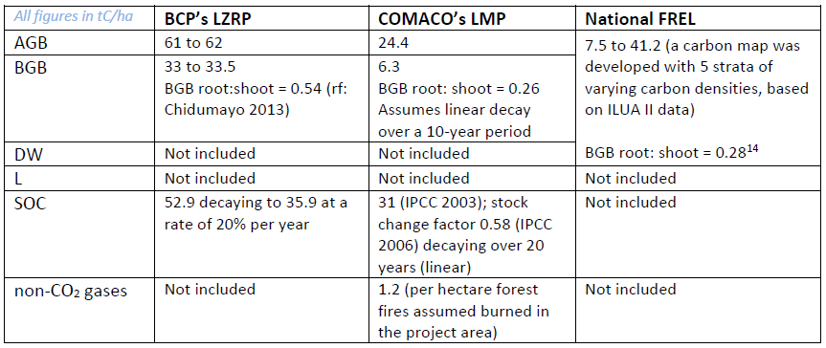
Emissions Factors
Notes:
Projects make use of a variety of data sources for their Emissions Factors resulting in varied estimates of key attributes
Pools as well as Non CO@ gasses differ amongst projects as well as the FREL
These inconsistencies should not be amplified when Zambia creates its first sub-national FREL for the ZIFLP project

Slide 39
Scope of FREL and REDD+ projects
Notes:
In general, the scope of the various initiatives are aligned with all programs targeting deforestation
Carbon pools also appear similar although the national FREL does not include Soil Organic Carbon, yet
Gases is where we begin to see the differences and also highlight the challenges of quantifying these gases at the various scales.

Slide 40
Summary FREL/FRL elements
 | Scale | Activities | Duration | Pools | Adjust.
Côte d’Ivoire | Nat | Def/Enhan. | 00-15 | AB,BB,DW,L | N
Ethiopia | Nat | Def/Enhan. | 00-13 | AB,BB,DW | N
Ghana | Nat | Def/Deg/Enhan. | 01-15 | AB,BB,DW,S,L | N
Madagascar | Nat | Def | 05-13 | AB,BB,DW | N
Ref of Congo | Nat | Def/Deg | 00-12 | AB,BB,DW | Y
Uganda | Nat | Def/Enhan. | 00-15 | AB,BB | N
Zambia | Nat | Def | 06-14 | AB,BB,DW | N

