Slide 1
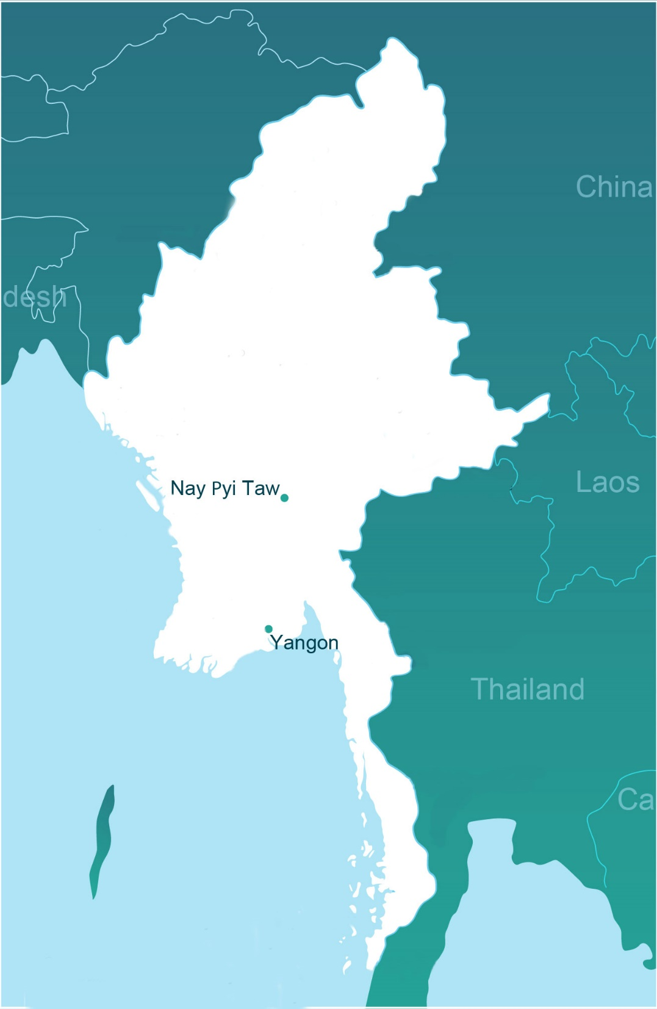



REDD+ supporting Green Development in Myanmar
By Khin Hnin Myint
National Programme Manager
UN-REDD Programme Myanmar
Date: November 16th, 2017
India
Myanmar
COP23 SIDE EVENT
REDD+ Programme Myanmar

Slide 2
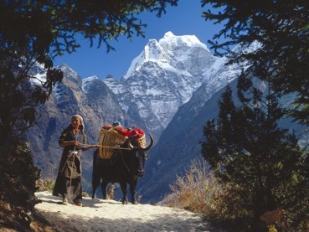

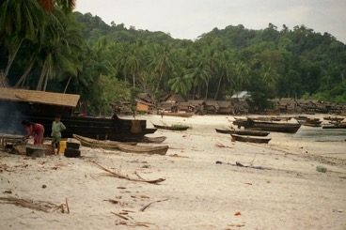
Introduction to Myanmar
Myanmar is the largest country in mainland S.E Asia and ranks 4th in Asia in terms of total forest area (after China, Indonesia, India; 30.6 million ha )
Enormous range of forest types from sub-alpine in northern Kachin to humid tropical lowland forests in the south
Mount Khakaborazi in northern Kachin
Population (52 million) is still largely rural (65%) with many ethnic groups
Deforestation rate remains high (nearly 400,000ha/year), largely due to agricultural development
Putao in Myanmar
Forest degradation also significant (biomass fuels)
Humid lowland forest in Mergui Archipelago, Tanintharyi

Slide 3
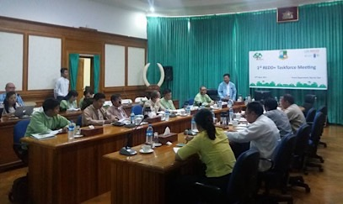
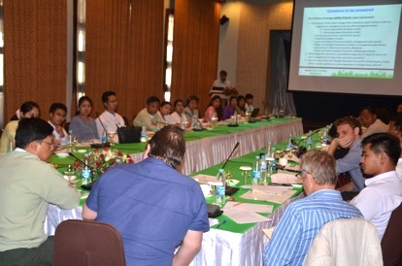
Overview of the REDD+ Programme Myanmar
REDD+ Readiness Roadmap developed in 2013;
UN-REDD support to implementation of the Roadmap began in 2015; and expected to continue up to 2020;
Draft National REDD+ Strategy undergoing broad consultation (across 7 Ministries and with CSOs; sub-national consultations in all states/regions underway; public comments period early in 2018;
The 1st Taskforce meeting
Initial FRL expected to be submitted before January 8th, 2018; and
Process overseen by National REDD+ Taskforce, reporting to Central Committee for National Environmental Conservation and Climate Change (Minister-level), and supported by three Technical Working Groups.
TWG Meetings of Stakeholders Engagement and Safeguards, & Drivers and Strategy for REDD+

Slide 4
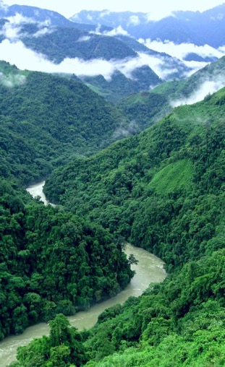
REDD+ and the NDC
The Mitigation component of Myanmar’s (I)NDC encompasses two sectors: Forestry, and Energy;
The Forestry target is that, by 2030, Myanmar’s Reserved Forests and Protected Public Forests amount to 30% of total national land area; and Protected Areas cover 10% of total national land area, as set out in the 30-Year National Forestry Master Plan (2001-30);
The Energy targets include the use of at least 30% renewable sources for rural electrification; and to distribute approx. 260,000 cookstoves between 2016-2031; and
The Adaptation component identifies 4 priority sectors: (1) agricultural resilience, including forest protection; (2) public health protection/water resource management; (3) coastal zone protection; and (4) energy & industry sectors, and biodiversity preservation.
Putao in Myanmar

Slide 5
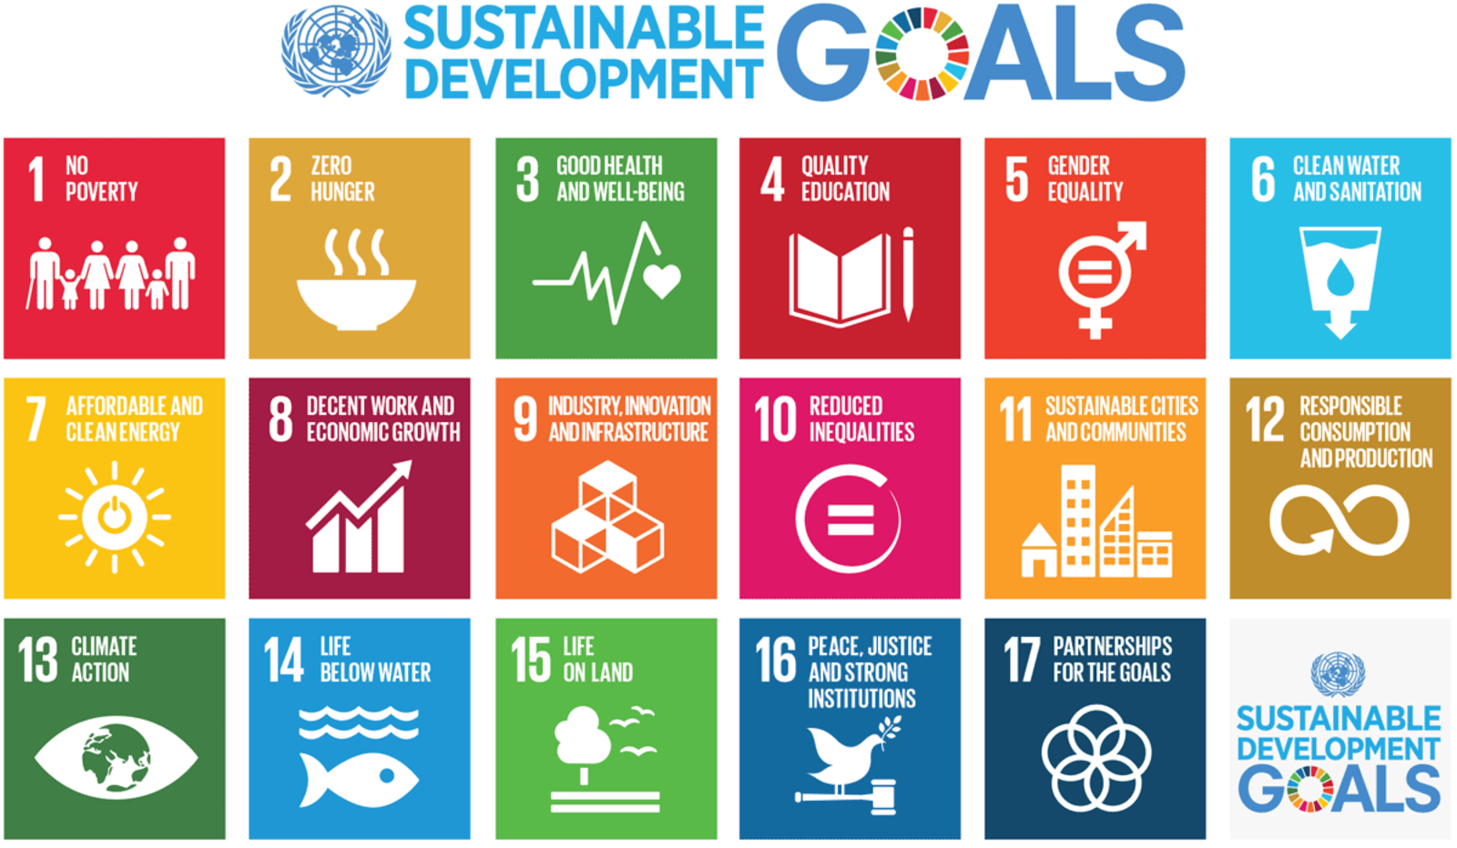
Main SDG’s related to REDD+ in Myanmar
For many of Myanmar’s poor (26%), living in rural areas, forests are a source of income. Through REDD+ their capacity to increase incomes from the forests will be developed
Forests are a direct source of food but also support the productivity of agro-ecosystems
Many women are leaders of community forest groups, in contrast to the gender situation in most of the rest of society
Revitalizing forest industries, including the Myanmar Timber Enterprise, can provide work and contribute to economic growth
Many rural communities are marginalized; empowering them through REDD+ can reduce inequality
As noted in the previous slide, forests are central to Myanmar’s (I)NDC
The underlying causes of threats to forests are often the same as those leading to conflict, including weak institutions. This is central to Myanmar’s efforts to resolve internal conflicts
REDD+ will work to protect, restore and enhance sustainable use of terrestrial ecosystems, sustainably manage forests, combat desertification, and halt and reverse land degradation and halt biodiversity loss

Slide 6
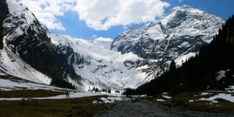
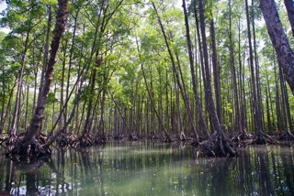
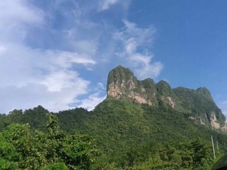
REDD+ in Green Development Strategy
Myanmar is well-advanced in developing a comprehensive policy framework in support of green development. This consists of a “Green Economy Policy Framework”, which encompasses:
  Environmental Policy
  Climate Policy
  Land Use Policy
  Waste Management Policy
Hkakaborazi Landscape’s World Heritage journey
  Information needs for the “Green Economy Policy Framework” will be supported through the Myanmar OneMap Initiative
The Mergui's mangrove forests
Zwekabin mountain in Kayin state

Slide 7
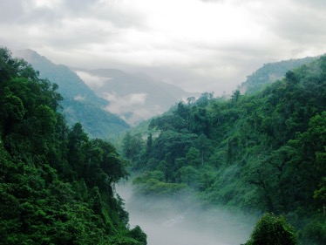
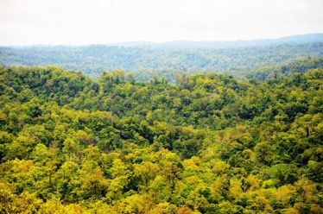
Results/progress/achievements
Myanmar has made dramatic advances from the incomplete and uncoordinated policy environment of a decade ago. Policy development is now much more inclusive – for example the Land Use Policy went through multiple rounds of extensive public consultation and inputs.
Forests in Myanmar. Photo: REDD+ Myanmar
The current government banned all logging for one year and in parts of Bago-Yoma for 10 years; annual allowable cuts reduced to sustainable levels and State Counsellor, Daw Aung San Suu Kyi, has called for no more forest conversion.
Despite starting on REDD+ readiness later than many countries, Myanmar is rapidly catching up, and is looking towards RBP’s by 2020.
Forests in Myanmar. Photo: REDD+ Myanmar

Slide 8
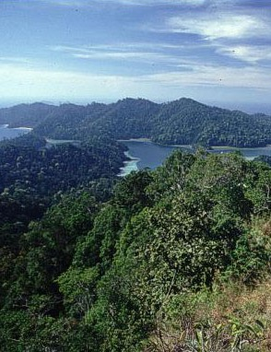
Key Lessons
REDD+ can be a catalyst not only for more sustainable forest management, but also for increased democratization of governance structures and conflict resolution – a very important issue in Myanmar.
The REDD+ Readiness process in Myanmar has contributed to empowerment of many stakeholder groups, including those that have been historically marginalized (e.g., women, Indigenous Peoples).
Addressing indirect drivers of deforestation and forest degradation is, first and foremost, a policy issue – the policy environment needs to support on-the-ground actions.
Myanmar stands on the brink of major progress in reducing deforestation and forest degradation, but needs additional international support. A recent exchange with Brazil has shown the value of international cooperation.
Mergui Islands by Micheal Capaldi

Slide 9
Thank You
Ms. Khin Hnin Myint
National Programme Manager
UN-REDD National Programme
Email: khin.hnin.myint@undp.org
Learn more about us:
Website: http://www.myanmar-redd.org/
Follow us: REDD+ Programme in Myanmar

