Slide 1
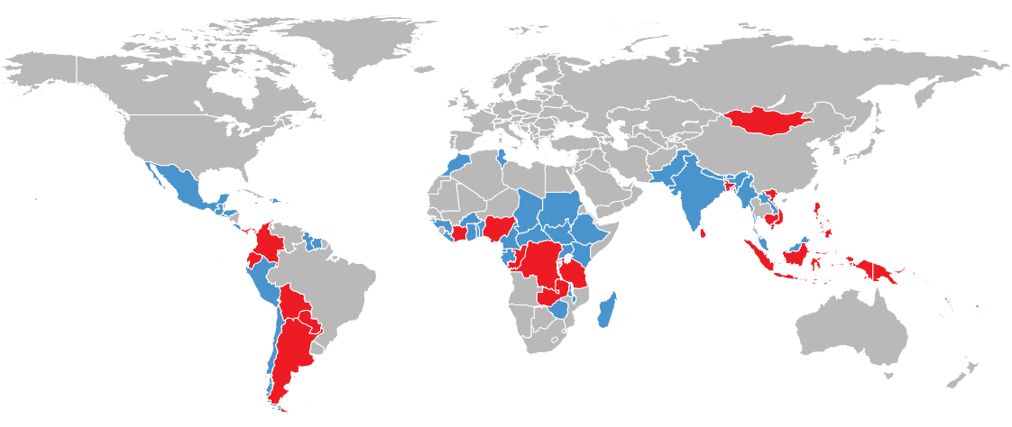
MONGOLIA
Moving Forward with REDD+ to Combat Climate Change and achieve Sustainable Development

Slide 2
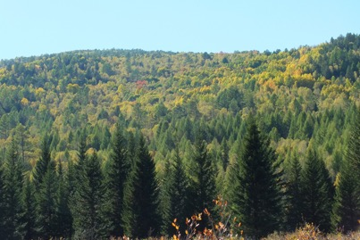
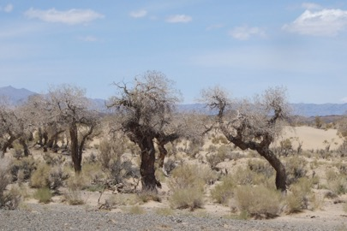
Introduction to Mongolia
Situation - Landlocked, extremely cold winters, low rainfall (50-400mm), short growing season, increasing fire & pest threats
Population – nomadic culture for 1000’s of years, but now 50% of 3 million live in capital city
Economy – heavily dependent on mining, grazing,
Forest & Economy - more than 300 million USD/year if consider ecosystem values alone)
Forest – Boreal forests and desert woodlands - Only boreal forest country in UN-REDD – 18 million ha
Scale - Low Deforestation; Moderate Degradation
Notes:
P

Slide 3
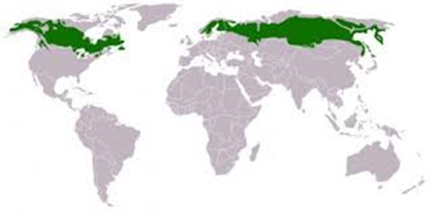
Important Note - Significance of Boreal Biome
Boreal biome
Mongolia is the only landlocked developing country with boreal forests and is in need of assistance
World’s largest biome
World’s largest carbon sink
World’s largest peatlands
World’s Top 3 deforestation countries in boreal biome (Hansen)
Highly threatened by climate change impacts

Slide 4
Important Note – Climate Change Future Drivers
Increased temperature & drought
Increased risk of forest fire and pests
Melting permafrost and lack of water in soils
Increased severity of winters
Forest health affected
Increased land degradation & desertification

Slide 5
Overview of the REDD+ Progress in Mongolia
UN-REDD partner
Readiness support - Roadmap draft
Readiness Roadmap
2011
2012
FRL, SIS, National strategy
2014
National Programme
2016
2018

Slide 6
Results/Progress/Achievements
Vision: REDD+ is framed in context of Mongolia’s unique situation thus focused on adaptation, sustainable development and mitigation rather than GHG mitigation alone;
New REDD+ Paradigm: A new paradigm is needed for boreal forest countries;
Stakeholder Participation: Building on principle of climate change adaptation, sustainable development, and ecosystem services;
Outcome: National Program to focus on Forests and Climate Change, completed in 2018 requires donor funding from developed countries; and
Partnerships: Partnerships with boreal forest countries needed.
Strategy: A REDD+ National Program and Action Plan - ongoing approved in 2018

Slide 7
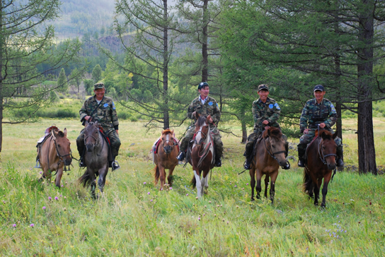
REDD+ and the NDC in Mongolia
INDC (2015) – 14% GHG reduction in energy, industry, agriculture and waste sectors, by 2030 (exl. LULUCF)
Mongolia’s INDC linked to Green Development Policy (2014); Sustainable Development Vision (2015) and NAP on Climate Change (2011-2022)
INDC has mitigation and adaptation components due to the countries climate change vulnerability
Forest Sector important for emission removals and carbon sequestration

Slide 8
REDD+ and Importance of Forests for Mongolia’s NDC
Mongolia is a low emission country
Forests are important in keeping emissions low
REDD+ can further address mitigation and keep the country on a low carbon pathway

Slide 9
REDD+ and INDC in Mongolia
Adaptation:
Mitigation
To maintain availability of water through protection of native ecosystems in river basins (and reduce permafrost melt through forest protection)
Increase protected areas to 25-30% of total area by 2030 and under sustainable financing mechanism
Improve pasture management and reduce rate of pasture degradation
Increase forest area up to 9% and reduce forest fire affected area by 30%, by 2030
To reduce forest degradation caused by human activities, fire and pest and to implement re-forestation and SFM strategies
To make forests resilient to CC by improving productivity and enhancing structure / composition
Notes:
Mongolia one of first countries to ratify Paris agreement and submitted its INDC prior to Paris Agreement.
Increasing forest area up to 9.0% by 2030 and reducing forest fire affected area by 30% would conserve ecosystems and increase carbon sink.

Slide 10
REDD+ and Sustainable Development Goals
Mongolia developed a Sustainable Development Vison in 2015
Objectives of REDD+ are closely linked to Sustainable Development Goals
SDG Indicators included in REDD+ Strategy Indicators

Slide 11
REDD+ Mongolia: Building climate resilient forest ecosystems, livelihoods and a sustainable economy for a greener future.

Slide 12
Key Lessons
Mongolia is a low emitting country but highly threatened by global emissions.
Mongolia is a developing country under the REDD+ program in need of assistance
REDD+ is important for addressing SDGs, maintaining low carbon pathway and adaptation to climate change.
Mongolia provides a unique REDD+ paradigm being the only developing boreal forest country.
Mongolia’s forests are only a small part of the world’s boreal forest biome which is a neglected ecosystem in UNFCCC negotiations and in REDD+ mechanisms
Policies and Measures will focus on REDD+ interventions not only to reduce net GHG emissions, but also to increase resilience to climate change.
Mongolia has considerable potential for investment in the forest sector to attain SDGs whilst maintaining and enhancing the forest stocks.

Slide 13
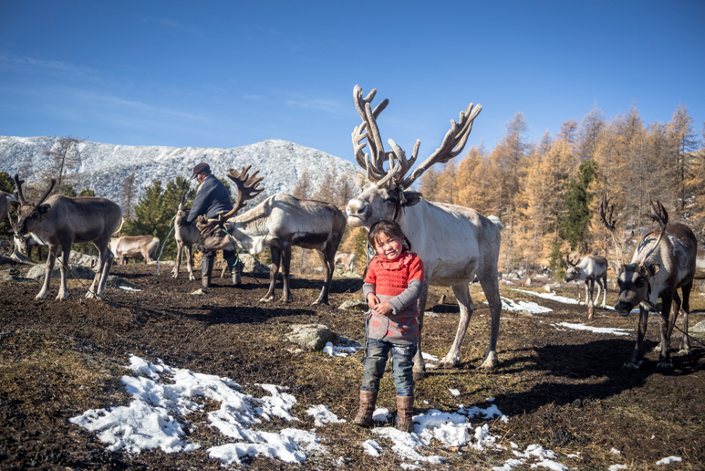
Call for Action on Boreal Forests
Partnership on Boreal Forests, Peatlands and Soils
Research, Capacity Building, Exchange Information
Funding Facility for Enterprises and Financing Mechanisms
Promote Role of Forests in Partner Countries

Slide 14
Thank you for your attention

