Slide 1
IDENTIFICATION AND VALUATION OF DIRECT ECOSYSTEM SERVICES FROM FOREST PROTECTED AREAS IN BANGLADESH: A CASE STUDY
Mohammed Jashimuddin,
Samiul Islam &
Tapan Kumar Nath
University of Chittagong, Bangladesh

Slide 2
Ecosystem Services
Defined as services provided by the natural environment that benefit people.
…….food, fibre and fuel provision and the cultural services that provide benefits to people through recreation and appreciation of nature, regulation of the climate, the purification of air and water, flood protection, soil formation and nutrient cycling.
In developing nations local communities obtain a large proportion of their livelihoods from forests
Protected areas (PA) symbolize a key global strategy in biodiversity conservation
More than 100,000 PA sites worldwide, covering nearly 12% of the land surface

Slide 3
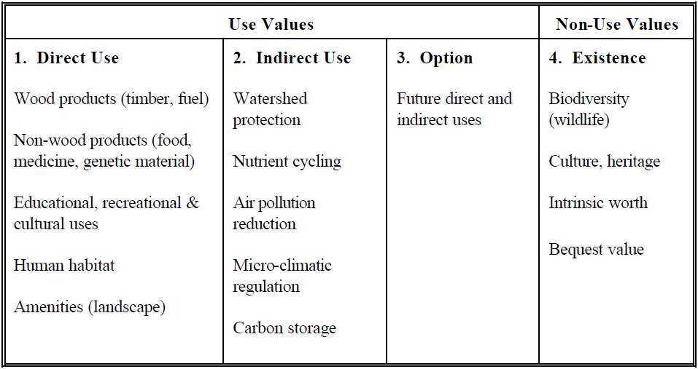
Types of Forest Values
Notes:
Intrinsic value= Fundamental value, not the market value; ethical or philosophic value of any property;
Bequest value= values placed on individual willingness to pay for maintaining or preserving an asset or resource that has no use now, so that it is available for future generations

Slide 4
Chunati Wildlife Sanctuary (CWS)
Located at the south-east part of Bangladesh
Declared as IUCN category IV protected area in 1986
Flagship species - Elephant
Covers an area of nearly 7,764 ha
More than 50,000 people live in or around the CWS
Forest resources collection is the major livelihood option for majority of the people
CWS was once home to numerous plant and wildlife species of which many are endemic to the region

Slide 5
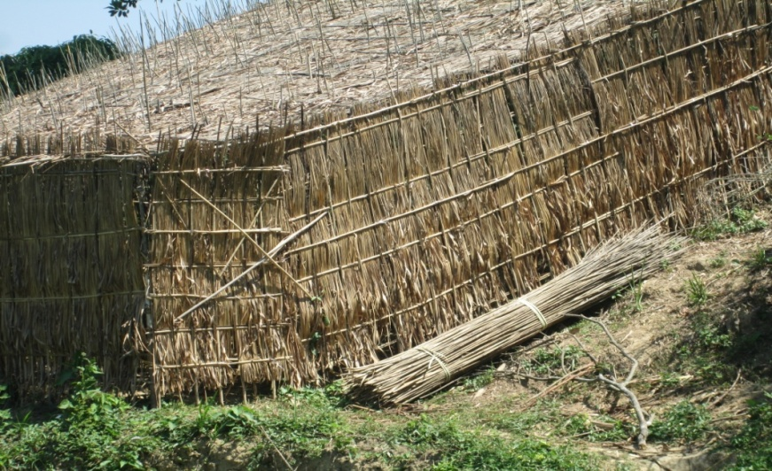
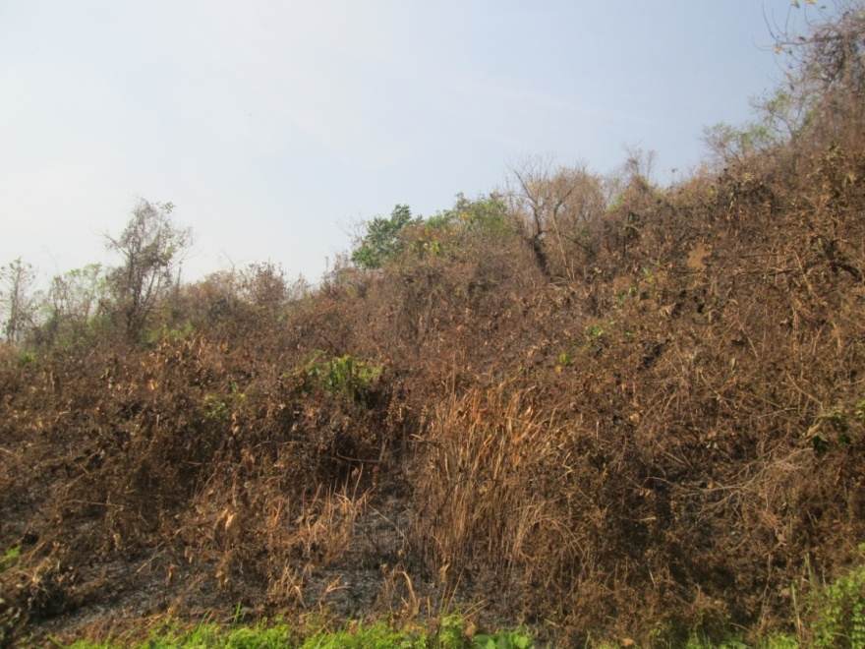
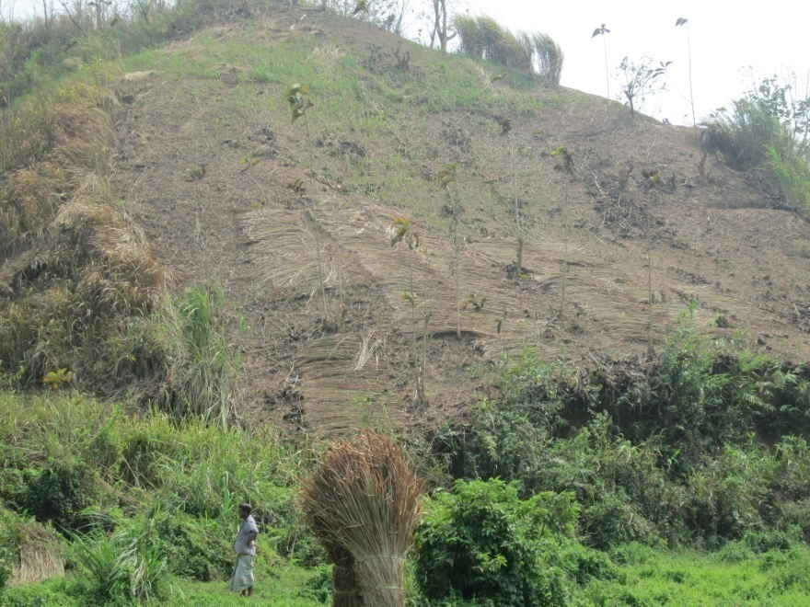
Threats to CWS
Over exploitation
Fuel wood, timber, bamboo, etc.
Encroachment
Fire (mostly intentional)
Conversion of natural forest to
agriculture
betel leaf cultivation
sun grass production areas
fast growing plantations
orchards

Slide 6
Objective (s) of the study
The study aimed
to explore the nature and type of forest resources collection, and
to quantify the amount of forest resources collected by local resource collectors.
Notes:
40

Slide 7
Methodology
interviewing forest resource collectors at the entry or exit points of the CWS.
28 forest trails (50%) were selected from a total of 56 trails in the CWS
trails were first categorized into three types based on frequency of use such as, heavily used, moderately used and less used.
selection of trails for the survey was random but care has been taken to select at least one forest trail from each type of forest trail in each range.
selected forest trails have been surveyed for 8 hours from 9.0 am to 5.00 pm.
collectors’ age, sex, mode of carrying, weight and purpose of uses have been recorded.
resources were recorded based on end use
market based approach was used to estimate the value of the collected resources by interviewing the resource collectors and cross checking the selling price of that particular resource from the adjacent local markets.

Slide 8
Distribution of forest resources collectors, value of resources collected, visit time and distance travelled by range and age category
Range | Age category | Average age (Yr) | Resource collectors (nos.) |  |  | Mean value of resource collected (BDT) | Mean visit time (hrs.) | Mean distance travelled (km)
 |  |  | Female | Male | Total
Chunati | Minor | 11.46 | 13 (3) | 22 (5) | 35 (8) | 100 | 4.57 | 5.71
 | Adult | 38.27 | 41 (9) | 109 (22) | 150 (31) | 203 | 5.90 | 6.09
Jaldi | Minor | 11.98 | 14 (3) | 26 (5) | 40 (8) | 92 | 5.16 | 5.85
 | Adult | 36.30 | 36 (7) | 220 (46) | 256 (53) | 419 | 5.84 | 6.78
Total |  | 33.09 | 104 (22) | 377 (78) | 481 (100) | 301 | 5.71 | 6.41
Note: Values in the parentheses represent percentages of total

Slide 9
Distribution of forest resource collectors by resource types
Range | Bamboo/ Shoot | Broom stick | Fuel wood | Timber | Fruits | Sungrass | Grass | Agri. Products | Leaves & Twigs | Total
Chunati | 29 (6) | 3 (1) | 61 (13) | 22 (5) | 23 (5) | 12 (2) | 22 (5) | 4 (1) | 9 (2) | 185 (38)
Jaldi | 20 (4) | 7 (1) | 82 (17) | 32 (7) | 41 (9) | 37 (8) | 14 (3) | 47 (10) | 16 (3) | 296 (62)
Total | 49 (10) | 10 (2) | 143 (30) | 54 (11) | 64 (13) | 49 (10) | 36 (7) | 51 (11) | 25 (5) | 481 (100)
Note: Values in the parentheses represent percentages of total

Slide 10
Distribution of forest resource collectors by means of resource carrying in the study area
Range | Data collection points | Means of carrying forest resources |  |  |  | Total collectors | Average collectors (Nos./trail/day)
 |  | Shoulder load | Head load | Hand load | Van/Truck load
Chunati | 12 | 114 (24) | 61 (13) | 4 (1) | 6 (1) | 185 (38) | 15
Jaldi | 16 | 190 (40) | 84 (17) | 1 (0) | 21 (5) | 296 (62) | 19
Total | 28 | 304 (63) | 145 (30) | 5 (1) | 27 (6) | 481 (100) | 17
Note: Values in the parentheses represent percentages of total

Slide 11
Distribution of resource extraction intensity by distance covered to collect resources
Distance covered (km) | Resource collectors | Value of collected resources (BDT) | Quantity of collected resources (kg) | Average resource extracted (kg) | Percentage of quantity of resources
0-4 | 147 (31) | 9,214 | 1,786 | 12.1 | 11.2
5-8 | 237 (49) | 46,920 | 7,069 | 29.8 | 44.2
9-12 | 90 (19) | 61,235 | 5,322 | 59.1 | 33.2
>12 | 7 (1) | 350,000 | 1,830 | 261.4 | 11.4
Total | 481 (100) | 467,369 | 16,007 | 33.28 | 100.0
Note: Values in the parentheses represent percentages of total

Slide 12
Distribution of resource extraction intensity by distance covered to collect resources

Slide 13
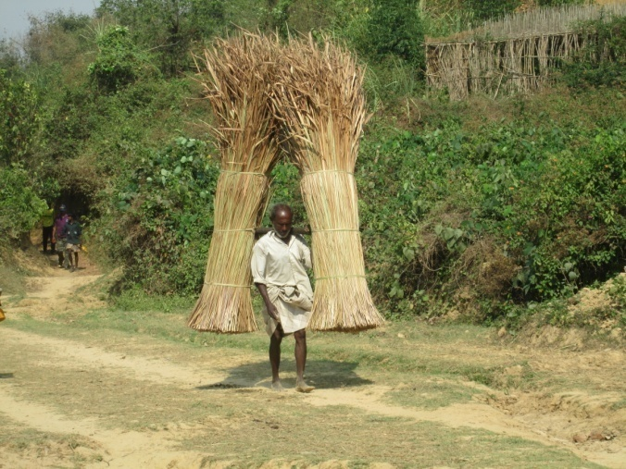
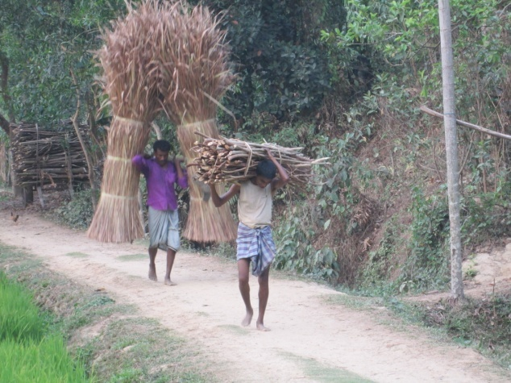
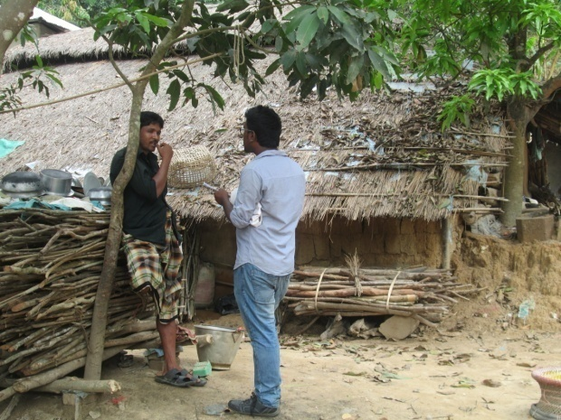
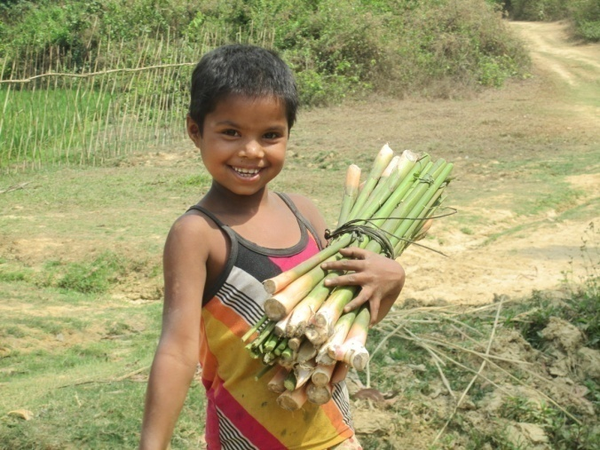
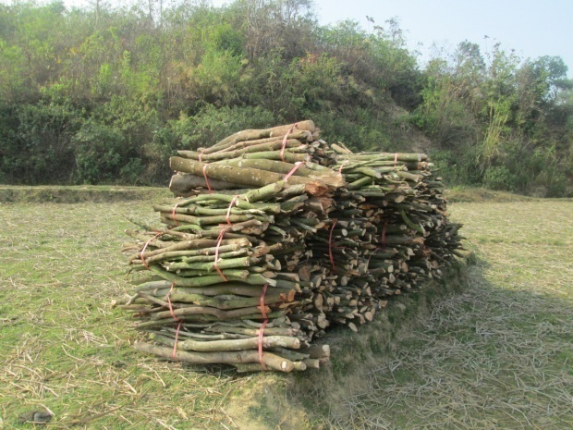
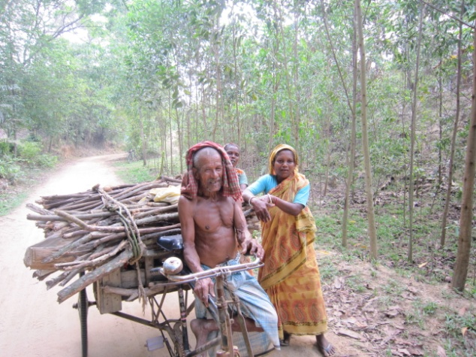
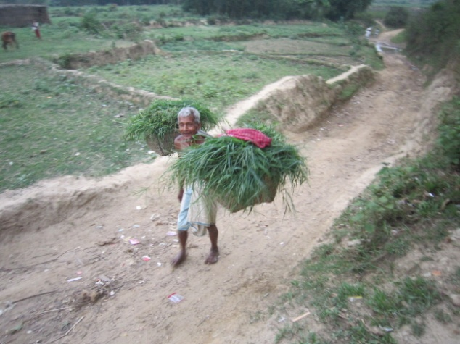
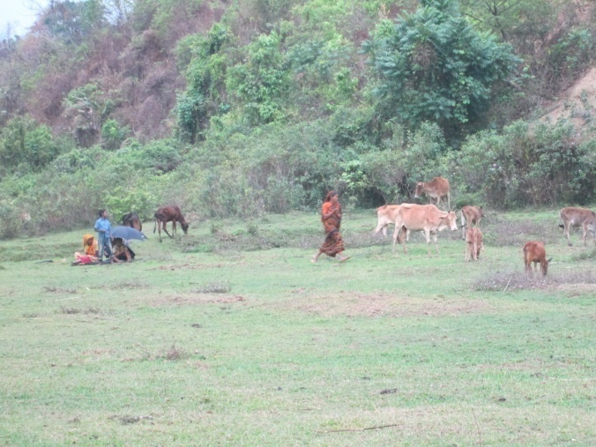
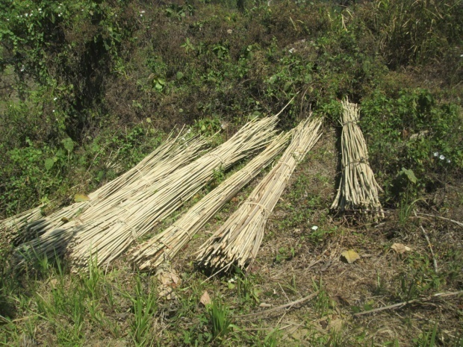
Forest Resources Collection

Slide 14
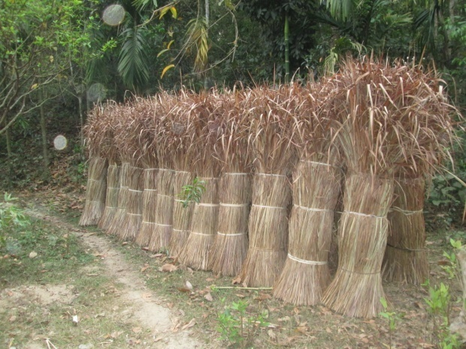
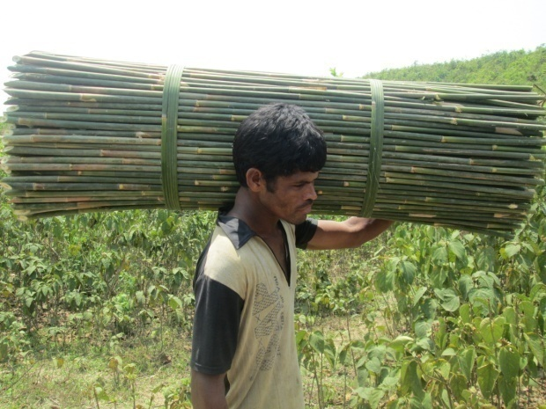
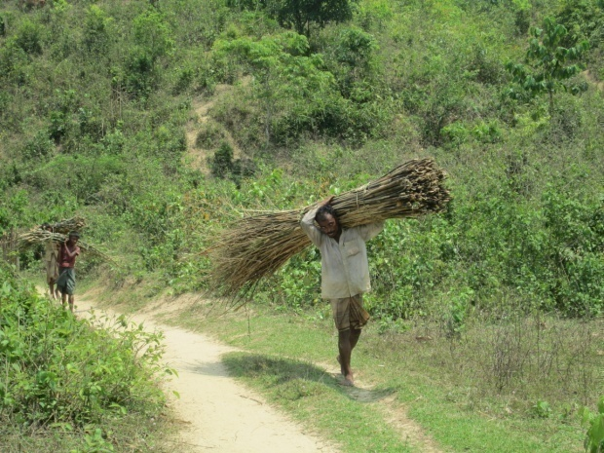
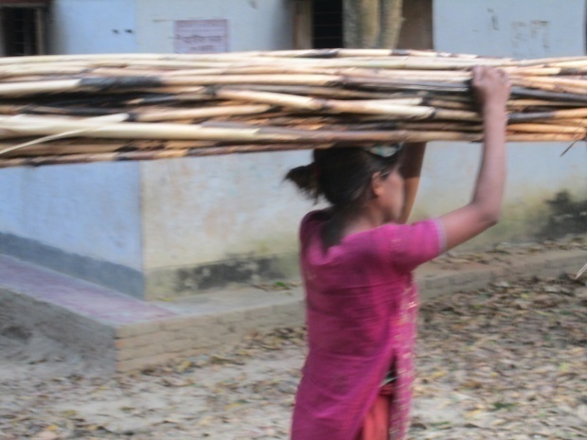
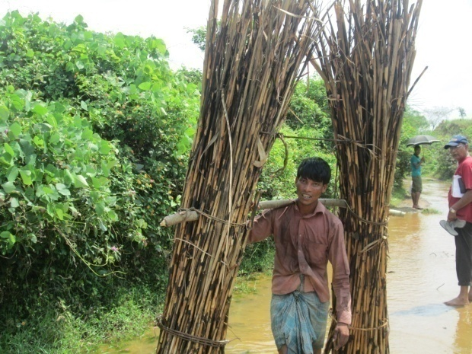
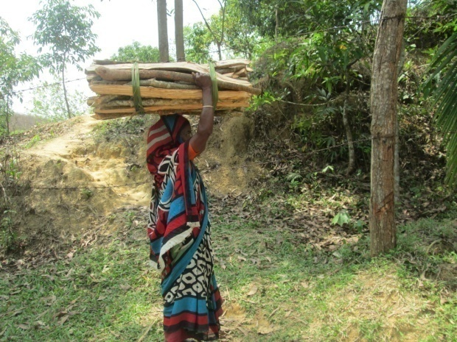
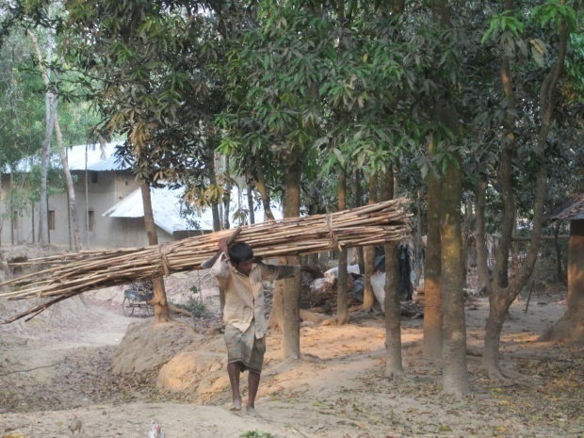
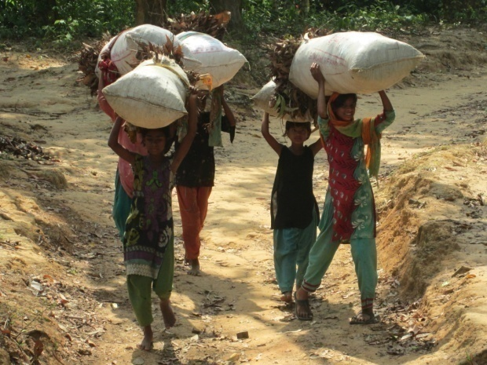
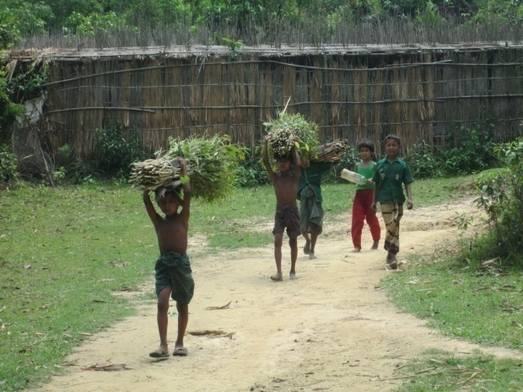
Forest Resources Collection

Slide 15
Key Findings
Total resource collectors recorded from the surveyed points - 481
78% male and 22% female
84% adult (age range 18-72) and 16% minor (age range 5-17)
Average age – 33 years (37 for adults and 12 for minor)
Majority collecting fuelwood (30%) followed by fruits (13%), timber (11%), agri. Products (11%), bamboos (10%), sungrass (10%), etc.
The mode of carrying of collected forest resources from the forests was by shoulder load (63%), head load (30%), motor driven small truck or push cart load (6%) and hand load (1%).
On average resource collectors spent 5.71 hours and travelled 6.41 km in the forests
16 tons of resources were collected from the forests on the surveyed day of which 77% resources were collected by travelling 5-12 km inside the forests

Slide 16
Estimate of direct values
It might be estimated that on average 962 resource collectors enter the CWS each day making 28,860 visits per month and 346,320 visits per year for the purpose of resource collection (through 56 trails).
The value of the resources collected per day by the local communities might be estimated as BDT 289,562 (USD 3,697.16) for the whole of CWS
Total values of the collected resources per year from CWS might be estimated as BDT 8.69 million (USD 0.11 million) per month and BDT 104.24 million (USD 1.33 million)

Slide 17
Conclusion
Local communities are very much dependent on CWS on one hand and the forests are being depleted day by day on the other hand.
Valuation of direct ecosystem services will be helpful to understand the importance of the forests to the local communities and also estimate the payments for ecosystem services (PES) to conserve the forests.
Findings of this study will be useful to the managers and policy makers for the valuation of total ecosystem services provided by a forest protected area, and will give a better insight to the problem of forest degradation.
As a general rule there is always a negative relationship between peoples’ livelihoods and biodiversity resources or forests.
If we think of conserving biodiversity resources or forests we should consider alternative livelihood options for the local communities.
Otherwise no conservation initiatives will be successful.

Slide 18
Actions for the Government of Sri Lankan
Assess both direct and indirect values of forests
Aware and educate people about the values of ecosystem services
Apply payments for ecosystem services (PES) system to conserve the forests
Create alternative livelihood options especially for forest dependent people
Ensure peoples’ participation by providing legal rights to and involving in managing ecosystem services

