Slide 1
Valuing Ecosystem Services Together (VEST):
A social marketing strategy for the promotion of
Payment for Ecosystem Services in Northern Mindanao,
Philippines
EVANS ROSAURO I YONSON
eyonson@xu.edu.ph
@evansyonsonph

Slide 2
Background
Cagayan de Oro City, Philippines
17 Dec 2011 (Washi/Sendong)
Affecting 700,000 people
Damaging 40,000 homes
Large amount of water came from Mt Kalatungan, Bukidnon.

Slide 3
PES Project
public and private sectors partnership
Cooperation of the communities from the downstream and highlands of Northern Mindanao to landscape rehabilitation
Providing ecological services of preventing flood and a supply of clean, potable water

Slide 4
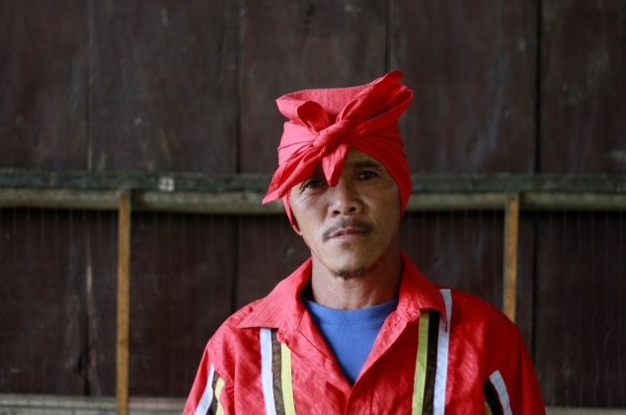
Sellers
MILALITTRA (Talaandigs)
2,500 households
1,800 hectares
Community Development Plan
> Environment
> Livelihood
> Infrastructure support
> Health services
> Education
> Culture and Tradition

Slide 5
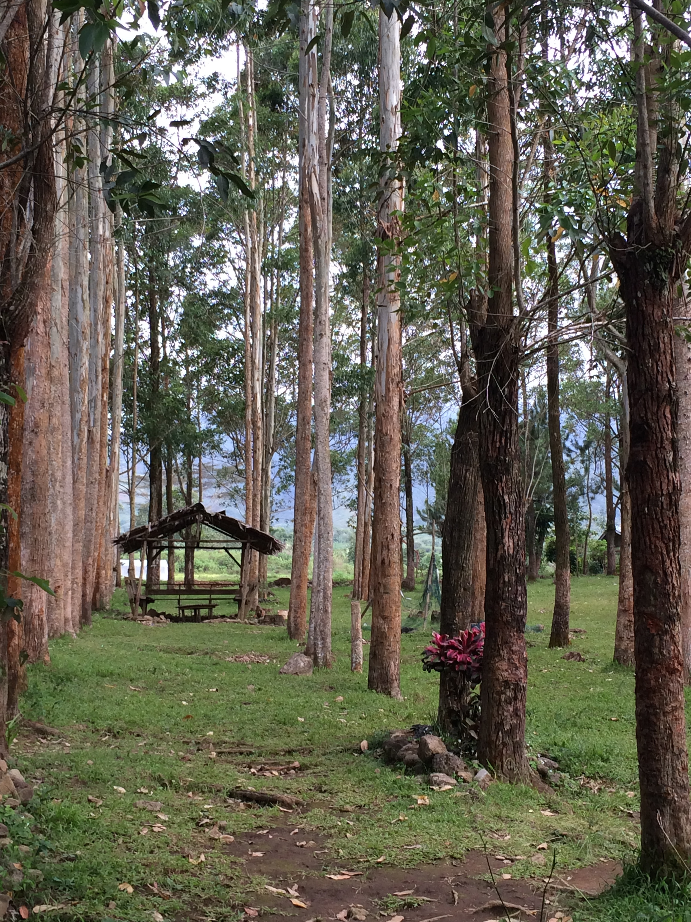
Rehabilitation
Farmers and foresters
832 hectares for reforestation
816 hectares for agroforestry
PES: 14KPhp/year/ha (289 USD)
Xavier Science Foundation as the Fund Manager

Slide 6
Buyers (Sectors)
Corporations
Cooperatives
the Church
Schools
the Households

Slide 7
VEST
Conduct of a knowledge, attitude, and practices survey
Design of the campaign materials
Identify the PES champions
10 visits to Mt Kalatungan
Launching of the Campaign
> Traditional media
> New media technologies

Slide 8
VEST and media forms
Newspaper articles and print ads
Radio/TV plugs and guestings
Short documentary films (14)
Original song compositions (16)
Lectures/orientations
Seminars
MTVs (10)
Social Media
@vestogether

Slide 9
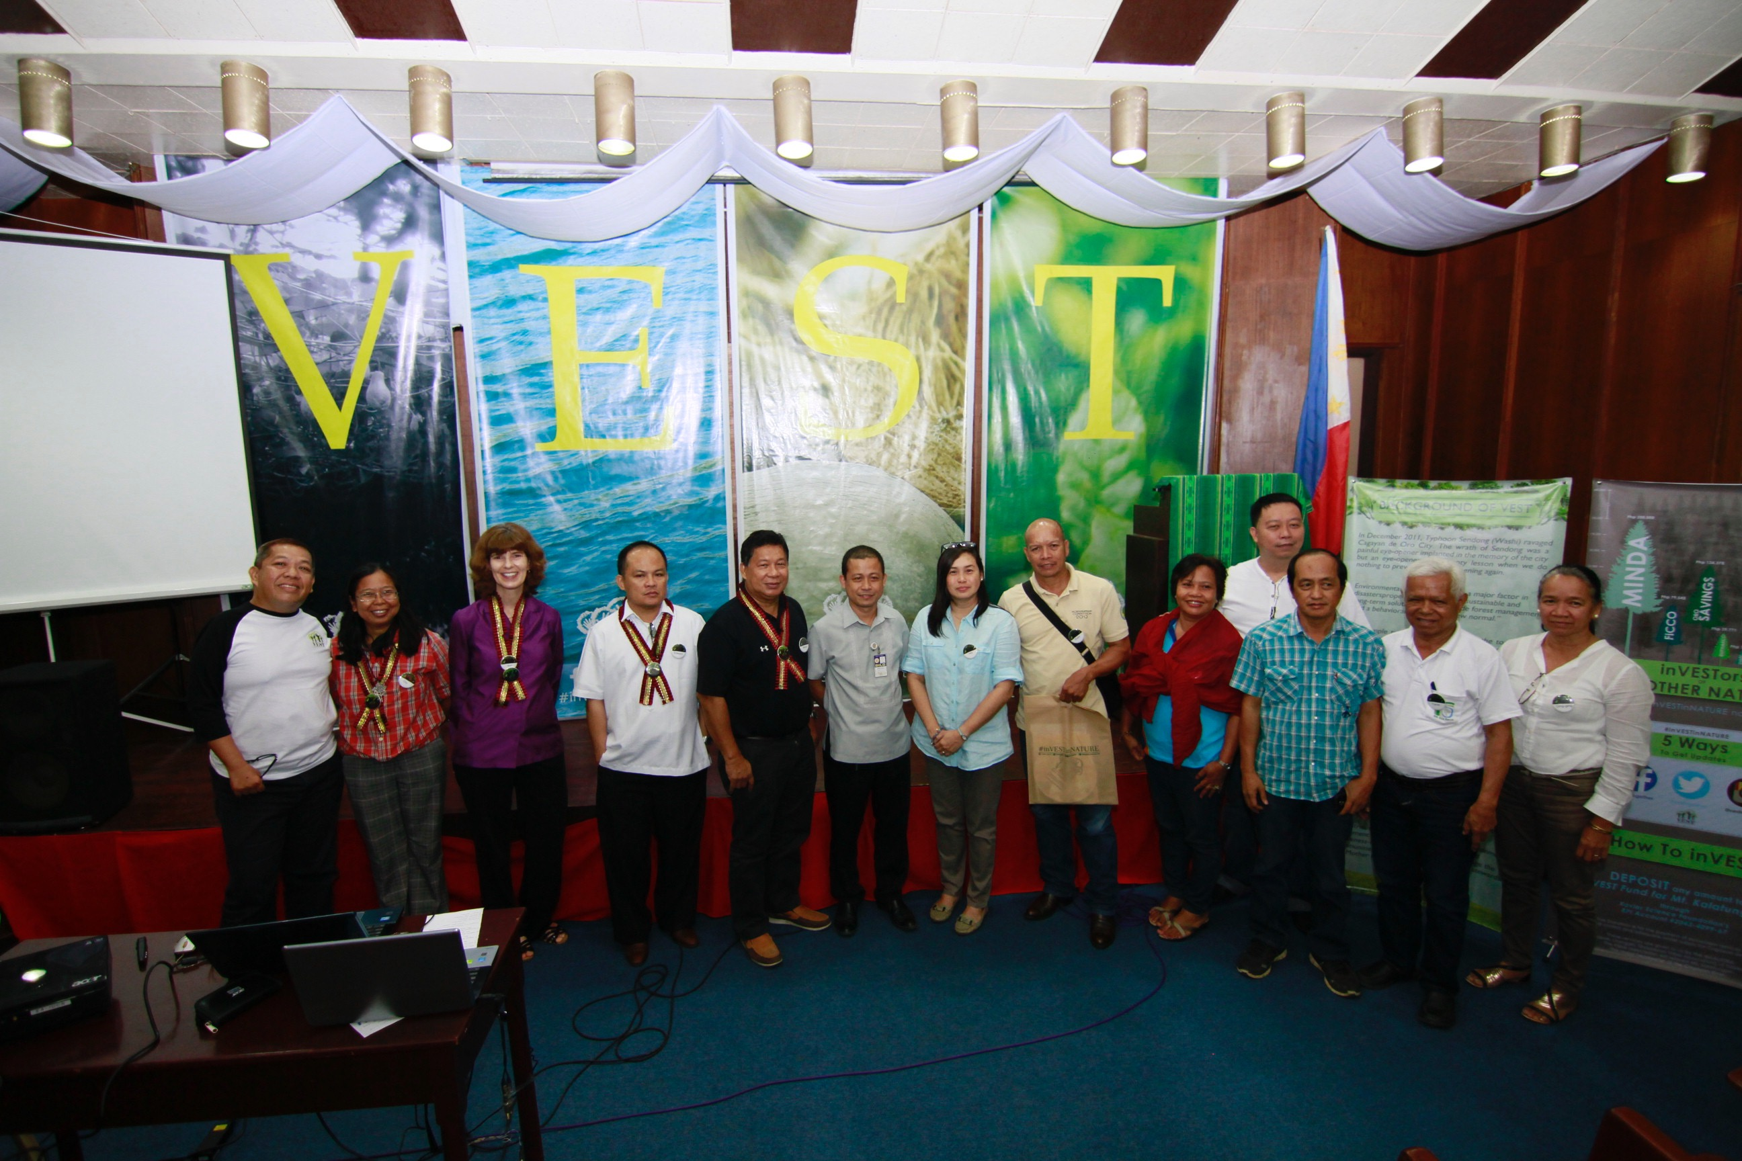
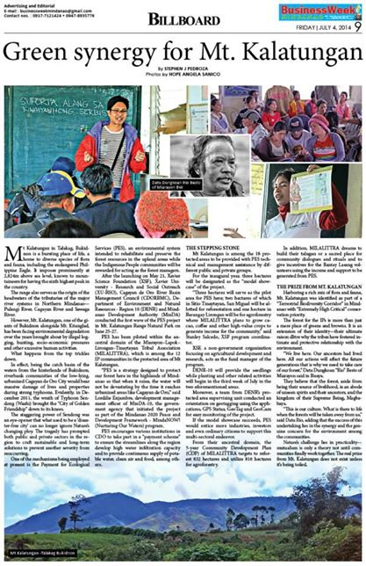
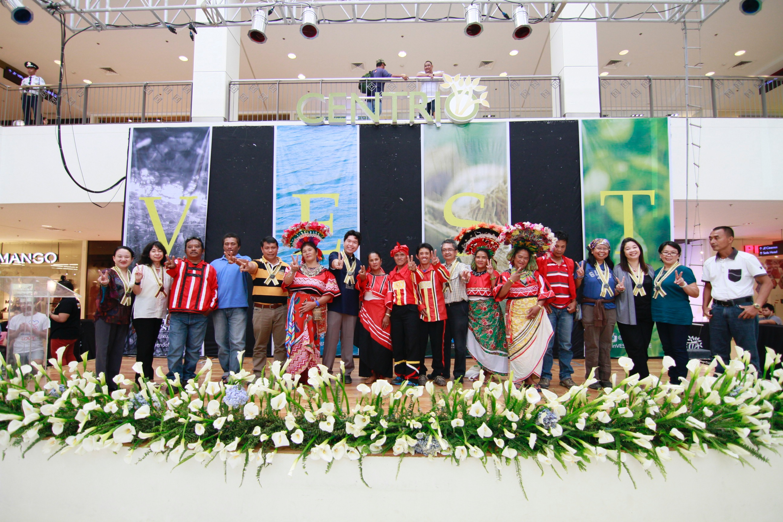
VEST and media forms

Slide 10
Results
Issuance of municipal orders adapting PES
Partnerships with LGUs, corporations, >300 cooperatives, church, schools
Raised 33K USD
CHEd Memorandum Order

Slide 11
Recommendations
Involve local government units in your efforts
Private sector participation should be explored
Sellers should be actively involved
An independent fund manager should help out the community/sellers
National government provides mechanism for PES to work

