Slide 1
Natural Capital, Ecosystem Services and Role of Environment Valuation in Policy Making
H. M. Gunatilake
Director, Environment and Safeguards Division
Asian Development Bank

Slide 2
Outline
Background
Overview in Ecosystems Services Valuation/Values
Incorporating Ecosystems Services Valuation into Policy Making
The Way Forward

Slide 3
A. Ecosystem Values
Why Value Ecosystem Services ?
Markets, prices and resource allocation
Market failures – decline in supply of ES
Valuation assesses human welfare changes associated with environment quality changes or natural resource availability changes
Anthropocentric, monetary values

Slide 4
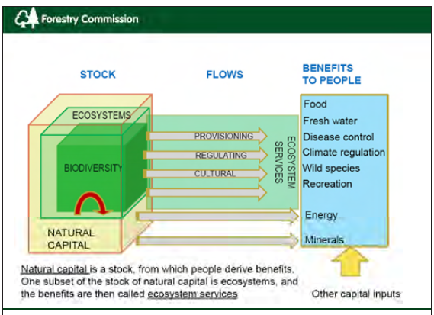

Slide 5
Millennium Ecosystems Assessments

Slide 6
Natural Capital – Loss and Degradation
Issues | Trends
Land degradation ↑ | 25% of land area in Asia-Pacific degraded (2008) 43% of agricultural land degraded in South Asia >50% of dry land ecosystems affected by desertification
Forests ↓ | Overall positive trend, but.... 3.32 Mha loss (primary forests) in SE Asia (1990-2010)
Climate ↑ (GHG emissions) | 15-20% of global GHG emissions from land use change & tropical deforestation. 5-6% of global emissions from deforestation in South and SE Asia.
Biodiversity ↓ | 67% reduction in species and populations in Asia-Pacific (1970-2010)
Coral reefs ↓ | Over 40% of the coral reefs and mangroves disappeared over the last 40 years – declining fish stocks
Notes:
I will not go into all the details of this slide.
Just a few examples:
About 25% of the total land area in Asia and the Pacific is degraded and 50% of dry land ecosystems are affected by desertification.
Primary forests continue to be lost, even as forest restoration programs increase in places such as the PRC.
This has serious implications for biodiversity, which has seen a 60% decline in Asia-Pacific in the past 30 years (twice the global rate)
Coral reefs in particular have been decimated, with 40% lost in the last 40 years.
These losses have serious impacts on water and food security, while contributing to climate change and reducing resilience.
6

Slide 7
Ecosystems and Human Wellbeing
Biophysical Structure or process (e.g. vegetation cover or Net Primary Productivity
Function (e.g. slow water passage, biomass)
Service (e. g. Flood protection, products)
Benefits (s) (contribution to health, safety, etc.)
Econ (Value) (e.g. WTP for protection or products)
R. S. de Groot et al, 2010

Slide 8
Economic value linked to forest goods and services
Use value |  |  | Non-use value
Direct use value | Indirect use value | Option value | Existence value | Bequest value
Extractive, consumptive or structural value, mainly derived for goods that can be extracted, consumed or enjoyed directly | Services that the environment provides | Value attached to maintaining the possibility of obtaining benefits from ecosystem goods and services at a later date, including from a low value now but could have a much higher value in future because of new information and knowledge | Value people derive from the knowledge that something exists even if they never plan to use it | Value derived from the desire to pass on ecosystems to future generations
Material goods Cultural and amenity services | Regulating services Supporting services | All services | All services | Supporting services
Source: PLS ADD APPROPRIATE SOURCE FORMAT (details in notes)
Notes:
Source: Standing Forestry Committee ad hoc Working Group on Valuation and Compensation Methods for non-wood goods and services, November 2008: http://ec.Europa.eu/agriculture/fore/public/sfc_wgi_final_report_112008_en.pdf
Economic valuation is based on economic value. Total economic value can be looked at from two angles: use and non use value
Direct use values - actual price paid for an ecosystem services such as timber. Economic valuation is based on adding many services that have direct use and market prices. In addition to commercial value, direct use can also involve non-commenrail activities such as subsistence livelihoods (possible example from MYA pilot in Bruce’s RETA)
Indirect use values – related to regulating and supporting ecosystem services such as water cycling, nutrient cycling, pollination. Includes indirect benefits from ecosystem services such as maintenance of water quality, and flow, maintenance of biodiversity
Option value – e. .g. value of retaining biodiversity to keep open the future possibility of identifying medicinal plants for pharmaceutical uses
Existence value e.g. certain forests or watersheds exists
Bequest value – leaving the ecosystem intact for the next generatin

Slide 9
Valuation Methods
Direct Market Valuation
Market Prices
Cost based approaches
Production function based approaches
Surrogate Market Valuation
Travel cost, hedonic pricing
Stated Preference Methods
Contingent Valuation, Conjoint Analysis
Benefit Transfer

Slide 14
Notes:
Climate regulations, 328 = 11.10%
Water supply, 21 = 0.70%
Erosion control, 360 = 12.20%
Soil formation, 15 = 0.50%
Nutrient recycling, 1360 = 46.10%
Waste treatment, 128 = 4.30%
Food production, 47 = 1.60%
Raw materials, 463 = 15.70%
Genetic resources, 60 = 2%
Recreation, 165 = 5.60%

Slide 15
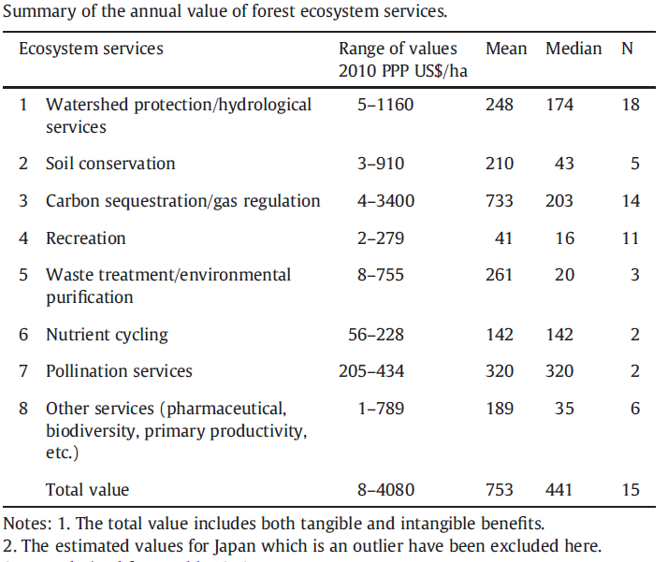
Source: “Valuing forest ecosystem services: What we know and what we don't”, K.N. Ninan and Makoto Inoue, 2012

Slide 16
Forest Ecosystem Services Valuation- Summary
Values sensitive to number of services valued, price/method used, and local contexts.
Total value vary between 8 – 4080 $/ha/year, mean 753
Values are higher for watershed protection services, carbon sequestration, waste treatment, environment purification, and pollination services

Slide 17
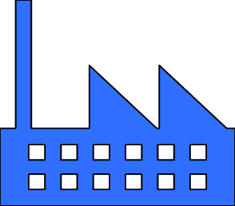
Macroeconomics: opportunity and vulnerability
It is not negligible:
US$ 7.5 billion
in East Asia & Pacific,
US$ 4 billion
in South Asia
US$ 6 billion
in Europe & Central Asia
(for 2005)
It is at risk! e.g. decline in NC can really affect GDP: e.g. loss of 17-34% Kiribati from rising sea levels
Wealth
Millions of jobs and exports
The Wealth of the Nations. 2005.
Notes:
In an economy, natural capital complements produced capital, or manufactured like infrastructure and machinery, and intangible capital (e.g. like human, social and institutional capital) to generate wealth
Natural capital: Crop Pasture Land Timber NTFR Protected Areas Oil Natural Gas Hard coal Soft coal Coal Minerals Subsoil Assets
Results show that in 2005 natural capital amounted to US$7,512 billion in East Asia & Pacific, US$3,796 billion in South Asia and US$6,256 billion in Europe & Central Asia -of which US$5,235 billion were from China. The values could be even higher, as they do not reflect the impact of ecosystem services on economic goods–like the contribution of natural pollinators to crop production.
The high dependency on natural resources displayed across the Asia Pacific is consistent with most developing regions, which show that on average 30% of their national wealth comes from natural capital. The average percentage worldwide is lower (5%), and high income countries like those in the OECD have the lowest dependency of natural capital for national wealth (2%). The study suggests that –for most countries – the initial high dependency on natural resources is reduced as countries “manage their assets in the long term and reinvest in human and social capital as well as in building strong institutions and systems of governance” (The World Bank 2011).
The components of natural wealth vary across the region. Agriculture and forests are important sources of wealth for East and South Asia, while countries in Central Asia depend more on their subsoil assets-many of them non-renewable. The higher the dependence, the higher the rate of use and extraction.
CHANGES IN THE NATURAL CAPITAL BASE HAVE DIRECT IMPACTS ON GDP. E.g. The cost of rising sea levels – 17-34% of 1998 GDP in Kiribati

Slide 18
Cost Benefits in Policy contexts:
China:
$255 billion investment vs
$1208 benefits
National returns to investing are higher than the investment costs
Central Asia:
$53 billion vs
$288 billion
Uzbekistan:
$11 billion investment vs
$50 billion benefits
Project level ERR from sustainable management can be high (linked to type of activities, ecosystems, and their services)
Protected areas in Sri-Lanka: $45m WB loan with15.4% ERR
Amazons: $470m ($162m loan from IDB), 14.4% ERR.
EbA often highly cost-effective in relation to other types of adaptation
Fiji: $19.5 EbA versus $9 engineering
Tropical breakwaters: up to $188k pm, versus $470 for reef restoration
Notes:
Multiplier effects
Conflicsts across borders
There have been a series of recent attempts to calculate the national benefits and costs of land management:
China is seriously affected by grassland degradation, deforestation and cropland degradation. A recent detailed study estimates that it would cost US $ 255.45 billion to rehabilitate this over a 30 year period. The benefits or avoided costs of degradation are US $ 1208 billion during the same period. This shows that benefit to cost ratio of over four (Deng et al., 2016).
For India, the costs of land degradation are estimated in 2009 at about $ 5 billion. The benefits (avoided cost of inaction) exceeds cost of action against land degradation in every state. The ratio of action over inaction is about 20–40 % in humid states and above 40 % in sub humid and arid states (Mythili et al., 2016).
Central Asia including the five countries of Kazakhstan, Kyrgyzstan, Tajikistan, Turkmenistan and Uzbekistan suffers severe land degradation such as salinization in the irrigated lands, soil erosion in rain-fed and mountainous areas and decline of rangelands. The most detailed study of land degradation in Central Asia shows that benefits are greater than costs by a factor of four. The results show that it costs $ 53 billion over a 30-year period to reduce land degradation, while the benefits (or avoided costs of inaction) over the 30 year period would be 288 billion USD during the same period (Mirzabaev et al., 2016).
For Uzbekistan land degradation is a major challenge. A detailed study found that the economic value of land degradation costs including the costs of lost ecosystem services, in Uzbekistan in 2009 as compared to 2001 was 0.84 billion USD, i.e. about 4 % equivalent of the Gross Domestic Product (GDP) in 2007. The results show that the costs of action against land degradation are lower than the costs of inaction in Uzbekistan by more than 4 times over the 30 year horizon. The costs of action were found to equal about 11 billion USD over a 30-year horizon, whereas the benefits (avoided costs) are almost 50 billion USD during the same period (Aw-Hassan et al., 2016).
Further, reef restoration projects have been shown to be an order of magnitude cheaper in hazard mitigation then hard engineering solutions. For examples the construction of tropical breakwaters can cost anywhere up to US$188,000 per lineal meter are simple reef restoration projects can be as cheap as US$470 per lineal meter. (Ferrario et al., 2014). In the Maldives use the replacement cost method with a shame that the reefs were lost in the cost involved would be as a minimum the building of hard infrastructure such as seawalls, break walls and other form of coastal protection. The replacement cost of natural reefs were estimated at US$ 1.6 billion – 2.7 billion. In contrast conserving the reefs to prevent their ongoing degradation through activities such as the establishment of marine protected areas would cost US $34 million in start-up costs and US$ 47 million annually (Emerton et al., 2009)
In the Philippines Baig et al., (2015) found that mangrove protection provided avoided damages for shoreline protection of USD 206,621, as compared to building a seawall, which provided avoided damages of USD 180,046 with a 10% discount rate. The cost of building a sea wall was estimated to be $6010 -7268 USD while mangrove protection was estimated $338 USD over a 20 year period.

Slide 19
TEEB Findings
50% reduction in deforestation rates by 2030 would reduce GHG emissions by 1.5 to 2.7 GT CO₂ -US$3.7 trillion in NPV terms.
Over-exploitation of fish stocks reduce the income from global marine fisheries by US$50 billion annually.
Coral reefs -30 million people in coastal communities are totally reliant on reef-based resources for livelihood.
Bee keeping generates US$213 million annually in Switzerland.
Tree planting - 400,000 trees - US$20-67 million over the period 2008-2012 in Canberra.
Notes:
A single bee colony ensured a yearly agricultural production worth (US$1,050) in pollinated fruits and berries in the year 2002, compared to just US$215 for direct products from beekeeping.
400,000 trees were planted to regulate microclimate, reduce pollution, and thereby improve air quality, reduce energy costs for air conditioning and store and sequester carbon. Benefits were around US$20-67 million over the period 2008-2012 in Canberra.
Coral reefs are home to an estimated 1-3 million

Slide 20
Shortcomings of FEV Studies
Limited coverage of forest sites,
There are underserved FES in valuation studies
Watersheds, soil conservation, carbon sequestration, recreation well studied
Nutrient recycling, pollination, purification – little attention
Poor design- scale, year of the study, many methodological issues, stock/flow, data description,

Slide 21
Shortcomings of FEV Studies Cont..
Marginal value vs total value
Inconsistent use of terminologies
Disservices have not been valued
No consensus on double counting
Interdependencies amongst different ecosystems are not considered.

Slide 22
The Way Forward
Valuation Studies
Sound evidence (Science, Economics) –Credibility
Focus on underserved ES
Make available studies accessible
Uniformity and common approach to quality control
Link to policy/project, marginal values

Slide 23
The Way Forward
Promoting investment on natural capital
Rigorous valuation combine with employment, financial and fiscal impacts data.
Combine with physical infrastructure investments
Combine with poverty reduction programs – conditional cash transfer
Mobilize private financing – green business
ADB’s work on natural capital

Slide 24
Thank you

