Slide 1
PERFORMANCE OF COASTAL VEGETATION IN DISSIPATING THE ENERGY OF THE UPCOMING FLOW
INTERNATIONAL RESEARCH SYMPOSIUM ON VALUATION OF FOREST ECOSYSTEMS AND THEIR SERVICES
18th OCTOBER, 2016
Eng. R.M.C.L. BANDARA
B. Sc. Eng. (Hons) (University of Moratuwa, Sri Lanka)
Eng. E.A.D.D.D. EGODAWATTE
B. Sc. Eng. (Hons) (University of Moratuwa, Sri Lanka)
Eng. H.R. ABEYWICKRAMA
B. Sc. Eng. (University of Moratuwa, Sri Lanka)
Under The Supervision Of
Prof. S.S.L. HETTIARACHCHI
B. Sc. Eng. (Hons) (Moratuwa), PhD (London), DIC, Professor, Department of Civil Engineering, University of Moratuwa, Sri Lanka.
Notes:
Topic and Brief

Slide 2
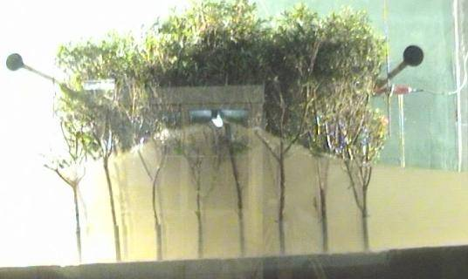
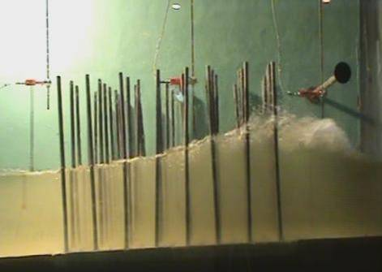

Hydraulic Performance of Coastal Eco-Systems
“Hydraulic Performance of Coastal Eco-Systems” has been continuously investigated by University of Moratuwa (in collaboration with Arizona State University) since 2006.
The studies are done in different phases covering performances of coral reefs and coastal vegetation.
Research studies on the subject matter are still being continued at University of Moratuwa.
Findings of many of the previous investigations have been included in the publication;
Notes:
Overview not much details

Slide 3
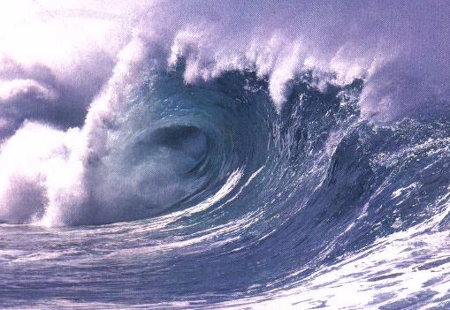
‘Upcoming Flow’ Due to Various Coastal Hazards
Chronic hazards
  Shoreline erosion
  Flooding
  Sedimentation
  Sea level rise
  Coastal environmental and resource degradation
Episodic hazards -very limited predictability , but causing severe damages
(could either initiate chronic conditions or increase the existing chronic hazards)
    Tsunamis - Severe Storms
    Earthquakes - Oil spills
Sri Lanka is also vulnerable
Notes:
1) There are Two main types of coastal hazards
2) This Study mainly concerns about upcoming flow due to episodic hazards
3) We have to Keep in mind that sri lanka is also vulnerable

Slide 4
Coastal Hazard Mitigation Measures
Measures that mitigate the impact of the hazard
Measures that mitigate exposure and vulnerability to the hazard
Measures that promote successful evacuation from the hazard
Reducing the impacts of waves prior to reaching the shoreline
Mitigating the severe impacts of waves on entry to shoreline
Protecting the coastal zone by preventing the inland movement of waves
Artificial Structures and Natural Eco-Systems
Notes:
1) Coastal hazard mitigation measures could be classified under 3 categories
2) Our interest is about measures that mitigate the impact of the hazards
3) Both artificial methods and natural eco systems can be classified under this category

Slide 5
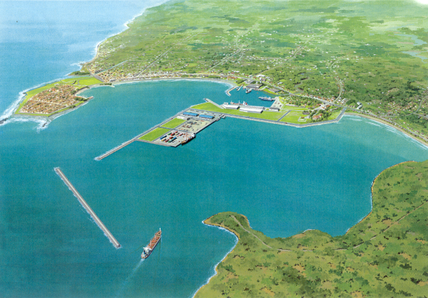
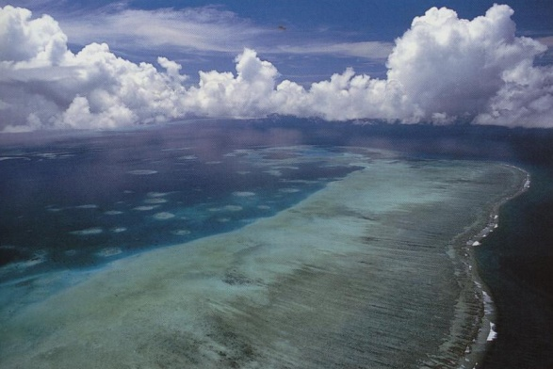
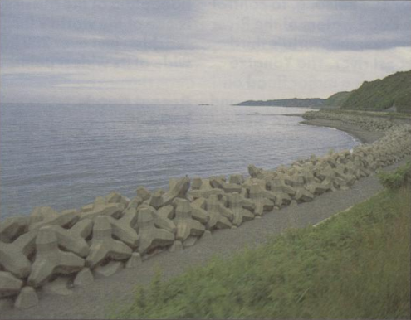
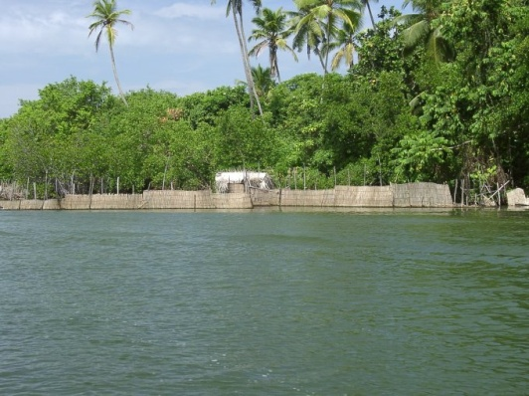
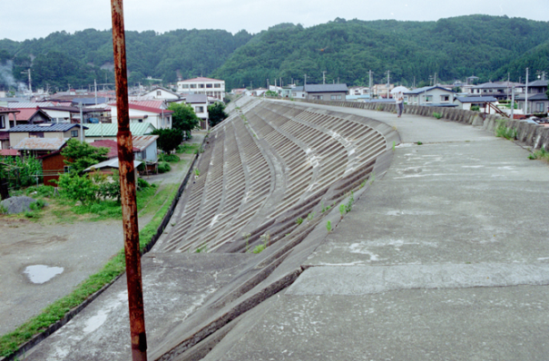
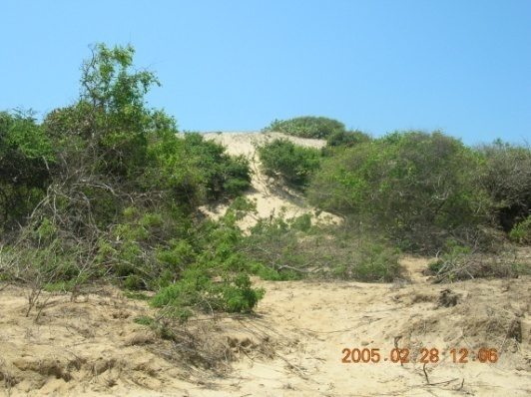
Impact Mitigation of Tsunami Waves
Tsunami and Offshore Breakwaters Coral Reefs
Reduce the impacts of tsunami waves prior to reaching the shoreline.
Revetments, Dikes (Low Crest) Mangrove Forests
Mitigate the severe impacts of tsunami waves on entry to the shoreline.
Revetments, Dikes (High Crest) Sand Dunes
Prevent the inland movement of tsunami waves.
Notes:
1) Different form of impact mitigation measures perform differently in mitigating wave impacts
2) Mention three categories

Slide 6
Artificial Structures and Natural Eco-Systems
Artificial Structures (Hard Structures)
High construction capital
Natural
Eco–Systems (Soft Structures)
Effective energy dissipation
May not be the most feasible measures for developing countries (Frequency of occurrence is low for severe coastal hazards)
Sustainable
Enhance aesthetical appearance and aquaculture
Direct values : firewood, charcoal, construction material, raw materials for pulp and paper industries
Notes:
Mention statements and describe

Slide 7
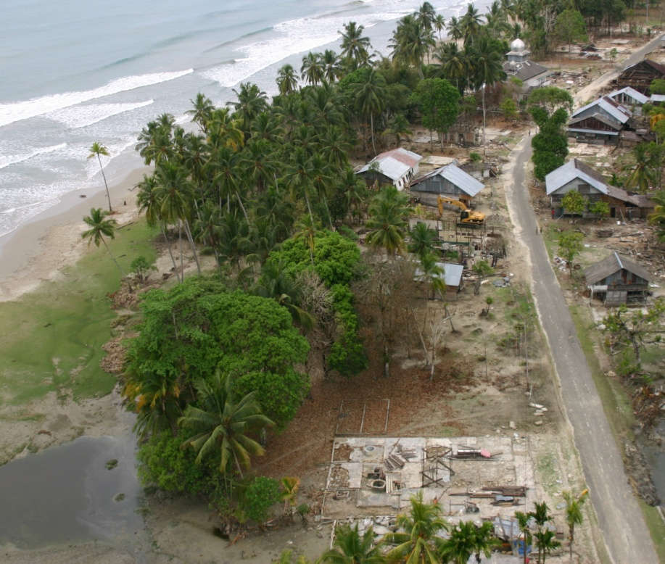
Evidence from Post-Tsunami Field Investigations
Indian Ocean Tsunami (2004)
Less damage behind 20-40 m wide vegetation barrier in Kaluthara (Norio Tanaka, et. al. 2006 ).
Reduced wave heights behind Mangrooves (M.Kaplan, F.G. Renaud & G. Lüchters, 2009) at several locations.
Trees have provided methods of evacuation in Hambanthota (JWRC 2008).
The protection provided by Mangrove forests in Tamil Nadu (Kandasamy and Narayansamy 2005).
The protection offered by the species Rhizophora apiculata, Rhizophora mucronata and Pandanus odoratissimum in Sri Lanka and Thailand (Fobes and Broadhead 2007).
Coastal Forest Protected Houses in
West Coast of Indonesia
Notes:
1) Many field investigations carried out along indian ocean tsunami affected areas has revealed the effectiveness of coastal vegetation
2) In many cases, it could be concluded that coastal vegetation has led to localized reductions in inundation depths because other topographical features were homogeneous
3) Picture shows less damages to the houses behind vegetation compared to the severe damages to the houses directly exposed to waves.

Slide 8
Performance of Coastal Vegetation – Hydraulic Aspects
Categorization of Plant Structures
Three distinctive components of the tree structure:
  Aerial (above ground) root system
  The (near) vertical stem
  The branch / leaf structure
These components, considered with the possible inundation depths, leads to the classification of four different categories.
Category I: Resistance provided by stem only
Category II: Resistance provided by stem and branch structure
Category III: Resistance provided by stem and aerial roots structure
Category IV: Resistance provided by stem, branch structure and aerial roots structure
Notes:
1) Three components of a tree could provide resistance to flow.
2) Trees can be classified under four categories as per the contributions from the above components

Slide 9
Performance of Coastal Vegetation
The resistance offered by coastal vegetation against overland flow depends on BOTH:
Characteristics of Individual Plant Elements – Influence the Drag Force Coefficient C_{d} and Projected Area A_{0.}
  Size and shape of individual elements – Governed by the standing structure of trees.
  Resilient characteristics of individual units which depends on:
    Breaking strength and flexibility of trees – Governed by the material properties and stem/branch sizes.
    Erosion at the root zone of the trees – Governed by the bed level velocity of flow and the structure of the root zone.
Characteristics of Vegetation as a Whole – Since the wake formed at the upstream bodies influence the wake formation at downstream bodies.
  Density
  Porosity
  Extent
  Tortuosity – Governed by the pattern of distribution of plants
Notes:
1) Performance of the vegetation depends on both individual characteristics of the plants and characteristics of vegetation as a whole.
2) Performance is ultimately governed by the ability of the plant to resist the flow without being damaged or uprooted

Slide 10
Performance of Coastal Vegetation
In addition to characteristics of individual elements and characteristics as a whole, performance in dissipating wave energy depends on:
Location – Governed by the distance to vegetation belt from the shoreline.
Local topography of the shoreline
Investigation of Influences by Each Characteristics
Interdependency of characteristics – Difficult to develop relationships between characteristics and performance.
Influence of each characteristic investigated separately.
Under this Study
  Porosity of the vegetation belt
  Extent of the vegetation belt
Notes:
Mention

Slide 11
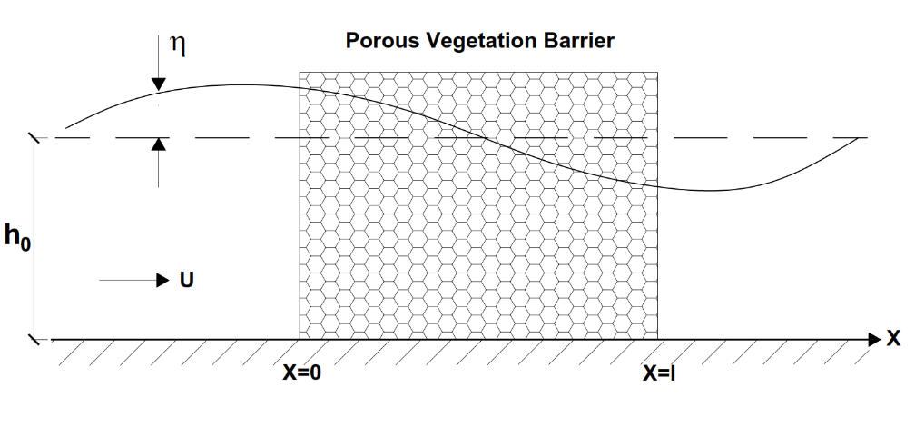
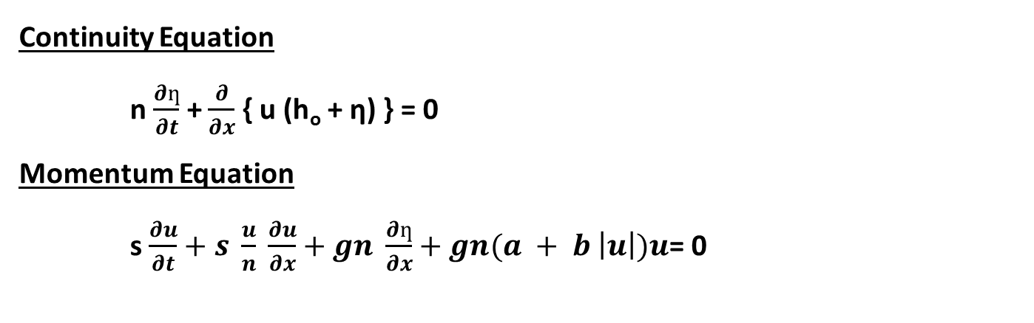
Experimental Study
Flow behavior through a porous vegetation barrier was investigated under steady state and unsteady state flow conditions, which represent realistic flow scenarios;
    Large Scale River Flooding.
    Oceanic Waves, etc.
    The relationship between ‘head loss gradient’ and ‘bulk velocity’ through the vegetation barrier was analyzed to determine corresponding flow coefficients; a and b.
    Determining the flow coefficients for a particular media pays dividend for all practical applications, when solving the ‘Governing Equations of Motions’ inside the porous barrier:
Continuity Equation
n $\frac{∂ƞ}{∂t}$ + $\frac{∂}{∂x}$ { u (h_{o} + ƞ) } = 0
Momentum Equation
s $\frac{∂u}{∂t}+s \frac{u}{n} \frac{∂u}{∂x}+gn \frac{∂ƞ}{∂x}+gn(a + b \left|u\right|)u$= 0
where; u – horizontal component of the macroscopic velocity (discharge velocity)
n – porosity of the barrier
F – Non-Darcy friction term which is estimated using the Forchheimer equation and is expressed as
F = a + b |u| → a and b taken from I = au+bu²
s – factor expressing the effect of unsteady motion and is given by;
s = 1+ k_{a} (1-n)
k_{a} – added mass coefficient which typically varies between 0.5-1 (taken as equal to unity for this research study)
Notes:
Describe

Slide 12
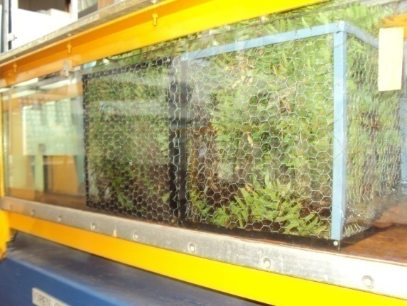
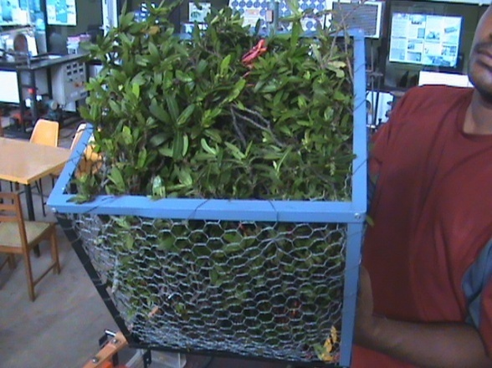
Experimental Study
Experimental Set up
  Carried out inside a Hydraulic flume (L– 10m, W– 30cm, H– 31cm)
  Analysis done considering one dimensional flow movement.
  Simulation of vegetation:
    Cages of 30cmx30cmx30m made with chicken mesh (to minimize impacts of the cage structure)
    Filled with small stems and leaves
    Selected scales – horizontal 1:100 and vertical 1:10 (approximate)
    Individual impacts of front and rear faces of the barrier and side wall effects were neglected.
Extent of Barrier
  30 cm (one cage)
  60 cm (two cages)
Porosity of Vegetation
  93.36%
  95.83%
  97.15%
Flow Conditions
  Steady Flow Conditions
  Simulation of Tsunami Wave Conditions
Notes:
Describe

Slide 13
Steady State Flow - Results and Conclusions
Experimental Study
When the length of the barrier in the direction of flow increases;
  Total energy dissipation increases.
  Hydraulic gradient (i) decreases.
Even short barriers can perform effectively.
Lengthy barriers may not always be necessary to dissipate considerable amounts of energy.
Notes:
Describe

Slide 14
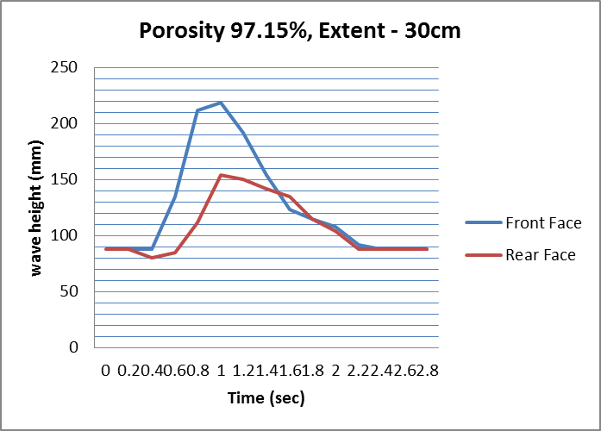
Unsteady State Flow - Results and Conclusions
Experimental Study
Velocity Profile was developed over the entire flow depth by moving a timber plank attached to rails.
Analysis done considering the wave heights at the front face and the rear face of the barrier.
For all three porosities, shorter barriers have shown higher head loss gradients.
Even short barriers can perform effectively.
Lengthy barriers may not always be necessary to dissipate considerable amounts of energy.
Notes:
Describe

Slide 15

Highlights
  Hazards like Tsunamis;
    Posses very limited predictability – Possibility of future hazards can not be denied.
    Create devastating damages – Need to adopt, properly planned, effective counter measures against the hazards.
    Less frequency of occurrence compared to other hazards – sustainable and cost effective impact mitigation measures to be adopted (especially in the context of developing countries).
  Many post-Tsunami field investigations have revealed the effectiveness of coastal vegetation.
  In order to offer resistance against particular wave heights;
    Sufficient Height of Barrier
    Sufficient Length of Barrier
    Sufficient Density/Porosity of Barrier
    Individual Elements need to have sufficient resilient characteristics
H₁
Inundation Height
Height of mangroves (Hm)
Mangrove Forest
U₁
H₁
U₂
H₂
L (Length)
Notes:
Describe

Slide 16
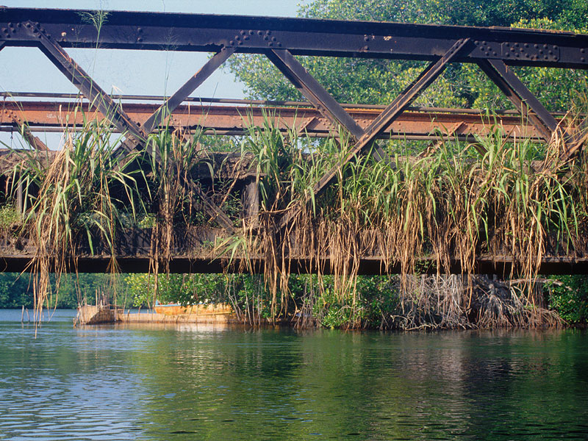

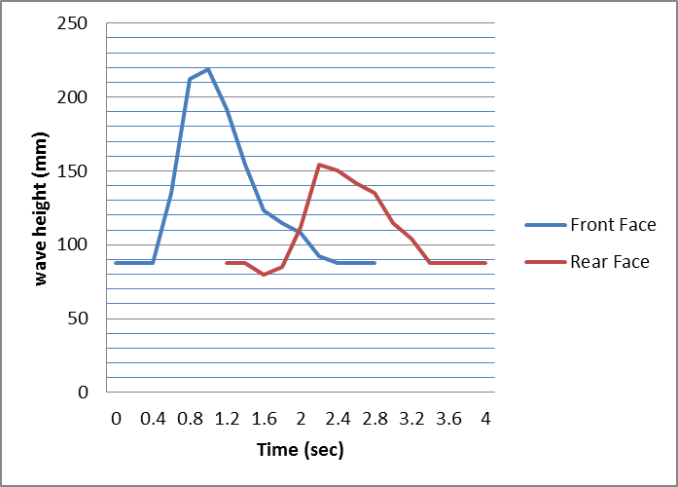
Highlights
  Tsunami Waves Create high velocity profiles at the bed level.
  Important to identify specific species which offer sufficient resilience (especially at the root zone).
Crest
Trough
Long waves of high amplitude
Plants must offer sufficient resilience against the flow
  Species possessing adequate plant characteristics, shall have sufficient lengths, heights and porosities when taken as a whole.
Height (H)
Dissipated Energy
H
Length (L)
L
Notes:
Describe

Slide 17
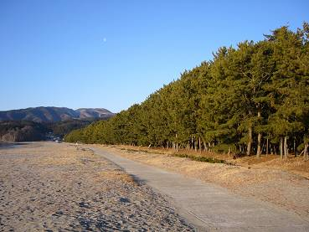
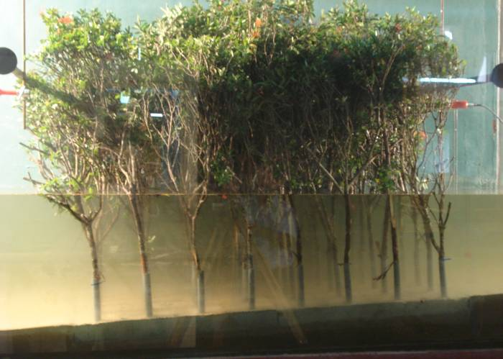
Highlights
  ‘Planned Forests’ could be adopted as possible hazard impact mitigation measures, provided that they are planned and created with;
    Appropriate plant species (possessing sufficient resilient characteristics)
    Sufficient extents
    Sufficient bulk porosities
    Sufficient heights
  Important to establish above mentioned parameters based on scientific evidence – by carrying out necessary;
    Laboratory experiments
    Mathematical modelling
Coastal Forest
Rikuzen-Takada
From Dr.T.Tomita
Notes:
Describe

Slide 18
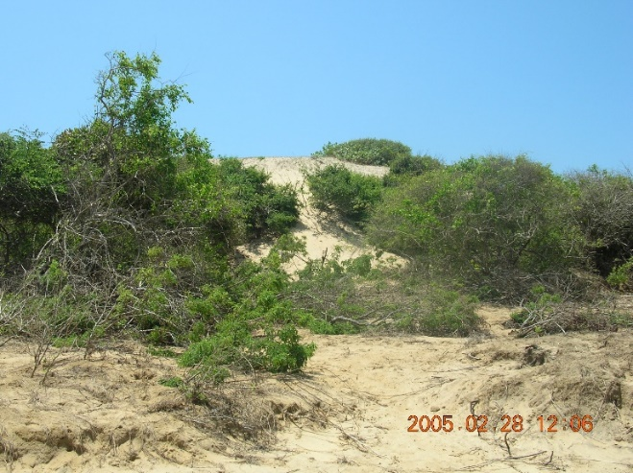
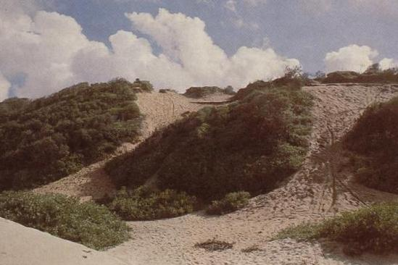
Recommendations
  If eco-systems are to be used for hazard mitigation, it has to be based on scientific evidence.
  Filed investigations and individual studies have proven the effectiveness of vegetation.
  However a planned programme of research covering varying incident conditions and forest characteristics are required (research including laboratory experimental studies, mathematical modelling, field investigations, etc.).
    Required characteristics of vegetation barriers to mitigate impacts of particular waves (with particular heights) shall be established by carrying out experimental studies and mathematical modelling.
    The potential of existing eco systems shall be assessed from a scientific point of view.
    Need for rehabilitation of existing eco systems shall be assessed by referring the hydraulic parameters.
    Further investigations shall be conducted in order to understand and quantify the performance of ‘Hybrid Solutions’ (combination of coastal vegetation and sand dunes).
Notes:
Describe

Slide 19
THANK YOU !!

