Slide 1
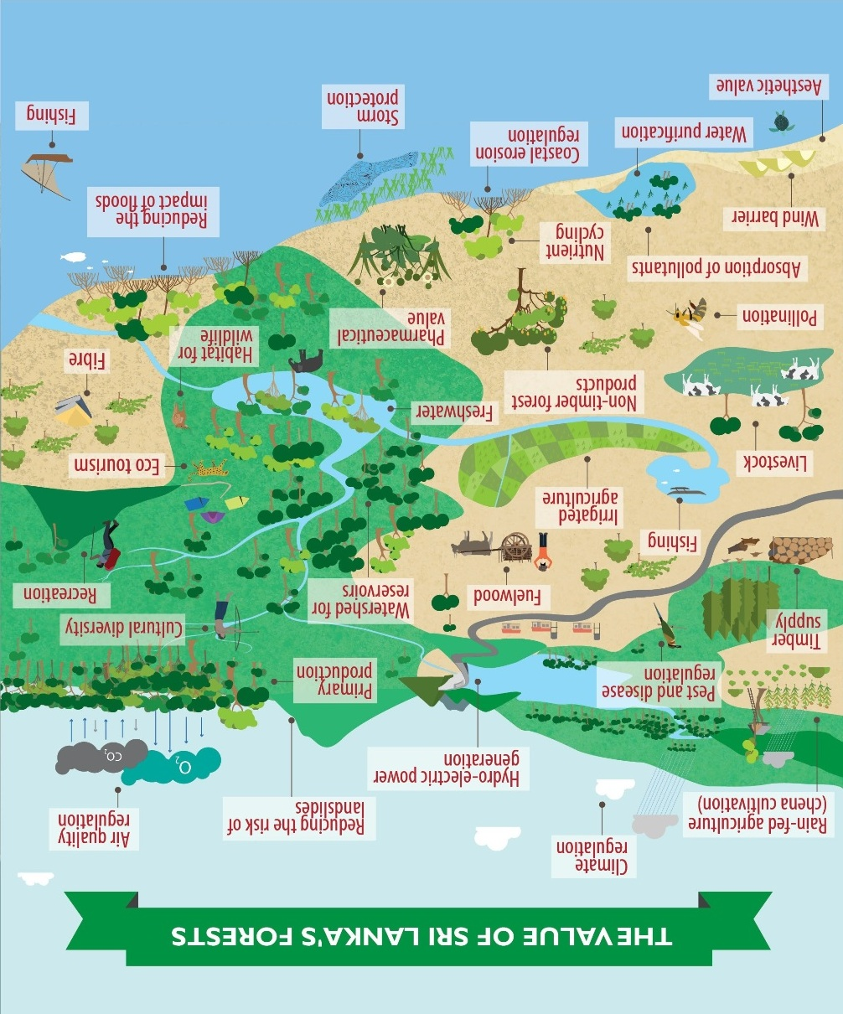
00:11:58

Slide 2
00:11:57
Session 1 - Chairperson: Prof. Nimal Gunatilleke

Slide 3
00:11:57
Session 1 - Chairperson: Prof. Nimal Gunatilleke
Keynote Address
Assessment of carbon and non-carbon benefits of tropical homegardens in relation to natural forests for REDD-related activities in Sri Lanka
Eskil I. Mattsson, M.I. Ostwald, S.P. Nissanka

Slide 4
00:11:57
Session 1 - Chairperson: Prof. Nimal Gunatilleke
Presentations
Mini-hydro: an injurious novel threat to highland
forest ecosystems of Sri Lanka.
E.I.L. Silva and E.N.S. Silva

Slide 5
00:11:56
Session 1 - Chairperson: Prof. Nimal Gunatilleke
Presentations
The ecological and economic value of natural forests in relation to the Sri Lankan leopard.
Andrew Kittle, Anjali Watson, Samuel Cushman and David Macdonald

Slide 6
00:11:56
Session 1 - Chairperson: Prof. Nimal Gunatilleke
Presentations
Assessment of canopy dieback in Horton Plains National Park using multispectral satellite data.
Tithira Lakkana, Sisira Ediriweera, Prabha Rupasinghe

Slide 7
00:11:55
Session 1 - Chairperson: Prof. Nimal Gunatilleke
Presentations
Performance of coastal vegetation in dissipating the energy of the upcoming flow.
R.M.C.L. Bandara, E.A.D.D.D. Egodawatta, R.Abeywickrama, S.S.L. Hettiarachchi

Slide 8
00:11:54
It’s
time !
Please be at your seats in 15 minutes SHARP for
Session 2 – Demonstrating the value of forest ecosystems.

Slide 9
00:11:53
Session 2 - Chairperson: Alexis Corblin

Slide 10
00:11:50
Session 2 - Chairperson: Alexis Corblin
Keynote Address
Natural capital, ecosystem services and role of environment valuation in policy making.
Herath M. Gunatilake

Slide 11
Session 2 - Chairperson: Alexis Corblin
Presentations
Valuing ecosystem services together (vest): a social marketing strategy for the promotion of PES in northern Mindanao, Philippines.
Evans Rosauro I. Yonson

Slide 12
Session 2 - Chairperson: Alexis Corblin
Presentations
Potential income from REDD+ activities from Nepal’s Terai Arc Landscape.
Basanta Gautam

Slide 13
Session 2 - Chairperson: Alexis Corblin
Presentations
Recognising forest ecosystem services and benefits.
Priyanie Amerasinghe, Matthew McCartneyand and Sanjiv de Silva

Slide 14
Session 2 - Chairperson: Alexis Corblin
Presentations
Identification and valuation of direct ecosystem services from a protected forest area in Bangladesh: a case study.
Mohammed Jashimuddin, Samiul Islam, Tapan Kumar Nath

Slide 15
It’s
time !
Kindly follow instructions regarding your lunch
Please be at your seats in 60 minutes SHARP for
Session 3 – Demonstrating the value of forest ecosystems.

Slide 16
Session 3 - Chairperson: Dr Ananda Mallawatantri

Slide 17
Session 3 - Chairperson: Dr. Ananda Mallawatantri
Keynote Address
Incorporating ecosystem services and biodiversity benefits into decision making through economic incentives and reducing environmentally harmful subsidies due to governmental or institutional inaction.
Madhu Verma

Slide 18
Session 3 - Chairperson: Dr. Ananda Mallawatantri
Presentations
Biofilm biofertilizers for incorporating biodiversity benefits and reducing environmentally harmful subsidies in agriculture.
Gamini Seneviratne and P.C. Wijepala

Slide 19
Session 3 - Chairperson: Dr. Ananda Mallawatantri
Presentations
Valuing ecosystem benefits through reforestation of degraded rain forest patches in Sri Lanka whilst helping to mitigate climate change.
Lakmini Senadheera, W.M.P.B.S. Wahala, Shermila Weragoda

Slide 20
Session 3 - Chairperson: Dr. Ananda Mallawatantri
Presentations
Mikoko Pamoja: a small-scale mangrove REDD+ project in Kenya
J. Kairo and M. Czachur

Slide 21
Session 3 - Chairperson: Dr. Ananda Mallawatantri
Presentations
Assessment of land cover changes and it’s implications for carbon Stock of a conservation area of southwest, Nigeria
Oluwole John Pelmo and Maureen U. Ogoliegbune

Slide 22
It’s
time !
Please be at your seats in 15 minutes SHARP for the
Panel Discussion

Slide 23
Panel Discussion
Panelists:
Mr. Anura Sathursinghe
Dr. Ananda Mallawatantri
Prof Nimal Gunatilleke
Prof. Madhu Verma
Dr. Herath Gunatilake
Dr. Eskil Mattsson

Slide 24
Best Research Paper Award
Selected by the Review Panels
Recognising the value of forest ecosystems and their services
Prof. Nimal Gunatilleke - Emeritus Professor, University of Peradeniya
Prof. Savitri Gunatilleke - University of Peradeniya
Prof. Siril Wijesundara - Researcher, National Institute of Fundamental Studies
Prof. Aruni Weerasinghe - Faculty of Agriculture, Rajarata University of Sri Lanka
Demonstrating the value of forest ecosystems and their services
Dr. Prashanthi Gunawardena - Head, Department of Forestry and Environment Sciences, University of Sri Jayawardenepura
Dr. Athula Senarathne - Environment Economic Policy Unit, Institute of Policy Studies
Capturing the value of forest ecosystems and their services
Prof. K.Karunathilake - Department of Sociology, University of Kelaniya
Dr. Nora Devaoe - Advisor, Forest Department
Dr. Janaka Kuruppuarchchi - Open University of Sri Lanka
Dr. Roshan Perera - Open University of Sri Lanka

Slide 25
Concluding Remarks:
Prof. Nimal Gunatilleke

Slide 26
Contact us:
e-Mail: info@redd.lk
URL: www.redd.lk

Slide 27
Thank You!

